Slide 1
Option 2: Predictive Insights
Harshil Patel
10/23/2020

Slide 2
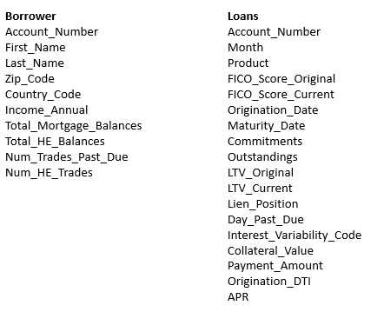
Problem Statement
Data Fields
Loan Delinquency Prediction
Loan default prediction is one of the most critical and crucial problem faced by financial institutions and organizations as it has a noteworthy effect on the profitability of these institutions.
Delinquency occurs when a borrower misses a payment against his/her loan. Delinquency rate is a pivotal credit risk metric used to assess the quality and health of KeyBank’s credit portfolios.
Given the information like mortgage details, borrowers related details and payment details, the objective is developing a model to predict the Home Equity Loan (HELOAN) customers who will become delinquent the following month with using 6 months of data.
Classify if Account Number/ Borrower is going to be delinquent or current in given month, with model utilizing rolling 6-month data.

Slide 3
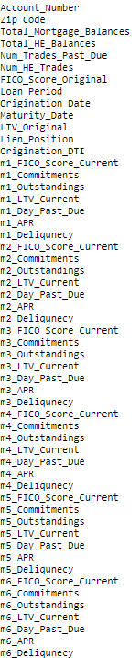
Data Considerations
Data Setup For Model Fitting:
Create a dataset which aggregates the data by account number/loan customer.
Created fields for 6 months of unique data by account number in given month.
Created Delinquency Data Field for Each Month for If Dequilent or Not in that given Month
Removed month 6 as that is the directly correlated to response field.
Removed data fields with deterministic/constant data
Hot Encoded or Removed Categorical Features to Reduce Model Complexity
Removed Zip Code and Lien Positions likely do offer much predictive power
Removed Data Field > 0.3 missing: 'Num_Trades_Past_Due’
Imputated missed data using common mode for Categorical Variables and Mean for Numerical Variables
Did not consider treating outliers as those could be considered good indicator of Loan Delinquency.
Feature Engineering: Added ‘Loan Period’ = Origination Date – Maturity Date and removed those fields to keep mostly categorical and numerical variables.
Response: Binary Classification
m6_Deliquency: Loan Delinquency =1 and Current = 0, represents the month which generalizes a prediction if delinquency will occur using rolling 6-month data.
The response variable is a Binary Categorical Variable
All other data fields will be factors/features.

Slide 4
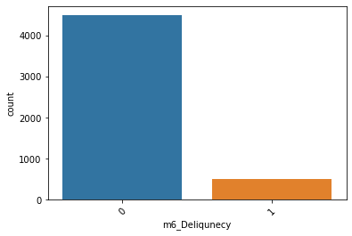
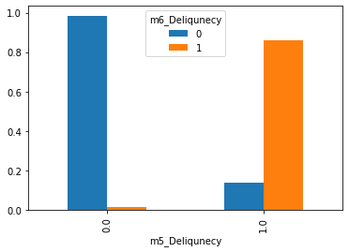
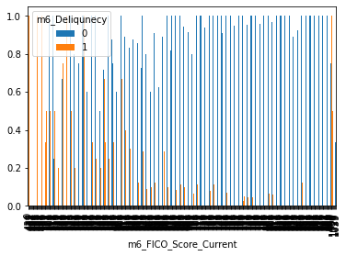
Approach, Assumptions, EDA, Insights…
Response Variable Frequency
Last Known Delinquency Comparison to Current Delinquency
Delinquency Comparison to Last. FICO Score
EDA: plotted many scatter plot, crosstabs and histograms to check if I can get any intuition through exploratory data analysis
Approach:
Insights: lower FICO score leads to more loan delinquency. Also if you were delinquent in the previous month, you are very likely to be delinquent the next month. Opposite cannot be necessarily true as you must be non-delinquent once to be delinquent. Overall features on previous history related loan payment health greatly impact chances of delinquency.
1. Use full balanced train data to train the model.
2. Use binary classification algorithms with some parameter tuning if needed.
3. Don't do binning or any heavy feature engineering.
4. Use AUC metrics to evaluate your model.
Major Problem: Over-Sampling of Response Variable (m6_Deliquency) in Model Training Data

Slide 5
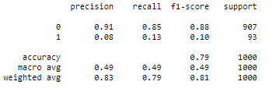
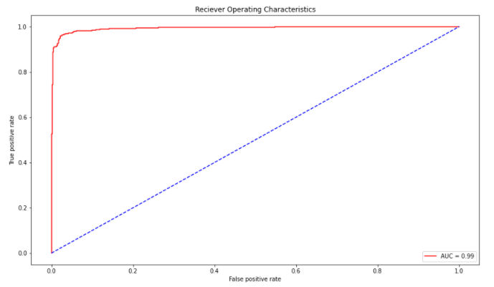
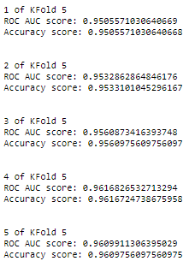
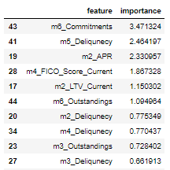
Model
1.) Training and Testing Data
2.) Model Selection: Logistic Regression
I’ll up-sample the 1’s in Response using the SMOTE algorithm (Synthetic Minority Oversampling Technique) to address response value imbalance. At a high level, SMOTE works by creating synthetic samples from the minor class instead of creating copies -> randomly tweaked, new observations. Creates a balanced model fitting dataset to reduce bias.
Created an 80/20 split training and test data to fit model and assess performance against.
Using a lot of Numerical and some Categorical Variables
LG is a primary binary classification algorithm. our binary outcome is m6_Deliquncy if 1 is Dequilent and 0 is current. It is an estimation of logit function. Logit function is simply a log of odds in favor of event.
Use Ski0kit Learn In Python.
4.) Model Results
6.) Model Robustness:
Check robustness of model to unseen data
I will use k-fold cross validation with stratification (rearranging data)
3.) Model Fitting
Standardization of datasets is a common requirement for many machine learning estimators implemented in scikit-learn; they might behave badly if the individual features do not more or less look like standard normally distributed data: Gaussian with zero mean and unit variance.
Fitted training data to Logistic Regression Model and assessed performance with test data.
ROC Curve, AUC = 0.98
5.) Feature Importance:
Variables are most valuable in determining whether account holder is predicted to be current or delinquent.
Look at Logistic Regression Coefficients
As previously hypothesized, Previous monthly delinquency and commitments/outstanding's are most powerful to address problem.
ROC Curve Plotted for last fold. Summarized tradeoff of sensitivity and specificity.
High AUC -> Higher Pred. Power

Slide 6
Improving Model
Model Takeaway
Model has high performance metrics, meaning a basic logistic regression model is likely capable to perform prediction of account/loan borrowers who will be delinquent in the given month, when model is fed previous 6-month data
Inspect model assumptions, dataset construction with SME to conduct feature engineering, removing highly correlated variables, and brainstorm factors that can affect loan delinquency.
More EDA -> Understand how your data looks like, apply relevant techniques which will work on that data.
Address if overfitting is occurring, but likely not as we used k-folds and balanced response data.
Boosting algorithms (gradient descent) or Logistic Regression model hyperparameter tuning using DOEs.
Different binary classification models (Random Tress/Decision Trees, or Support Vector Machines). Neural Nets may be overkill.
Model Links/Evaluation
https://github.com/harshilpatel1799/keybank-case-study/blob/main/Option%202_Predictive%20Insights.ipynb

