Slide 1


Project on Insect identification and related recommendations using no code ML-based ORANGE data Mining and Literature Survey
Presented by-
Harshilkumar Ponkiya (202319002) - Report writting
Sanskar Shete (202319004) - No code ML-based ORANGE data Mining model
SatTyam Kumbhar (202319005)- Data collection and literature survey
Hemanth B S (202319009) – Prepared model using cnn(Convolutional Neural Network
Abhay Kumar (202319012) – Presentation and code Documentation

Slide 2
ContentS
Introduction
Dataset
Objective
Methods
No code ML-based ORANGE data Mining
Work flow of ORANGE data Mining
Code & Results-
Conclusion

Slide 3
Introduction
Insects found in crops are a major threat that causes production and economic loss.
Insects play a significant role in our ecosystems, impacting agriculture, biodiversity, and even human health. However, identifying insects accurately can be a challenging task, especially for non-experts.
Traditional methods often involve manual observation, expert knowledge, and extensive fieldwork.
Orange Data Mining offers a no-code solution, empowering users to delve into the world of data analysis without extensive programming expertise.

Slide 4
Dataset
The Dangerous Farm Insects Image Dataset is a curated collection of images featuring 15 different types of insects commonly found in agricultural settings. It contains 1601 files belonging to 15 classes.
https://www.kaggle.com/datasets/tarundalal/dangerous-insects-dataset

Slide 5
Objective
Identification of Insects using AI-ML Techniques.
Recommending the Solution based on the identification of insects.
Comparison between Modern Data Mining Techniques and Traditional Coding in Python Programming.

Slide 6
Methods
ML-based Orange data mining tool
Deep learning
- CNN(Convolutional Neural Network )
Library :
- Tensorflow
- Keras

Slide 7
No code ML-based ORANGE data Mining
Orange is an open-source data visualization, machine learning, and data mining toolkit. It features a visual programming front-end for explorative qualitative data analysis and interactive data visualization.
They range from simple data visualization, subset selection, and preprocessing to empirical evaluation of learning algorithms and predictive modeling.
Orange uses common Python open-source libraries for scientific computing, such as numpy, scipy and scikit-learn, while its graphical user interface operates within the cross-platform Qt framework.

Slide 8
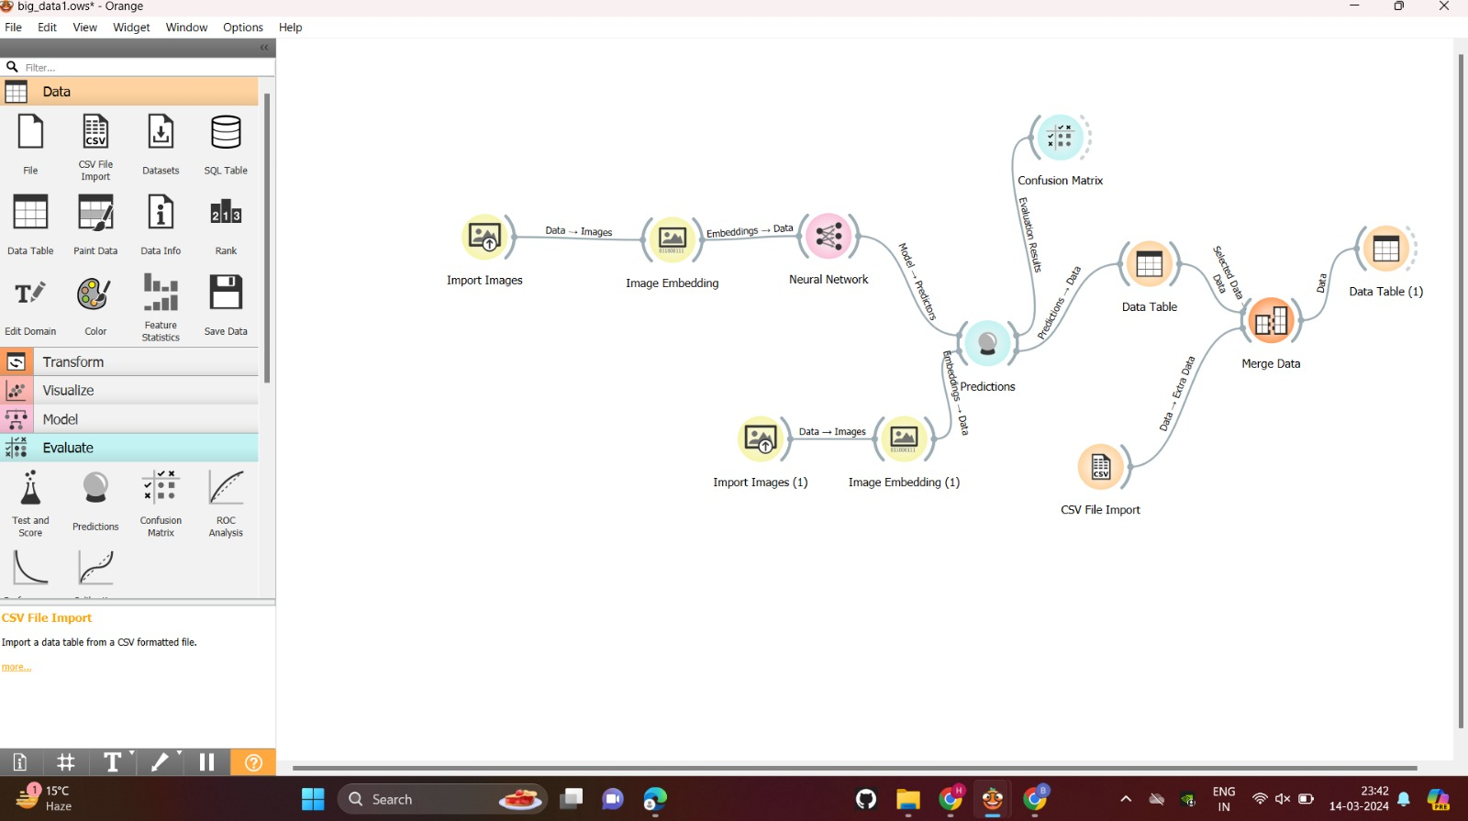
Work flow

Slide 9
Steps for Model Preparation: Building a Robust Framework
Data set collection and preprocessing-
Constructing and training a convolutional neural network-
Verification of the model accuracy of neural network

Slide 10
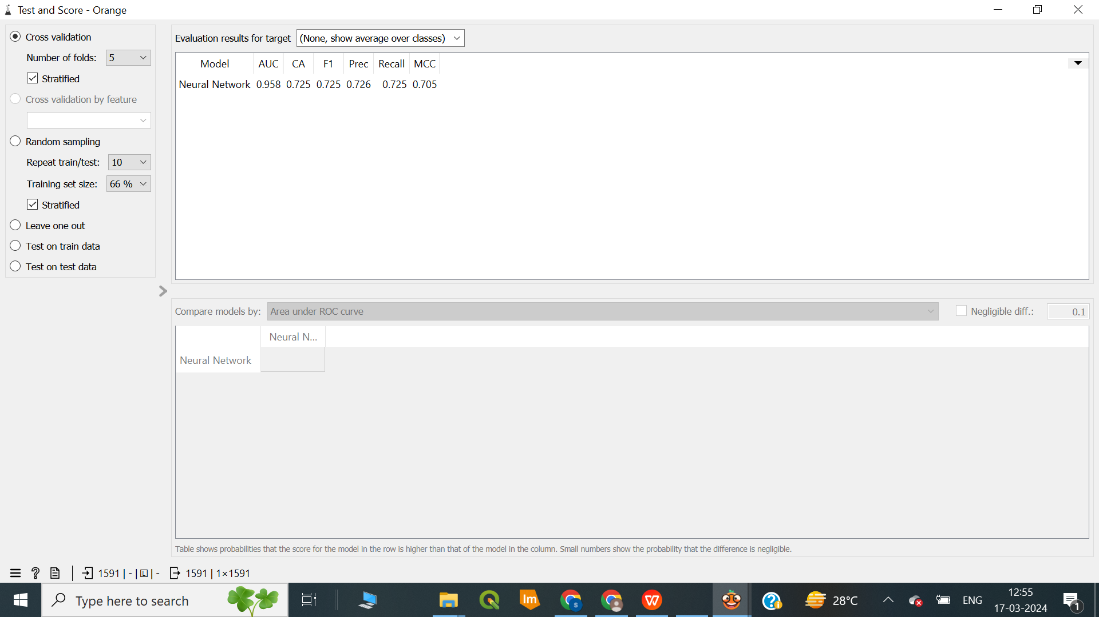
Result
The model seems to perform reasonably well, with good discrimination ability, a balance between precision and recall, and a decent overall quality of binary classifications.

Slide 11
Code & Results
https://colab.research.google.com/drive/1jNCP0BwQw7yjh6slo_7-qmgVLRJ3Nd2z#scrollTo=b_9x6LJ0mFrC
Accuracy of CNN MODEL is - 89%

Slide 12
Conclusion
The Orange Data Mining Model outperforms the CNN model in predictive performance. It has higher AUC, F1 score, precision, recall, and MCC, indicating its superior ability to classify instances correctly.
The model was able to identify the insect from the new image, and as a result, it provided successful recommendations.
When it comes to achieving the best predictive performance, the Orange Data Mining Model is a better choice than the CNN model using Python.
To train the model in orange, it takes less than a minute, whereas in Python, it takes nearly 8 minutes.

Slide 13
THANK YOU…

