Slide 1
A system for tracking all vehicles all the time at the "Edge of the Network"
Harshil Shah
Mentors: Dr. Umakishore Ramachandran, Ph.D Zhuangdi Xu
Notes:
Greeting
Harshil Shah.
Researching at EPL.
Mentors are prof and andy.
Topic is a system for tracking all vehicles all the time at the edge of the network.
Lets first define what do I mean by edge of the network and how it applies to this research and this topic in particular.

Slide 2


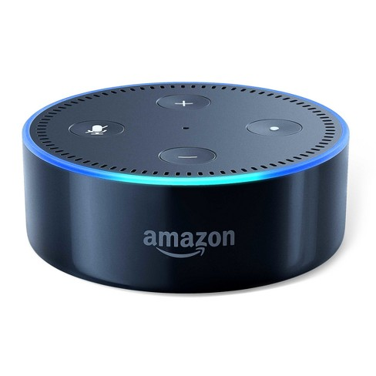
What is "Edge of the Network"?
AMAZON CLOUD SERVICE
Hey Alexa, what’s the good word?
Speech Recognition
Natural Language Understanding
THwG
Get information from the internet
Convert response into voice stream
Notes:
What do I mean By Edge of the Network?
-Everyone in this room owns a mobile device, right? Pause. And most of the mobile devices these days are equipped with some sort of voice assistant which can be Siri, Google Assistant, or Alexa.
- So what exactly happens in the background when you ask a question to your voice assistant? Your speech gets recorded, it gets sent over to the cloud where numerous algorithms run on it for example, speech recognition, Natural Language Understanding etc and response gets sent over to you as a voice stream.
- The diagram on my left exactly shows the flow of information for one single request.
- In reality, there are millions and billions of devices communicating with one single entity, THE CLOUD. Because of which there is a latency factor involved in the exchange of information because of geographical separation and performance pressure on the cloud as its trying to cater lots of user request at one time.
- So how can we solve this problem of latency and performance?
Define Fog Computing. Give examples of voice assistants. Client side and cloud side

Slide 3

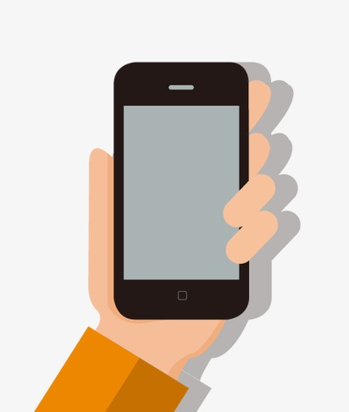

What is "Edge of the Network"?
CLOUD
Big data processing, Information Archive, Resources Manager, Business Logic
Extend cloud’s resources to the edge nodes.
Decentralize data gathering, analysis, and computations.
Alleviate latency involved in exchanging information with the cloud because of geographical proximity and network bandwidth.
EDGE LAYER
Real time analysis
Network Services
Micro data center
IoT DEVICES
Notes:
The answer to that question is using the power of Edge Computing.
Edge Computing is defined as extending the resources of the cloud and bring them georgraphically closer to theuser, the devices.
As you can see in the picture, the edge layer contains network resources, micro data centers, computational power of the cloud so that it serve requests instantly without having the need to always process it in the cloud.
So does that mean that THE CLOUD is useless? No, the cloud is still responsible for big data processing, high level business logic, and long-term processes. But the tasks that can be decentralized and distributed are the ones that will be executed in the edge layer.
So, the edge, being the peer of the cloud helps in reducing the latency factor and improves the workload balancing->thus improving the performance of our architecture.
Edge the peer of the cloud

Slide 4
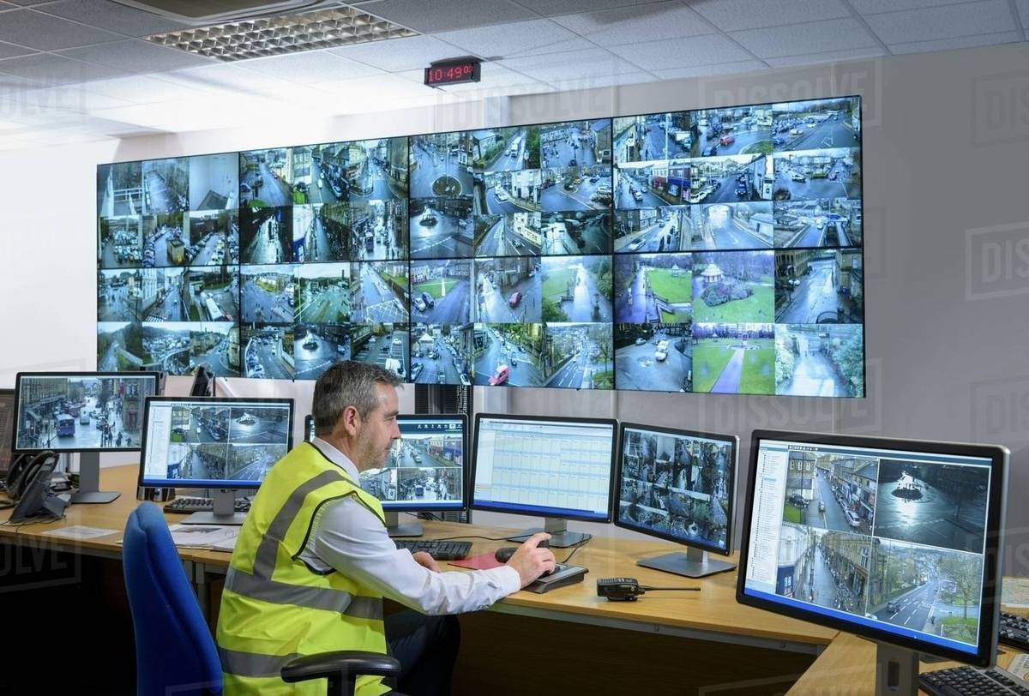
Problem Statement and Motivation
The current state of traffic surveillance system requires:
large storage space to save monitored streams
manual inspection for tracking suspicious vehicles
high latency
The research proposes a novel way of:
leveraging Edge Computing to create a network of smart traffic cameras
storing space-time trajectories for optimum space usage and faster query responses.
Existing technologies:
Alert-based traffic surveillance
Notes:
So the problem that we are trying to solve is to track all vehicles all the time at the edge of the network. So why is there a need to solve such a problem? Well, in the current state of traffic surveillance system, the only thing we do is store terabytes and petabytes of video recordings of the vehicles in the cloud. This consumes lots of storage space, involves high latency in sending huge files, and when something goes wrong, then it requires manual inspection of all the video recordings.
This is clearly not the best way to deal with this problem. So we propose to leverage edge computing to create a network of smart cameras that can track and store the space time trajectories of the vehicles that can be queried and stored efficiently.
Before I move on, I also want to talk a bit about the existing technologies which primarily Alert-based models which require you to preidentify the vehicle, enter that into the system and track it. However, more often than not, the suspect is usually unknown until something bad happens on the road. Hence, we suggest this model which has its own benefits and challenges.
Img src: https://cdn8.dissolve.com/p/D943_151_662/D943_151_662_1200.jpg

Slide 5
Goals
Create a Publish-Subscribe(Pub-Sub) policy for cameras in the network.
Forward propagation of vehicle information.
Automatic static camera topology management.
Technical Challenges
Synchronization and singularity of information in the network.
Ability to extract information from the video feed spontaneously using compute resources of the Edge node.
Notes:
The research goals that I particularly focused on were to create a publish-subscribe communication scheme in the network of cameras, forward propagation of vehicle activity, and automatic static camera topology management. And I will surely expound upon all three of these in the next slides.
The major technical challenge is to make sure that all information in the network of cameras is synchronized and there is only one instance of that information in the network.
The other challenge is with spontaneous image recognition of camera feed but we make the assumption that that has already been done for us by our friends in the computer vision department.

Slide 6
Pub-Sub Camera Communication Policy
Each camera subscribes to a topic for receiving message.
Each camera segregates messages into classes and publishes them on the queue.
Message is the vehicle activity in the range of the camera.
Why Pub-Sub?
To achieve loose coupling in the network of cameras.
Notes:
The major task of this project is to allow communication amongst the network of cameras without involving the cloud. And for that we use the publish-subscribe communication scheme where each camera acts as a subscriber as well as a publisher.
A cameras publishes a message, which will be the vehicle activity in our case, and all the subscribers of that camera will receive the message through the edge node.
And the reason why we use Pub-Sub system is because even though our network is strongly connected, each camera must still be independent from each other because in an event where one camera fails, we don't want our system to shut down.
Why pub-sub? Allows for independence among cameras in the network.
Why don’t we use observer pattern?
Pub Sub because enable event-driven architectures, or to decouple applications in order to increase performance, reliability and scalability

Slide 7
Problem with Pub-Sub
Performance declines with the growing size of the camera distribution.
Broadcast leads into wasteful network bandwidth.
How do we address this problem?
Forward Propagation in a geographically restricted region.
Notes:
But there are indeed problems with this communication model. Performance sharply declines with the growing size of the camera network which results in lots wasted network bandwidth.
Hence, to address this problem we use the method of Forward Propagation in a geographically restricted region. So what that means is that, if a camera at student center generates some sort of vehicle activity, then we don't want the camera at tech square to receive that message just because it has subscribed to that type of message.

Slide 8
Forward Propagation
Upon detection of a vehicle, the metadata is passed on to downstream cameras in a neighborhood to help with re-identification.
The number of downstream cameras are finite in a given region for a particular camera.
The current camera is appended to the partial trajectory of the vehicle to form its path.
Notes:
The idea behind forward propagation is that when a camera detects a vehicle, its metadata gets sent to the cameras that are in its neighborhood. So basically, each camera is a subscriber to all the cameras in its neighborhood.
Let's have a look at an example.

Slide 9
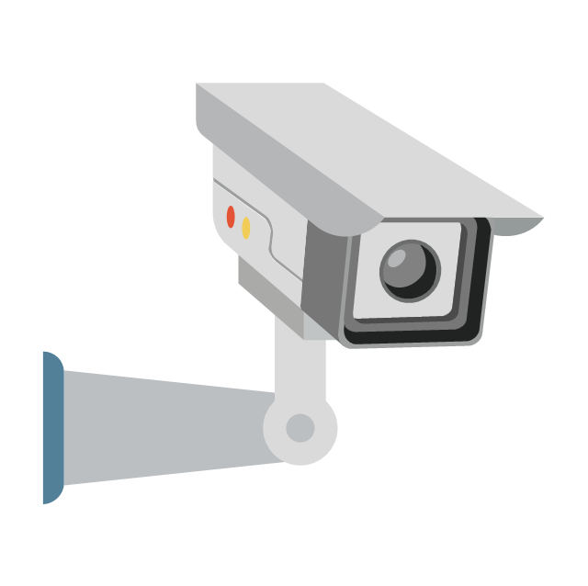

Forward Propagation To Generate Vehicle Trajectory
A
Signature | Ramblin’ Wreck
Path | A
C
D
B
Notes:
Camera A detects Ramblin Wreck and passes on the signature to the cameras in its neighborhood: B and C. Note that D does receive information because only the neighbors of the camera can be its subscribers.

Slide 10
Forward Propagation To Generate Vehicle Trajectory
A
Signature | Ramblin’ Wreck
Path | A
C
Signature | Ramblin’ Wreck
Path | CA
D
Signature | Ramblin’ Wreck
Path | BA
Reidentified | Yes
B
Notes:
When Ramblin Wreck arrives at camera B, B reidentifies the vehicle, updates its trajectory and sends a message to delete its signature from the previous cameras. This way, we limit our communication to neighboring cameras and generate a space time trajectory that can easily be queried and stored in either the edge node or the cloud.

Slide 11
Forward Propagation To Generate Vehicle Trajectory
A
C
D
Signature | Ramblin’ Wreck
Path | BA
Reidentified | Yes
B
Notes:
This image just shows the final stage after the signature has been deleted.

Slide 12
Automatic static camera topology management
Because of technical errors, power failures, or other external factors, cameras in the network can stop working.
The network needs to take corrective action to operate smoothly irrespective of the dysfunctional camera.
Notes:
The third area that I have been working on is the automatic static camera topology management. In the case of power failure of one camera, we want our network to be smart enough to redeploy a new camera topology for detecting and reidentifying vehicles. And the way we achieve that is using this concept of Automatic camera topology reorganization.

Slide 13
Automatic static camera topology management
Heartbeat
Topology
1) Initial Configuration
2) Camera B is dysfunctional
3) New configuration deployed
CLOUD
CLOUD
CLOUD
EDGE
EXTENSION
EDGE
EXTENSION
EDGE
EXTENSION
B
C
B
C
C
A
A
A
D
D
D
Notes:
The way this works is that
1) Once we have a map of a certain geographical region, I convert it into a simplified graph with vertices as intersections and edges as roads which is shown as blue edges in the picture.
2) Using an initial configuration file of camera topology, I deploy that on the current graph.
3) Each camera has a daemon function that sends a heartbeat to the edge node at a certain time interval which is shown as red dashed edges.
4) In the second stage, you can see that Camera B has stopped sending heartbeat to the edge node. This is a signal for the edge node to recalculate the topology by performing DFS and excluding the B camera as shown in the 3rd stage.
5) This new topology is then deployed on the map and used for forward propagation as mentioned earlier.

Slide 14
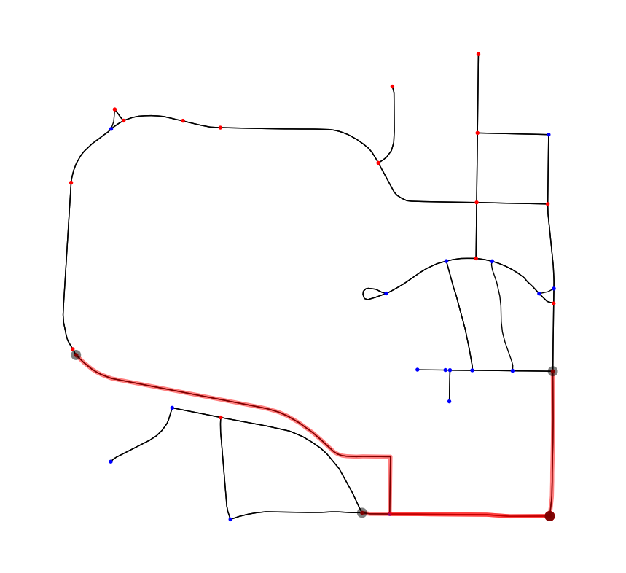
Evaluation/Results
Python simulation result of forward propagation and automatic topology reorganization on the simplified map of Georgia Tech loaded with 37 cameras at all intersections
Notified Cameras
Vehicle detection
Notes:
This is an image from the simulation that I ran on a simplified map of GT with 37 cameras where each camera is continuously sending heartbeat to the edge node and there is a vehicle that gets detected on your bottom right corner with its metadata being propagated to the annotated cameras.

Slide 15
Future Work
Extend the idea of static camera topology management to that of moving cameras on emergency vehicles.
Improving camera network performance horizontally by leveraging distributed/grid computing.
Extending cloud first services like Cassandra, Amazon ElasticSearch, Kafka etc. to operate on Edge.
Notes:
Basically the above three bullet points.

Slide 16
Conclusion
Edge computing will provide high performance in this time-sensitive, geo-distributed application of this vehicle tracking system.
Effective camera communication policy will help in storing space-time trajectories instead of massive video feeds.
Recent implementation of Edge Computing: Google Stadia
Notes:
Hierarchial and geo distributed
Edge computing is a very powerful hierarchial technique in a time-sensitive, geo-distributed environment especially in the vehicle tracking system where there is so much happening at every microsencond.
One recent implementation of Edge Computing is the Google Stadia which is an in-browser gaming platform with almost 7500 edge nodes all around the world.

Slide 17
QUESTIONS?

Slide 18
THANK YOU!

