Slide 1
Tempo
A planning-support agent that tells you the truth about your day
Detects when a day's demand doesn't match your real capacity — and makes that mismatch visible instead of hiding it.
Hackathon submission · Notion + Google Calendar + Google Sheets

Slide 2
The problem
Most AI schedulers optimize for a fuller calendar — not an honest one.
They silently drop what doesn't fit
!
A task disappears instead of showing up as deferred — the calendar looks clean, the day was never actually possible.
A typical claim
"Your day is fully scheduled"
They never say a day is impossible
!
6 hours of tasks against 4 available hours still gets scheduled as if it fits.
Looks complete — but 2 tasks were quietly never scheduled.
They treat every hour as interchangeable
!
What Tempo shows instead
No account for the cost of switching between deep work, admin, and errands.
"6.2h requested, 4.7h available"
Explicit, with the 2 deferred tasks named.

Slide 3
The idea
Tempo detects when a planned day's demand doesn't match a person's real capacity — and instead of hiding that mismatch behind a schedule that looks fine, it makes the mismatch visible, explains why, and offers a way through it.
The one-sentence pitch
Reads real tasks
Checks real availability
Writes real events
Never overbooks

Slide 4
How it works
Three real integrations, one deterministic scheduler at the center.
Notion
Google Calendar
Google Sheets
Task inbox
Real availability
Ledger + evaluation
Fit scheduler
Priority + deadline + demand-vs-capacity check, no randomness
Writes back: Calendar event, Notion status, Sheets ledger row

Slide 5

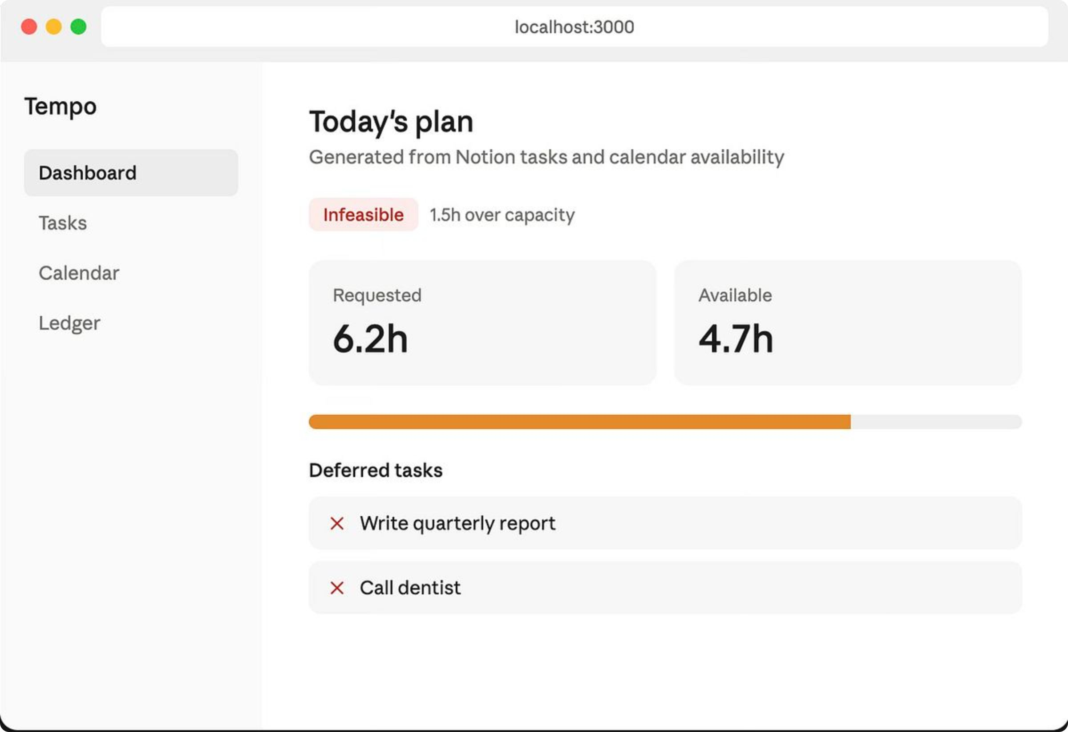
Today's plan: The demand-vs-capacity view
What Tempo shows when a day is infeasible

Slide 6

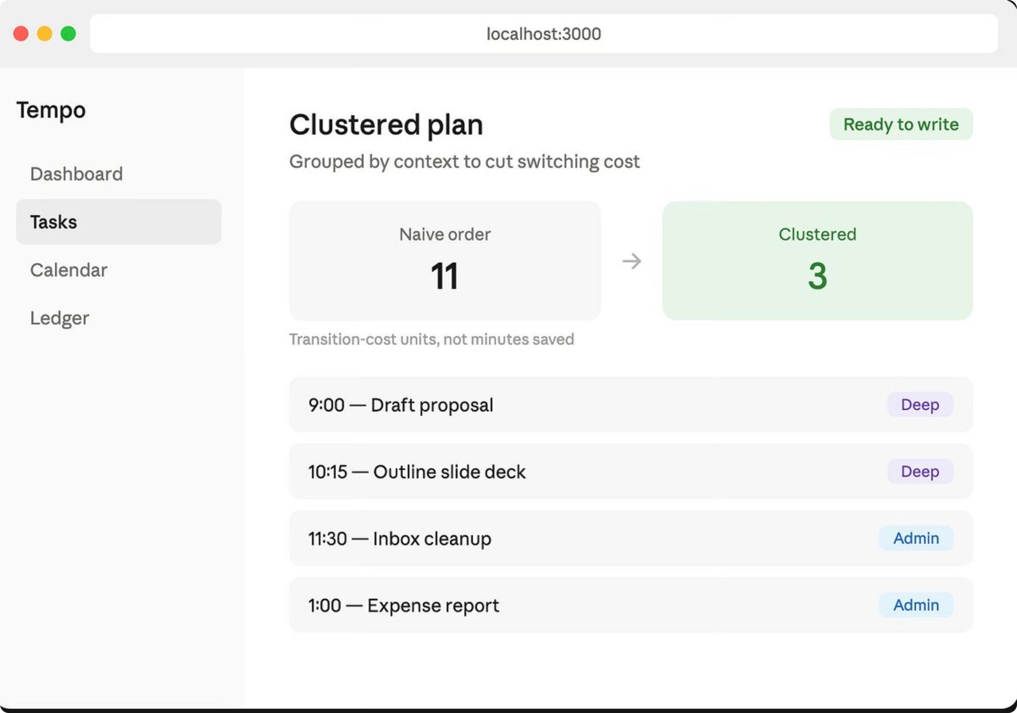
Clustered plan: Transition-cost optimization
Grouped by context to cut switching cost

Slide 7

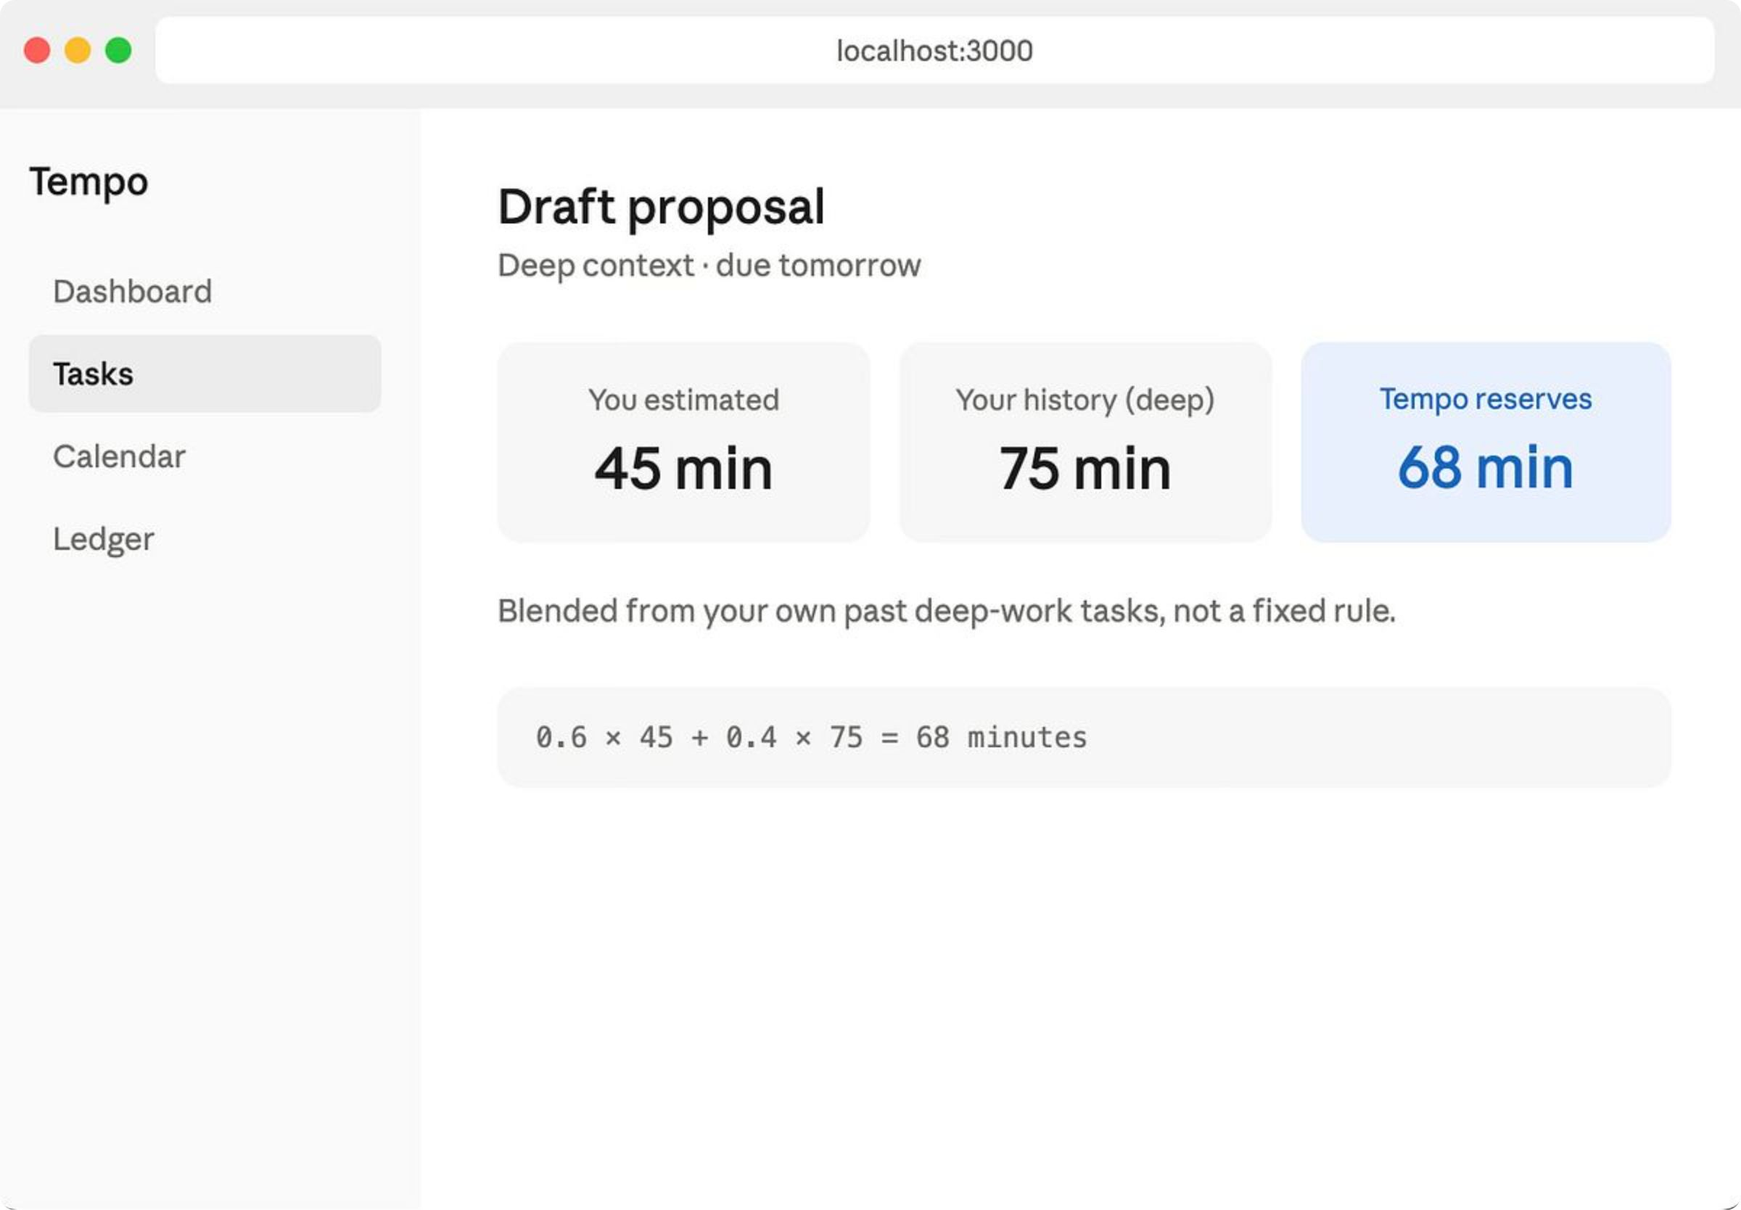
Duration calibration from history
Blended from your own past deep-work tasks, not a fixed rule

Slide 8

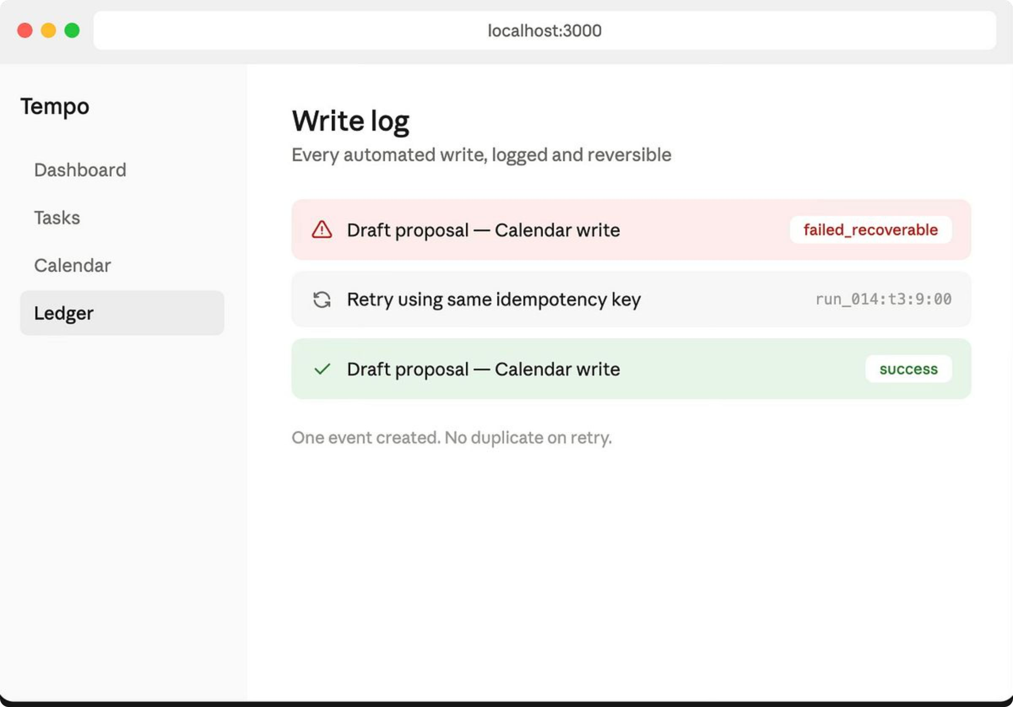
Write log: Idempotent writes with recovery
Every automated write is logged and reversible

Slide 9

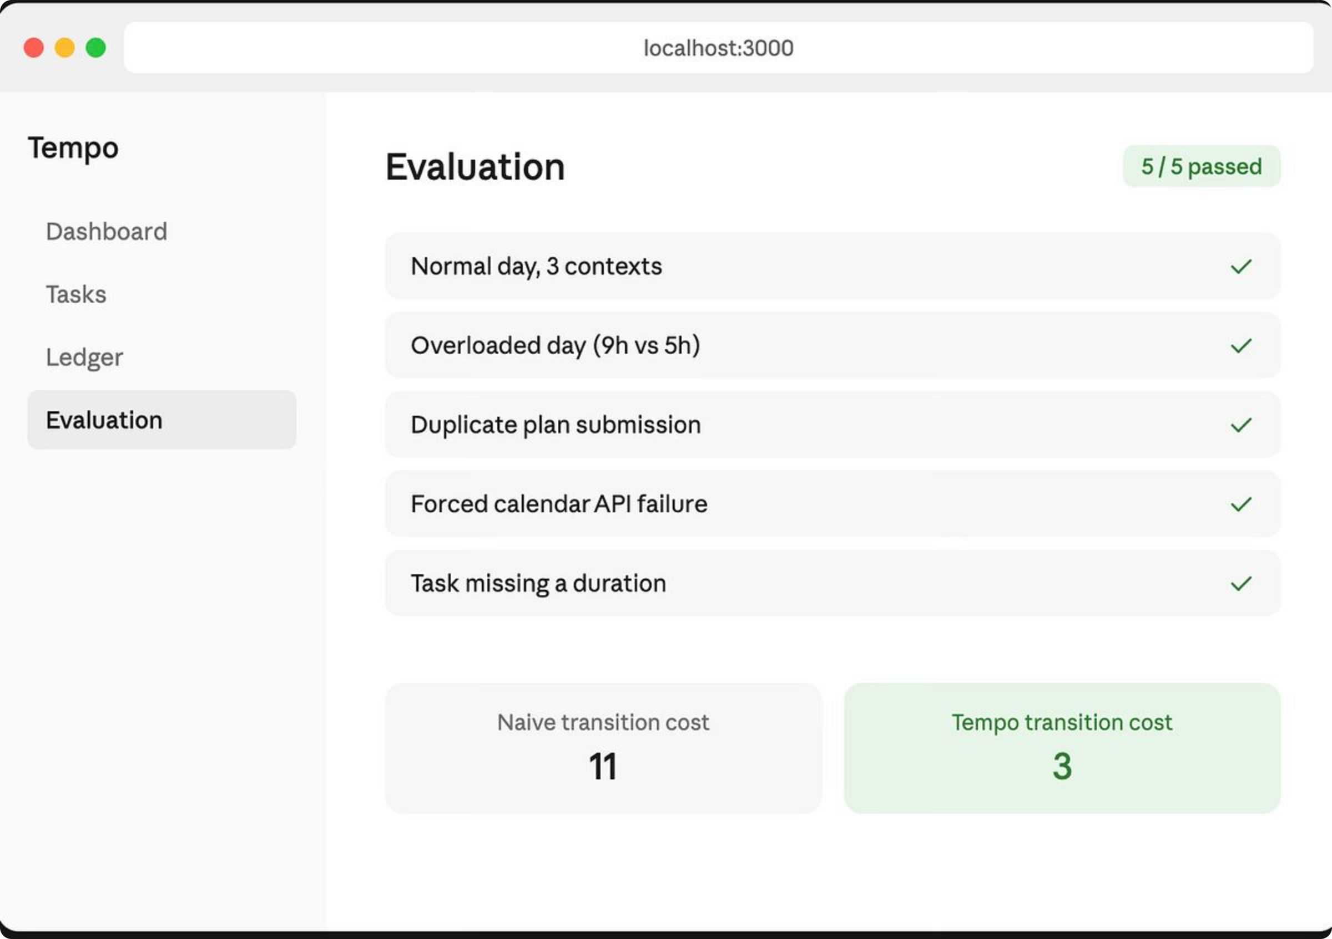
Evaluation: Five test scenarios, all passing
Logged pass/fail results — not a demo we hope survives

Slide 10
Where we actually are
A smaller thing that is true beats a bigger thing that is claimed.
Built — Phase 1
Roadmap — Phase 2 & 3
Reads live tasks from Notion
Reads real busy blocks from Google Calendar
Sorts by priority and due date, respects buffer time
Writes scheduled events back to Calendar
Logs every write to a Sheets ledger
Flips Notion status to Planned, stores event ID
Never silently drops a task — defers instead
Local test suite passes (test_phase1.py)
Transition-cost clustering by context
Explicit demand-vs-capacity display
Idempotent writes, five tested failure scenarios
Personalized duration calibration from history
Plain-rule friction labeling on deferred tasks
Isolated LLM explanation layer with fallback
Baseline comparison in the evaluation report

Slide 11
Why this isn't a generic scheduler
1
2
3
Transition-cost clustering
The system can say no
It survives a real failure
Groups same-context tasks together and measures the reduction — an 11-to-3 transition-cost drop, reported as a measured number, not a time-savings claim.
Demand vs. capacity is computed up front and shown explicitly, before any writes happen — an infeasible day is stated, not hidden.
Idempotent writes checked against a ledger before every Calendar call — a killed connection and retry produce exactly one event, never a duplicate.

Slide 12
Built to not overclaim
Non-negotiable engineering rules, followed from Phase 1 onward.
Deterministic scheduling owns every decision
✓
Availability, overlap checks, duration math, feasibility, and write authorization are all plain code. No randomness.
The LLM never touches the schedule
✓
It only turns an already-decided outcome into one explanatory sentence. If it times out, a deterministic template takes over — the app keeps working.
No silent drops, no invented scores
✓
A task that doesn't fit becomes an explicit Deferred state. Friction tags are plain if/else rules, never a weighted formula with made-up weights.
No clinical language
✓
Tempo observes a person's own task history and calibrates from it. It never claims to detect, diagnose, or treat anything.

Slide 13
How we prove it works
Five test scenarios, logged pass/fail to the Evaluation tab — not a demo we hope survives.
Scenario | What passes
Normal day, 3 contexts | Valid plan, zero overlaps
Overloaded day (9h requested, 5h available) | Explicit deferrals, nothing silently dropped
Duplicate submission of the same plan | Zero duplicate Calendar events
Forced Calendar API failure on first write | Shows failed_recoverable, retry makes exactly one event
Task missing a duration | Sent to clarification, never auto-guessed
Transition cost

Slide 14
The bigger idea
Tempo doesn't optimize for a fuller calendar. It detects when a day's demand doesn't match your real capacity, and makes that visible instead of hiding it behind a schedule that looks fine.
Today it learns that from your calendar. The architecture doesn't change if that signal later comes from somewhere else — it changes what feeds the calibration engine, not how it writes to your calendar safely.
github.com/harshim1/multi-agent-hacks
Tempo — a planning-support prototype, not a diagnostic or medical tool.

