Slide 1

DATA ANALYTICS AND VISUALIZATION(24DSB3101)
Business Intelligence Dashboard for Healthcare Performance Analytics
Batch – 3
2420030055 - Lahari
2420030292- Madhuri
2420030323- Harshini
2420030671 - Manasa

Slide 2
Methodology
The project follows a seven-stage pipeline from raw healthcare data to explainable insights.
1. Data Acquisition – benchmark healthcare datasets from UCI and Kaggle.
2. Data Preprocessing – missing-value handling, duplicate removal, encoding, scaling.
3. Exploratory Data Analysis – distributions, correlations, class balance, outliers.
4. Model Development – training of multiple supervised classification models.
5. Explainability Layer – SHAP for global importance, LIME for local explanations.
6. Performance Evaluation – Accuracy, Precision, Recall, F1-score and ROC-AUC.
7. Visualization – interactive Business Intelligence Dashboard for end users.

Slide 3
System Design & Architecture
Layered architecture of the proposed system:
• Data Layer – benchmark healthcare datasets (CSV) loaded and cached.
• Preprocessing Layer – cleaning, label/one-hot encoding, standard scaling, train–test split.
• Modelling Layer – Logistic Regression, Decision Tree, Random Forest, XGBoost, CatBoost.
• Explainability Layer – SHAP explainer (global) and LIME explainer (instance-level).
• Evaluation Layer – metric computation and comparative analysis across models.
• Presentation Layer – Streamlit dashboard with eight navigable analytical modules.
Data flow: Raw Data → Preprocessing → EDA → Model Training → Prediction → SHAP / LIME → Dashboard.

Slide 4
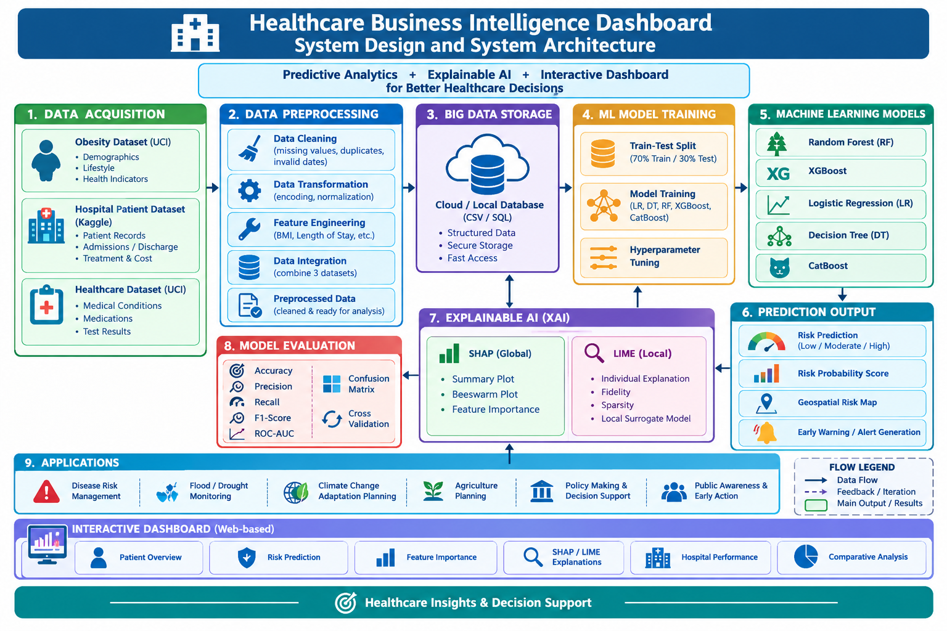


Slide 5
Dataset Description & Preprocessing
Datasets used:
• Estimation of Obesity Levels Based on Eating Habits and Physical Condition (UCI) – demographic, lifestyle and health-indicator attributes with seven obesity-level classes.
• Hospital Patient Records Dataset (Kaggle) – patient demographics, admission, treatment and discharge records.
• Healthcare Dataset (Kaggle) – medical, treatment and healthcare-cost attributes.
Preprocessing steps applied:
• Removal of duplicate and inconsistent records.
• Handling of missing values through imputation.
• Label and one-hot encoding of categorical attributes.
• Feature scaling and normalization of numeric attributes.
• Stratified train–test split to preserve class distribution.

Slide 6
Modern Tools & Technologies
• Programming Language – Python 3.
• Data Handling – Pandas, NumPy.
• Machine Learning – Scikit-learn, XGBoost, CatBoost.
• Explainable AI – SHAP, LIME.
• Visualization – Matplotlib, Seaborn, Plotly.
• Dashboard Framework – Streamlit (deployed locally on port 8501).
• Development Environment – Jupyter Notebook, Visual Studio Code.
• Version Control – Git and GitHub.

Slide 7
Implementation – Machine Learning Models
Models trained for disease-risk prediction:
• Logistic Regression – linear baseline, highly interpretable.
• Decision Tree – rule-based, captures non-linear splits.
• Random Forest – bagging ensemble, reduces variance and overfitting.
• XGBoost – gradient-boosted trees, strong performance on tabular data.
• CatBoost – boosting optimized for categorical healthcare attributes.
Each model is trained on the same preprocessed split and evaluated using identical metrics to ensure a fair comparison.

Slide 8
Implementation – Explainability (SHAP & LIME)
SHAP – Global Explainability
Computes SHAP values to quantify each feature’s contribution to predictions.
Summary and beeswarm plots identify the most influential health and lifestyle factors.
LIME – Local Explainability
Builds a simple surrogate model around a single patient record.
Explains why an individual prediction was made, supporting clinical trust.
FIDELITY
Measures how closely the LIME explanation matches the original model’s prediction behavior.
SPARSITY
Uses a small number of important features to provide a simple and easy-to-understand explanation.

Slide 9
Implementation – BI Dashboard (Streamlit)
The dashboard is built with Streamlit and runs as a multi-section web application with sidebar navigation.
Modules implemented:
• Dashboard Overview – project summary and key healthcare indicators.
• EDA & Dataset Insights – distribution, correlation and class-balance plots with explanations.
• Machine Learning – model training, prediction and metric display.
• SHAP Explainability – global feature-importance visualizations.
• LIME Explainability – instance-level prediction explanations.
• Comparative Analysis – side-by-side comparison of all models.
• Data Explorer – interactive filtering and inspection of records.
• Conclusions – summarized findings for decision-makers.

Slide 10
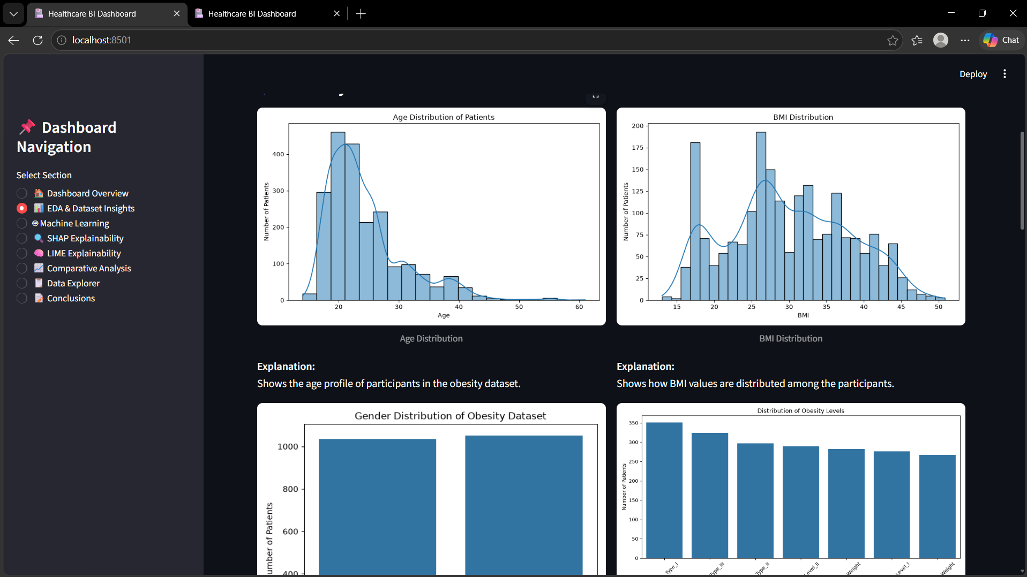
Results – Exploratory Data Analysis
Age and BMI distributions, gender balance and obesity-level class counts generated from the dataset, each accompanied by an in-dashboard explanation.

Slide 11
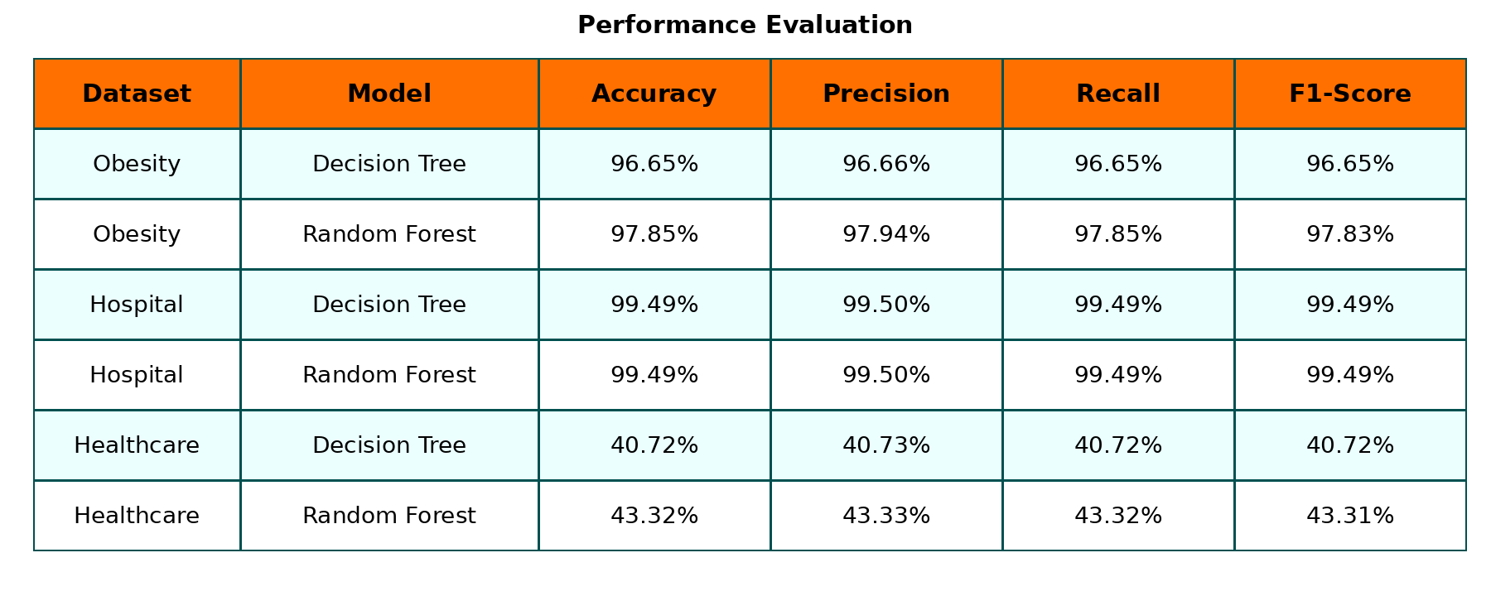

Slide 12
Performance Evaluation & Key Findings
• Ensemble models (Random Forest, XGBoost, CatBoost) outperform the single-learner baselines on all reported metrics.
• Weighted F1-score is used as the primary criterion because the obesity-level classes are multi-class and not perfectly balanced.
• SHAP analysis identifies weight, height-derived BMI, age, frequency of physical activity and family history as the dominant predictors.
• LIME confirms these factors at the individual-patient level, showing consistency between global and local explanations.
• The combination of high accuracy with readable explanations addresses the interpretability gap identified in Review-1.

Slide 13
Conclusion & Future Work
Conclusion
• An end-to-end pipeline combining healthcare analytics, machine learning, explainable AI and interactive visualization has been implemented.
• Multiple models were compared on both predictive performance and explainability.
• The Streamlit dashboard converts complex model output into readable healthcare insights.
Future Work
• Extend the evaluation to the remaining hospital and healthcare-cost datasets.
• Add hyperparameter tuning and cross-validation for further performance gains.
• Deploy the dashboard on a cloud platform for wider access.
• Complete and submit the research paper.

