Slide 1
REACT COMPONENTS
Harshini.M
2101102038
IoT-A

Slide 2
TABLE OF CONTENTS
01
02
03
What are react Components?
Why are they useful?
Example codes and demonstrations

Slide 3

Definition :
React components are like building blocks that help developers create different parts of a web page. They are like small, self-contained pieces of code that handle specific tasks or show specific things on the screen.
Components are independent and reusable bits of code. They serve the same purpose as JavaScript functions, but work in isolation and return HTML.

Slide 4
TYPES OF REACT COMPONENTS
Functional Components
Class Components
These are also known as Stateless Components .They are simple JavaScript functions that take input data (props) and return a React element to describe what should be rendered on the screen. Functional components are used for presenting static content and don't have their state. They are easier to read, test, and maintain.
These are also known as Stateful Components . Class components are created using ES6 classes and can maintain their state using the state object. They have more features and are commonly used when a component needs to manage complex state, handle lifecycle methods, or use local state and logic.

Slide 5
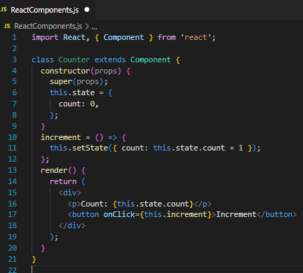
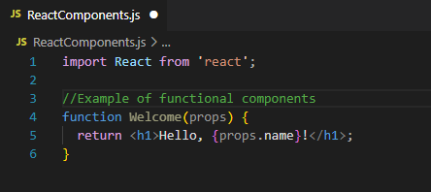
Examples of Functional and Class Component

Slide 6
Why React Components?
Modularity
Easy to understand and collaborate
Reusability
Maintenance
Components break down a web page into smaller, manageable parts. It's like having LEGO blocks that you can put together to build something bigger and more complex.
Components make the code easier to read and understand. Each component focuses on a specific task, making it clear what it does and how it works.
Once you create a component, you can use it as many times as you want in different parts of your website. It's like having a favorite LEGO piece that you can use in multiple structures.
Since components are small and focused, they are easier to maintain and update. If you need to change something, you can do it in one place (the component) rather than searching through a large codebase.

Slide 7
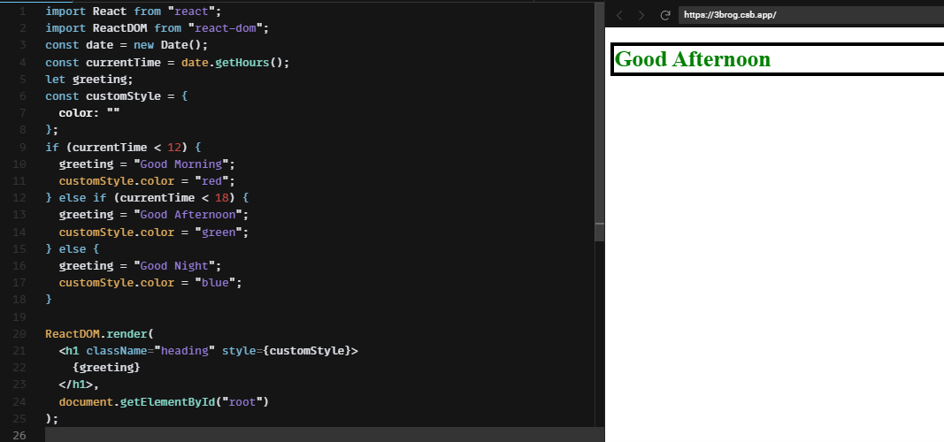
Example Code

Slide 8
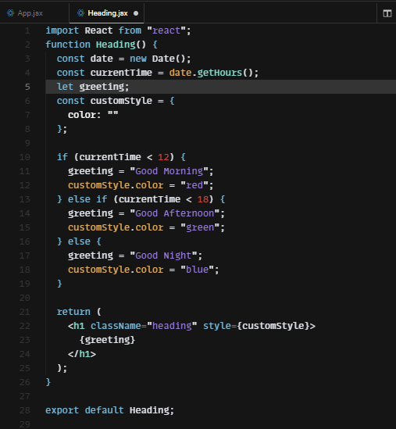

Slide 9
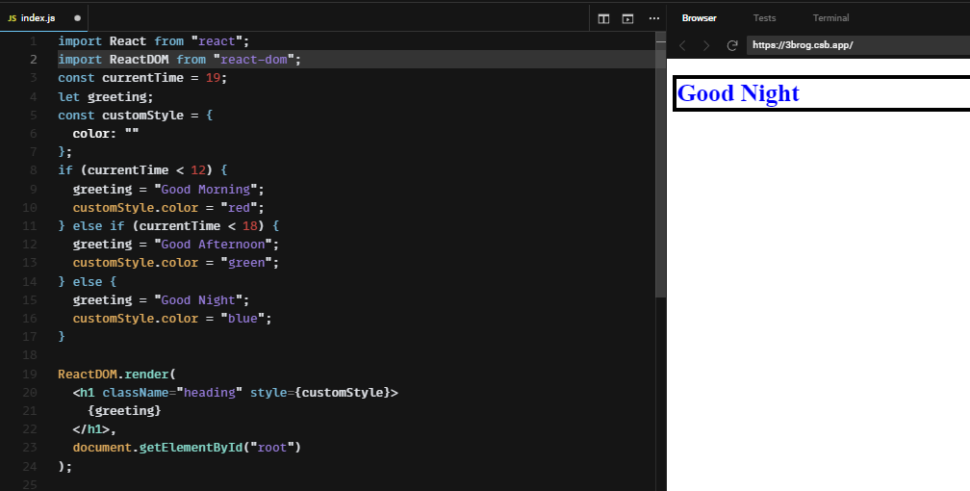

Slide 10
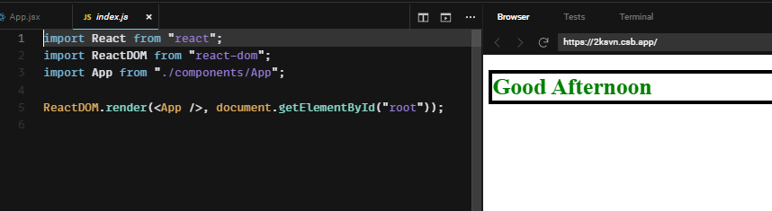
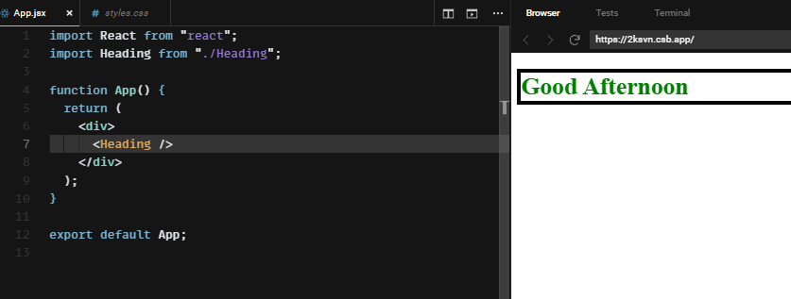

Slide 11
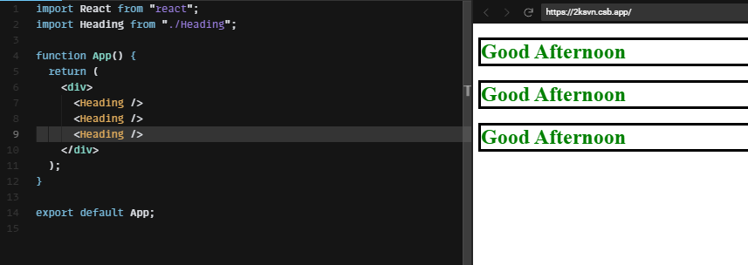

Slide 12
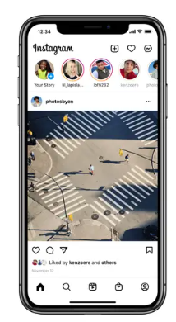
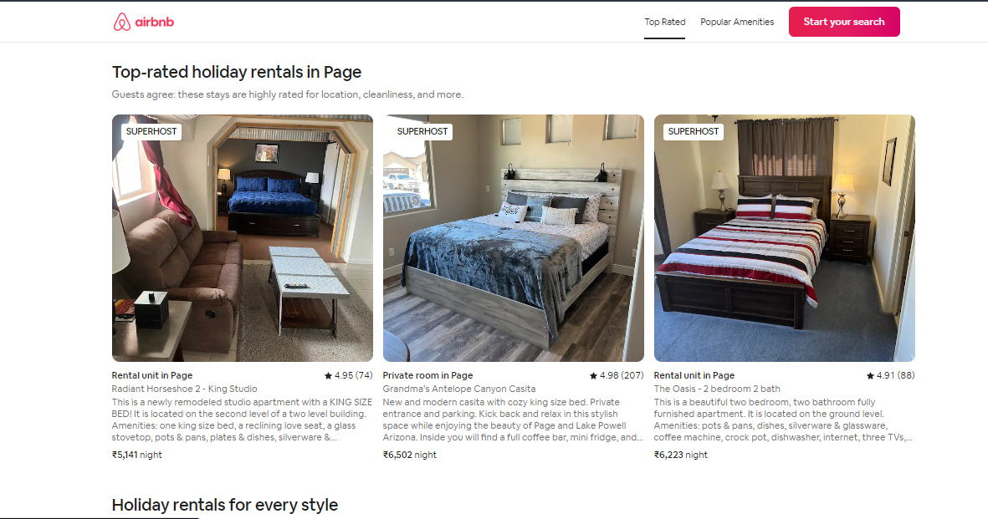

Slide 13
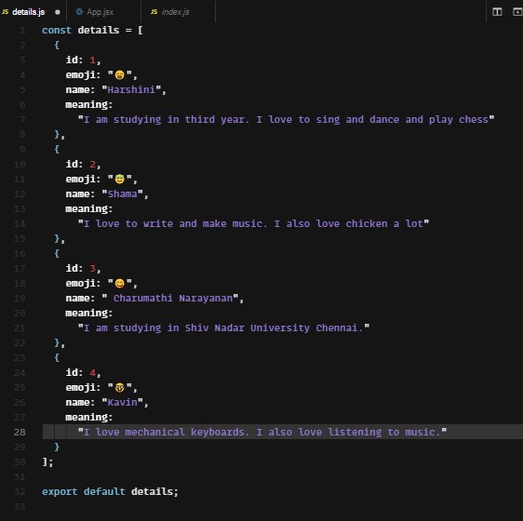

Slide 14
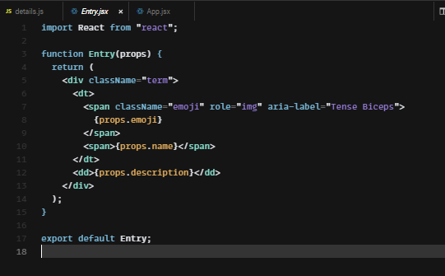
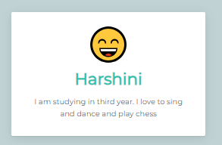

Slide 15
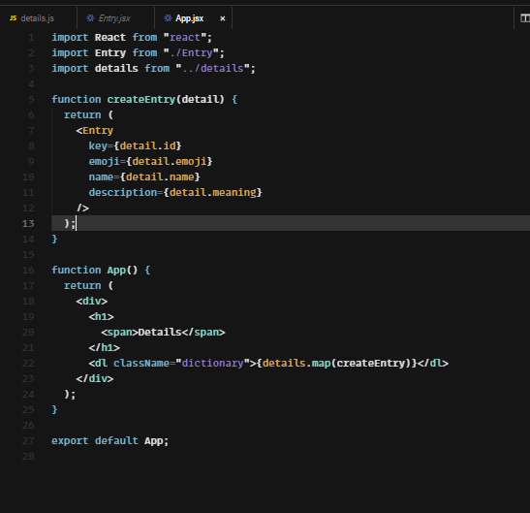

Slide 16
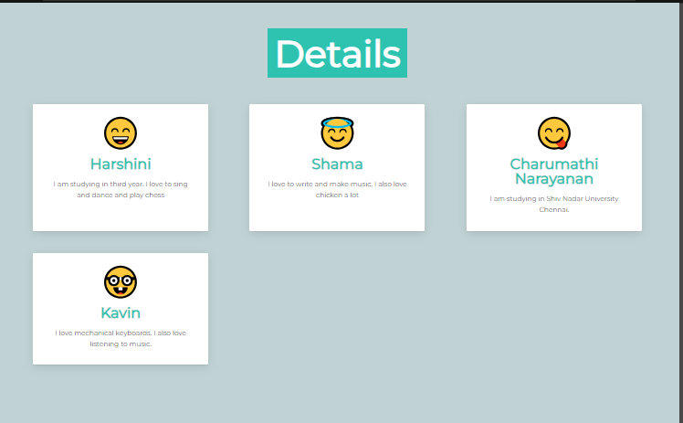

Slide 17
Thank you

