Slide 1



Harshini Vijaya Kumar
NYU CSE Masters, Ex-Founder, Researcher,
Check it out!
Try it live
hebbia.up.railway.app
emailhv2201@nyu.eduphone+1 (848) 240-7937

Slide 2
Why Hebbia?
The reason Hebbia caught my attention: a lot of my recent work is about
making LLM output over financial data actually trustworthy.
TECHNICAL CO-FOUNDER
Causal financial simulation engine for CFOs
DESIGNED & BUILT
Agentic causal-graph engine for headcount & cash-runway
Roles I'm interested in:
Backend Engineer, Agents (1c18a253-3c4d-4e5a-952d-cd35ba690ea7)
Forward Deployed Engineer (b35852eb-97ac-491a-b375-91fd13d0b7b3)

Slide 3

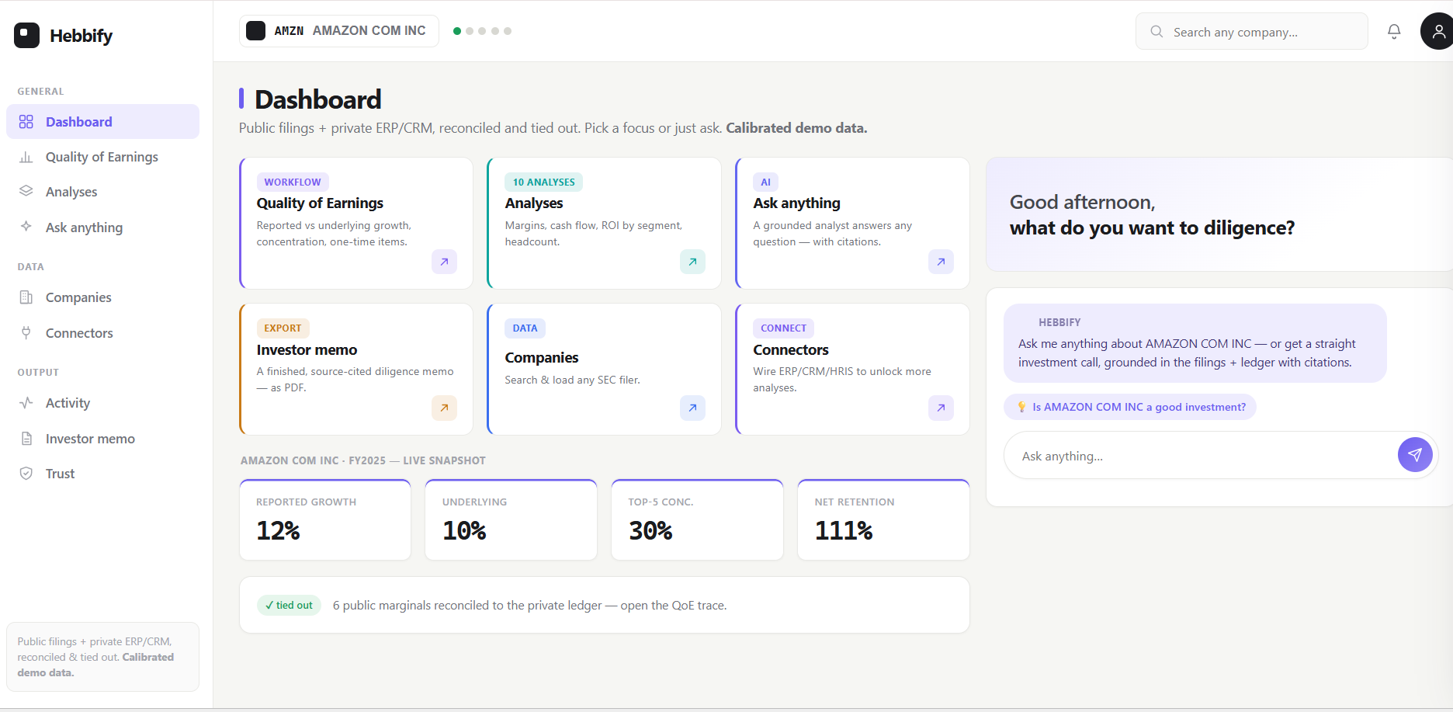
Case Study: Hebbify
Solving the Reliability Problem
I built Hebbify, a financial answer-evaluation harness that verifies LLM-extracted SEC figures against rigid accounting identities so Hebbia can scale autonomous analysis without the risk of shipping a hallucinated number to a client.
Link: hebbia.up.railway.app
Accounting Identities
Assets = Liabilities + Equity
✔ Validated
Structural Checks
Segment roll-ups & margin derivations
Testing Grounds
Real filings: COST, AMZN, KHC
By enforcing fundamental accounting laws at the extraction layer, this harness mitigates hallucinations and ensures the data integrity essential for complex financial reasoning.

Slide 4
ERP + CRM: exactly how they help
Matrix’s real job is unifying internal company data with external filings — checked by the same engine.
📄 External
SEC 10-K · XBRL
Hebbify engine
does the granular detail
reconcile to the filed total?
✓ Verified
diligence insight
🗄 Internal
ERP + CRM ledger
Synthetic ERP/CRM is calibrated to the company’s real XBRL — and tie-out proves it reconciles. “Calibrated demo data.”
ERP (NetSuite) unlocks
CRM (Salesforce) unlocks
• Customer concentration — top-5 % of revenue, never broken out in the 10-K.
• Underlying growth — the real rate, ex the largest customer.
• DSO drift — collections slowing, before the cash-flow statement.
• Net revenue retention — cohort expansion net of churn.
• Pipeline coverage — does pipeline cover next year’s growth need?
• Recurring vs one-time — how much of the top line actually repeats.
The same engine that grades the filing proves the internal ledger ties out to it — the trust layer that lets Matrix act on internal data.

Slide 5

Experience Time
Machine Learning Intern | Capgemini
Feb 2026 – May 2026 | New York, USA
Deployed modular LSTM-Attention Autoencoder on edge devices to predict hardware degradation.
5-STAGE PIPELINE
windowing → LSTM auto-encoder → temporal attention → reconstruction-error scoring → alerting
Graduate Research Assistant | NYU VIDA Lab
Mar 2025 – May 2026 | Brooklyn, USA
Architected HRNet-based pose estimation pipeline for pedestrian behavior research achieving 95% accuracy.
PIPELINE
person detection → HRNet keypoint regression → multi-object tracking → behavior features
Software Engineer Intern | Sycamore
Jun 2025 – Aug 2025 | Massachusetts, USA
Designed Full-Stack engine using React.js UI and PostgreSQL for modular stateful trees and interactive monaco editor.
STACK & DESIGN
recursive React tree editor · typed Node REST APIs · normalized PostgreSQL for versioned tree state
Skills: Python, Java, React.js, Node.js, SQL, TensorFlow, PyTorch, Kubernetes, Docker, AWS (EC2), ETL, Generative AI

Slide 6
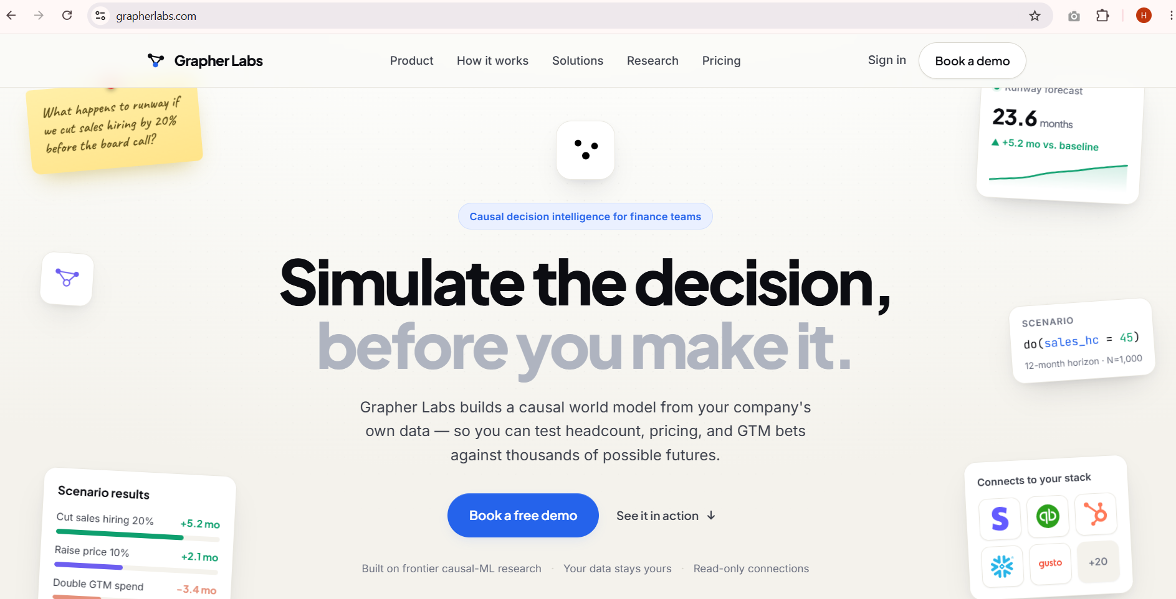
Ex-Founder Story: Grapher Labs
Causal financial simulation engine for CFOs. Completed customer discovery calls and evaluated product market fit. Selected and completed NYU Leslie Accelerator program | September 2025 — May 2026
151
Customer Discovery Calls
3
Letters of Intent(LOIs) Signed
2
Pilots Tested
1
Networking Event Hosted
Key Milestones & Learning
Built & shipped MVP: Architected the core simulation engine.
Talked to real buyers: Direct feedback from CFOs and VPs of Finance.
Learned to sell: From discovery to closing design partners.
Navigated the hard parts: Managing pilots and design iteration.
Link: GrapherLabs.com

Slide 7
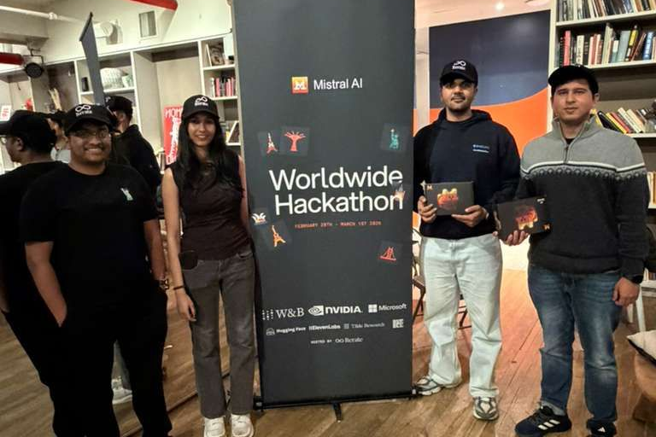
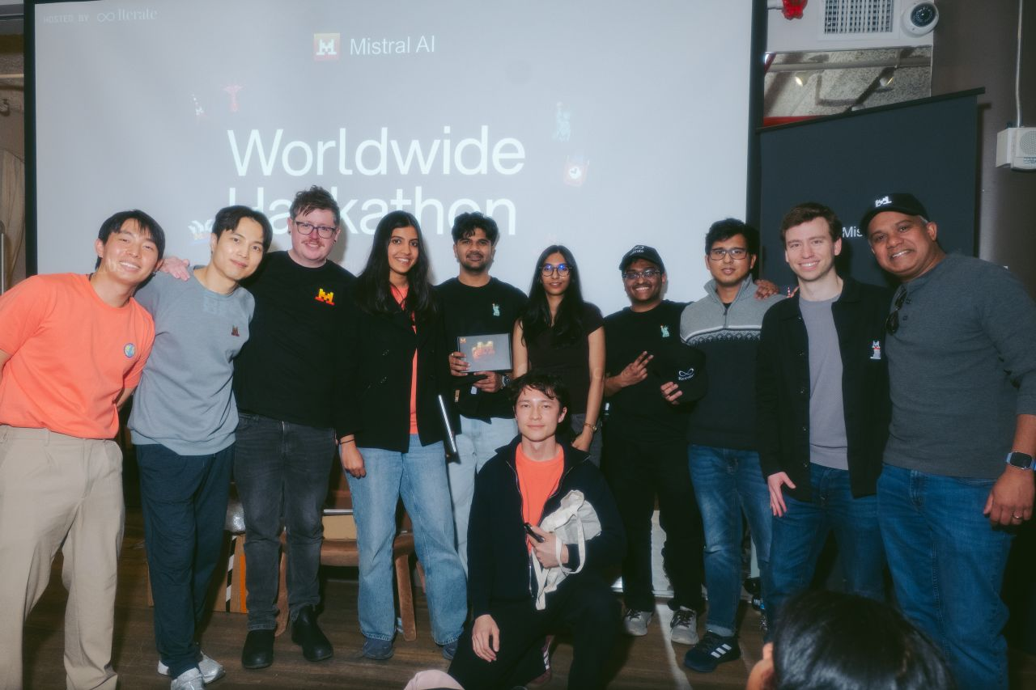
Hackathon Story:
Mistral AI Worldwide Hackathon’26
Winner (Best Use of Hugging Face) - Mistral AI Worldwide Hackathon '26
Developed "Agentic World": Behavioral Digital Twins using Mistral Small 3.1 and Codestral to auto-generate DOM interaction scripts.
Stack: Mistral Small 3.1 · Nvidia Nemo · Nvidia 49b · Codestral · Hugging Face · Playwright · Python

Slide 8
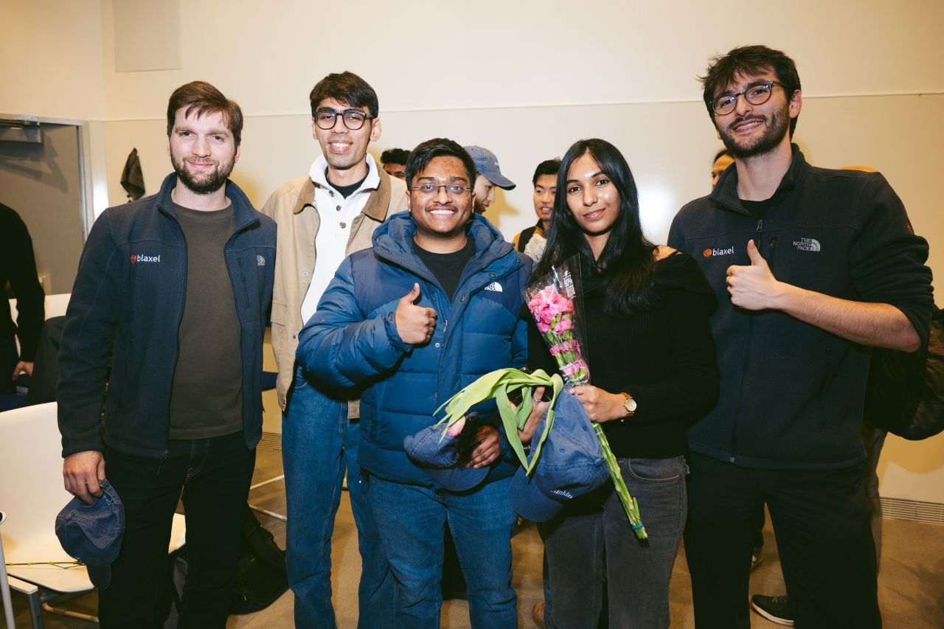
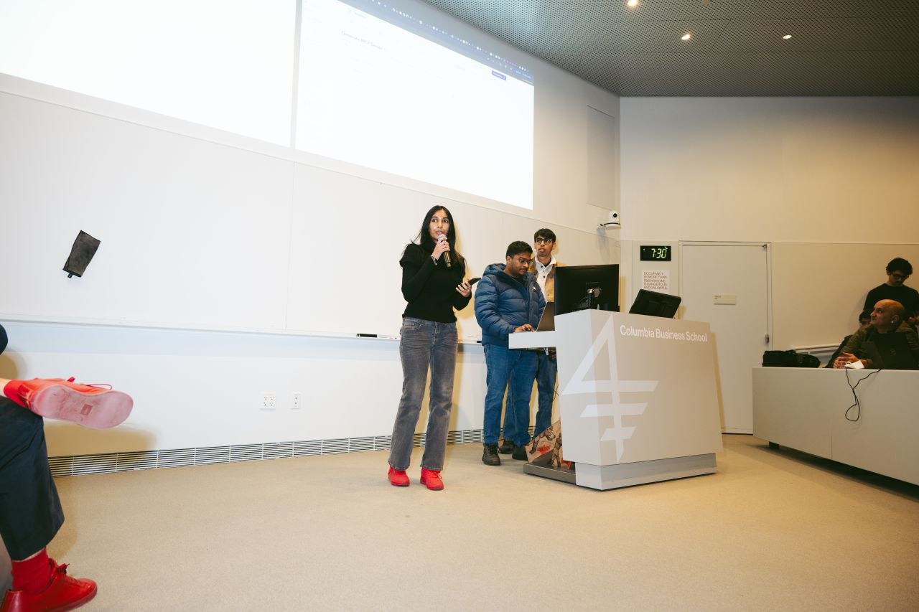
Iterate X Columbia Hackathon
Had to do impromptu talk on stage if selected as finalists!
3rd Place Overall & Best Use of Blaxel (YC’25) - Iterate X Columbia Hack'26
Built an automated MCP adapter sandbox: parses any OpenAPI/Swagger spec and code-generates typed, agent-callable MCP tools on sandboxed serverless functions and REST APIs into LLM tools with zero glue code.
STACK: OpenAPI → MCP codegen · JSON-Schema tool defs · sandboxed serverless execution · tool-calling

Slide 9
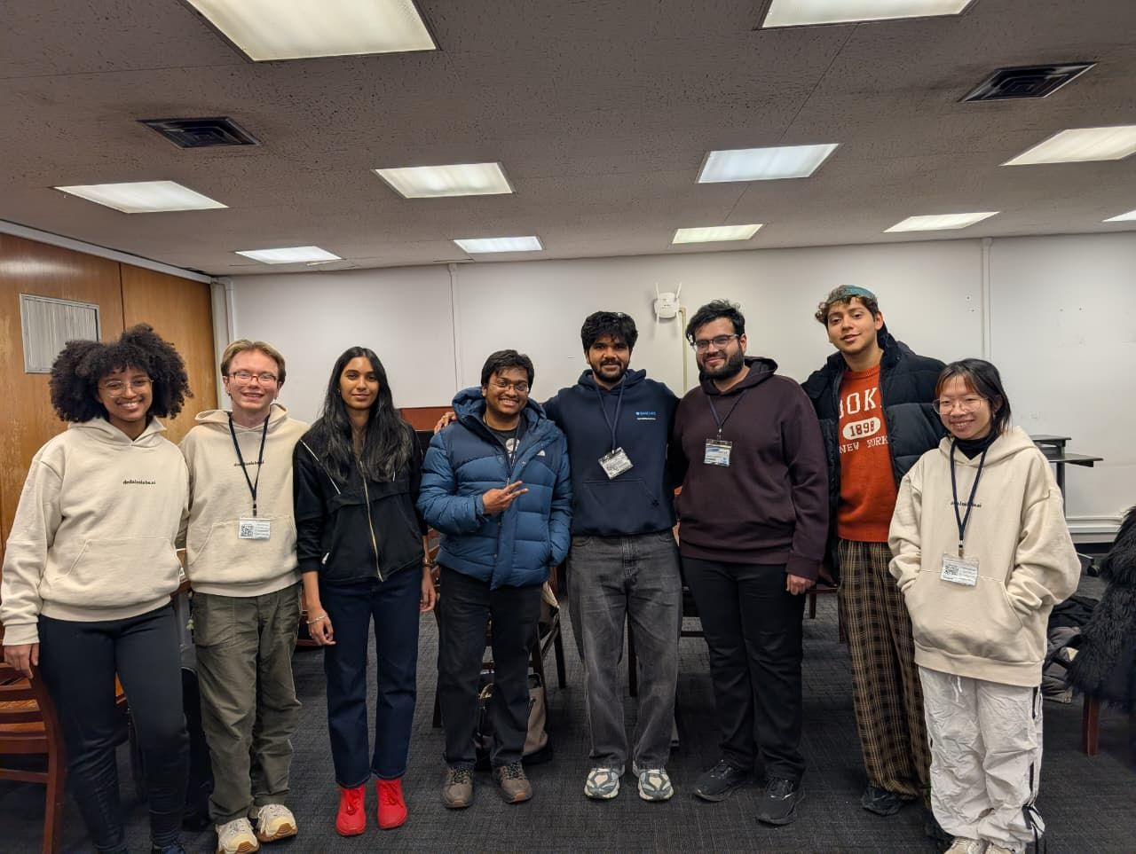
Columbia Devfest Hackathon
Pulled an all nighter for this one at the Columbia Library
Winner (Best Use of Dedalus Labs) - Columbia Devfest '26
Built an end-to-end orchestration pipeline that scaffolds, containerizes, and deploys production-ready MCP servers — spec → Dockerized service → hosted endpoint, in one flow.
PIPELINE: scaffold → Docker build → CI/CD deploy → hosted endpoint + health checks

Slide 10
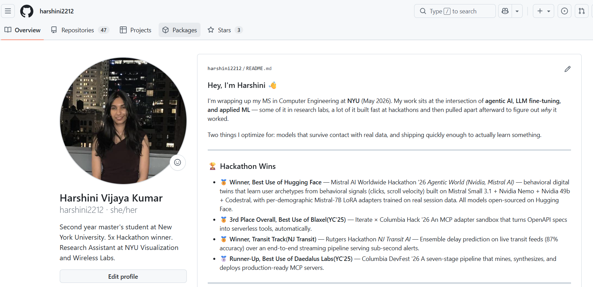
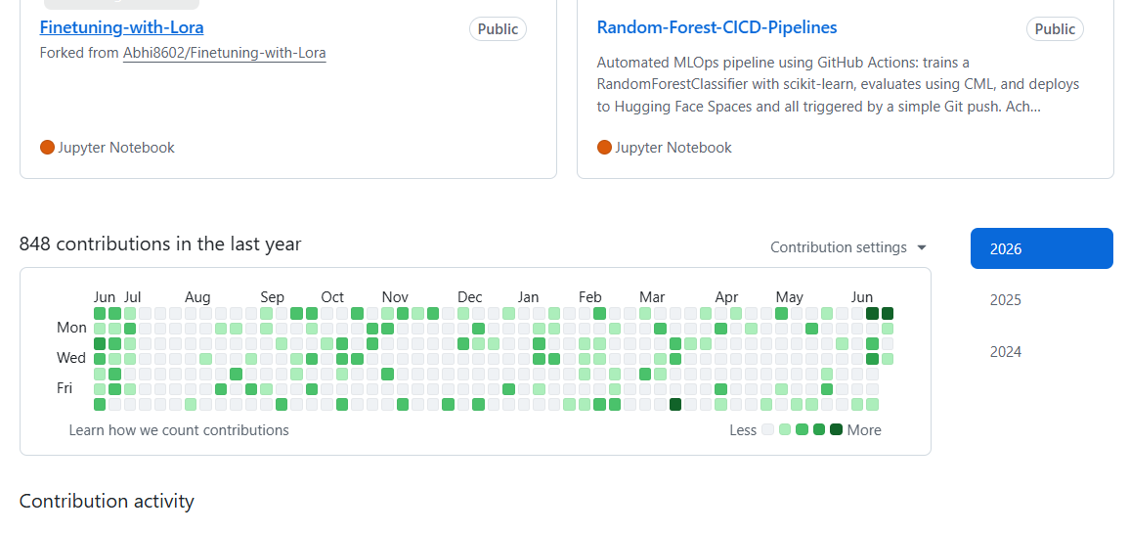
Github: Harshini2212

Slide 11



WHY HEBBIA, WHY ME
Let's build financial AI that's actually trustworthy.
It's the problem I keep choosing to work on and exactly what Hebbia is building. I'd love to build it with you.
Harshini Vijaya Kumar
hv2201@nyu.edu · +1 (848) 240-7937
SCAN FOR MY CODE
harshinivijay.com

