Slide 1



Harshini Vijaya Kumar
NYU CSE Masters, Ex-Founder, Researcher,
Check it out!
Try it live
modal-ai.up.railway.app
emailhv2201@nyu.eduphone+1 (848) 240-7937

Slide 2
Why Mercury?
The reason Mercury caught my attention: a lot of my recent work is about
making AI output over spend & cash flow actually trustworthy.
TECHNICAL CO-FOUNDER
Causal cash-flow & runway engine for CFOs
DESIGNED & BUILT
Agentic causal-graph engine for burn & cash-runway
Roles I'm interested in:
Software Engineer, AI & Agents
Forward Deployed Engineer

Slide 3

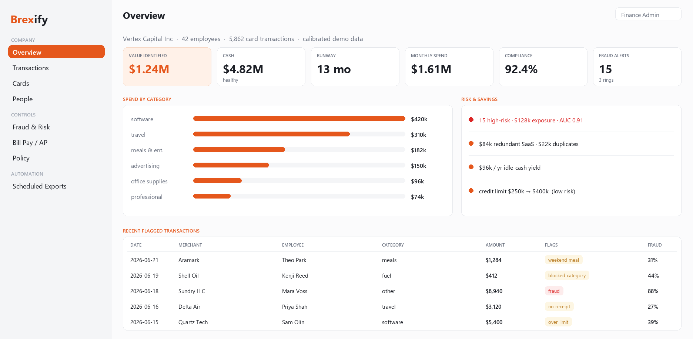
Case Study: Agentic Mercury
Solving the Reliability Problem
I built Agentic Mercury, a financial-correctness harness for Mercury spend that scores every transaction for fraud, replays policy, and tie-out-verifies every number — so Mercury can scale autonomous finance agents without the risk of approving a fraudulent charge.
Link: modal-ai.up.railway.app
Policy + Identities
spend within limit · books tie out
✔ Enforced
Structural Checks
Three-way match · duplicate & bank-change detection
Testing Grounds
Calibrated Mercury tenant · fraud ROC-AUC 0.89+
By enforcing spend policy and accounting identities at the decision layer, the harness catches fraud, duplicate invoices, and policy violations before money moves — the integrity Mercury needs to let agents act on real dollars.

Slide 4
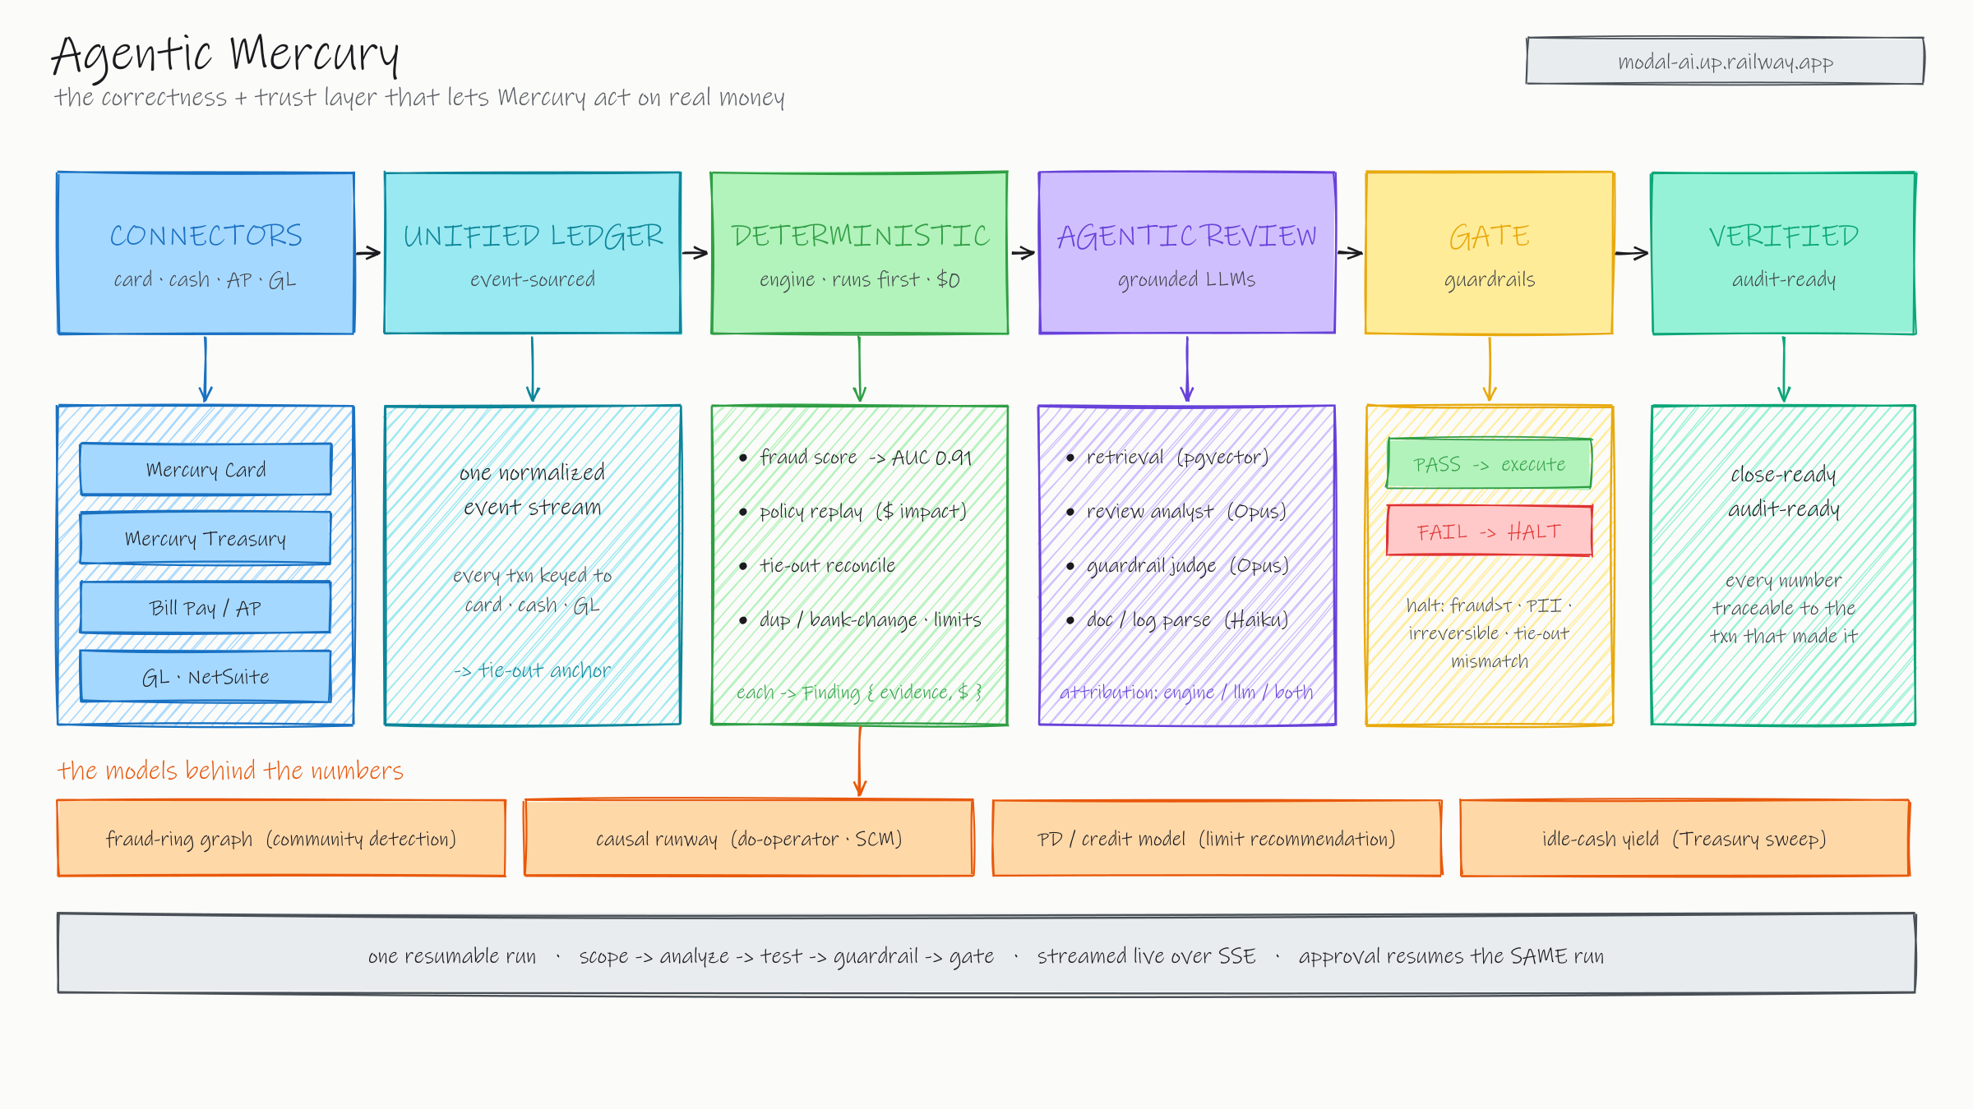
Notes:
Architecture - the trust layer under Mercury's finance agents.
- Deterministic engine runs FIRST, for $0: fraud score (gradient-boosted + graph features, AUC 0.91), policy replay (re-run a policy over history for its dollar impact), tie-out reconciliation (every number rolls up to the GL), duplicate / bank-change detection. Each emits a Finding with evidence and dollars at risk.
- Where the numbers come from - real models: a fraud-ring graph (community detection over shared-card edges), causal runway (do-operator on a structural causal model, not a re-plotted trend), a PD / underwriting model for the credit-line limit, and an idle-cash yield optimizer for the Mercury Treasury sweep.
- Only then does the LLM layer run, grounded by pgvector retrieval over policy / runbooks / incidents: a review analyst (Opus) co-signs or extends each finding - every finding is tagged engine / llm / both - and an adversarial guardrail judge (Opus) tries to break the proposed action. Haiku does the cheap doc / log parsing (model routing).
- A proposed action is replayed on a synthetic tenant before it touches money. The gate auto-executes only when everything passes; anything risky (fraud over threshold, PII, an irreversible bank change, a tie-out mismatch, materiality over budget) HALTS for a human with the diff shown.
- It is one resumable run, streamed live over SSE; approving a halted run resumes the SAME run - it never restarts. That is the trust layer that lets Mercury act on real spend.

Slide 5
Card + Cash + ERP: exactly how they connect
Mercury Assistant’s real job is unifying card spend, cash, and the GL into one ledger — checked by the same engine.
📄 Books
GL · ERP (NetSuite)
Agentic Mercury engine
scores every txn · replays policy
reconcile to the GL?
✓ Verified
close-ready & audit-ready
🗄 Mercury
Card · Mercury Treasury · AP
A synthetic Mercury tenant is calibrated to realistic spend — fraud, policy, and tie-out all proven on it. “Calibrated demo data.”
Card + AP unlocks
Cash + Credit unlocks
• Fraud rings — shared-card collusion the static rules miss.
• Policy leakage — replay a new policy over history, see the $ impact.
• Duplicate & bank-change AP — stopped before Bill Pay sends a cent.
• Causal runway — do-operator what-ifs, not a re-plotted trend.
• Idle-cash yield — the Mercury Treasury sweep opportunity, quantified.
• Underwriting & limits — a PD model recommends the credit line.
The same engine that scores a charge proves the books tie out to it — the trust layer that lets Mercury Assistant act on real spend.

Slide 6

Experience Time
Machine Learning Intern | Capgemini
Feb 2026 – May 2026 | New York, USA
Deployed modular LSTM-Attention Autoencoder on edge devices to predict hardware degradation.
5-STAGE PIPELINE
windowing → LSTM auto-encoder → temporal attention → reconstruction-error scoring → alerting
Graduate Research Assistant | NYU VIDA Lab
Mar 2025 – May 2026 | Brooklyn, USA
Architected HRNet-based pose estimation pipeline for pedestrian behavior research achieving 95% accuracy.
PIPELINE
person detection → HRNet keypoint regression → multi-object tracking → behavior features
Software Engineer Intern | Sycamore
Jun 2025 – Aug 2025 | Massachusetts, USA
Designed Full-Stack engine using React.js UI and PostgreSQL for modular stateful trees and interactive monaco editor.
STACK & DESIGN
recursive React tree editor · typed Node REST APIs · normalized PostgreSQL for versioned tree state
Skills: Python, Java, React.js, Node.js, SQL, TensorFlow, PyTorch, Kubernetes, Docker, AWS (EC2), ETL, Generative AI

Slide 7
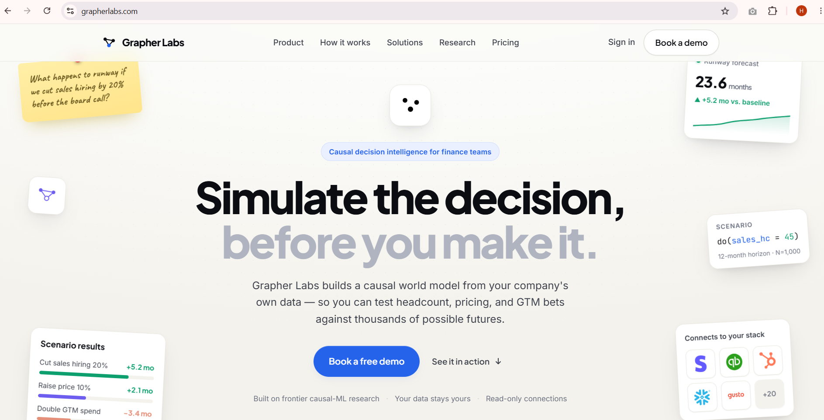
Ex-Founder Story: Grapher Labs
Causal cash-flow & runway simulation engine for CFOs. Completed customer discovery calls and evaluated product market fit. Selected and completed NYU Leslie Accelerator program | September 2025 — May 2026
151
Customer Discovery Calls
3
Letters of Intent(LOIs) Signed
2
Pilots Tested
1
Networking Event Hosted
Key Milestones & Learning
Built & shipped MVP: Architected the core cash-flow engine.
Talked to real buyers: Direct feedback from CFOs and VPs of Finance.
Learned to sell: From discovery to closing design partners.
Navigated the hard parts: Managing pilots and design iteration.
Link: GrapherLabs.com

Slide 8
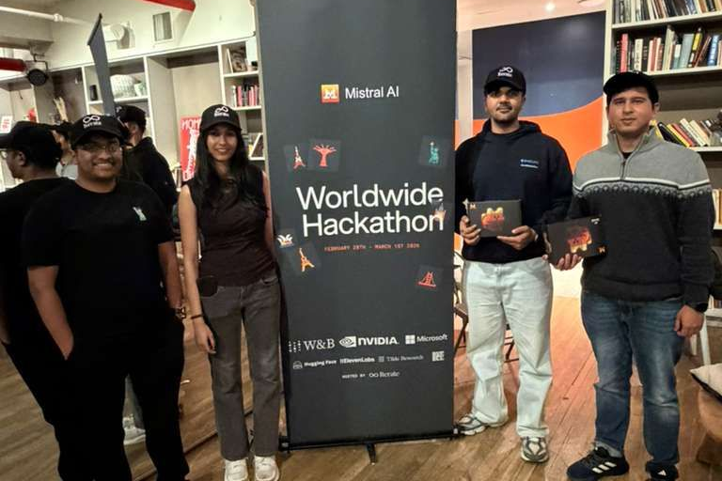
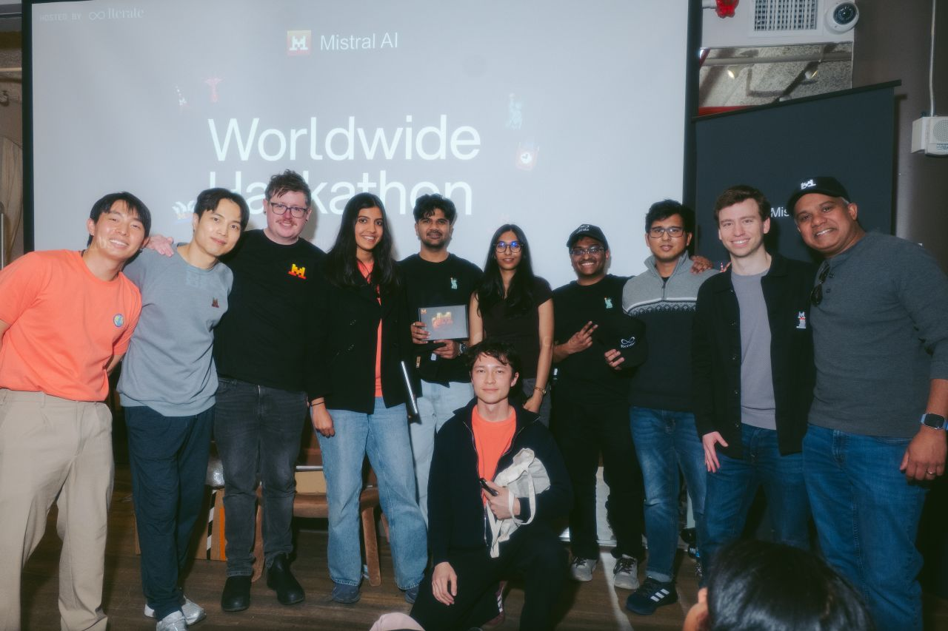
Hackathon Story:
Mistral AI Worldwide Hackathon’26
Winner (Best Use of Hugging Face) - Mistral AI Worldwide Hackathon '26
Developed "Agentic World": Behavioral Digital Twins using Mistral Small 3.1 and Codestral to auto-generate DOM interaction scripts.
Stack: Mistral Small 3.1 · Nvidia Nemo · Nvidia 49b · Codestral · Hugging Face · Playwright · Python

Slide 9
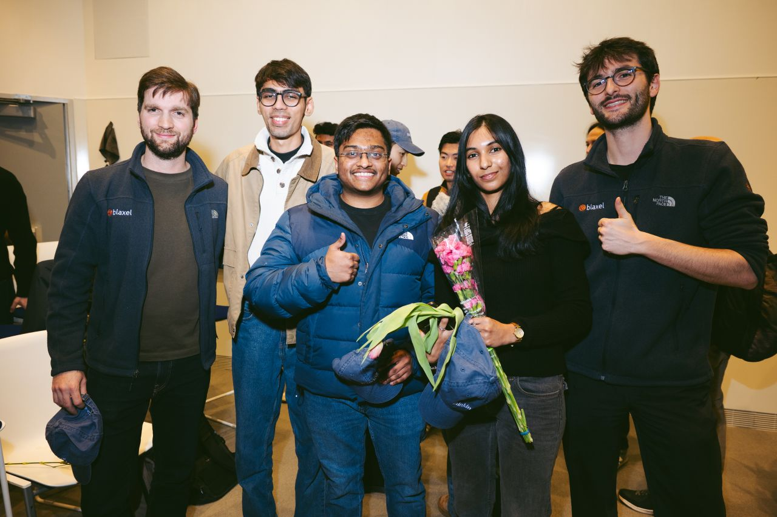
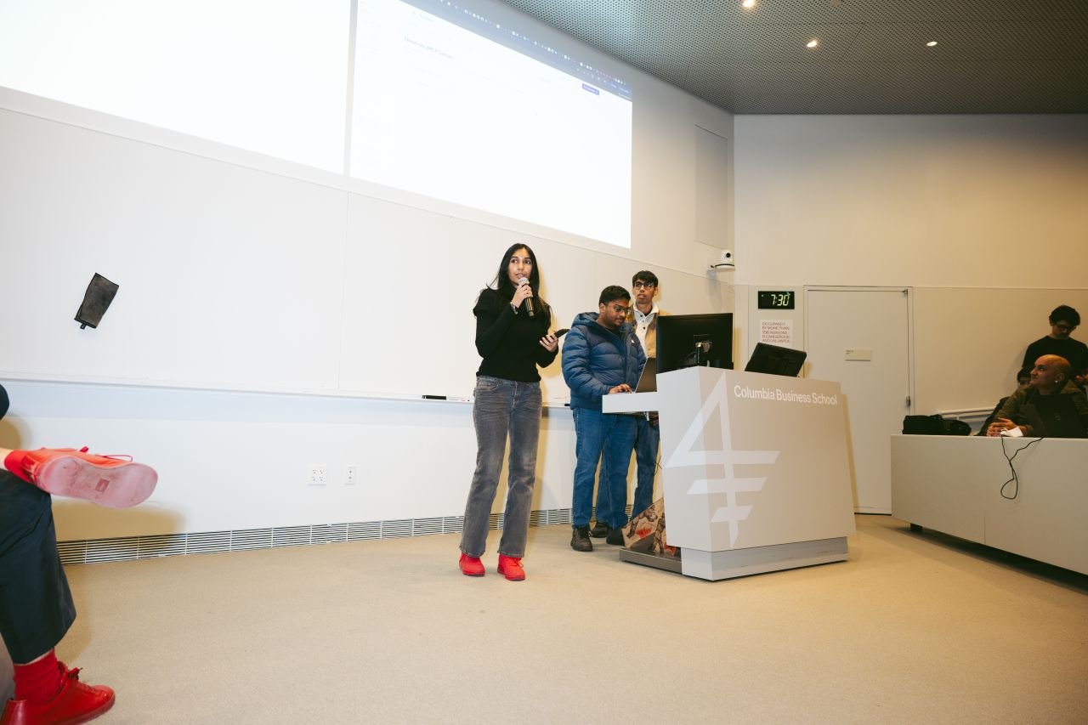
Iterate X Columbia Hackathon
Had to do impromptu talk on stage if selected as finalists!
3rd Place Overall & Best Use of Blaxel (YC’25) - Iterate X Columbia Hack'26
Built an automated MCP adapter sandbox: parses any OpenAPI/Swagger spec and code-generates typed, agent-callable MCP tools on sandboxed serverless functions and REST APIs into LLM tools with zero glue code.
STACK: OpenAPI → MCP codegen · JSON-Schema tool defs · sandboxed serverless execution · tool-calling

Slide 10
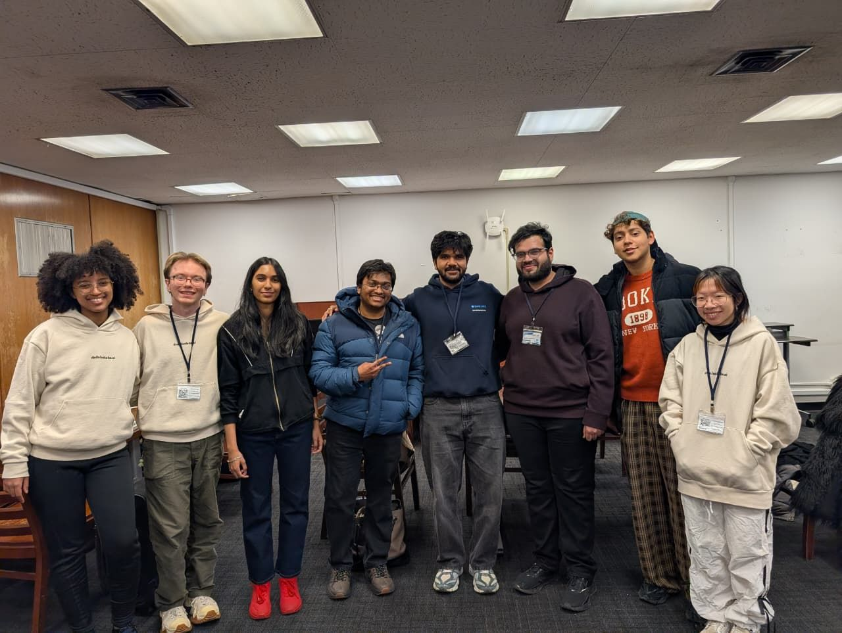
Columbia Devfest Hackathon
Pulled an all nighter for this one at the Columbia Library
Winner (Best Use of Dedalus Labs) - Columbia Devfest '26
Built an end-to-end orchestration pipeline that scaffolds, containerizes, and deploys production-ready MCP servers — spec → Dockerized service → hosted endpoint, in one flow.
PIPELINE: scaffold → Docker build → CI/CD deploy → hosted endpoint + health checks

Slide 11
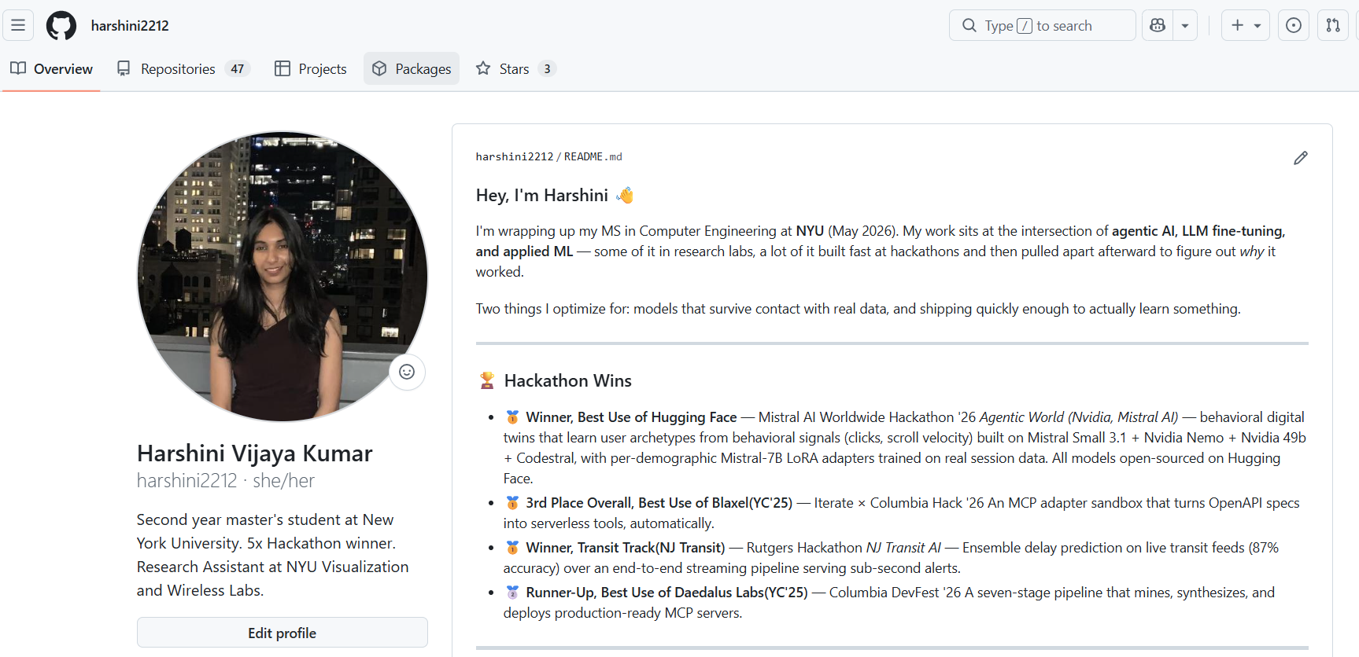
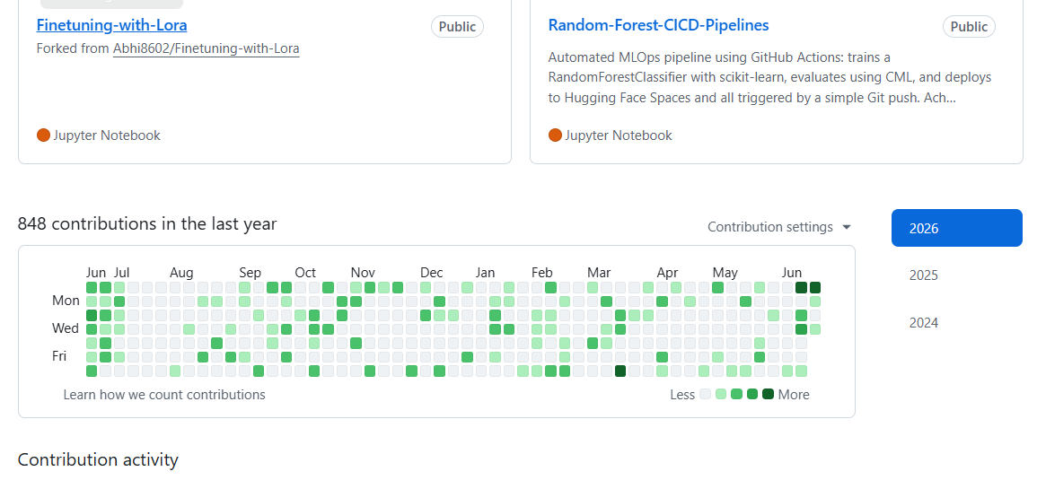
Github: Harshini2212

Slide 12


WHY MERCURY, WHY ME
Let's make spend & cash flow AI actually trustworthy.
It's the problem I keep choosing to work on and exactly what Mercury is building. I'd love to build it with you.
Harshini Vijaya Kumar
hv2201@nyu.edu · +1 (848) 240-7937
SCAN FOR MY CODE
harshinivijay.com

