Slide 1
NAME: HARSHINI PRIYANNA S
DEGREE :B.TECH
BRANCH :3RD YEAR INFORMATION TECHNOLOGY
COLLEGE NAME:GOVERNMENT COLLEGE OF TECHNOLOGY
GMAIL-ID:hars.71772118114@gct.ac.in
NM-ID:au71772118114
TNSDC_ GENERATIVE_AI Final Project
3/21/2024 Annual Review

Slide 2



PROJECT TITLE:
FOOD REVIEW SUMMARIZER
3/21/2024 Annual Review

Slide 3

AGENDA
The sequential agenda of the project:
Step-1: Project Setup and Configuration in the Google Collab Environment
Step-2: Data Acquisition from kaggle and Preprocessing
Step-3: Model Fine-Tuning model using T5 model
Step-4: Model Evaluation to assess summarization quality.
Step-5: Inference and Summarization
Step-6: Results Analysis and Visualization
Step-7: Optimization and Refinement
Step-8: Documentation and Reporting
Step-9: Deployment using the Flask framework with basic HTML and CSS
Step-10: Future Work and Extensions
3/21/2024 Annual Review

Slide 4


AGENDA
BIDIRECTIONAL ENCODER
CONDITIONAL GENERATION
MULTITASK LEARNING
T5 models capture contextual information from both left and right contexts in review texts, leading to more coherent summaries.
T5 models generate summaries based on input review texts, ensuring contextually relevant summaries.
T5 models are trained on multiple NLP tasks simultaneously, enhancing their ability to generate high-quality summaries.
3/21/2024 Annual Review

Slide 5

PROBLEM STATEMENT
Description: Build algorithms to automate the generation of summaries for customer reviews. We receive numerous reviews from different customers for various orders, and we need to generate summaries from the hundreds of reviews collected.
For instance:
Input:
Review 1: Praises about the quality
Review 2:Praises about the Timeliness
Review 3: Complaints about Quantity
Output:
Summary: People usually praise this kitchen’s quality,but they have an issue with the quantity of the food provided. They also appreciate the proper timely delivery from this kitchen.
3/21/2024 Annual Review

Slide 6

PROJECT OVERVIEW
Project Objective
Secondary Objectives:
Develop a robust and scalable system for automating the summarization of food reviews using state-of-the-art machine learning techniques.
Emphasize the importance of accurately summarizing a large volume of reviews to extract actionable insights for businesses and improve decision-making for consumers.
Optimize algorithms and codebase to ensure efficient processing of reviews, minimizing computational resources and time required for summarization.
Fine-tune the T5 Transformer model and incorporate advanced natural language processing techniques to enhance the accuracy and relevance of generated summaries.
3/21/2024 Annual Review

Slide 7




WHO ARE THE END USERS?
Main Focus : Online Food Delivery Platforms
The review summarizer tool can be seamlessly integrated into platforms like Swiggy and Zomato to enhance their user experience and business operations. By efficiently summarizing user reviews, the tool provides valuable insights into customer sentiments and preferences, enabling businesses to make data-driven decisions and improve their services.
3/21/2024 Annual Review

Slide 8


MY SOLUTION AND ITS VALUE PROPOSITION
01
AUTOMATIC SUMMARIZATION:
Our project aims of automating the summarization of food reviews using advanced machine learning techniques.
02
EFFECTIVE ACTION INSIGHTS:
It emphasizes the importance of efficient review summarization for businesses to extract actionable insights and for consumers to make informed decisions.
3/21/2024 Annual Review

Slide 9
YOUR SOLUTION AND ITS VALUE PROPOSITION
1. Tailored Summaries:
Customizing the model with your dataset ensures summaries fit your specific domain or task, adding a personal touch. It's like tailoring a suit to perfection, enhancing both accuracy and resonance to improve the customer satisfaction and effectively apply the demanded improvements.
2. Increased Efficiency:
Automated summarization saves time and effort by swiftly extracting key information from large texts cutting off manual tasks and adding more efficiency. It's like having a reliable assistant streamlining your workflow, allowing you to focus on more creative or strategic tasks.
3. Improved Performance:
Fine-tuning the model optimizes its accuracy and quality, akin to honing a skill to perfection. This personalized attention results in summaries that exceed expectations, unlocking the model's full potential to enhancing the overall customer's experience on our products.
3/21/2024 Annual Review

Slide 10

THE WOW IN MY SOLUTION
1. Enhanced User Experience: Provide users with concise summaries of reviews, helping them quickly grasp the overall sentiment and key points without having to read through lengthy texts.
2. Data-Driven Decision Making: Gain valuable insights into customer feedback and preferences, empowering businesses to identify areas for improvement and optimize their services accordingly.
3. Improved Operational Efficiency: Save time and resources by automating the process of analyzing and summarizing reviews, allowing businesses to focus on delivering exceptional customer experiences.
4. Competitive Advantage: Stay ahead of the competition by leveraging advanced technology to enhance the quality of service and engagement with customers.
5. Enhanced Brand Reputation: Demonstrate a commitment to customer satisfaction and innovation, enhancing brand reputation and loyalty among users.
3/21/2024 Annual Review

Slide 11
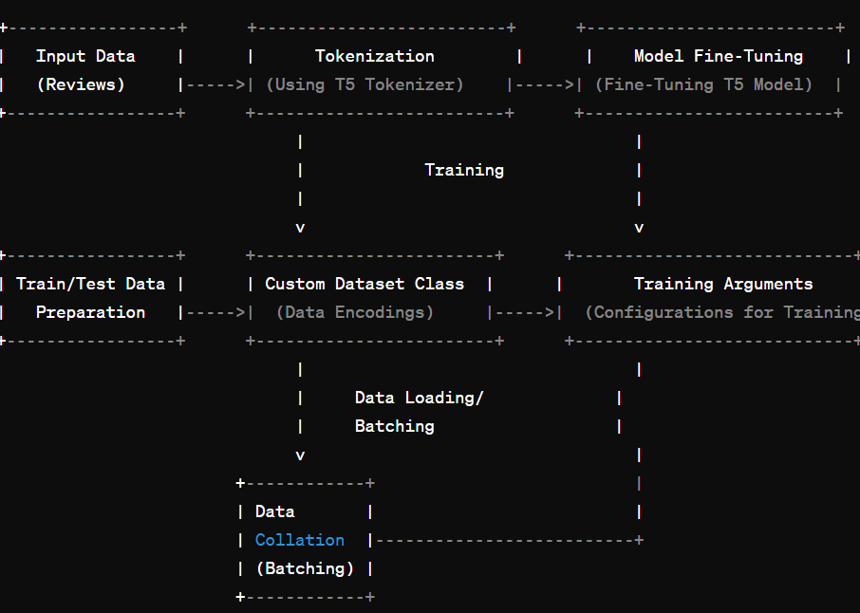
MODELLING
3/21/2024 Annual Review

Slide 12
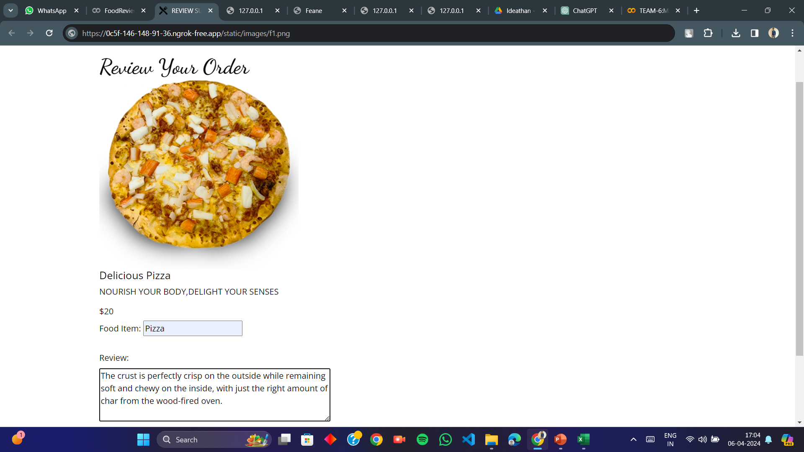
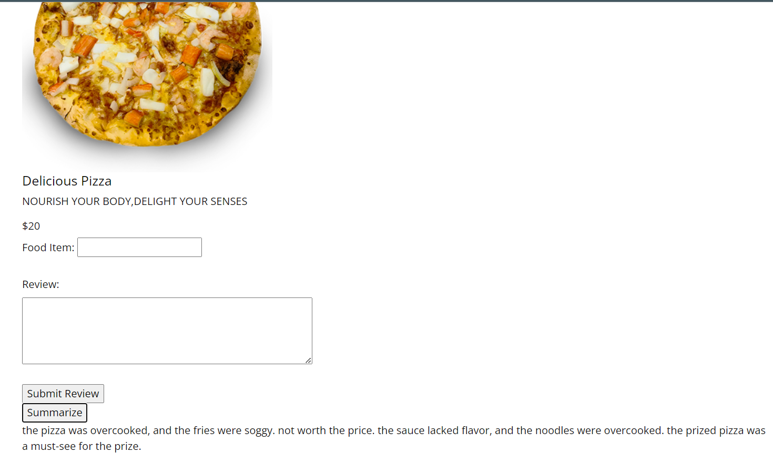
RESULTS
Review
Summarizer
https://github.com/harshini258/TNSDC_-GENERATIVE_AI---Review-Summarizer-Project.git
3/21/2024 Annual Review

