Slide 1
DATAQUEST 3.0
ROUND 1
OFFICIAL PARTICIPANT PPT TEMPLATE
PROJECT DETAILS
TEAM & MEMBERS
PROJECT TITLE
AI POWERED EMPLOYABILITY AND CAREER READINESS ANALYZER
ONE-LINE PITCH
CareerLens is an AI-powered career guidance platform that matches students’ skills and interests with suitable job roles, identifies skill gaps, and provides a personalized roadmap to become job-ready.
TRACK
DQWL
TEAM
SheCodes
PARTICIPANTS
Pooja Sriram
Nayana Priya
Harshini K
Shreya Balakrishnan
Pranamitha B Nair

Slide 2
DATAQUEST 3.0 · ROUND 1
02 Problem Definition
Who is impacted · Today's workarounds · Why current methods fail · Concrete proof
01 · AUDIENCE
02 · STATUS QUO
WHO ARE AFFECTED - College/university students preparing for placement drives, internships, and entry-level career roles.
Placement Cells / Career Service Departments needing batch-level employability tracking.
HOW OFTEN - Continuous throughout the academic year, escalating sharply during placement seasons, application periods, and ahead of job interviews (weekly to daily usage).
CURRENT APPROACH
Students and placement cells rely on resumes, ATS/keyword checkers, GitHub reviews, spreadsheets, online assessments, and self-reported skills. These methods are mostly manual and fragmented, making it difficult to verify whether a student's claimed skills are actually demonstrated through real projects or work.
03 · DEFICIENCY
04 · VALIDATION
WHY IT FALLS SHORT
The current approach is time-consuming, manual, and difficult to scale.The main bottleneck is poor scalability and high manual effort. Reviewing resumes, GitHub projects, and assessments individually takes significant time, can lead to inconsistent evaluations, and becomes difficult to manage for large numbers of students.
EVIDENCE
Mercer | Mettl's India Graduate Skill Index 2025, based on 1M+ students across 2,700+ campuses, reported 42.6% overall graduate employability among Indian graduates, while the World Economic Forum's Future of Jobs Report 2025 found that 63% of employers identify skill gaps as a major barrier to business transformation, highlighting the need for better skill-gap identification, continuous assessment, and upskilling.
Sources: Mercer | Mettl, India's Graduate Skill Index 2025;
World Economic Forum, Future of Jobs Report 2025.

Slide 3
DATAQUEST 3.0 · ROUND 1
03 Proposed Solution
System identity · End-to-end user workflow · Competitive advantages
SOLUTION CORE
CAREER LENS
CareerLens is an evidence-first employability platform that combines a student's:
Resume + GitHub + Portfolio + Professional Profile
Core philosophy : Claim → Evidence → Verification → Decision → Action
USER FLOW
1. USER INPUT
Student provides: - Resume — PDF/DOCX - GitHub username/profile - Portfolio URL - LinkedIn PDF/text export - Target career role
➔
2. PROCESSING
Resume Parser - Evidence Engine - Claim-Evidence Engine - Readiness Engine - Gap & Roadmap Engine
➔
3. OUTPUT
Student receives: Job Readiness Score - Claim-Evidence Matrix - Role-Fit Ranking - Skill Gap Analysis - Personalized Roadmap - What-If Score Simulator - Interview Questions - Evidence-based Resume Improvements
ADVANTAGE
INNOVATION
WHY IT IS BETTER
-Traditional flow : Resume -> Keywords -> Score
-CareerLens flow : Resume -> Claims -> Real proof of work -> Evidence strength -> Claim verification -> Role requirements -> Explainable score -> Skill gap -> Action plan
-Key improvement: CareerLens evaluates evidence, not just presence of keywords.
WHAT IS DIFFERENT
1.Claim-Evidence Engine
2.Explainable Readiness
3.What-If Career Simulator
4.Student + Institution in one system

Slide 4
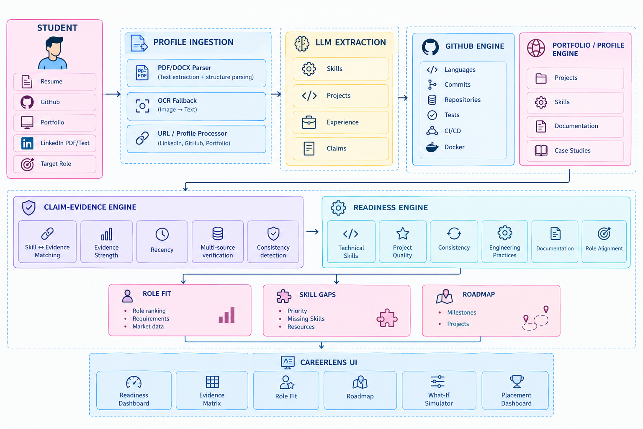
DATAQUEST 3.0 · ROUND 1
04 System Architecture
SYSTEM DIAGRAM

Slide 5
TECH 01
TECH 02
TECH 03
FRONTEND
React + Vite + TypeScript + Tailwind CSS + Recharts
Why:
rapid hackathon development
reusable components
interactive dashboards
data visualization
strong ecosystem
Backend
Python + FastAPI
Why:
rapid API development
natural integration with Python AI/ML ecosystem
asynchronous API support
clean service separation
Intelligence & Data
LLM + GitHub REST API + Embeddings + PostgreSQL/SQLite
LLM:
structured resume extraction
claim extraction
explanations
roadmap generation
Deterministic logic:
GitHub statistics
repository signals
evidence scoring
readiness calculations
This separation is intentional.
HARDEST PART
Claim → Evidence Mapping
The biggest technical challenge was verifying whether a candidate’s claimed skills were actually supported by their work.
Challenge:
Resume claims alone cannot prove technical expertise.
Our Approach:
Claim → Evidence Search → Evidence Strength → Verdict
Example:
“Expert in Docker” → No Dockerfile / Compose / recent usage → UNSUPPORTED
“Experienced in Python” → 7 repositories + Python files + commits + tests → VERIFIED
Key Insight:
CareerLens validates skills using real, multi-source evidence—not claims alone.
VALIDATION
We evaluate the prototype using 4 measurable parameters:
1. Analysis Latency
Upload → Dashboard
→ Test on 5+ profiles
→ Report median analysis time
2. Extraction Quality
50 manually labelled skills/claims
→ Compare expected vs extracted
→ Measure precision & recall
3. Evidence Verification
Test cases: Verified / Partial / Unsupported
→ Compare with human labels
→ Measure agreement
4. API Reliability
Run N analysis requests
→ Track successful completions
→ Report X/N success rate
Key Principle:
Use measured results — never invent accuracy or performance numbers.

Slide 6
DATAQUEST 3.0 · ROUND 1
05 Feasibility & Scope
Concrete boundaries · Operational run rate · Risk mitigation · Post-hackathon plans
01 · BOUNDARIES
02 · ECONOMICS
1. SCOPE
IN - Resume upload,Structured resume parsing,Claim extraction,GitHub analysis,Portfolio/profile inputs,Claim-Evidence Matrix,,Readiness score,Role-fit ranking,Skill-gap analysis,Personalized roadmap,What-if simulator
OUT - Automated LinkedIn scraping,Full-scale recruiter platform,Private repository access,Large-scale enterprise deployment,Full Figma/Behance integrations,Autonomous hiring decisions
2. RUNNING COST
Uses open-source Python libraries and GitHub public APIs.
Local processing wherever practical; no GPU required.
Lightweight database with minimal storage cost.
Limited LLM API calls to reduce token usage.
Resume processing → per analysis.
GitHub analysis → API usage.
Frontend/backend → low-cost or free-tier hosting.
03 · CONTINGENCY
04 · HORIZON
3. RISKS & FALLBACK
GitHub API limit: Use cached/demo repository data.
LLM failure: Use structured parser, retry mechanism, or stored analysis.
Messy/scanned resume: Use OCR as a fallback.
Portfolio unavailable: Mark evidence as unavailable and lower confidence.
LinkedIn restrictions: Use user-provided PDF export or pasted text.
Job API unavailable: Use a preloaded job-description dataset.
4. AFTER THE HACKATHON
Product Hardening - Authentication & student profiles, improved evidence extraction & role matching,Portfolio integration
Placement Intelligence - Placement dashboards, Recruiter-role matching,Skill-gap & training recommendations
Career Intelligence - Live job-market skill demand, Continuous readiness tracking,Personalized projects & learning resources

Slide 7
DATAQUEST 3.0 · ROUND 1
06 Impact & Metrics
Primary measurable impact · Transparent calculation · Stakeholder advantages
PRIMARY METRIC
(Claims with observable evidence ÷ Total verifiable claims) × 100
HOW IT WAS MEASURED
Evaluate a sample of resume claims and identify the evidence expected for each claim. Compare these claims against observable evidence from GitHub repositories, project files, portfolios, or documented work. Record whether each claim has at least one traceable evidence source, then calculate the percentage using the formula shown.
IMPACT 01
IMPACT 02
IMPACT 03
WHAT IMPROVES
Students receive specific evidence-backed improvement actions, rather than generic advice.
WHO ELSE BENEFITS
CareerLens maps candidate profiles against structured role/skill taxonomies.
Use ESCO/O*NET-aligned role and skill concepts rather than manually inventing every job requirement.
ESCO provides structured relationships between occupations and skills and is designed to support job/skill matching.
RISKS / MISUSE
Risks
incomplete public evidence,outdated repositories,over-reliance on a numerical score
Mitigations
Confidence score,Evidence traceability,
Human-readable explanations,Fairness constraints,No identity-based scoring

Slide 8
DATAQUEST 3.0 · ROUND 1
07 Why This Project?
Direct contrast with today's alternatives · Unfair technical advantage
STATUS QUO
OUR SOLUTION
CURRENT APPROACH
Resume / ATS tools
Focus mainly on:keywords,formatting,Manual GitHub review
Requires a recruiter/mentor to inspect:repositories,code,documentation
Student self-assessment Relies heavily on: "I know Python."
Placement spreadsheets Capture:
"Python - Yes"
but not:
"What evidence demonstrates Python proficiency?"
OUR APPROACH
We don't score the resume. We score the evidence behind the resume and every score can be traced back to: Claim → Source → Evidence → Score Impact → Recommended Action
Traditional ATS tools ask: "Does the resume contain the keyword?"
CareerLens asks: "Where is the proof?"
Over time, every analysis creates structured relationships between:
Student ↔ Skill ↔ Evidence ↔ Project ↔ Role ↔ Gap ↔ Action
That data model becomes substantially harder to reproduce than a simple resume chatbot.
MOAT / DIFFERENTIATION
KEY DIFFERENCE
CareerLens doesn't measure how impressive a resume sounds. It measures how much of it can be proven — and tells the student exactly what to build next.
Others measure what your resume CLAIMS. CareerLens verifies what your profile can PROVE.
Then it turns PROOF → READINESS SCORE → ACTIONABLE SKILL GAPS.

Slide 9
DATAQUEST 3.0 · ROUND 1
08 TRUST LAYER
EVIDENCE-BACKED SCORING
CLAIM → EVIDENCE → VERIFICATION → SCORE
HOW IT WORKS:
CareerLens extracts skill claims from the resume and checks them against observable evidence from GitHub, projects and portfolios. Each claim is classified as Verified, Partial or Unsupported before contributing to the readiness score.
CLAIM–EVIDENCE TRACEABILITY
DETERMINISTIC AI PIPELINE
TRUST & FAIRNESS
Every score is linked to the evidence behind it.
Repository & code evidence,Project implementation, Recency & activity, Tests, CI/CD & documentation
Result: “Why did I get this score?” is answerable.
LLM: extracts claims, skills & projects
Evidence Engine: validates observable signals
Scoring Engine: calculates readiness
LLM: explains results & generates roadmap
Key principle: AI interprets; evidence decides.
Risks: Missing evidence • outdated profiles • score over-reliance
Controls:
Confidence indicators
Evidence traceability
Explainable scoring
Missing evidence ≠ no skill
No identity-based scoring

