Slide 1
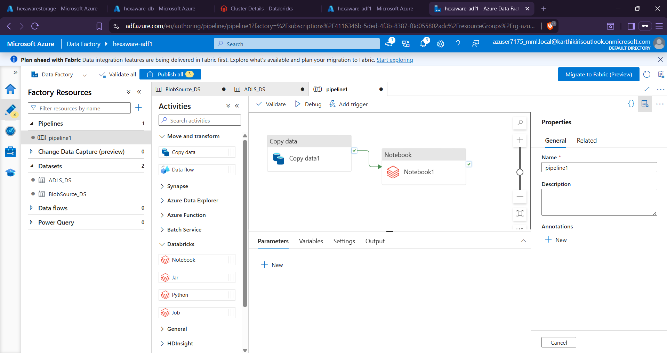
PYSPARK PROJECT
Inventory Management
Analysis & Reporting System
Azure Data Factory • Azure Databricks • ADLS • PySpark
End-to-end Cloud Pipeline
Prepared by: Harshini G, Prashanth R
Hexaware Data Engineering B5
Notes:
Good morning sir. My project is Inventory Management Analysis and Reporting System. It is a PySpark-based data engineering project built using Azure Data Factory, Azure Databricks and Azure Data Lake Storage. The main aim is to automate the movement of source CSV files, process them, and generate dimension, fact and report outputs.

Slide 2
Why we created this project
Purpose before tools
Before
Manual upload, manual checking, slow reporting
1
Manual CSV movement and report preparation takes more time.
2
This project automates ingestion, processing and inventory reporting.
After
Automated pipeline with verified outputs
Inventory Management Analysis & Reporting System
02
Notes:
First, why we created this project. In real inventory systems, source files may land frequently, and manually moving files and preparing reports is slow and error-prone. So the project automates the complete flow from file upload to final reporting output.

Slide 3
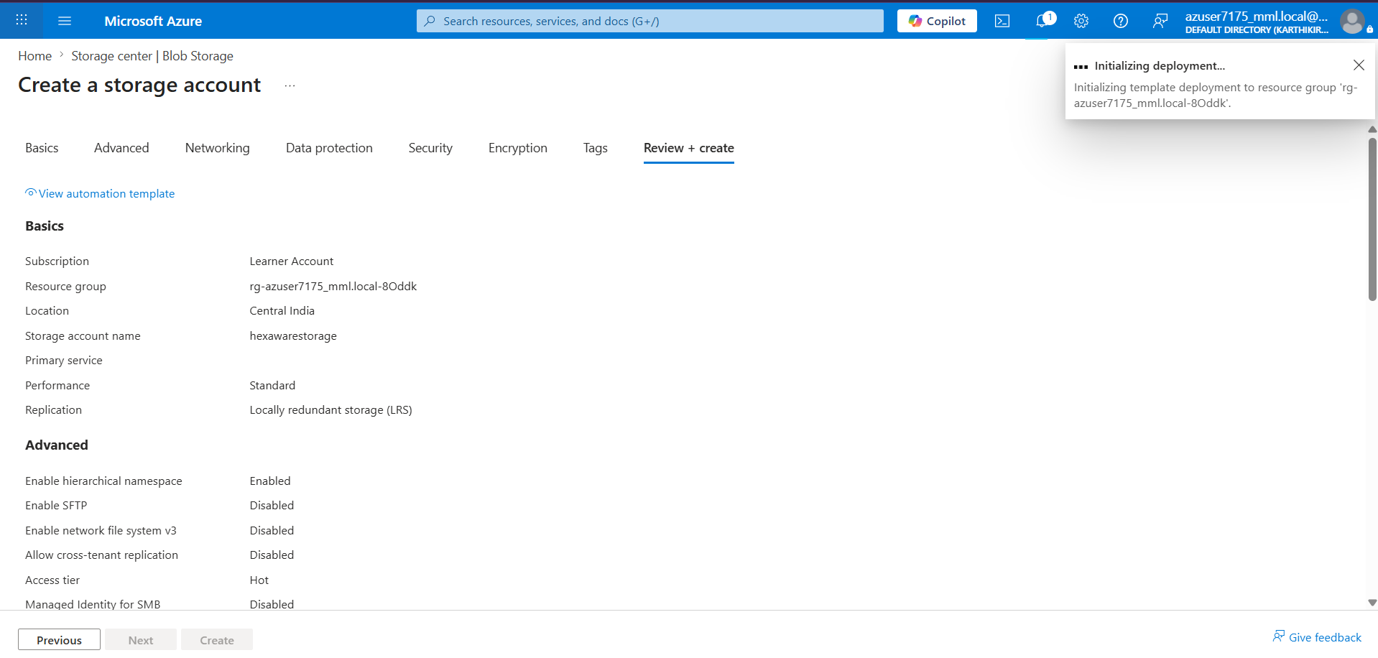
What kind of project is this?
Cloud data engineering + reporting
1
It is a cloud-based data engineering pipeline project.
2
ADF orchestrates the workflow; Databricks runs PySpark transformations.
Azure resource setup
Inventory Management Analysis & Reporting System
03
Notes:
This is not only a PySpark coding task. It is a complete cloud data engineering project. Azure Data Factory controls the flow, Azure Databricks executes the notebook, and Azure storage keeps the source and output files.

Slide 4
Overall project flow
From raw CSV to reports
1
Source CSV files land in Blob Storage.
2
ADF triggers Databricks and outputs are stored in ADLS/Delta.
Blob
Source
ADF
Pipeline
Databricks
PySpark
ADLS +
Delta
Reports
CSV
Inventory Management Analysis & Reporting System
04
Notes:
The flow is simple. Source CSV files are uploaded to Blob Storage. ADF detects and runs the pipeline. The pipeline copies files to ADLS and then runs the Databricks notebook. Finally, the notebook creates CSV outputs, Delta tables and report datasets.

Slide 5
Azure services used
Each service has a clear role
1
Blob Storage and ADLS store source and processed data.
2
ADF handles orchestration; Databricks handles PySpark processing.
Storage
Raw input + processed output containers
ADF
Trigger, Copy Data, Notebook activity
Databricks
Cluster + PySpark notebook
Inventory Management Analysis & Reporting System
05
Notes:
The main services are Storage, Data Factory and Databricks. Storage keeps the source and output containers. Data Factory automates the activities and trigger. Databricks runs the PySpark notebook to transform the data.

Slide 6
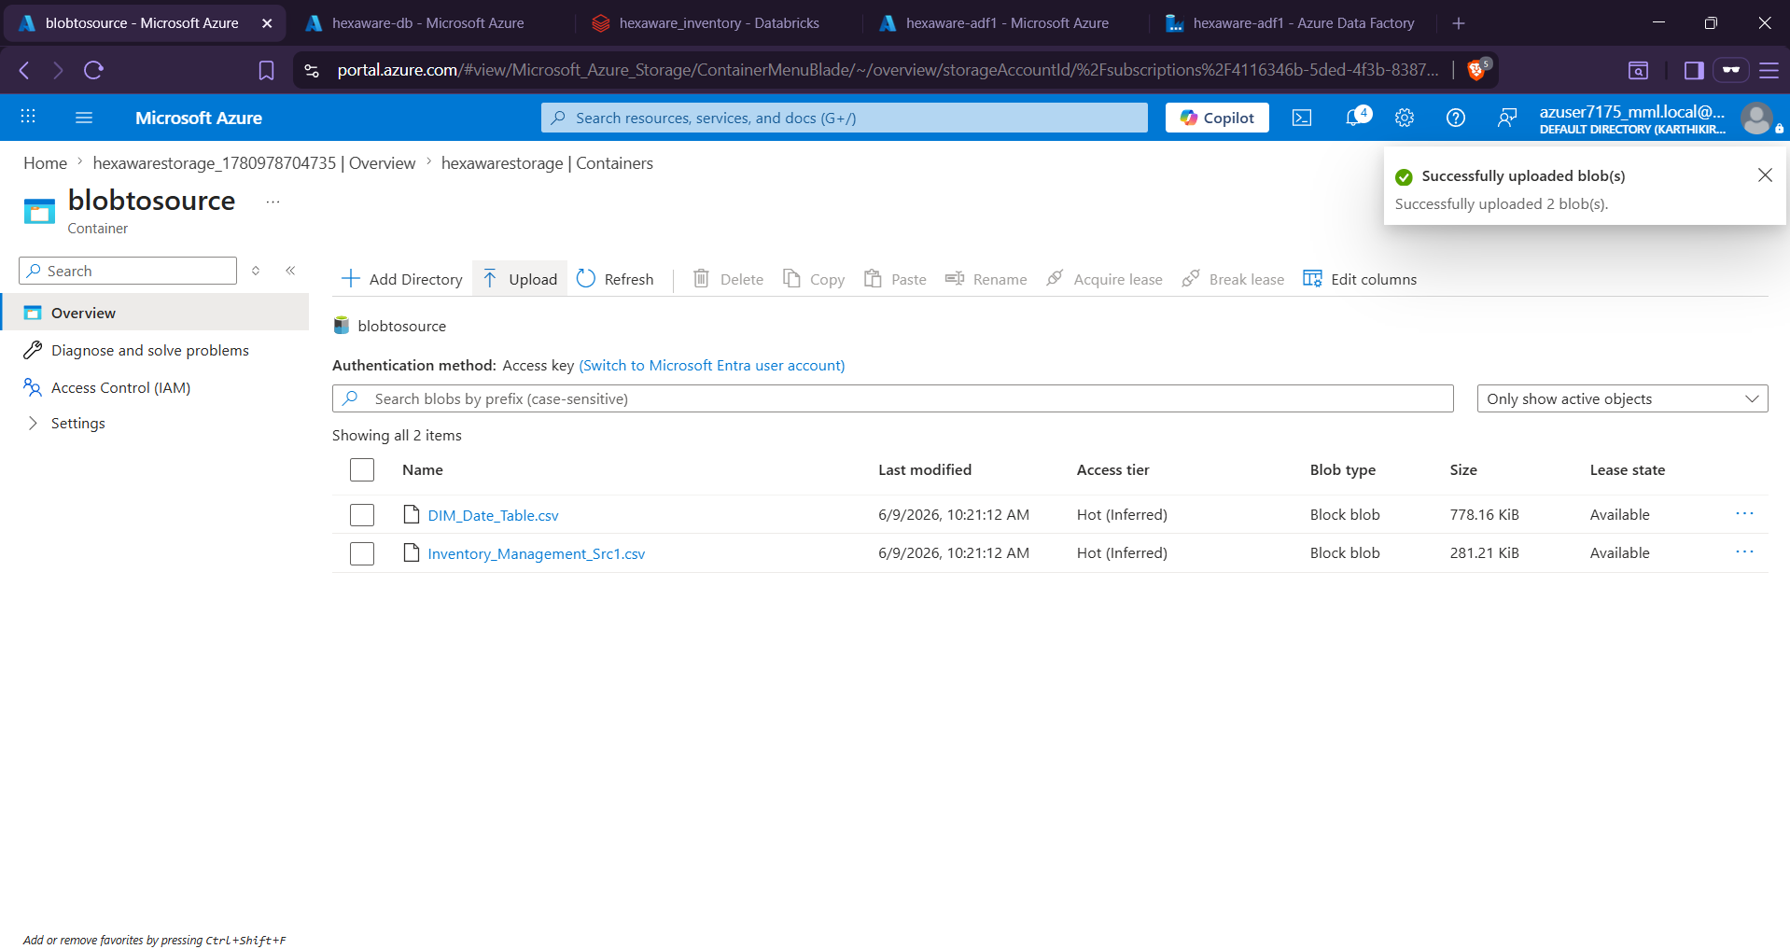
Input data and data model
Source files converted into analytics tables
1
Input files: Inventory_Management_Src1.csv and DIM_Date_Table.csv.
2
Created dimensions, fact table and reporting datasets.
DIM_Customer
DIM_Product
DIM_Seller
DIM_Time
DIM_Transaction
FACT_Inventory
Inventory Management Analysis & Reporting System
06
Notes:
The project uses two source files. The first file contains inventory transactions, customers, products and sellers. The second is the date table. From these inputs, the notebook builds dimension tables, a fact table and report outputs.

Slide 7
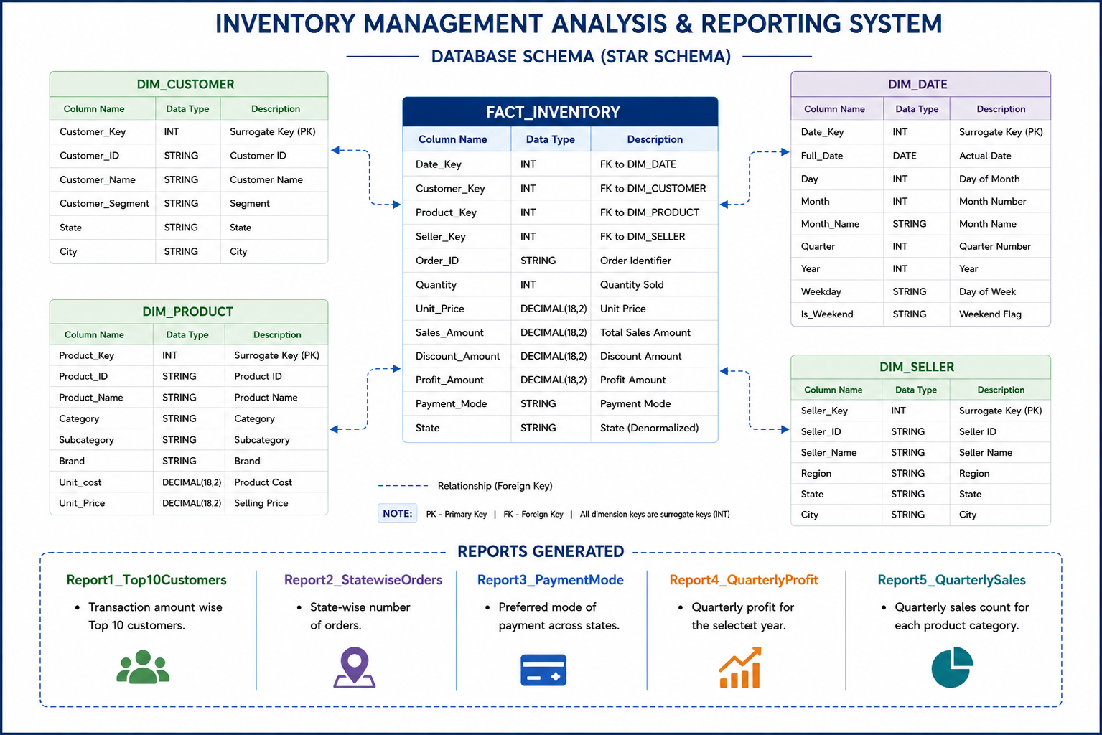
Star Schema Model
Dimensional view of the inventory reporting system

Slide 8
ADF pipeline design
Copy first, process next
1
Copy Data moves CSV files from Blob Storage to ADLS.
2
Notebook activity runs only after the copy activity succeeds.
Inventory Management Analysis & Reporting System
07
Notes:
In ADF, the pipeline has two main activities. First is Copy Data, which moves files from the Blob source to ADLS. Second is the Databricks Notebook activity, which starts only after the copy activity is successful.

Slide 9
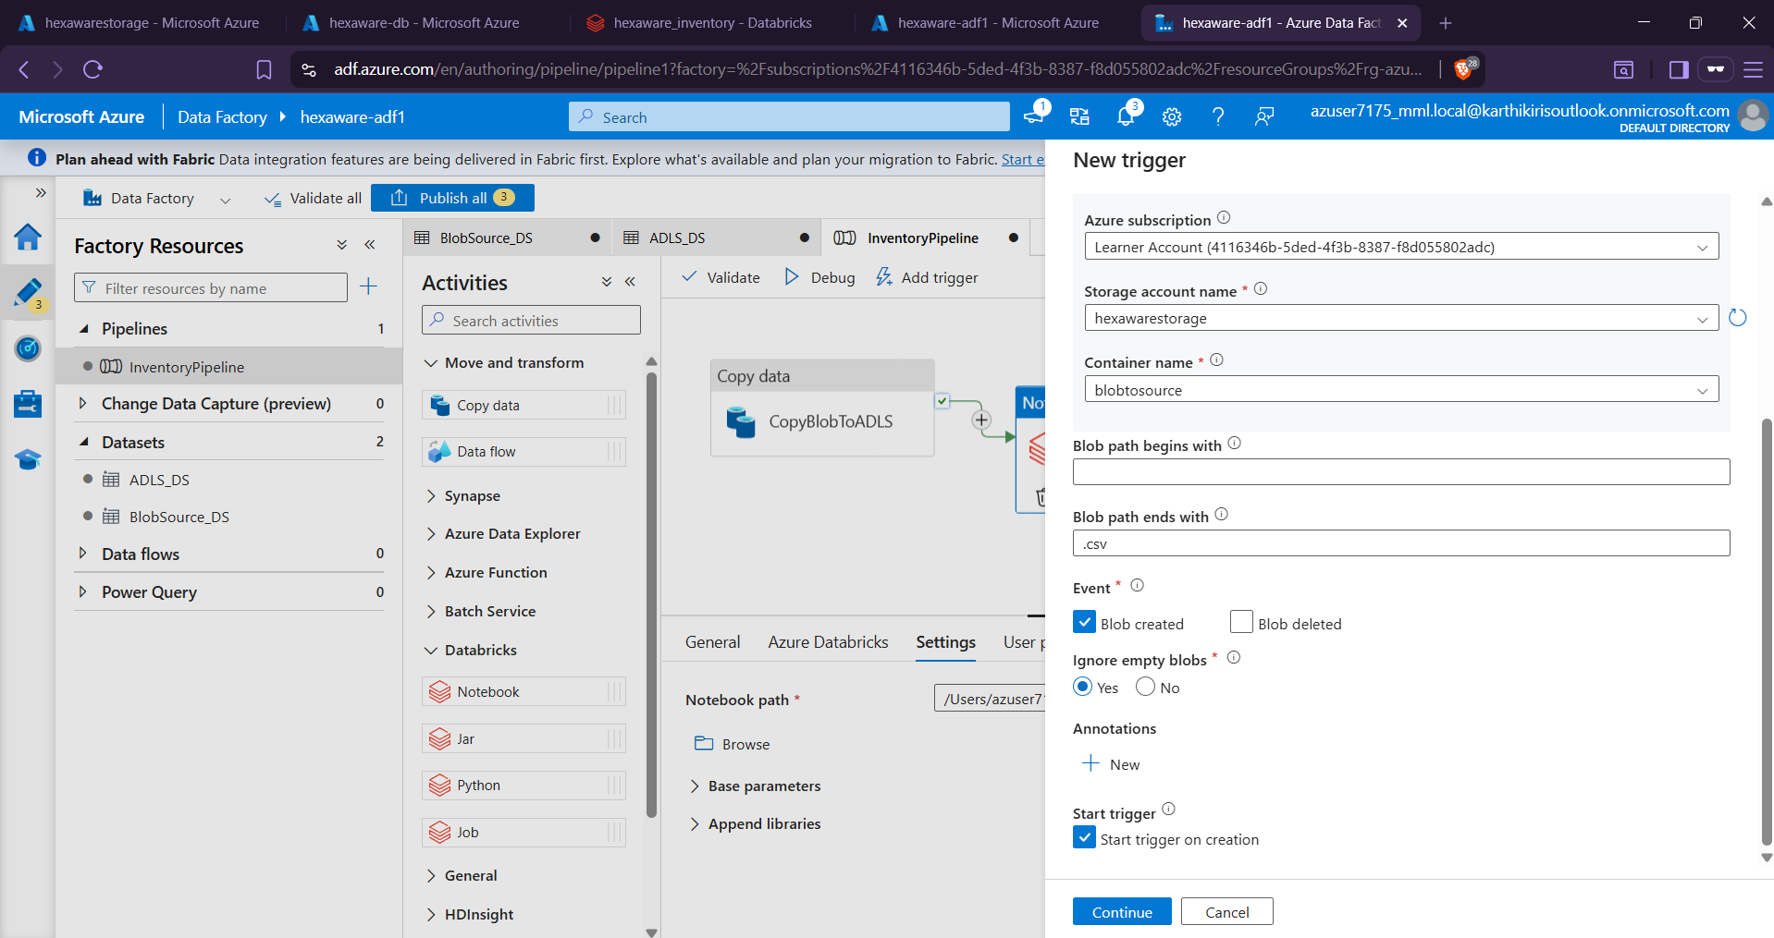
Trigger-based automation
Pipeline starts when files arrive
1
Storage event trigger watches CSV file creation in the source container.
2
This satisfies notebook execution after files land in storage.
Inventory Management Analysis & Reporting System
08
Notes:
For automation, I configured a storage event trigger. When CSV files are uploaded to the source container, the trigger starts the ADF pipeline automatically. Then the copy activity runs, followed by Databricks notebook execution.

Slide 10
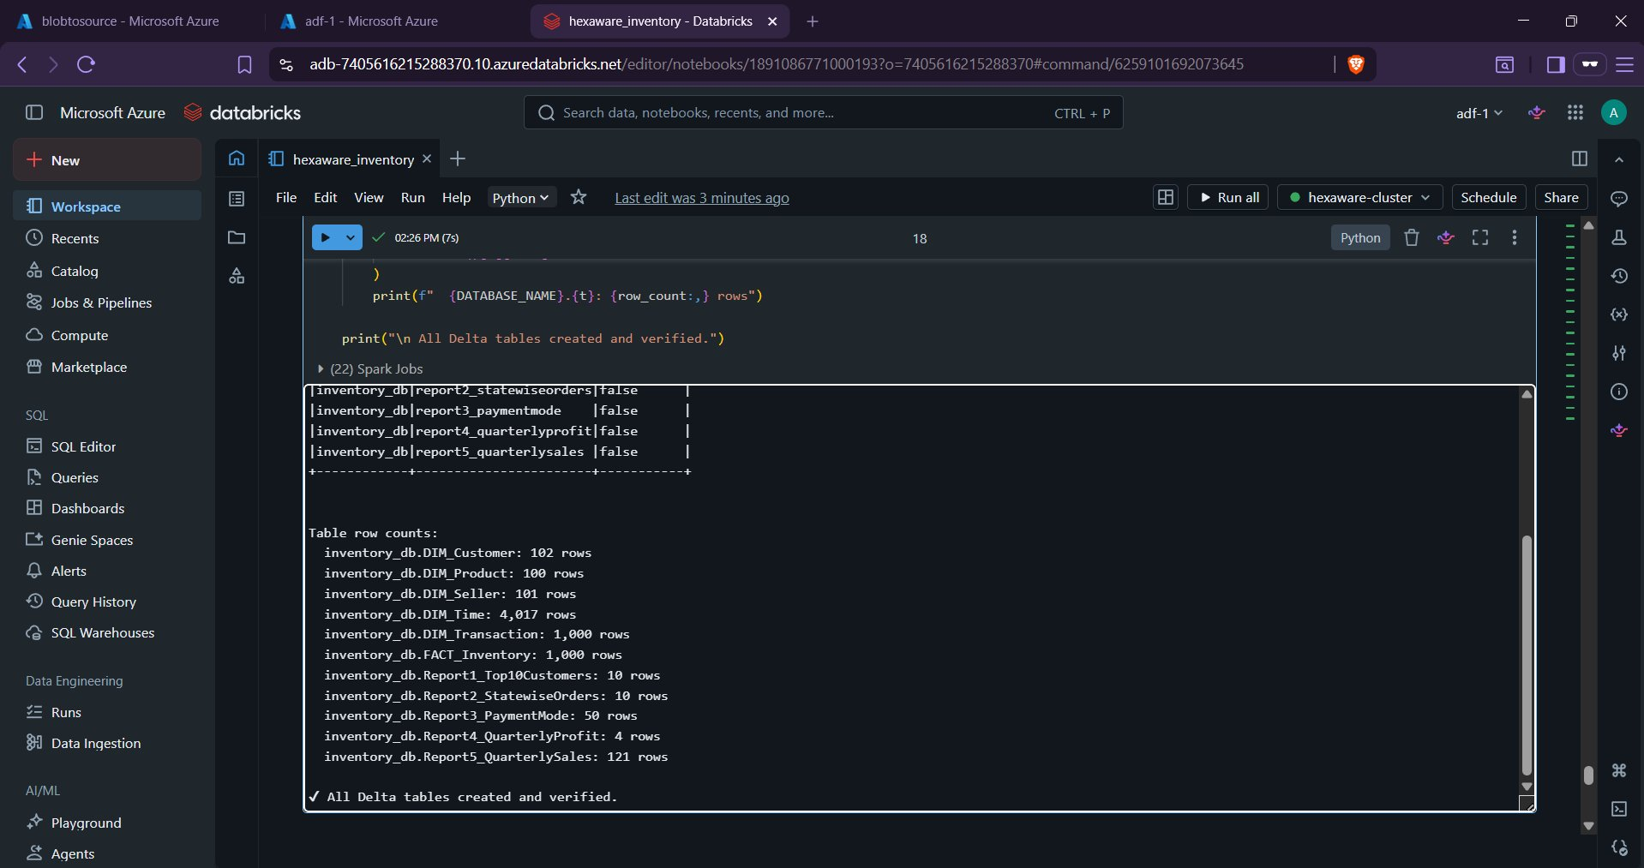
PySpark processing logic
Notebook creates tables and reports
1
Reads source files, validates availability and cleans date columns.
2
Writes dimension, fact and report outputs as CSV and Delta tables.
Notebook output
11 permanent Delta tables verified
Inventory Management Analysis & Reporting System
09
Notes:
Inside the notebook, PySpark reads the source CSV files, checks that the required files are available, cleans date-related data, creates the inventory database, and generates dimensions, fact data and reports. Outputs are written both as CSV folders and Delta tables.

Slide 11
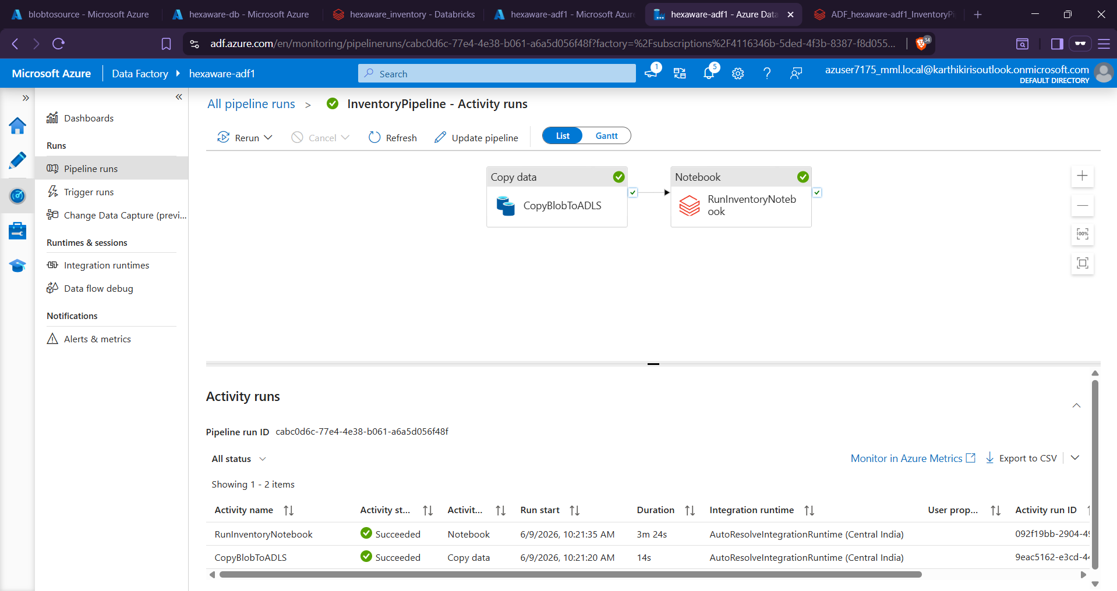
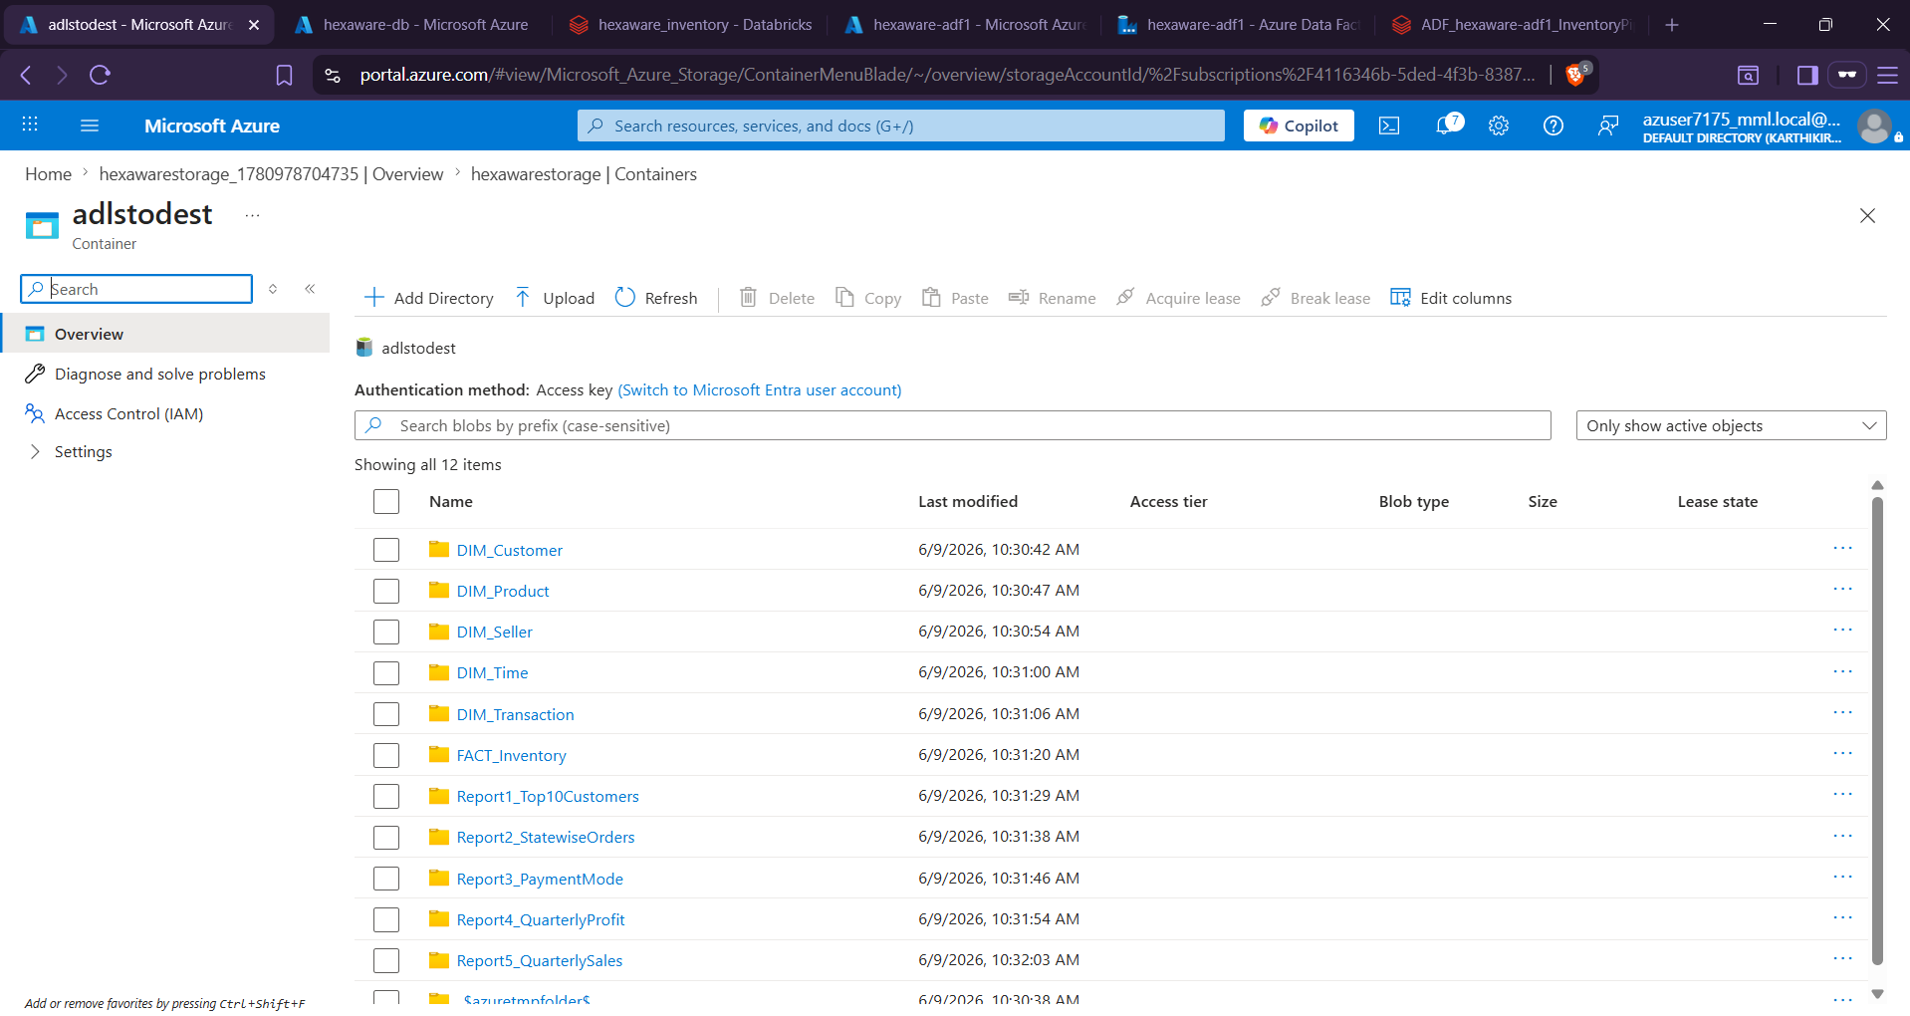
Execution and output verification
ADF run + output folders verified
1
ADF monitoring shows Copy Data and Notebook activity succeeded.
2
ADLS destination contains dimension, fact and report output folders.
Inventory Management Analysis & Reporting System
10
Notes:
After execution, I verified the ADF monitoring screen. Both activities completed successfully. Then I opened the destination container and confirmed that all dimension folders, fact folder and report folders were generated.

Slide 12
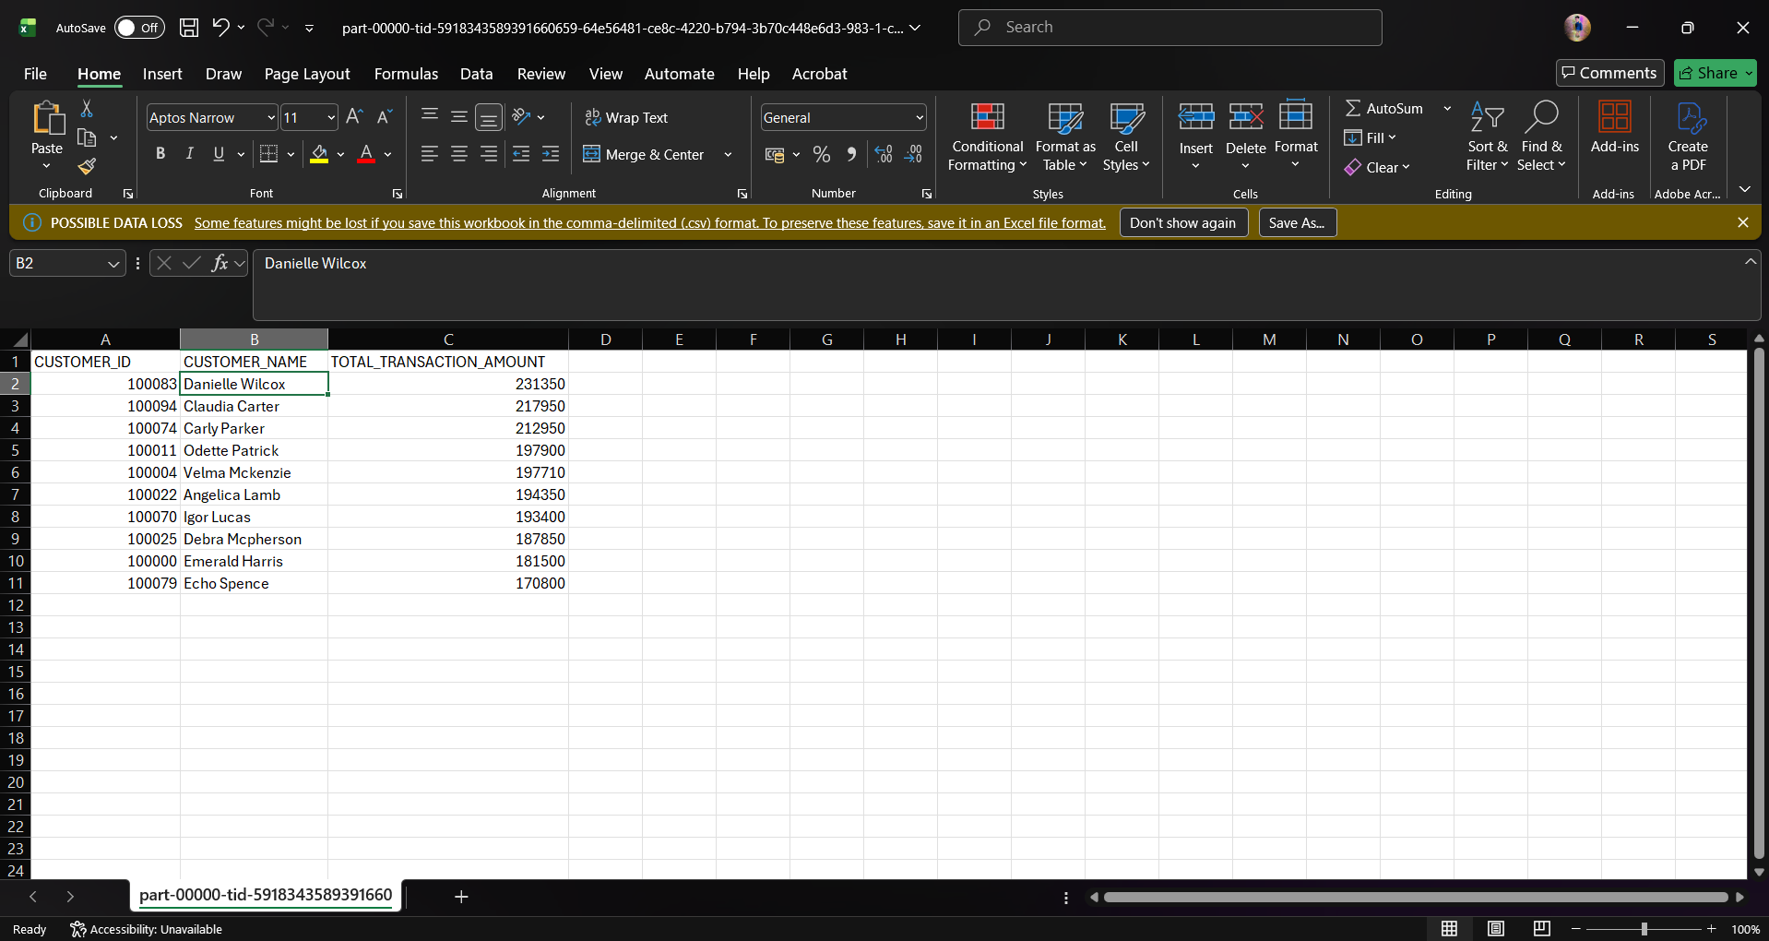
Reports generated
Final business-ready outputs
1
Reports include Top 10 Customers, State-wise Orders and Payment Mode.
2
Quarterly Profit and Quarterly Sales outputs were also generated.
Inventory Management Analysis & Reporting System
11
Notes:
The final reports generated from the transformed data are Top 10 Customers, State-wise Orders, Payment Mode, Quarterly Profit and Quarterly Sales. I also opened the generated CSV files in Excel to confirm that the outputs are readable and correct.

Slide 13
Result and conclusion
Project completed successfully
1
End-to-end pipeline ran successfully from file upload to reports.
Business value
Automation
+
Clean Tables
+
Reports
2
Inventory data is now organized, verified and analytics-ready.
Thank You
Inventory Management Analysis & Reporting System
12
Notes:
To conclude, the project was completed successfully. The source files were uploaded, the pipeline triggered automatically, Databricks processed the data, and the final CSV and Delta outputs were verified. This makes the inventory data ready for reporting and analysis. Thank you.

