Slide 1
Multi-Cloud-Based Transportation Recommendation System
Anirudh Sharma Harshini M N Kamalesh Kumar MG
sharmani@iu.edu hmn@iu.edu kmandak@iu.edu
ENGR-E 516 Engineering Cloud Computing

Slide 2
Outline
Multi-Cloud
Preliminary
Key ideas/techniques proposed in the paper
Results
Summary

Slide 3
Multi Cloud Application
What is it?
Using multiple cloud platforms (like AWS, Azure, Google Cloud) for our application.
Uses:
Cost optimization
Disaster recovery
Compliance
Innovation
Motivation:
Avoid vendor lock-in
Scalability
Resilience

Slide 4
Key ideas/techniques
Microservices Architecture
Integration with Flask Backend
API Integration with Google Maps
Scalability and Multi-Cloud Considerations

Slide 5
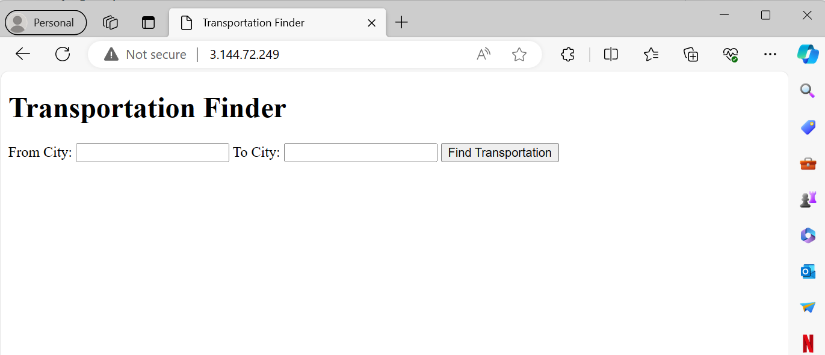

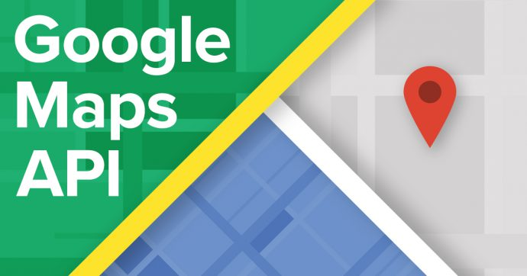
Transportation Recommendation System Overview
Our system is designed to find the most efficient route between two locations
Leveraged the Google Maps API to enable robust mapping and route optimization
Modular and scalable codebase with configurable settings for potential multi-cloud expansion
Overall our application showcases a thoughtful blend of microservices architecture, API integration, asynchronous processing, and user-centric design

Slide 6
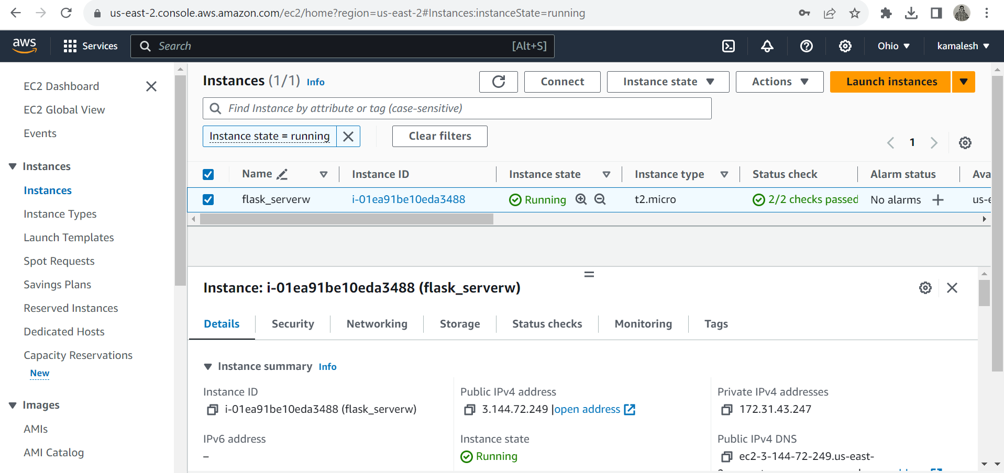
Cloud Integration - AWS
Created an EC2 Instance in AWS
Defined security groups to control inbound and outbound traffic
Connected to the EC2 instance using SSH
Uploaded Flask Application and installed required dependencies
Configured Gunicorn as the WSGI server and Nginx to forward requests to the Gunicorn server
Started the Flask application on Ubuntu using Gunicorn
http://3.144.72.249

Slide 7
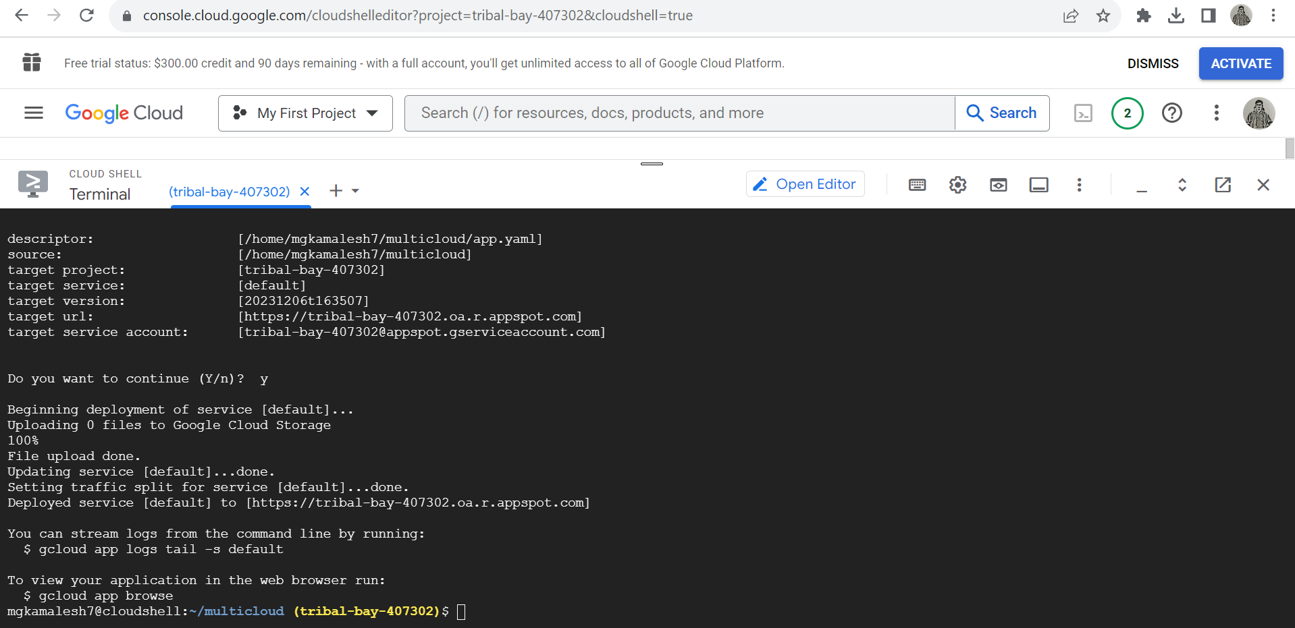
Cloud Integration - Google Cloud Platform (GCP)
Created a project in google cloud console
Uploaded the Flask application code and files to the instance on GCP
Added dependencies to requirements.txt
Created an app.yaml configuration file specifying runtime, entry point, and other essential settings
Used gcloud app deploy cmd to deploy the application
https://tribal-bay-407302.oa.r.appspot.com

Slide 8
The Model
Our Flask application showcases a thoughtful blend of microservices architecture, API integration, asynchronous processing, and user-centric design. These key features collectively contribute to a robust, scalable, and user-friendly Multi-Modal Transportation Finder.
Modular and scalable codebase with configurable settings for potential multi-cloud expansion.

Slide 9
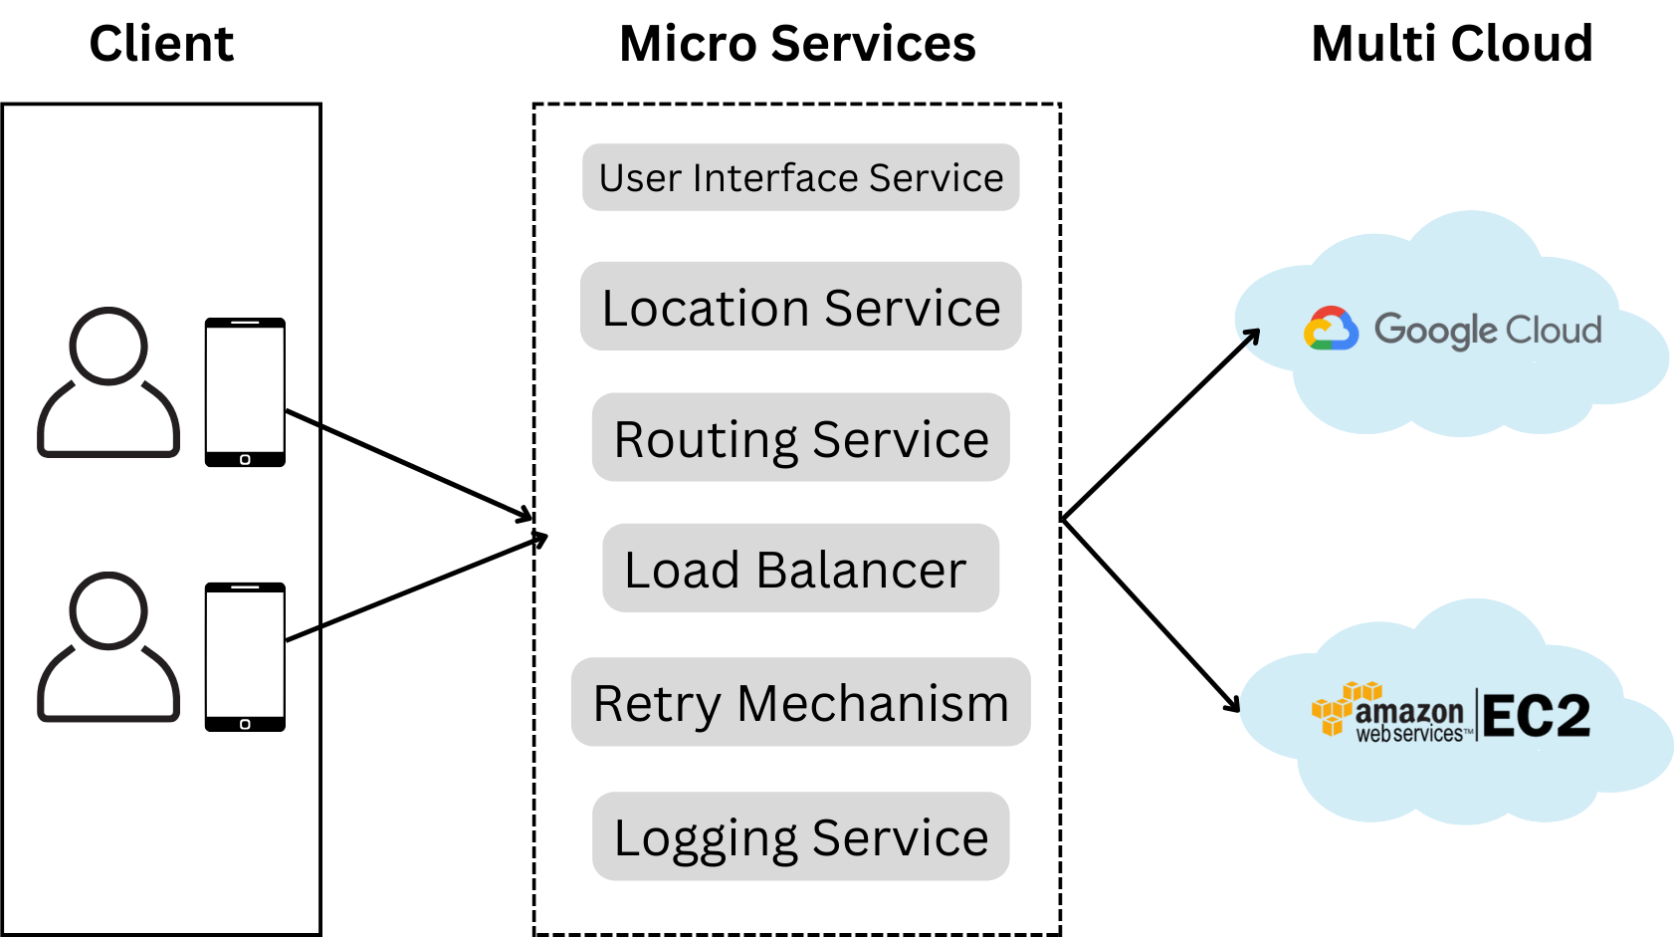
Model - Microservices Architecture with Multi-Cloud
Notes:
Location Service
Ip stack API
Load Balancer
AWS - AWS Cloudwatch API
GCP- Cloud Monitoring API

Slide 10
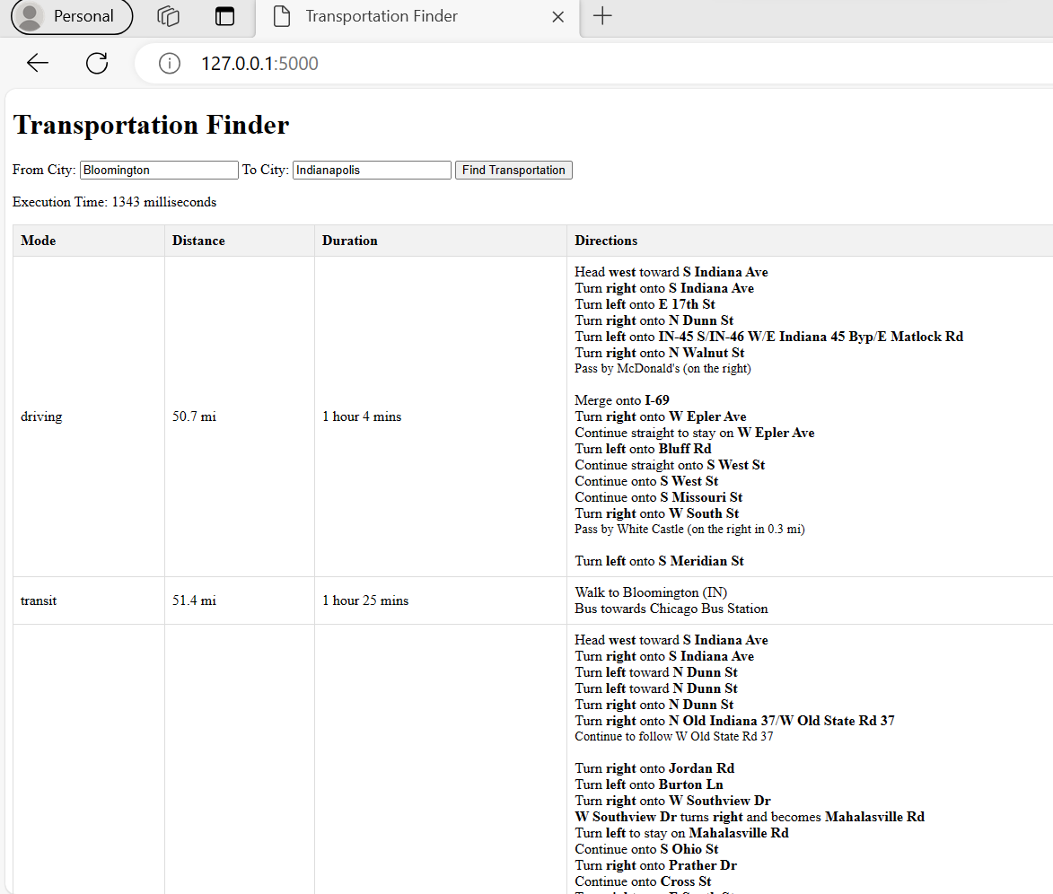
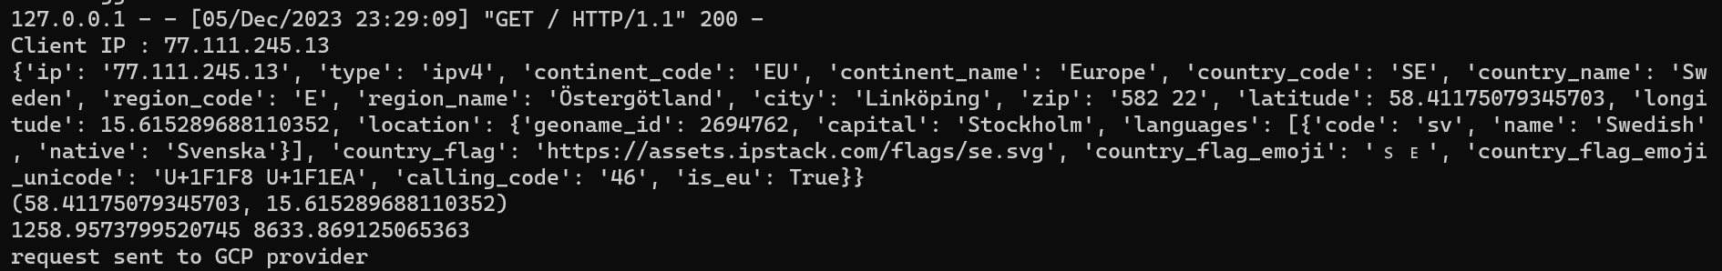
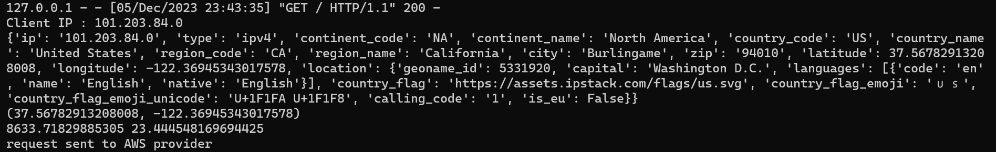
Results

Slide 11
Results
AWS: http://3.144.72.249
GCP: https://tribal-bay-407302.oa.r.appspot.com
Github: https://github.iu.edu/hmn/ENGR516-MultiCloud

Slide 12

Q & A
Any questions/comments from the audience?

