Slide 1
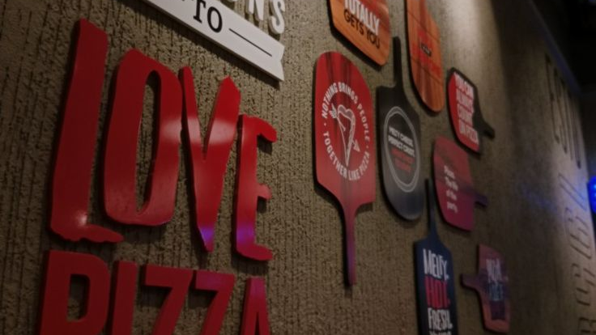
PIZZA HUT SALES ANALYSIS
By Harshini Pulagala

Slide 2

CONTEXT
About Pizza Hut
Objective
Business Context
Basic Analysis and Insights
Intermediate Analysis and Insights
Advanced Analysis
Recommendations
Conclusion

Slide 3

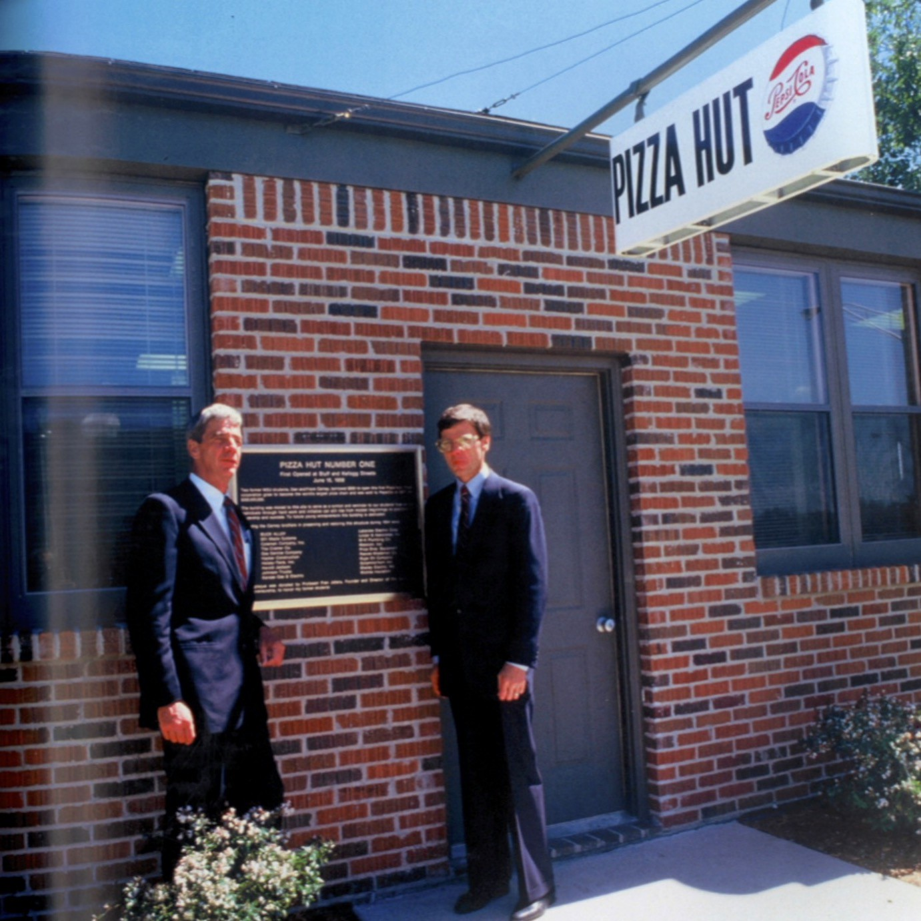
About Pizza Hut
Pizza Hut is a globally recognized American restaurant chain known for its delicious pizzas and wide variety of Italian-American dishes. Founded in 1958 in Wichita, Kansas, by Dan and Frank Carney,
The brand is famous for its signature pan pizzas, pasta, sides and desserts, served in a friendly and casual dining atmosphere.
With its focus on innovation, quality ingredients and customer satisfaction, Pizza Hut continues to be a favorite destination for pizza lovers worldwide.

Slide 4


To analyze Pizza Hut’s sales data using SQL to uncover valuable business insights such as:
Customer ordering behavior and preferences
Revenue generation trends and top-selling pizzas
Identification of most popular pizza types and categories
Gaining hands-on experience in applying SQL for real-world data analysis

Slide 5
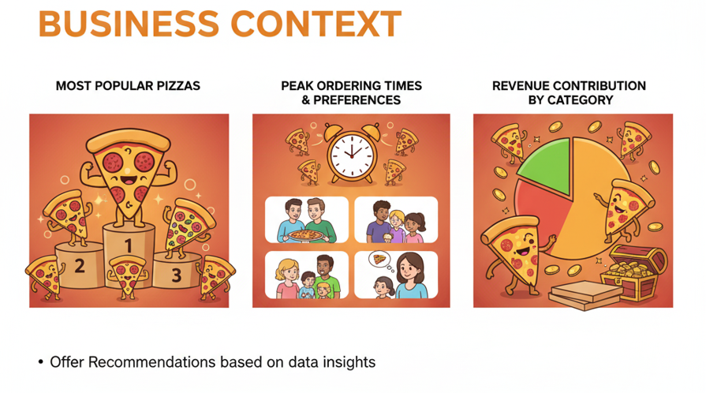


Slide 6


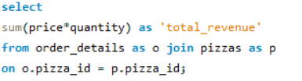

BASIC ANALYSIS
TOTAL ORDERS COUNT
REVENUE CALCULATION

Slide 7
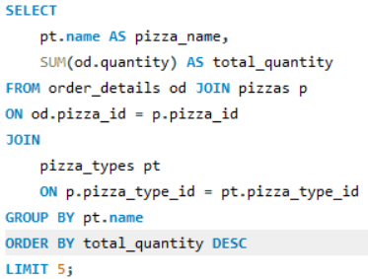
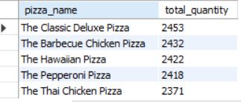
TOP 5 POPULAR PIZZAS

Slide 8


INSIGHTS
The Total number of orders placed by customers are 21,350.​
The Total Revenue Generated is $817,860.0499​
The Most Expensive Pizza is ''The Greek XXL'' with price $35.95​
The Most Ordered pizza size is Large with 18,526 Orders​
It reflects customer behavior — group and family orders dominate.​
The Top 5 Popular Pizza are The Classic Deluxe Pizza, The Barbeque Chicken Pizza, The Hawaiian Pizza, The Peppeoni Pizza, The Thai Chicken Pizza.​
The most frequently ordered pizzas highlight customer favorites and menu strengths.​

Slide 9
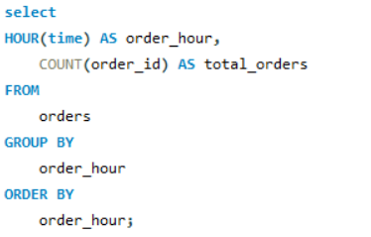
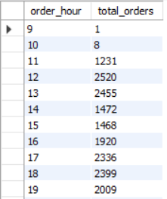
INTERMEDIATE ANALYSIS
Order Trends by Hour

Slide 10
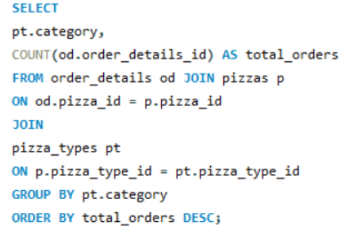
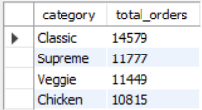
Pizza Distribution by Category

Slide 11
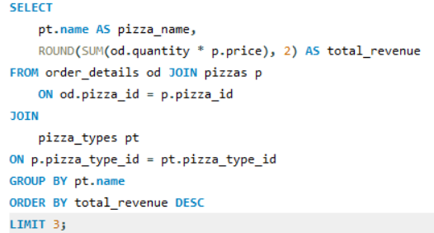
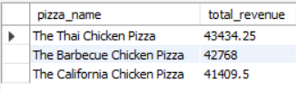
Top Pizza Types by Revenue

Slide 12

INSIGHTS
There are four categories of pizza – Classic,Veggie,Supreme and Chicken. Among all,
the Classic category dominates the quantity sold(14,888)
The Average Daily Pizzas Sold is 138
The business experiences a significant lunchtime rush and an even more pronounced dinner peak.
Peak Ordering Hours :Lunch Rush-12 PM (2,520 orders) and 1 PM (2,455 orders)
Dinner Peak: 6 PM (1,920 orders), 7 PM (2,336 orders) and 8 PM (2,399 orders).
The Top 3 Pizzas by Revenue is Thai Chicken Pizza - $43,434.25, The Barbecue Chicken Pizza -$42,768.00, The California Chicken Pizza - $41,409.50 The total revenue generated by the top three pizzas is $127,611.75.

Slide 13
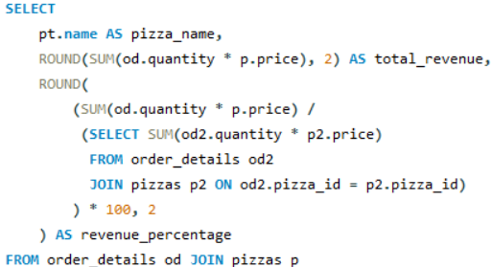
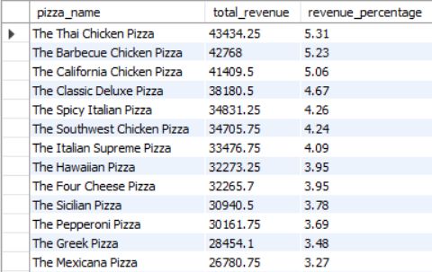
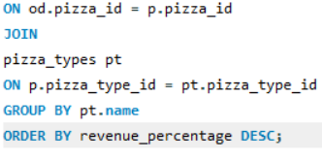
ADVANCED ANALYSIS
Revenue Contribution by Pizza Type

Slide 14
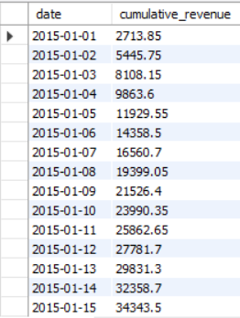
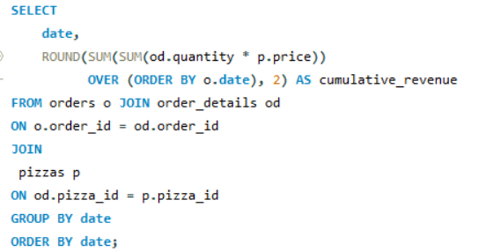
Cumulative Revenue Over Time

Slide 15
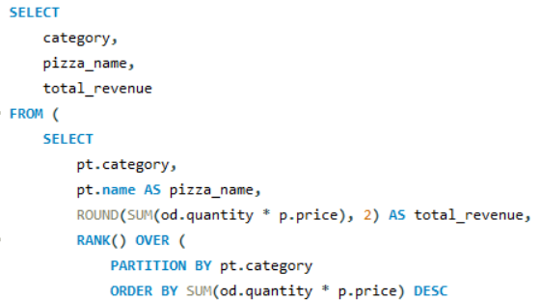
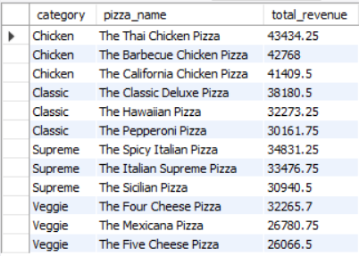
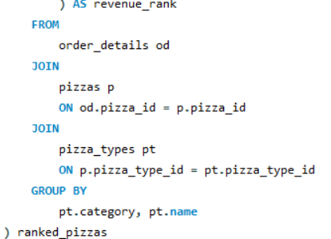
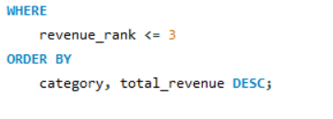
Top 3 Pizza Types by Revenue in Each Category

Slide 16

INSIGHTS
The top three pizzas are all Chicken variants—are highly profitable, generating over 15.6% of the total
revenue alone.
The Revenue Growth is consistent and strong daily. Tracking this daily cumulative revenue is essential for understanding the overall financial momentum and setting long-term growth targets.
Top 3 revenue-generating pizzas within each of the four categories, confirming the high value of the Chicken category, which includes the top overall pizza.

Slide 17

Recommendations
Maintain or slightly increase the price point of these premium items, as their high revenue contribution suggests they can sustain a higher margin despite lower overall volume.
Explore introducing new, high-margin, specialty Chicken items to further capture revenue from customers willing to pay a premium for unique flavors.
Implement a scheduling model that significantly increases kitchen and delivery staff starting 1 hour before the peak rush periods.
Pre-prep core ingredients required for the best-selling Classic and Large-size pizzas during off-peak hours to ensure rapid assembly during the rush, maintaining high customer satisfaction.
Review the bottom-performing pizzas (like "The Brie Carre Pizza") and their associated ingredient costs to determine if they should be removed from the menu to reduce complexity, lower ingredient waste, and free up kitchen focus for high-demand items

Slide 18



CONCLUSION
The comprehensive SQL analysis successfully provided a data-driven blueprint for enhancing Pizza Hut's performance. The study revealed a clear dual strategy prioritizing Classic pizzas to meet high volume demand and aggressively promoting Chicken pizzas to capitalize on their high revenue contribution.
By focusing on menu optimization such as introducing premium variants in the underperforming Veggie segment and by aligning staffing with the lunch and dinner peak hours, Pizza Hut can tangibly increase profits and improve customer satisfaction. This project under scores the direct, real-world value of data analytics in formulating effective business decisions.

