Slide 1
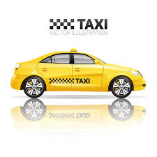



Yellow Taxi Fare Analysis
A Data-Driven Exploration of Trip Patterns, Fare Insights, and Passenger Behavior
Tools Used:
Presented By :
Harshit Kumar

Slide 2
Objective & Dataset Overview
Project Objective:
To analyze fare patterns and passenger trends in NYC Yellow Taxi rides.
To identify the impact of passenger count and payment type on fare amount.
To test whether there’s a significant difference in fare between cash and card payments.
To generate insights that can help optimize pricing and ride efficiency.
Feature | Description
Source | NYC Yellow Taxi Dataset
Rows & Columns | 2.4 million rows & 20 columns
Time Period | January 2022 – March 2022
Key Columns | fare_amount, trip_distance, passenger_count, payment_type, pickup_datetime, dropoff_datetime

Slide 3
Data Cleaning & Preprocessing
Steps Performed:
Changed Data Types
Converted pickup_datetime and dropoff_datetime columns to datetime format.
Converted passenger_count column to integer type for consistency.
Handled Missing Data
Dropped rows with null values in passenger_count (~3% of total records).
Removed Duplicates
Identified and removed duplicate rows to avoid double-counting of trips.
Filtered Irrelevant Data
Retained only records with valid payment types: Cash and Card.
Kept trips with passenger counts between 1 and 6 (removed outliers and invalid entries).
Metric | Before Cleaning | After Cleaning
Total Records | 2463931 | 1116915
Total Columns | 20 | 5
Null values | ~3% | 0
Payment Types | 5+ | 2(card, cash)
Passenger Count | 0-7 | 1-6

Slide 4
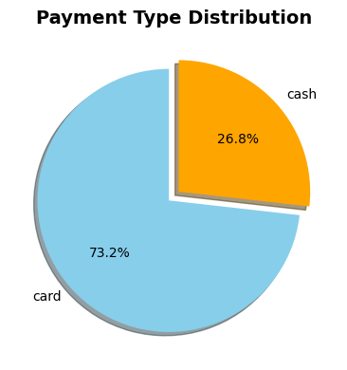
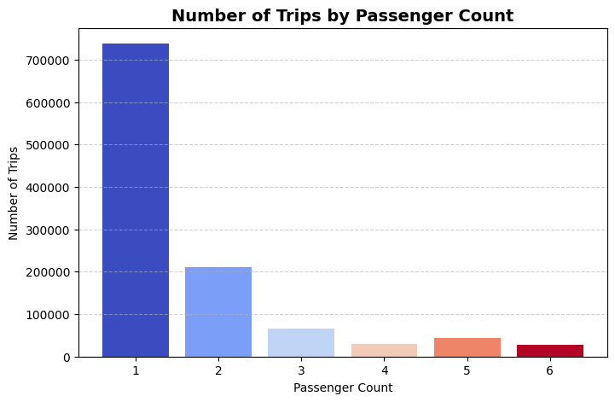
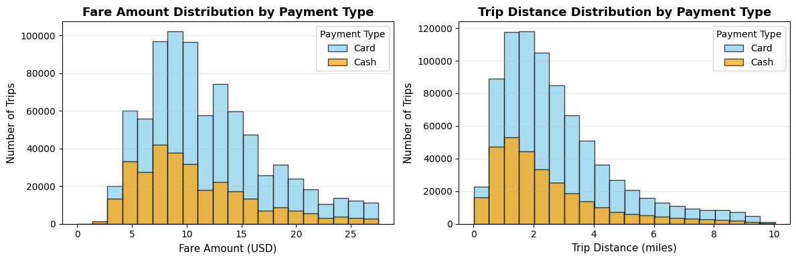
Exploratory Data Analysis (EDA)
Key Insights from EDA:
Passenger Count:
Most rides have 1–2 passengers (around 80% of trips).
Payment Type:
Card payments account for ~73% of trips.
Fare Distribution:
Average fare: $11.56, most fares between $5–$12.
Trip Distance:
Median trip distance: 2.2 miles.

Slide 5
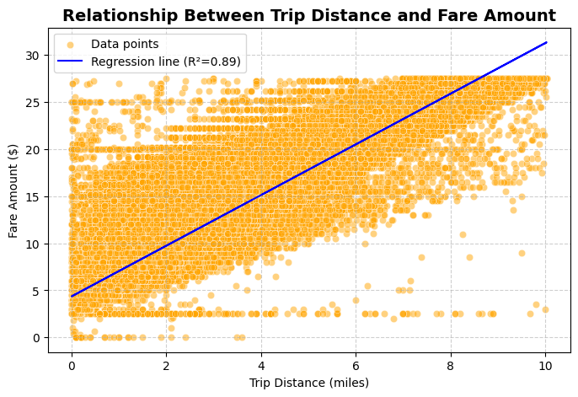
Trip Distance vs Fare Relationship
Interpretation:
Scatter plot shows a strong positive correlation (r ≈ 0.94).
Fare increases linearly with distance — pricing model appears consistent.
Some outliers visible due to tolls, traffic delays, or flat-rate trips (e.g., airports)
Metrics | Value
Correlation(r) | 0.944
Avg fare per mile | $4.3

Slide 6
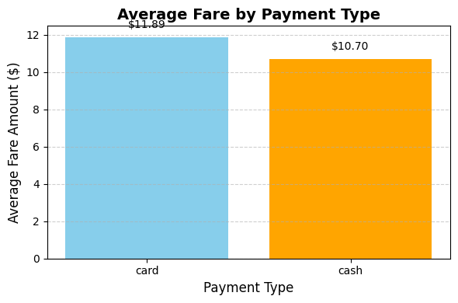
Hypothesis Testing – Cash vs Card Fares
Hypothesis:
H₀: There is no difference in average fare between card and cash payments.
H₁: There is a significant difference in average fare.
Test Used: Independent t-test
Statistics | Value
Avg Fare (card) | $11.89
Avg Fare (cash) | $10.70
Mean difference | $1.19
t- statistics | 104.592
p value | 0.00
Decision | Reject Ho
Interpretation | Average fare differs significantly based on payment type.

Slide 7
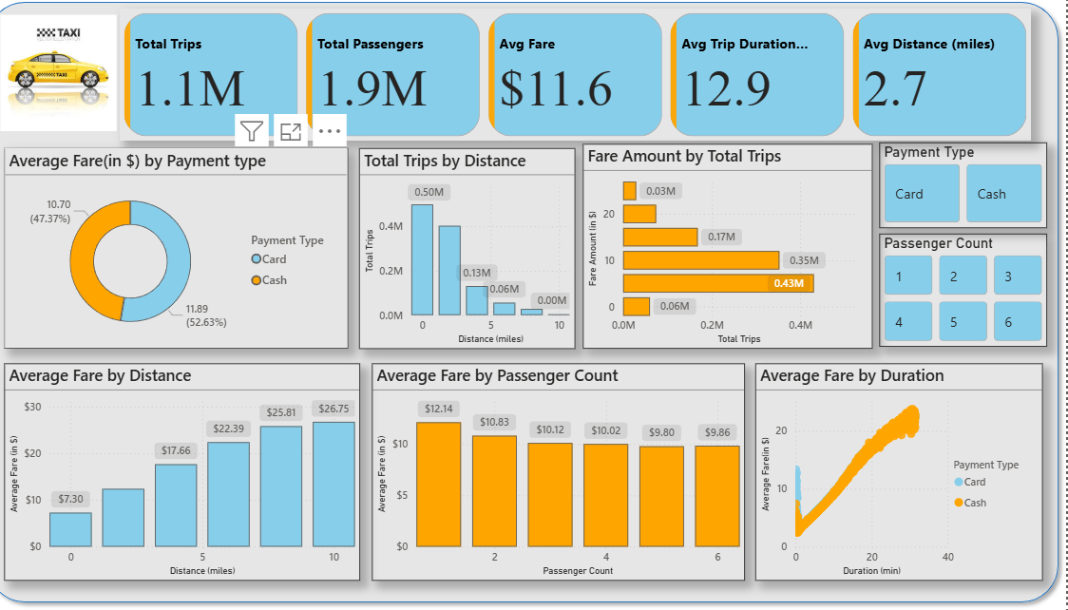
Dashboard Overview
An interactive Power BI dashboard summarizing key performance indicators (KPIs) of Yellow Taxi trips, enabling quick insights into trip patterns, fare behavior, and passenger trends.
KPIs Displayed:
🚖 Total Trips: 1.1 Million
👥 Total Passengers: 1.9 Million
💵 Average Fare: $11.6
⏱️ Average Trip Duration: 12.9 minutes
📏 Average Distance: 2.7 miles

Slide 8
Business Insights & Recommendations
Key Insights:
Card Payments Dominate (73%) → Encourage digital discounts or loyalty programs.
1–2 Passengers Common → Opportunity to promote ride-sharing or pooling options.
Fare-Distance Consistency → Reinforces transparent pricing, can be highlighted in marketing.
High Fares for Card Trips → Possibly due to business or airport rides; target corporate plans.
Short Trips Most Frequent → Add micro-ride promotions (below 3 miles).
Recommendations:
Develop targeted offers for frequent solo riders.
Encourage more card transactions for operational transparency.
Analyze time-of-day trends next to optimize driver allocation.

Slide 9
Thank YOU !

