Slide 1
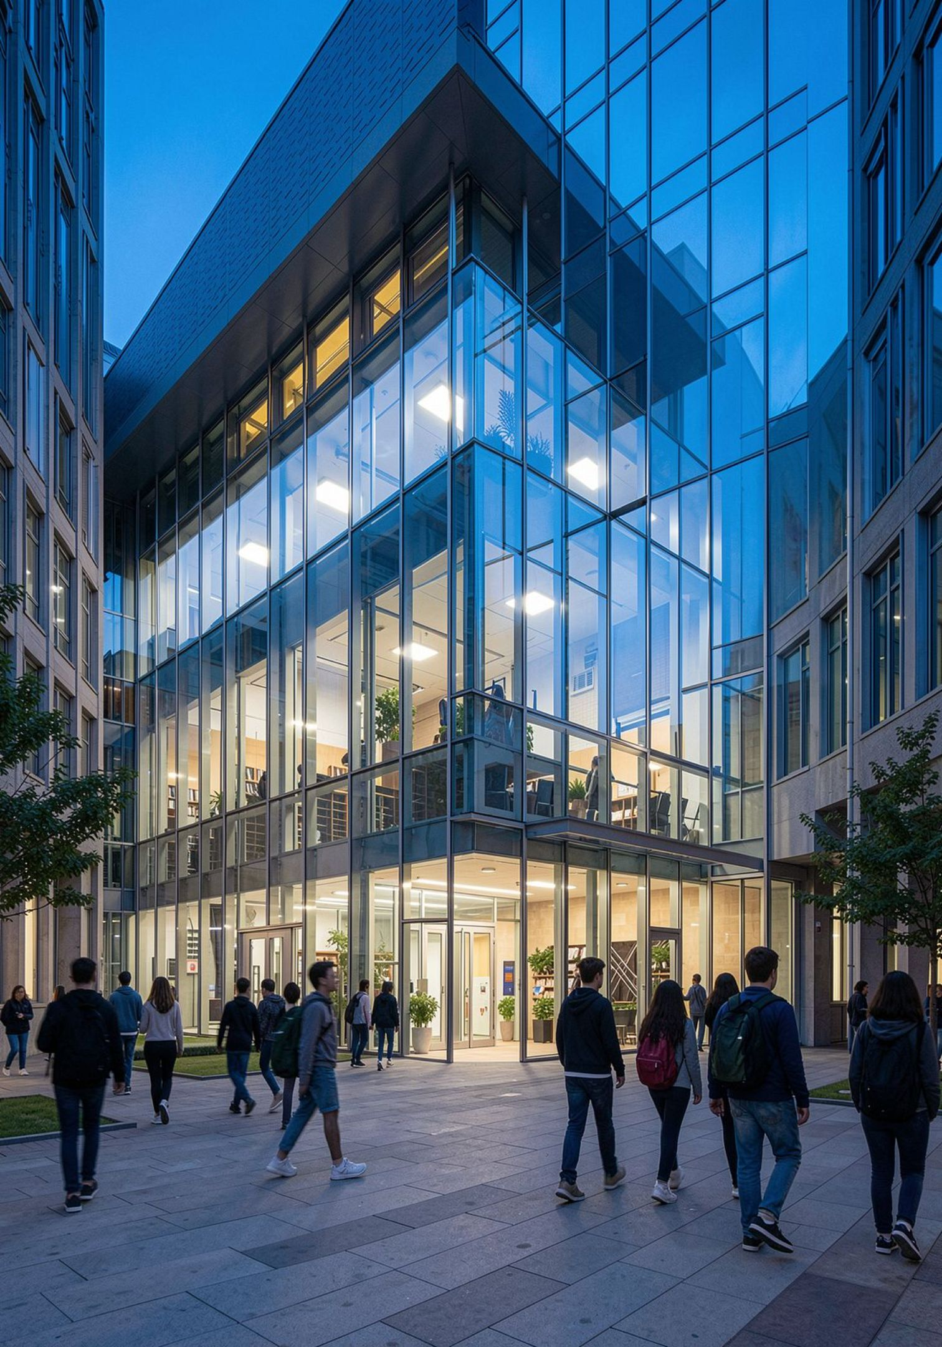
CollegeBuddy
Smart Campus Event Management, Anti-Fraud Ticketing & Predictive Intelligence System
FULL-STACK WEB DEVELOPMENT
DISTRIBUTED SYSTEMS
APPLIED MACHINE LEARNING
CLOUD INTEGRATION
GL Bajaj Institute of Technology and Management
Harshit Kumar · Dhruv Soni · Devendra Pratap Singh · Devbrat

Slide 2
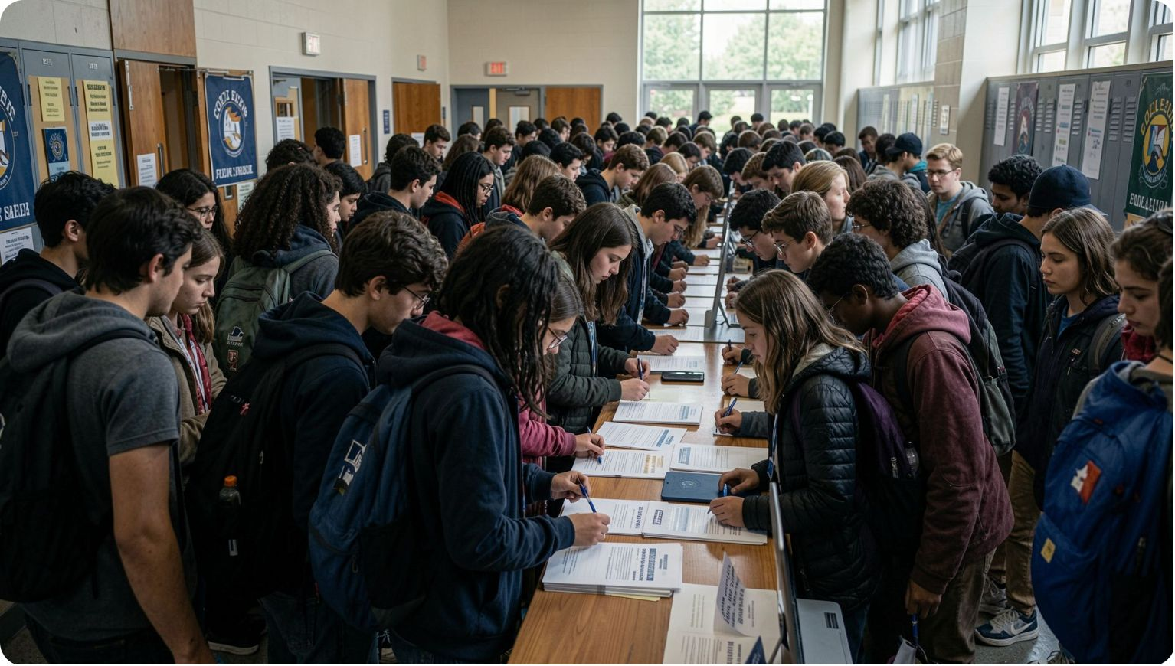
Introduction, Problem Statement & Objectives
Campus Events at Scale
University fests, hackathons, workshops, and symposiums may involve hundreds or thousands of students — yet most institutions rely on fragmented tools: WhatsApp groups, Google Forms, paper lists, and manual gate checks.
Critical Pain Points
Fragmented Communication — multiple unofficial channels
Manual Gate Management — long queues, paper lists
Ticket Fraud — screenshot sharing, proxy attendance, reusable passes
Attendance Uncertainty — 30–50% no-show rates; catering and venue waste
Volunteer Governance — insecure admin credential sharing
Unified Discovery
Fraud-Proof Ticketing
Zero-Install Scanner
Centralized, filterable event catalogue
Unique QR + UUID + server validation
Browser camera via html5-qrcode
AI Turnout Forecasting
Commerce & Governance
ML-based expected attendance
Razorpay + volunteer whitelisting + scoped RBAC

Slide 3
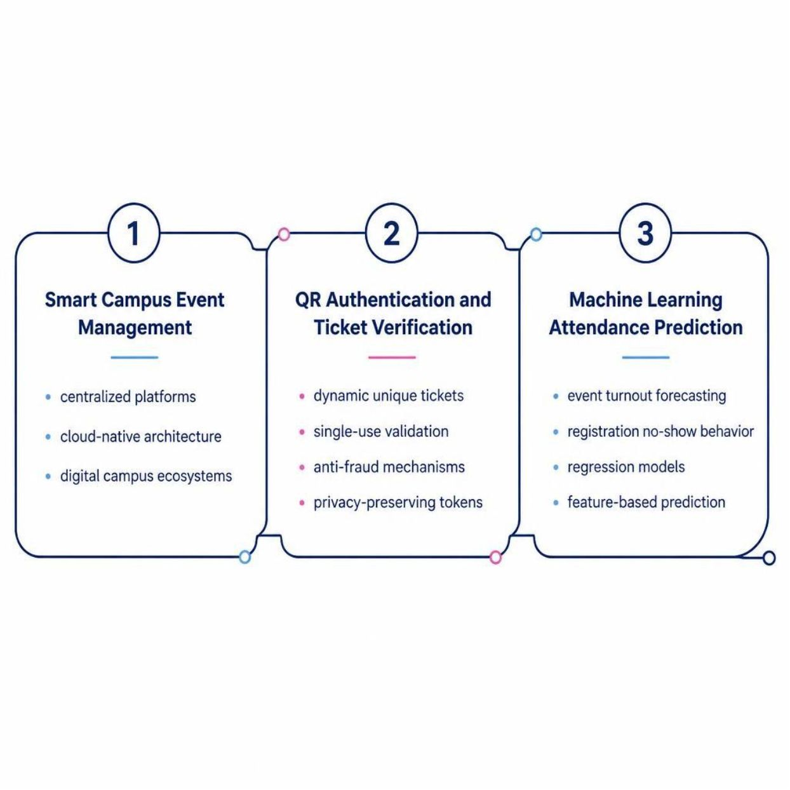
Literature Survey & Existing Systems
Existing System Comparison
System | Mechanism | Key Limitations
Google Forms + Sheets + WhatsApp | Registration + spreadsheet + messaging | No secure ticket lifecycle; manual gate checks; fragmented communication
Commercial Ticketing Platforms | Public event discovery + online ticketing | No academic identity context; lacks institutional governance
Traditional Campus ERP | Administrative institutional portal | Rigid UX; limited event-specific scanning; no predictive intelligence
Physical Paper Passes | Printed passes + manual checking | Forgery, transferability, slow verification, data loss

Slide 4
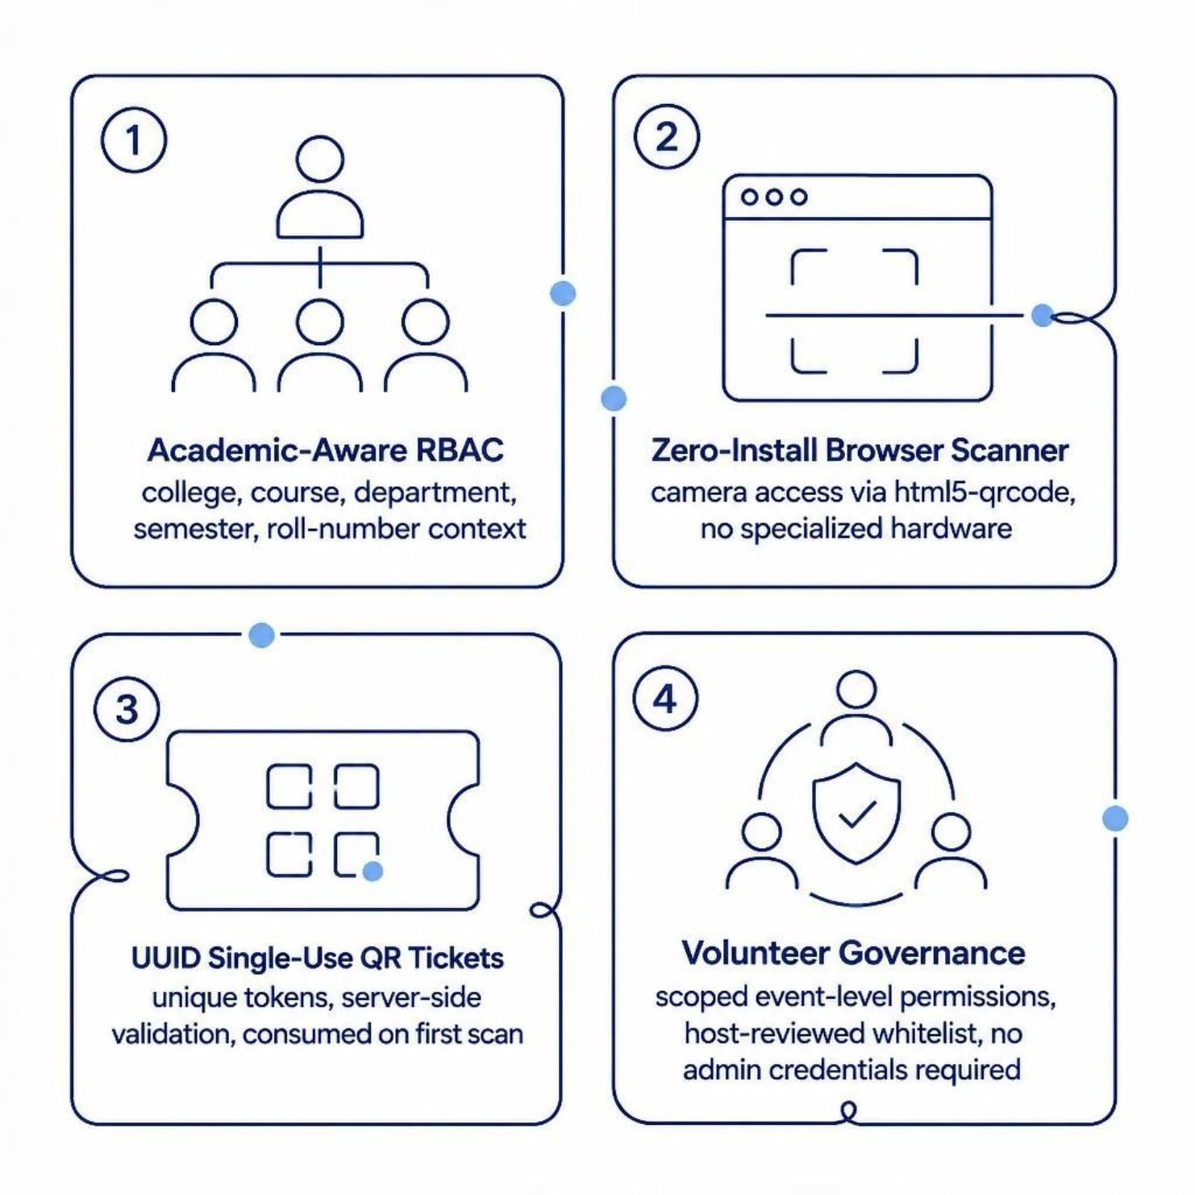
Why CampusIQ Is Needed: Key Differentiators
Problem 1 — Turnout Uncertainty
Free college events experience 30–50% no-show rates, causing catering over-ordering, oversized venues, and resource waste.
CampusIQ: Capacity + Fee + Registrations + Velocity → ML → Expected Attendance
Problem 2 — Gate Bottlenecks
Manual verification takes ~30–45 seconds per attendee. Browser-based QR scanning targets <1.5 seconds (research claim).
CampusIQ: QR Scan → Backend Validation → Entry Decision

Slide 5
Requirements Analysis: Software Stack
Frontend
QR Scanner
Backend
React 19 · Vite · TailwindCSS · Lucide React · React Router DOM v7
html5-qrcode — browser camera access, zero-install volunteer scanning
FastAPI · Python 3.10+ · Uvicorn ASGI — REST APIs, Auth, Events, Tickets, ML
Database
Security
ML Engine
PostgreSQL (prod) · SQLite (dev) · SQLAlchemy 2.0 ORM
JWT · Bcrypt · Passlib · Python-JOSE · RBAC
Scikit-Learn · Pandas · Joblib · Linear Regression (Ridge, SVR, XGBoost candidates)
Cloud & APIs
Razorpay SDK · Cloudinary CDN · Render PaaS · Managed PostgreSQL

Slide 6
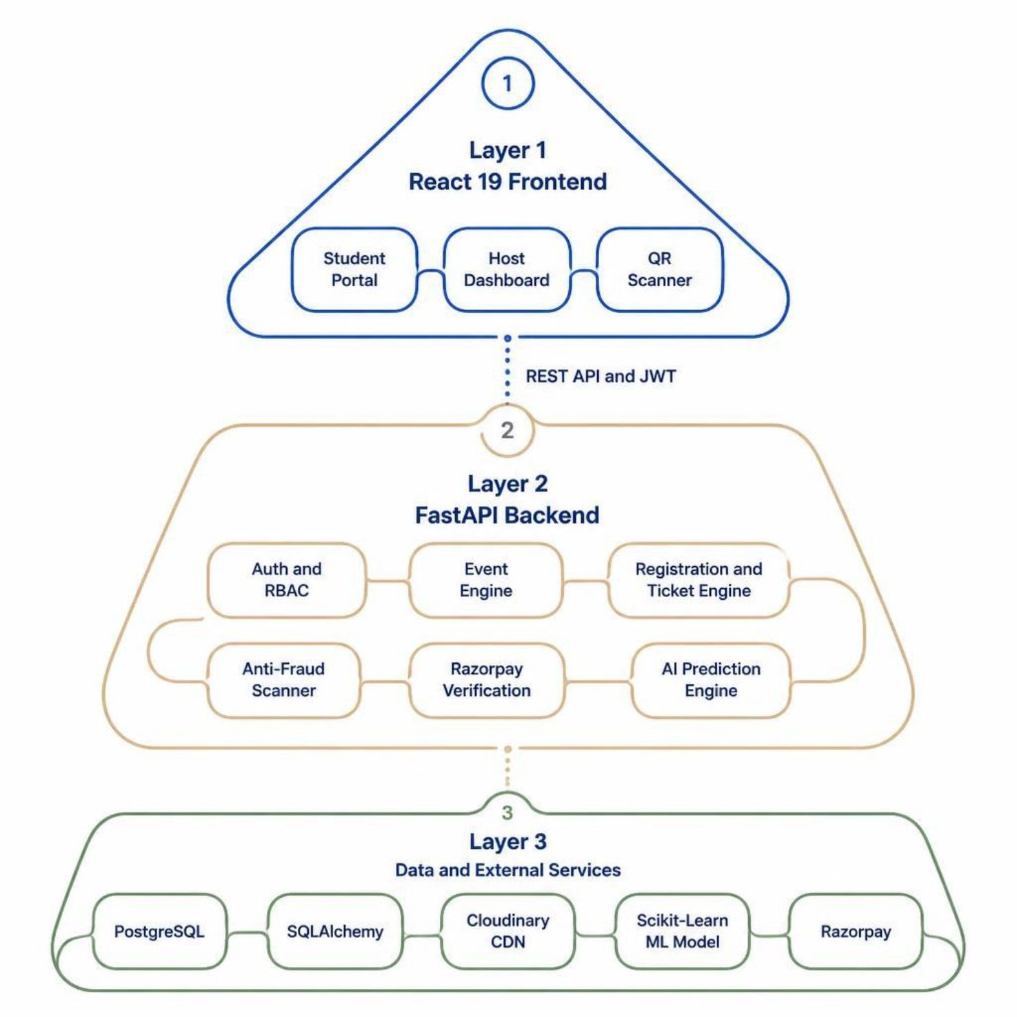

Hardware, Infrastructure & System Architecture
Hardware & Infrastructure
Dev: 64-bit CPU · 8 GB RAM · ~20 GB storage
Users: Smartphone, laptop, tablet (Chrome, Safari, Edge)
Volunteer Scanner: Any smartphone + camera + browser
Production: Render PaaS + Managed PostgreSQL + Cloudinary CDN + Razorpay
Core Design Principle: No specialized barcode scanner hardware required.

Slide 7
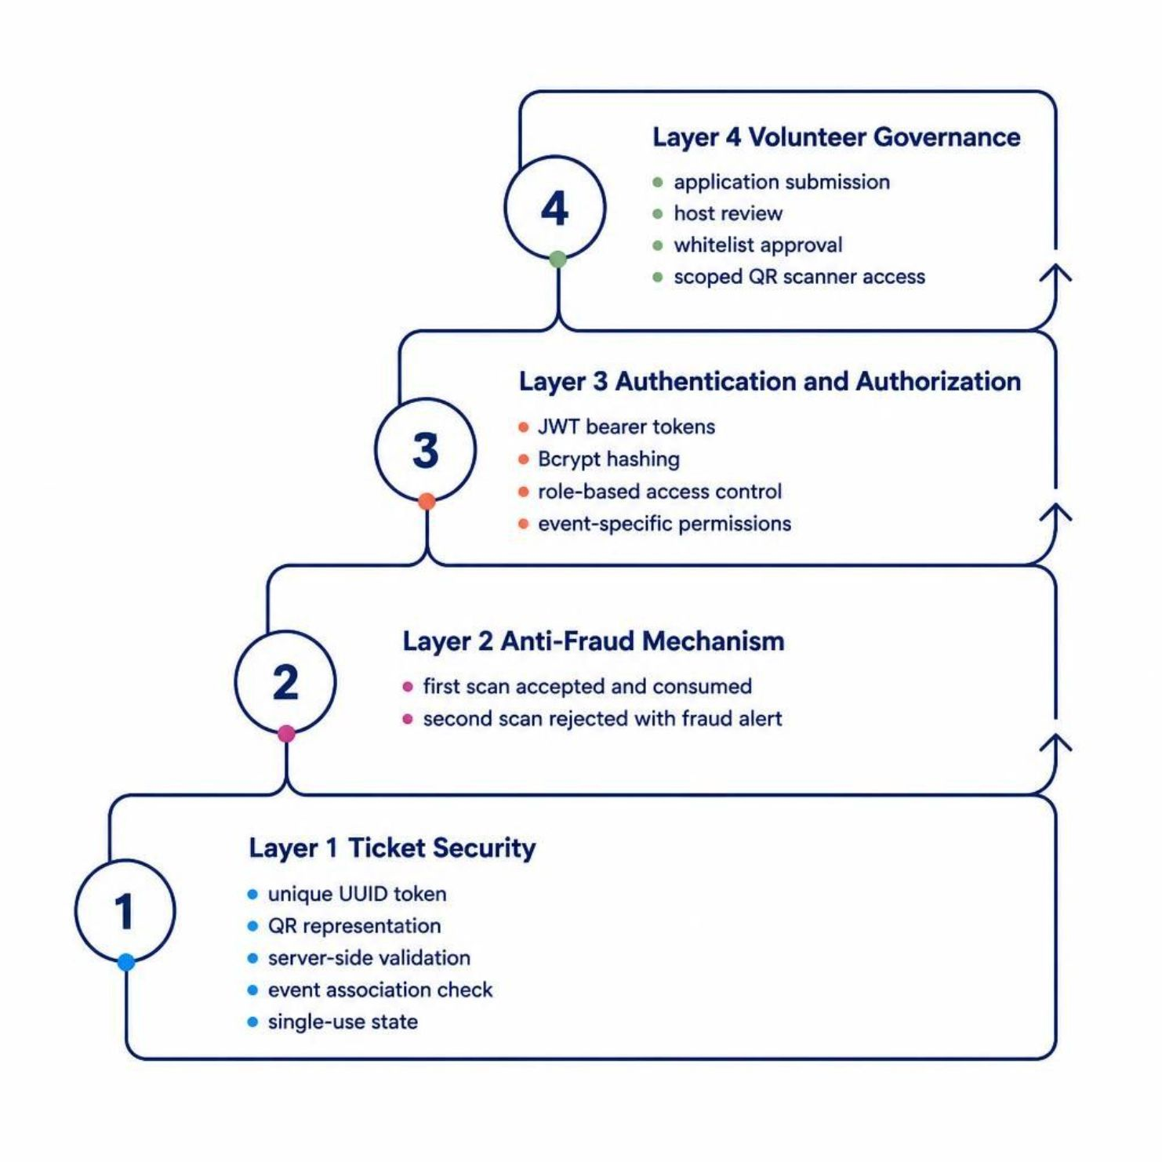
Security, Anti-Fraud & Volunteer Governance
Ticket Security
Each ticket is a unique UUID token, server-validated against event association and single-use state. No student PII embedded in QR.
TICKET:<unique-UUID-token> — Atomic check-in update prevents race conditions.
Anti-Fraud Logic
First scan: checked_in = False → Validate → True → Entry
Second scan: checked_in = True → Reject → Fraud Alert
Auth & Volunteer Governance
JWT + Bcrypt + RBAC + event-scoped permissions
Volunteer Application → Host Review → Whitelist → Scanner Access

Slide 8

AI/ML Attendance Prediction & Team Distribution
Work Distribution
Prediction Pipeline
Harshit Kumar
Architecture, FastAPI Backend, SQLAlchemy, JWT, Security & API Orchestration
Feature Vector
Predicted Attendance
Dhruv Soni
React 19 Frontend, TailwindCSS, Student Discovery, Host Dashboard & Navigation
Event Data
Devendra Pratap Singh
ML Models
QR Ticketing Engine, html5-qrcode Scanner, Anti-Fraud Validation & Check-In
Devbrat
Inputs: Participant limit, ticket fee, registration count, registration velocity.
Impact: Catering estimation, seating, venue planning, volunteer allocation.
Scikit-Learn Prediction, Razorpay Gateway, Cloudinary CDN & Test Suites

Slide 9
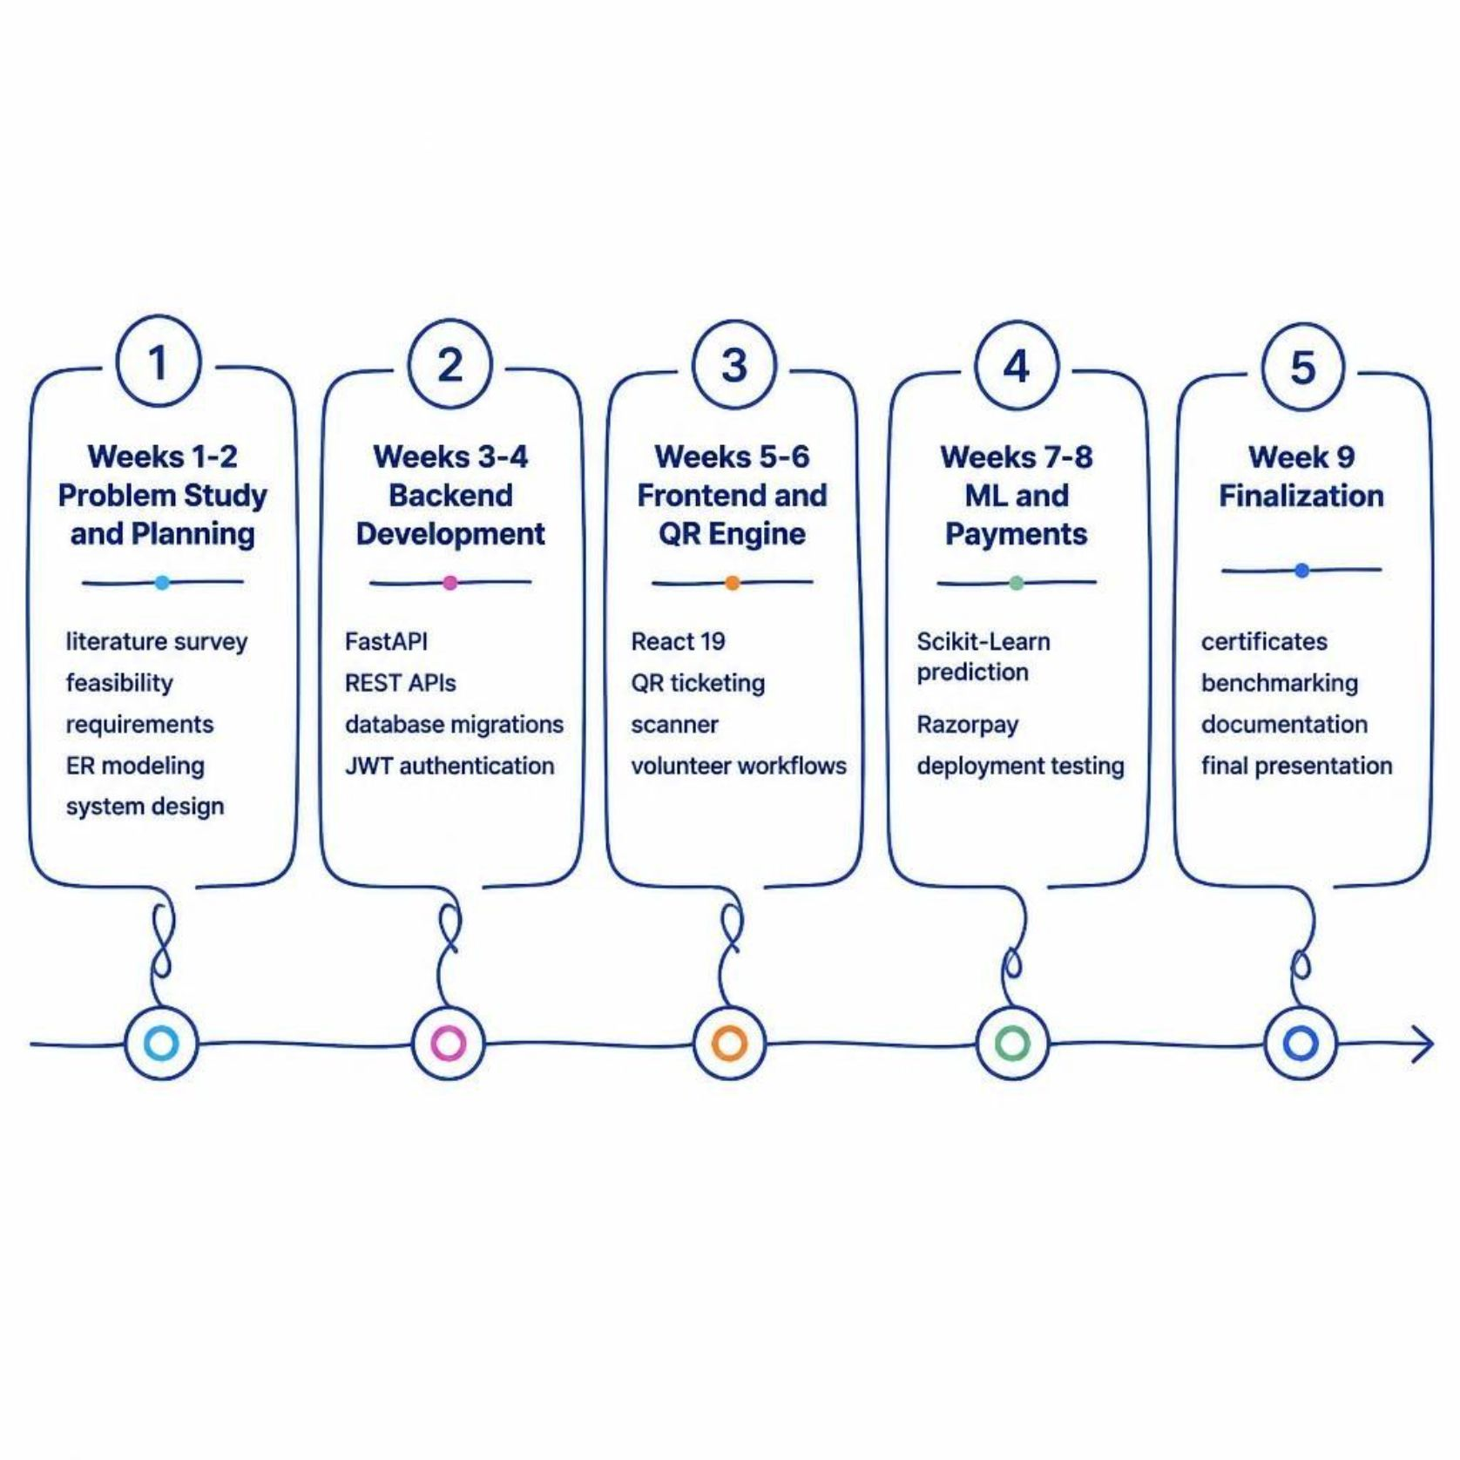
Project Status & 9-Week Gantt Chart
✅ COMPLETED
Multi-role auth (JWT + Bcrypt)
Event lifecycle (CRUD + poster upload)
Dynamic QR tickets + student wallet
In-browser scanner (html5-qrcode)
Volunteer whitelist + Razorpay + HMAC
AI prediction engine integrated
9-Week Timeline
🔧 IN PROGRESS
PDF certificate generator
Render + PostgreSQL deployment
Cloudinary CDN + camera optimization

Slide 10

RESEARCH AND REFERENCES
Primary References:
Who Will Attend? — Predicting Event Attendance in Event-Based Social Network— inspection procedures, infrastructure and compliance requirements. Link: AICTE Approval Process Handbook
Research Areas:
Competitor Platforms
Modern Campus Involve: moderncampus.com/products/student-engagement-and-learning-platform
Unstop: unstop.com
Eventbrite: eventbrite.com
Gap 1 — Mobile Verification Barrier
Existing systems require dedicated apps or hardware. CampusIQ: Any smartphone + browser + camera → event scanner.
Gap 2 — No-Show Resource Wastage
Registration systems expose counts only. CampusIQ: Registration Data → ML Prediction → Expected Attendance → Resource Planning.
Gap 3 — Fragmented Volunteer Governance
No structured volunteer access control. CampusIQ: Application → Host Review → Whitelist → Event-Specific Scanner Access.
Research → Solution Pathway
Regulatory Requirements → Evidence Collection → AI-Assisted Verification → Compliance Report
@SIH Idea submission- Template
6

