Slide 1









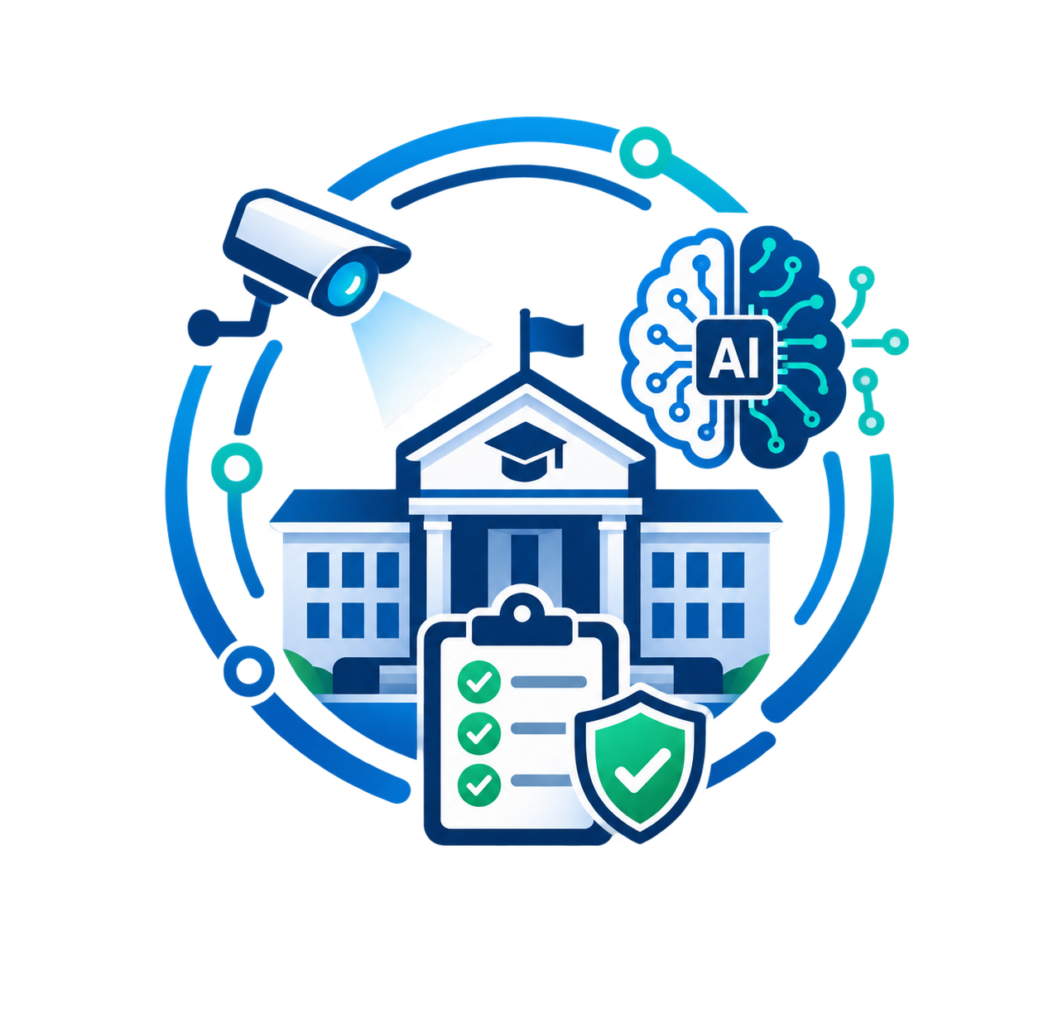





Evidence-Driven AI Inspection Platform
VigilNet
AI-assisted verification of institutional infrastructure, laboratory assets, documents and compliance
  PROPOSED SOLUTION :
  INNOVATION & UNIQUENESS :
Unified Evidence
Solves fragmented inspection evidence by combining CCTV/IP cameras, lab computers, network devices and institutional documents into one verification pipeline
Existing CCTV as Inspection Sensor
Technical Asset Discovery
Goes beyond visual inspection to capture device-level compliance data from lab PCs and network devices.
AI Visual Inspection
Leverages institutional infrastructure already in place -- no new hardware required.
Analyzes camera evidence for equipment presence, occupancy and visible compliance conditions.
Smart Document Verification
OCR and structured extraction verifies certificates and compliance documents, linking them directly to evidence.
Multi-Source Evidence Reconciliation
Explainable Compliance Engine
Inspector Verification
Unified verification across visual, technical, and document evidence in a single audit trail.
Transparent, rule-based AI decision-making — humans retain full regulatory authority.
AI flags findings → inspector reviews source evidence → confirms/rejects → corrective action and re-verification.
2
Notes:
2

Slide 2

TECHNICAL APPROACH
VigilNet
Layer | Technology | Purpose
Frontend | React / Next.js | Institution, inspector, and authority dashboards
Backend | FastAPI (Python)/Spring boot | API layer, business logic, orchestration
Camera ingestion | RTSP/NVR + FFmpeg/OpenCV | Pulls and normalizes existing CCTV streams
Computer vision | YOLO-family model + OpenCV | Detects equipment, occupancy, visual conditions
Document AI | OCR + structured extraction + LLM/RAG | Extracts fields from certificates, invoices, records
Asset discovery | Python agent + network discovery + SNMP/API | Lab PC and device inventory
Database | PostgreSQL or MongoDB | Institution, inspection, asset, evidence records
Evidence storage | Object storage / local institutional storage | Frames, documents, telemetry snapshots
Processing | Background workers / queue | Async CV, OCR, and reconciliation jobs
Reports | ReportLab | PDF report generation
Deployment | On-premise inspection gateway + central dashboard | Local sensitive data processing, central aggregation
Evidence Capture
CCTV
Lab/IT System
Documents
Computer vision
Asset Discovery
OCR/Document AI
Unified Evidence
Analysis & Review
Expected Vs Actual
Compliance & Risk
Inspector Review
Reporting & Action
3
Report + Corrective Actions
Re-Verification
Notes:
3

Slide 3
FEASIBILITY & VIABILITY
VigilNet
Why Feasible & Viable?
Challenges → Mitigations
Infrastructure Reuse: Integrates with existing CCTV/IP cameras via RTSP/ONVIF, minimizing new hardware and deployment cost
Tiered Asset Discovery: Combines network APIs, lightweight endpoint agents, and QR/barcode identification to reliably inventory both modern and legacy laboratory equipment.
Proven Technology Stack: Uses mature and accessible technologies such as Spring Boot, YOLO and OpenCV, reducing development and integration risk.
Software-First Architecture: Requires minimal additional hardware and can support on-premise or institution-controlled deployment for sensitive inspection data.
Human-in-the-Loop Validation: AI-generated findings are supported by source evidence and verified by inspectors, reducing the impact of AI false positives/negatives.
Modular & Scalable: The architecture can scale from one laboratory → one institution → multiple institutions without redesigning the complete system.
Focused MVP: A 10-phase vertical development approach validates core inspection, asset discovery, evidence reconciliation and reporting capabilities before expanding to diverse legacy equipment.
CCTV diversity | RTSP/NVR gateway
Equipment limits | Tiered discovery
Network restrictions | Local agent
AI errors | Human verification
Privacy | RBAC + encryption
Rule changes | Versioned rules
Scale | Modular architecture
LAB
INSTITUTION
MULTI-INSTITUTION SCALE
Notes:
4

Slide 4



IMPACT AND BENEFITS
VigilNet
Who gains from evidence-driven inspection, and what kind of value it creates
IMPACT ON STAKEHOLDERS :
Institutions
Regulatory authorities (AICTE)
Students & faculty
Higher-education ecosystem
Faster, less disruptive inspections; a clear evidence-backed view of their own compliance status; corrective actions are tracked instead of re-litigated each cycle.
Auditable, multi-source verification reduces reliance on self-reported data and gives authorities a defensible, traceable basis for approval decisions.
Greater assurance that declared labs, safety facilities and equipment actually exist, are counted, and are in working condition.
Directly addresses the credibility concerns raised around NAAC assessments and the NIRF verification challenge cited in the source material.
BENEFITS BY CATEGORY :
Institutional / governance
Social
Economic
Environmental
Cuts manual verification effort by reusing existing CCTV and lab infrastructure instead of new hardware; inspector review time falls as evidence is pre-organised.
Builds public trust in institutional quality claims and gives students, parents and employers a more reliable signal of what an institution actually offers.
Every finding is traceable to a rule, an evidence item, a timestamp and an inspector decision — supporting consistent, defensible governance.
Fewer repeat physical site visits and less paper-based stock-register reconciliation, through sampled digital evidence and on-premise processing.
5
Notes:
5

Slide 5
RESEARCH AND REFERENCES
VigilNet
Primary References:
AICTE Approval Process Handbook 2024–27 — inspection procedures, infrastructure and compliance requirements.
Link: AICTE Approval Process Handbook
UGC Regulations on Assessment & Accreditation — emphasizes transparent, objective and verifiable assessment.
Link: UGC Regulations
Pushkar (2025), International Higher Education —highlights credibility, verification and regulatory gaps in Indian higher education. Link: Research Paper – Pushkar (2025)
Research Areas:
Computer Vision for automated inspection.
OCR & Document AI for evidence verification.
Rule-based Compliance & Anomaly Detection.
Human-in-the-Loop AI for reliable decisions.
Research → Solution Pathway
Regulatory Requirements → Evidence Collection → AI-Assisted Verification → Compliance Report
@SIH Idea submission- Template
6
Notes:
6

