Slide 1

AI-Driven Recruitment & HR:
Recruitment Approval Workflow
Team Members:
D. Vinay Varma 2420030272
R Harshit 2420030271
Sai teja 2420030764
Name of the Guide: Neelima Gogineni
KL University
Department of Computer Science and Engineering

Slide 2
Project Design
Project Purpose
Design a modular, secure and intelligent recruitment workflow where recruiters create requests, evaluate candidates and submit them for HR approval.
Proposed System
SOA-based architecture with independent services, AI-assisted candidate evaluation, JWT/RBAC security and event-driven notifications.
Three Academic Pillars
1. PROJECT DESIGN
SOA decomposition, services, APIs, Gateway, Eureka, Kafka and data ownership.
2. METHODOLOGY ADOPTED
Requirement analysis → design → implementation → integration → testing → deployment.
3. TECHNICAL SOUNDNESS
Loose coupling, autonomy, reusability, discoverability, scalability, security and fault isolation.
Main Components
• React Frontend + Spring Cloud Gateway
• User/Auth, Recruitment, Approval + Notification Services
• AI-assisted candidate evaluation + Eureka service discovery
• Kafka event-driven communication + independent service databases

Slide 3
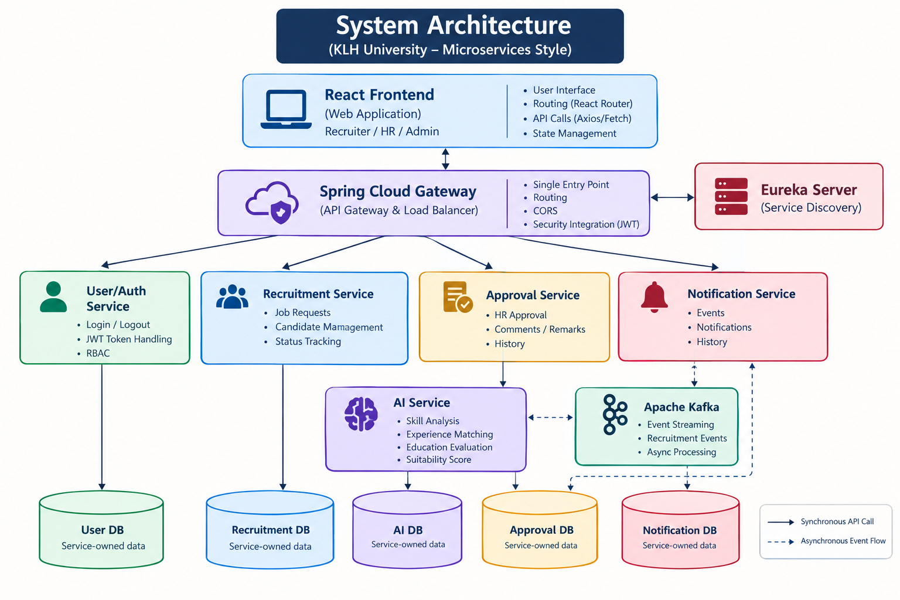
System Architecture
React Frontend
Recruiter / HR / Admin
Spring Cloud Gateway
Single entry point • Routing • CORS • Security integration
Eureka Server
Service discovery
User/Auth Service
Login • JWT • RBAC
Recruitment Service
Requests • Candidates • Status
Approval Service
HR approval • Remarks • History
Notification Service
Events • Notifications • History
AI Service
Skill • Experience • Education → Suitability score
Apache Kafka
recruitment-approved / recruitment-rejected events
User DB
Service-owned data
Recruitment DB
Service-owned data
Approval DB
Service-owned data
Notification DB
Service-owned data

Slide 4
Methodology Adopted
Requirement
Analysis
Service
Identification
SOA
Decomposition
Architecture &
API Design
Security &
Data Design
Implementation &
Integration
Testing &
Deployment
Methodology Focus
• Business responsibilities are mapped to independent services.
• REST APIs are designed for standardized synchronous communication.
• JWT, Spring Security, RBAC and password hashing are applied to protected APIs.
• AI integration supports candidate evaluation without replacing HR judgment.
• Kafka is introduced where asynchronous, loosely coupled communication is appropriate.
• Testing covers authentication, authorization, recruitment, AI evaluation, approval, events, notifications and error handling.

Slide 5
Technical Implementation
Frontend & Gateway
• React frontend
• Spring Cloud Gateway
• Request routing
• CORS
• Centralized entry point
Services & Security
• Java / Spring Boot
• User/Auth Service
• Recruitment Service
• Approval & Notification Services
• JWT + Spring Security + RBAC
Integration & Data
• Eureka discovery
• REST / HTTP / JSON
• Kafka events
• Independent databases
• AI-assisted scoring
Key Technical Features
• JWT-based authentication with backend-enforced role-based authorization.
• Service discovery through Eureka instead of hardcoded service locations.
• REST APIs for synchronous interaction between independent services.
• Kafka for asynchronous approval/rejection events and notification processing.
• Independent data ownership: services do not directly query another service's database.
• AI-assisted candidate evaluation returns suitability score, matching skills, missing skills and recommendation.
• Architecture supports independent deployment, scaling and future notification channels.

Slide 6
Technical Soundness
Area | Implementation in the Project
Loose Coupling | REST APIs and Kafka events avoid tight dependency on internal service implementations.
High Cohesion | Each service has a focused responsibility: users, recruitment, AI evaluation, approval or notifications.
Service Autonomy | Services own their business logic and data and can evolve independently.
Reusability | Standard APIs can be reused by web, mobile or future HR clients.
Discoverability | Eureka provides service registration and discovery.
Interoperability | HTTP/REST/JSON and Kafka provide standardized communication mechanisms.
Scalability | Independent services can be scaled according to their individual workload.
Fault Isolation | Kafka decouples notification processing from the approval workflow.
Security | JWT, Spring Security, RBAC, password hashing, protected APIs and audit-related controls.
Data Ownership | Each service manages its own database; cross-service data access uses APIs/events.

Slide 7
Conclusion
Project Overview
The AI-Driven Recruitment & HR system demonstrates how an end-to-end recruitment approval workflow can be decomposed into independent SOA services while keeping security, data ownership and communication concerns explicit.
Key Achievements
• SOA-based modular design with Gateway, Eureka and independent services.
• Secure recruiter, HR and admin access using JWT and RBAC.
• AI-assisted candidate evaluation that supports — but does not replace — HR judgment.
• Kafka-based approval/rejection events enabling loosely coupled notifications.
• Independent data ownership, service autonomy, scalability and maintainability.
PROJECT DESIGN • METHODOLOGY ADOPTED • TECHNICAL SOUNDNESS

Slide 8
THANK YOU

