Slide 1

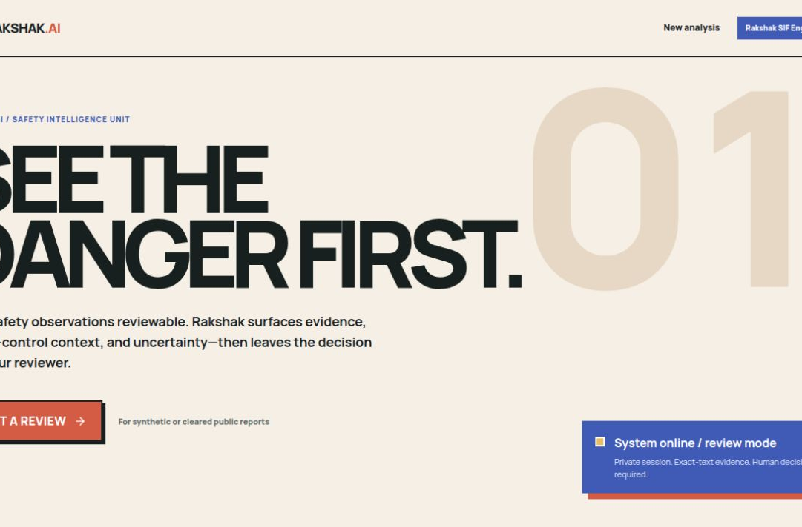
RAKSHAK.AI
SMART INDIA HACKATHON 2026 / TEAM SABLE
RAKSHAK AI
Explainable SIF intelligence from near-miss reports
SIH26165 · Software · Miscellaneous
A reviewer-first prototype that keeps exact evidence visible and uncertainty honest.
WORKING PROTOTYPE
LIVE DEMO ADD URL
VIDEO GUIDE ADD URL
GITHUB github.com/harshit-164/Rakshak-AI
Replace the two ADD URL fields before submission.
TEAM SABLE
1
Notes:
Project source: local Rakshak AI repository and running prototype captured on 2026-09-07. GitHub: https://github.com/harshit-164/Rakshak-AI

Slide 2
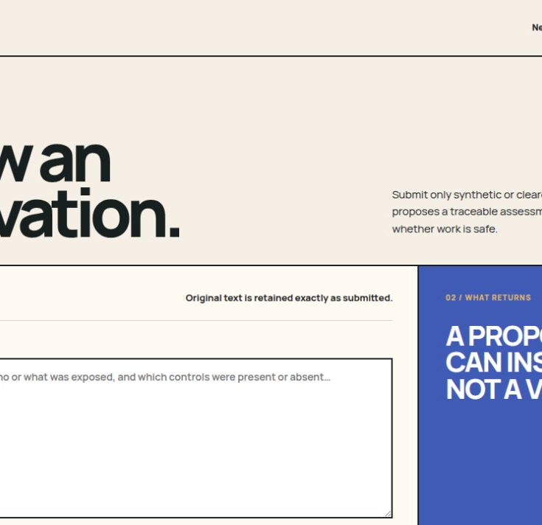
Idea and live demo
02 / SIH26165
One report becomes a traceable review proposal
1
Submit
2
Analyze
3
Verify
Paste a synthetic or cleared observation. Original text remains unchanged.
The engine proposes SIF potential, precursor tags, barriers, and rule context.
Every evidence quote must exist in the submitted text before the result is saved.
WHAT THE JUDGE CAN CHECK
✓
Three-state result
yes, no, or unknown
✓
Evidence trail
exact phrases from the report
✓
Human boundary
proposal separated from final decision
LIVE DEMO LINK · ADD URL
2-minute path: paste → analyze → inspect evidence
TEAM SABLE
2
Notes:
Implementation evidence: apps/web/app/analyze/analyze-form.tsx; services/api/app/validation.py; services/api/app/contracts.py. Prototype screenshot captured from the local app on 2026-09-07.

Slide 3
Technical architecture
03 / SIH26165
The interface stays stable while the model layer can change
REVIEWER EXPERIENCE
A
Next.js client
B
FastAPI service
C
Supabase
D
Analysis worker
HUMAN
REVIEW
Anonymous session, report entry, job status, result view
Auth checks, idempotency, quotas, orchestration
Postgres, row-level security, durable queue
Leases, retries, provider adapter, provenance
RAKSHAK SIF ENGINE
PROTOTYPE NOW
AFTER SELECTION
Gemini hosted baseline
Train, compare, then replace the adapter
Versioned rubric + strict JSON contract
Exact-text evidence and reference checks
Provider identity retained in backend provenance
DeBERTa-v3-small for classification
Qwen 2.5 1.5B with QLoRA for structured generation
Frozen test set, threshold review, model card, CPU reload check
Swap the model adapter only after evaluation. The UI, API, storage, and evidence checks remain.
TEAM SABLE
3
Notes:
Architecture evidence: README.md; apps/web/app/lib/safeguard-api.ts; services/api/app/routes.py; services/api/app/worker.py; services/api/app/validation.py; supabase/migrations. Model roadmap reflects the user's stated plan and is not presented as completed training.

Slide 4
Feasibility and risk control
04 / SIH26165
The prototype already proves the workflow. The remaining risk sits in data quality and evaluation.
PROVEN IN PROTOTYPE
MAIN RISKS
CONTROL PLAN
Owner isolation
Limited labels
Rights register
Anonymous JWT + row-level security
SIF precursor data needs expert review
Train only on cleared sources
Durable processing
Domain language
Two-model benchmark
Postgres queue with worker leases
Abbreviations and site terms vary
Compare classifier and small LLM
Grounded output
Alert fatigue
Human thresholding
Unsupported evidence quotes are rejected
Too many false positives reduce trust
Tune for review workload and recall
Safe retries
Sensitive reports
Audit trail
Idempotency keys protect duplicate requests
Industrial incident text may be restricted
Keep model, prompt, rubric, and input hashes
Prototype limit: use only synthetic or cleared public reports until the data-rights review is complete.
TEAM SABLE
4
Notes:
Implementation evidence: services/api/app/worker.py; services/api/app/validation.py; services/api/app/persistence.py; supabase/migrations; configs/references/source-register.v1.json. No production-readiness claim is made.

Slide 5
Impact and evaluation
05 / SIH26165
Better prioritization must be demonstrated with reviewer data
01
02
03
04
05
Near-miss text
SIF proposal
Verified evidence
Reviewer action
Learning loop
EVALUATION SCORECARD
SIF recall
Of expert-confirmed SIF precursors, how many did the system flag?
Safety coverage
Evidence precision
What share of surfaced evidence supports the proposed finding?
Explainability
False alert rate
How often does the system flag a non-SIF report?
Reviewer trust
Median review time
Minutes from opening a report to a recorded human decision
Operational value
No impact percentage is claimed yet. Baseline and target values will be set with OIL reviewers after pilot data is available.
TEAM SABLE
5
Notes:
The scorecard defines proposed evaluation metrics. No measured impact results are available in the repository as of 2026-09-07.

Slide 6
Research, roadmap, and submission links
06 / SIH26165
MODEL ROADMAP
PRIMARY REFERENCES
NOW
Hosted baseline
SafeOCS
Complete demo flow and collect structured reviewer feedback
Near-miss and offshore precursor data program
IOGP
NEXT
Curated labels
Process safety indicators and Life-Saving Rules
Resolve data rights, define splits, annotate with domain experts
Baker et al.
THEN
Model benchmark
Learning injury precursors from raw reports
Compare DeBERTa classifier and Qwen 2.5 1.5B QLoRA
Petrobras 3W
GATE
Safe replacement
Public benchmark for undesirable oil-well events
Promote only after held-out evaluation and model documentation
ADD BEFORE UPLOAD
LIVE DEMO ADD URL
VIDEO GUIDE ADD URL
GitHub github.com/harshit-164/Rakshak-AI
TEAM SABLE
6
Notes:
Sources accessed 2026-09-07:
SafeOCS: https://www.bts.gov/browse-statistical-products-and-data/precursor-safety-data-program/offshore-energy-safety-data
IOGP Life-Saving Rules: https://www.iogp.org/workstreams/safety/safety/life-savingrules/
Automatically Learning Construction Injury Precursors from Text: https://arxiv.org/abs/1907.11769
Petrobras 3W: https://github.com/petrobras/3W
Internal rights register: configs/references/source-register.v1.json

