Slide 1
Team- ELECTRO Team- Harshit Kapoor(leader) Reshul Jindal Aditya Khulbe
TinkerCAD link- https://www.tinkercad.com/things/4DjxdmHxEYI

Slide 2
Features
Remote Controlled lights and fans
Temperature controlled fan speed
Gas detection and alarming system
Light control using pir sensor
Automatic door control
Light controlled curtains

Slide 3
How to use
1pressed on remote turns on the light and 3 pressed on remote turns on the fan
Slider to vary the temperature which adjusts the fan speed accordingly
Door opens automatically on moving closer
Sudden entry into the room turn on the appliances
Light intensity controls the curtains in the room
Gas leakage can be detected and an alarm is triggered

Slide 4
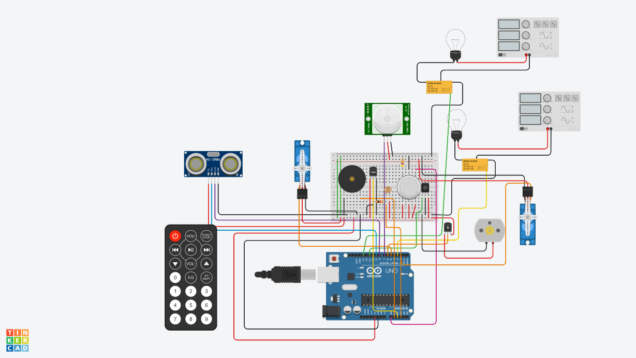
Circuit Diagram
Door
Curtain

Slide 5
Installation
- Our prototype can be converted into a working pcb which can then be installed at homes.
- Distance sensors will be installed on the door and servo motors on the hinges to allow movement of door
- For automating the appliances such as lights and fans, pcb can be installed at the back of the switch and we can also combine manual control along with it
- Gas sensors will be installed near the sensitive areas
PIR sensor can be installed and interfaced with a camera to prevent intruders from entering the house

Slide 6
Improvements
Moving forward, we can use IoT modules like esp8266 and esp32 instead of Arduino uno. These modules send the data to cloud platforms such as firebase, aws, azure etc. This well help us to control the home using smart home application.

Slide 7
Thank You

