Slide 1
Team- ELECTRO Team- Harshit Kapoor(leader) Reshul Jindal Aditya Khulbe
TinkerCAD link- https://www.tinkercad.com/things/4DjxdmHxEYI

Slide 2
Features
Remote Controlled lights and fans
Temperature controlled fan speed
Gas detection and alarming system
Light control using pir sensor
Automatic door control
Light controlled curtains

Slide 3
How to use
1pressed on remote turns on the light and 3 pressed on remote turns on the fan
Slider to vary the temperature which adjusts the fan speed accordingly
Door opens automatically on moving closer
Sudden entry into the room turn on the appliances
Light intensity controls the curtains in the room
Gas leakage can be detected and an alarm is triggered

Slide 4
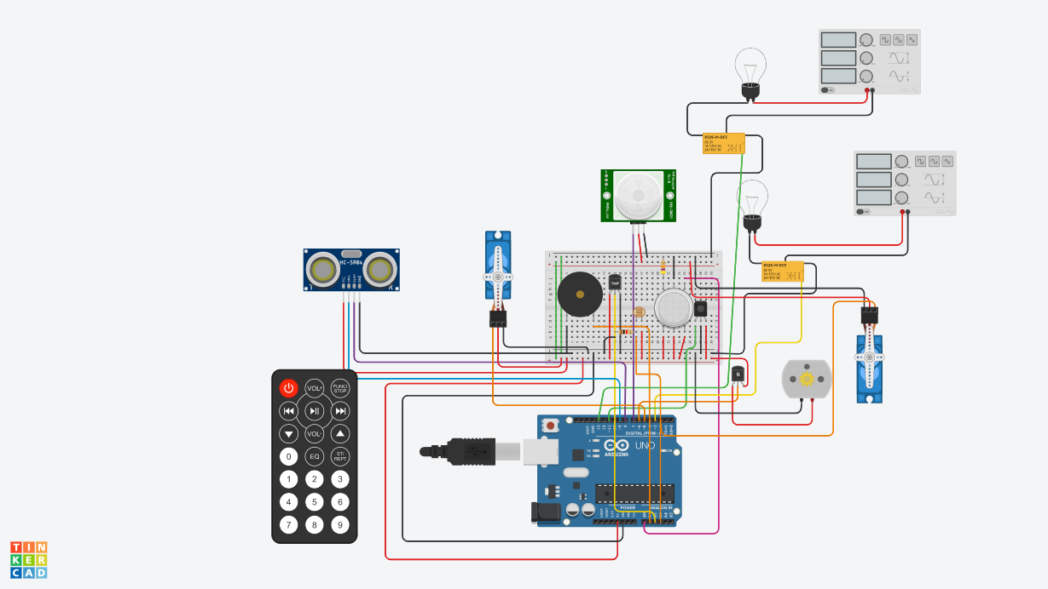
Circuit Diagram

Slide 5
Thank You

