Slide 1
ECE Florida
System-on-Chip Design
EEL 4930/5934 - Final Project
Spring 2025
PONG GAME WITH AUDIO
Team Members:
Harshit Raj
Alexis Villegas
Nitesh Bakhati
Benjamin Jacob

Slide 2
Objective
The goal of this project is to develop a System-on-Chip (SoC) that can play the pong game with the audio feedback for different game scenarios.

Slide 3
Tools and Hardware Overview
Vivado / Vitis
Real Digital Urbana Spartan 7 FPGA.
Micro USB cable to program the board and display the output in the terminal
HDMI monitor
PuTTY
Stereo audio speaker

Slide 4
Task Description
Audio Table Generation
PWM Driver Development
SoC Implementation without DMA
SoC Implementation with DMA

Slide 5
Task 1: Audio Table Generation
In this initial phase, 8-bit audio tables were created to represent different sound effects and melodies triggered by specific game events. The following scenarios were addressed:
• Win/Loss Event: When a player wins or loses, the system plays the melody "Mary Had a Little Lamb," following the provided reference.
• Ball Hits Paddle: A distinct 0.25-second tone is played each time the ball contacts a paddle.
• Point Scored: A separate 0.25-second tone, different from the paddle tone, is played whenever a point is scored.
These tables serve as the basis for audio playback in subsequent tasks.

Slide 6
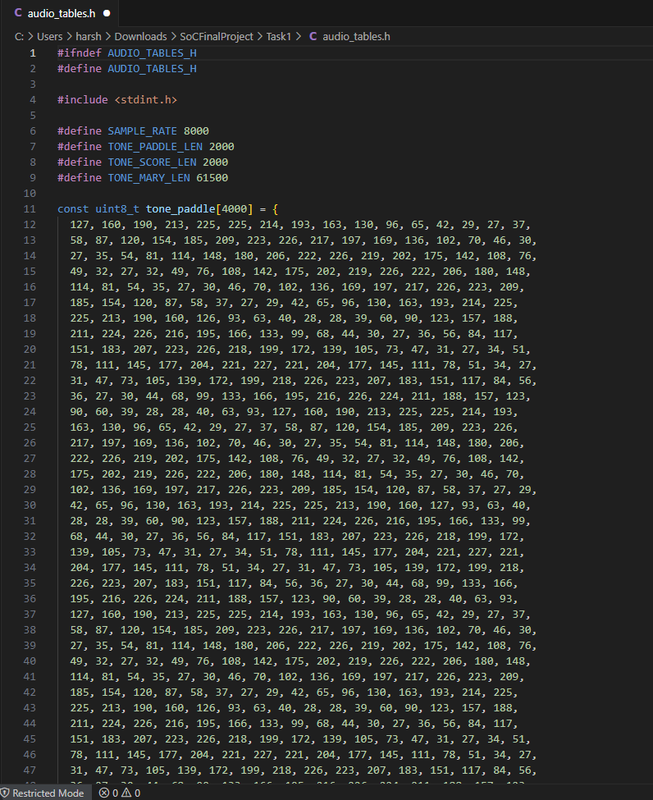
Task 1: Audio Table Generation

Slide 7
Task 2: PWM Driver Development
A Pulse Width Modulation (PWM) driver was developed to output audio signals through the Urbana Board’s audio port.
The PWM driver is responsible for converting the digital audio tables into analog signals, enabling the playback of tones and melodies via a connected speaker.
We have created two of the PWM custom IP one of them is AXI_Stream and the other one is AXI_MMSlave but have used AXI_Stream during our implementation.

Slide 8
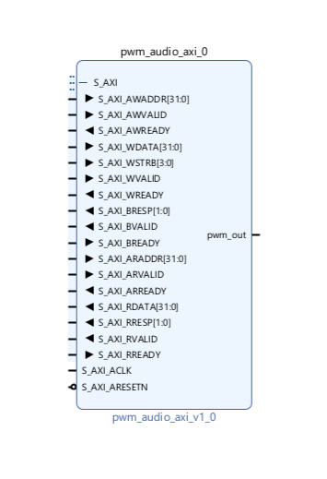
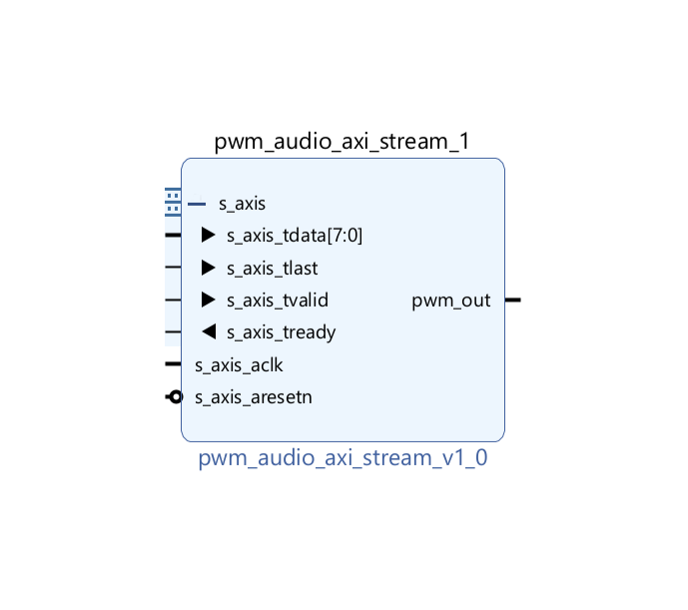
Task 2: PWM Driver Development

Slide 9
Task 3: Non-DMA SoC Implementation
In this stage, the system-on-chip (SoC) was constructed without using Direct Memory Access (DMA).
The implementation included integrating the Pong game logic (Player vs. Environment) from the previous lab and adding hardware to support PWM audio output.
Developing software to trigger and play the audio forms generated in Task 1, based on in-game events.
The result was a fully functional Pong game where the specified audio cues are played directly from the board in real time

Slide 10
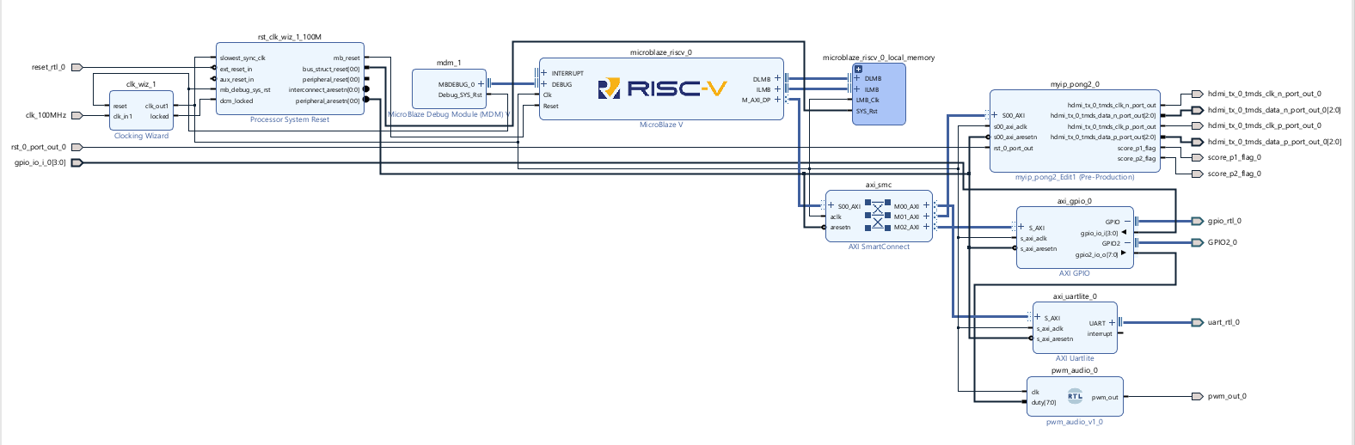
Task 3: Non-DMA SoC Implementation

Slide 11
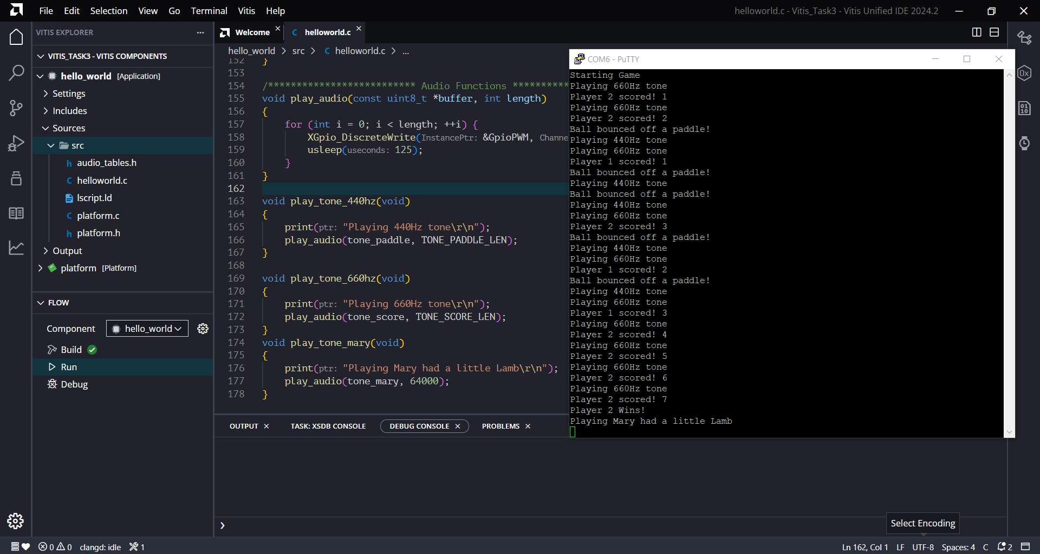
Task 3: Non-DMA SoC Implementation

Slide 12
Task 4: DMA SoC Implementation
In this task, we extended the previous implementation by incorporating the AXI Direct Memory Access (CDMA) controller.
This allowed efficient transfer of audio note data to the PWM driver, reducing CPU overhead and improving overall system performance.
The audio output behavior remained the same as Task 2, but with enhanced data handling using DMA.

Slide 13
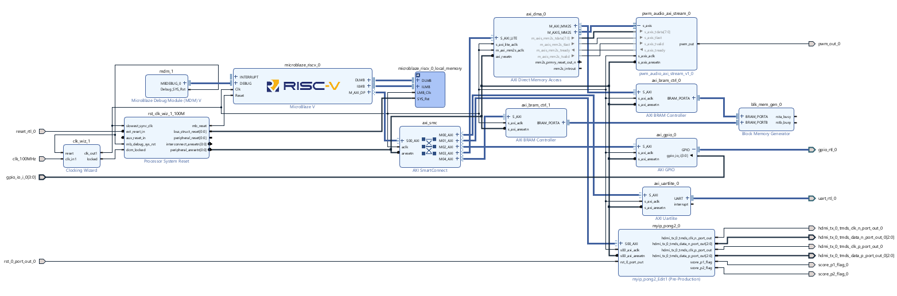
Task 4: DMA SoC Implementation

Slide 14
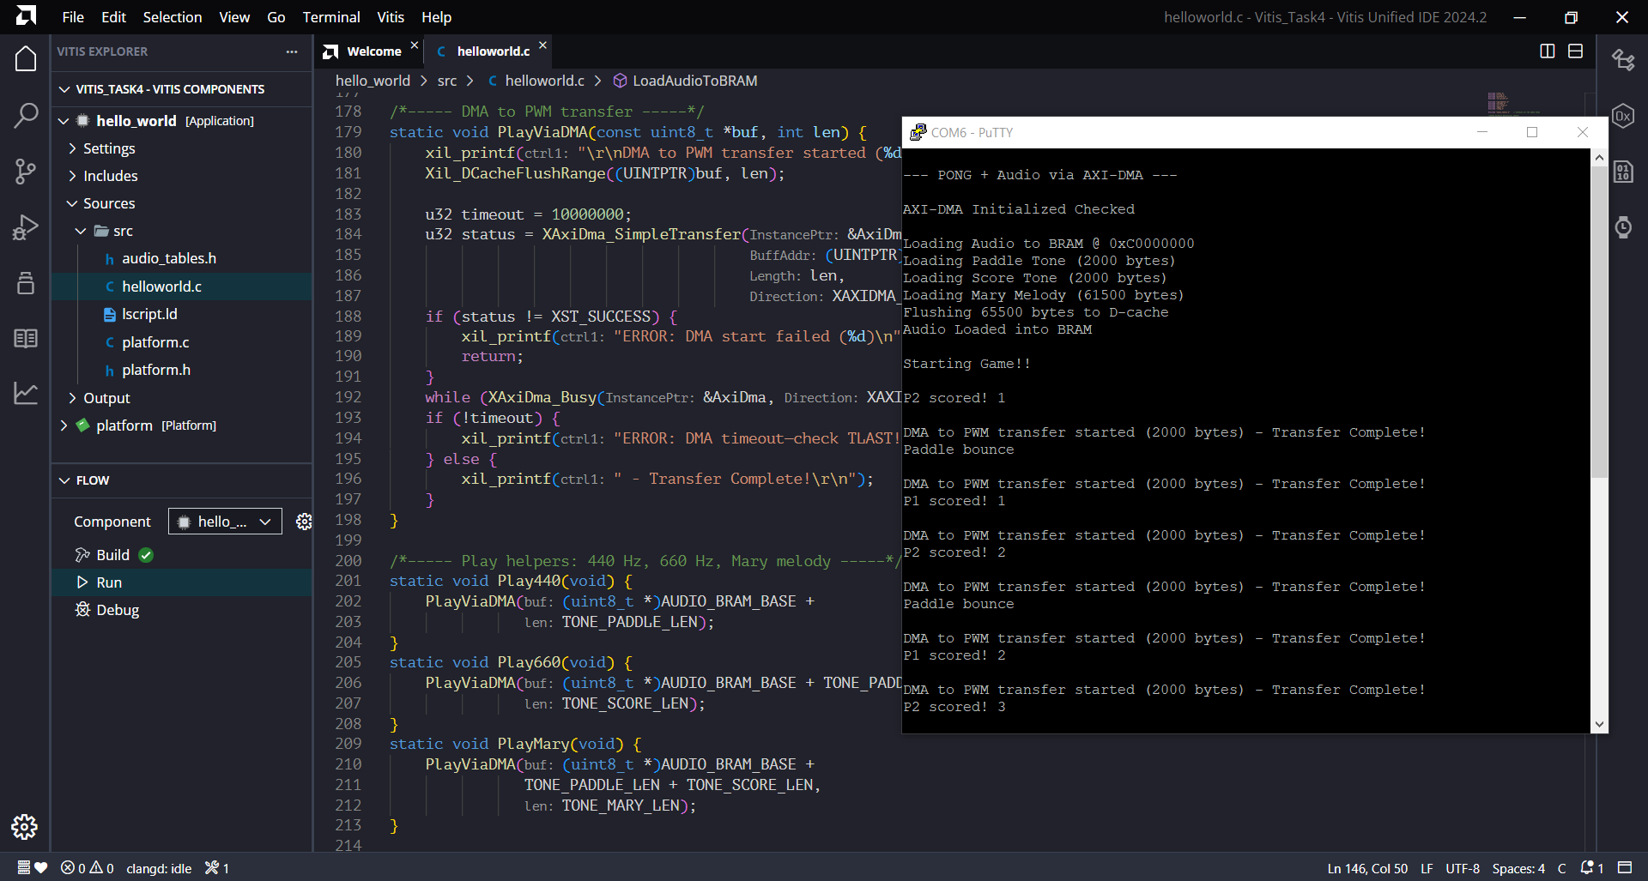
Task 4: DMA SoC Implementation

Slide 15
Conclusion
This project successfully demonstrated the integration of audio feedback into a classic Pong game implemented on the Real Digital Urbana Spartan 7 FPGA platform.
Through a systematic, task-driven approach, we designed and generated audio tables, developed a PWM driver, and incrementally incorporated these features into the Pong game system.

Slide 16
THANK YOU !

