Slide 1
EEL5764: Computer Architecture
Performance Analysis of x86 Multi-Core Architecture
Team Members
  Harshit Raj
  Nitesh Bakhati
  Dev Hitesh Parmar
  Kanak Sharma

Slide 2
Project Summary
Goal: To analyse the performance of x86 multi-core architecture in gem5 by scaling the number of cores, cache associativity, and cache size.
Workload: We are using the Parallel Merge Sort algorithm implemented in C++ along with OpenMP (static binary)
Observation:
      Effect of increasing cores on performance
      Impact of cache size and associativity on performance
Methodology:
      Running simulations on gem5
      Scaling core counts: 1, 2, 4, 8, 16 Cores
      Scaling cache associativity: 1, 2, 4, 8
      Collecting metrics like ticks, execution time, and hit/miss rates
Visualization: Plotting the collected metrics using Python/Matplotlib for analysis.

Slide 3
Feedback by TA and Professor on Project Proposal
Feedback that we received on our initial proposal from the professor:
“Missing information - the parameter values for L2 cache?”

Slide 4
Changes to Project
Our Project’s scope has not changed, but we are clarifying a missing information from the original proposal document.
We are doing three types of performance analysis of the X86 Multi-Core architecture.
  Core Scaling: Fix L1 and L2 cache parameters and simulate with 2, 4, 8, and 16 CPU cores.
  Cache Size Scaling: Fix the number of CPU cores and sweep the L1 and L2 cache sizes.
  Cache Associativity Scaling: Fix the number of CPU cores and vary associativity values for L1 and L2 caches.
All these analyses will use a parallel merge-sort workload written in C++ with OpenMP, compiled as a static binary, and executed in gem5.
The goal remains the same, which is to analyse the impact of core count and cache hierarchy parameters on the performance and memory behaviour of X86 Multi-Core systems.

Slide 5
Project Progress
We have successfully set up the gem5 simulation environment for the X86 architecture on Ubuntu.
Developed and tested the parallel C++ merge sort workload using OpenMP.
Successfully compiled the workload as a static binary file for compatibility with gem5.
We have also developed an automation script to launch the experiment, define the simulated machine, and loop through different parameters.
We have executed the full core-scaling script (2, 4, 8, 16 cores) and collected performance matrices.
We have also executed the full cache associativity and size-scaling script and collected performance matrices.
To implement the whole process automatically, we have also developed a run_all.sh script that will run our core scaling, cache size scaling, and cache associativity scaling scripts in sequential order.
We are currently developing a structured Python script that will generate the final plots for visualisation and analysis of the collected performance metrics.
We have also created a GitHub repository where you can check our real-time progress. https://github.com/harshit-raj15/x86-Performance-Analysis

Slide 6
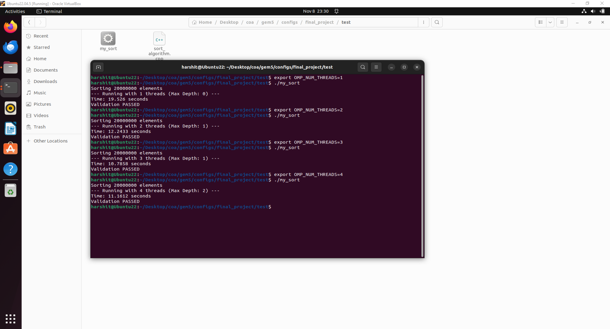
Project Progress
Initial Result
This is the terminal output showing the results after running the workload with different thread counts. This verifies that our merge sort algorithm with OpenMP is working correctly and executing in parallel.

Slide 7
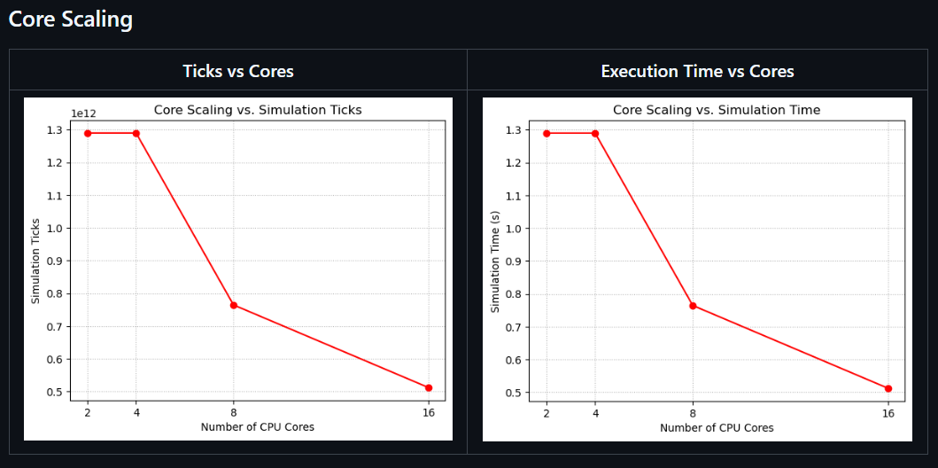
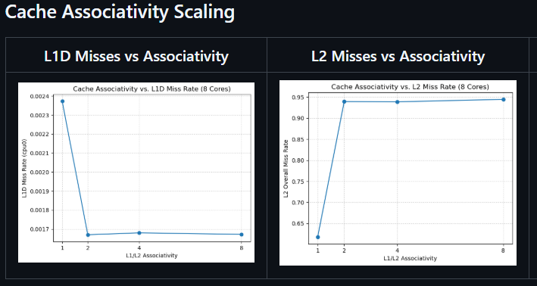
Project Progress
Initial Result
This is a visualization of our results for the Core Scaling and Cache Associativity Scaling experiments.
The Core Scaling graph demonstrates that as we increase the number of cores, the time to complete the work/task decreases.
The Cache Associativity graphs demonstrate that increasing associativity reduces L1 conflict misses, but this causes the L2 miss rate to rise because the L1 now has all the easy hits, leaving only a few requests for the L2 cache.
(These initial runs used the AtomicSimpleCPU model, which does not accurately model memory access timing. We are currently re-running the cache sensitivity experiments using the TimingSimpleCPU model to collect the correct timing data.)

Slide 8
Project Progress
Weekly Schedule:
Week | Task | Status
Week 1 | Set up gem5 environment, develop C++ workload. | Completed
Week 2 | Develop and test the simulation and workload automation script. | Completed
Week 3 | Develop and run all core scaling experiments and collect data. | Completed
Week 4 | Develop and run all cache sensitivity experiments and collect data. | Completed
Week 5 | Complete data analysis and generate all final plots. | In-progress
Week 6 | Prepare the final report and record the presentation. | In-progress

Slide 9
Feedback by TA and Professor on Project Progress
What cache sizes are you planning to explore? And why those sizes?
  Cache size experiments are not complete (I don't see it in the project progress slide)
Slide 7 - the core scaling plot needs to be rechecked. Why is there no improvement going from 2 cores to 4 cores?
The L2 miss rate, is it global or local?
You might want to explore L1 as a direct-mapped cache and L2 as a set-associative (4, 8)

Slide 10
Addressing the Feedback
For Cache size, we are sweeping the cache size below in a loop:
L1 Data Cache: 16kB, 32kB, 64kB, 128kB
L2 Cache: 128kB, 256kB, 512 kB, 1MB
We decided to go with this range as it reflects typical L1/L2 sizes used in many modern processors. Doubling the size at each step helps us get to the point where larger caches stop providing significant benefits.
Initially, we run the experiments with the AtomicSimpleCPU model, which is functionality accurate but not with timing. That caused flat results for cores while jumping from 2 to 4, cache associativity ticks and also in cache size scaling. We re-ran the experiments using CPU model O3CPU (still under run for cache size scaling), which behaves closer to a real core. The plots (updated in GitHub) now show a realistic difference for CPU cores and Cache Associativity.
The L2 miss rate we report is global.
We are exploring cache associativity for both L1 and L2 across a range of 1, 2, 4, and 8 ways to analyze how associativity impacts performance at each level.

Slide 11
Methodology
Our methodology consists of four major stages:
Workload Development
Simulation Scripts Development
Data Extraction and Visualization
Result Analysis

Slide 12
Workload Development
To evaluate the performance of an x86 multicore architecture, we needed a realistic, parallel, and compute-intensive workload that stresses both the CPU and the memory hierarchy.
For this, we designed and implemented a Parallel Merge Sort algorithm using C++ with OpenMP.
We chose Merge Sort because it is naturally heavy and scalable. It performs many recursive function calls. It uses large arrays during execution, which results in frequent memory access and high L1/L2 cache activity.
We use OpenMP (Open Multi-Processing), which is a standard API for parallel programming on shared-memory systems, to implement parallelism. It provides easy constructs that enable us to turn the recursive merge sort into a parallel merge sort algorithm.

Slide 13
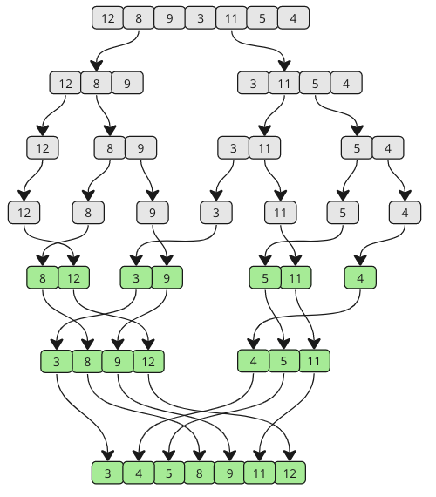
Workload Development
Merge Sort
It is a classic divide-and-conquer sorting algorithm that works by repeatedly splitting the array into smaller parts, sorting them, and then merging the results.
Dividing - The original array is repeatedly divided into two halves, and this process continues until each sub-array contains only one element.
Conquering - Once the array is split into individual elements, the algorithm begins sorting and merging them back. Adjacent elements are compared and arranged in sorted order.

Slide 14
Workload Development
Implementing Parallel Merge Sort
The implementation took place by setting an input for the setup, which includes:
Input Setup
N - which defines the size of the array. We took 1 million to generate significant computation and memory activity.
SERIAL_THRESHOLD – which decides when to stop parallelizing small subproblems. If a subproblem becomes smaller than this threshold, the algorithm switches to serial merge sort, which prevents excessive task creation and ensures efficient use of threads.
Merge Function
This function merges two sorted subarrays [left_to_mid] and [mid+1_to_right]. It uses three pointers i (left half), j (right half), and k (temp array) to traverse the data. Then it compares elements of array i and j and places the smaller value into the temp buffer. The fully merged and sorted segment is copied back to the original array.
Notes:
Serial Threshold- Creating a parallel task takes cycles to set up. If we try to parallelize a tiny array of just 100 elements, the setup cost is slower than just sorting it sequentially. So, if the data chunk is smaller than 30,000 elements, we skip the overhead and switch immediately to a standard Serial Merge Sort.
Merge Function - It runs a loop that compares the element at i with the element at j. Whichever is smaller gets written to our temporary buffer, and we increment the pointers. This ensures the new list is strictly increasing.

Slide 15
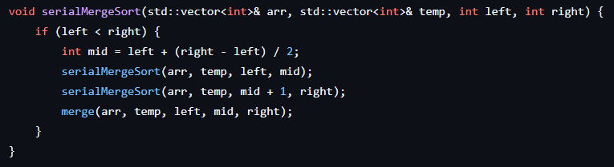
Workload Development
Implementing Parallel Merge Sort
serialMergeSort() Function
This function performs standard single-threaded sorting.
It is called by the parallel merge function when the subarray size drops below SERIAL_THRESHOLD (too small for parallel tasks) or when parallel execution is not efficient.
This avoids unnecessary overhead from creating too many small OpenMP tasks.
Notes:
We use serial merge sort below serial_threshold because creating OpenMP tasks costs CPU Cycles. For small data chunks, the parallel execution is not needed or is not efficient. This is used as the fallback for small subarrays and maximum recursion depth reached in the parallel version. This function is our efficiency fallback.
Working – It splits the array, recursively calls itself for the left and right halves, and then merges them. It runs entirely on a single thread with no OpenMP, no tasking.
Why This? - If we tried to use OpenMP tasks all the way down to a single integer, the simulator would spend more time managing the tasks than sorting the numbers. This serial merge function allows our cores to crunch through the small, dense chunks of data at maximum speed without the overhead of the parallel runtime.

Slide 16
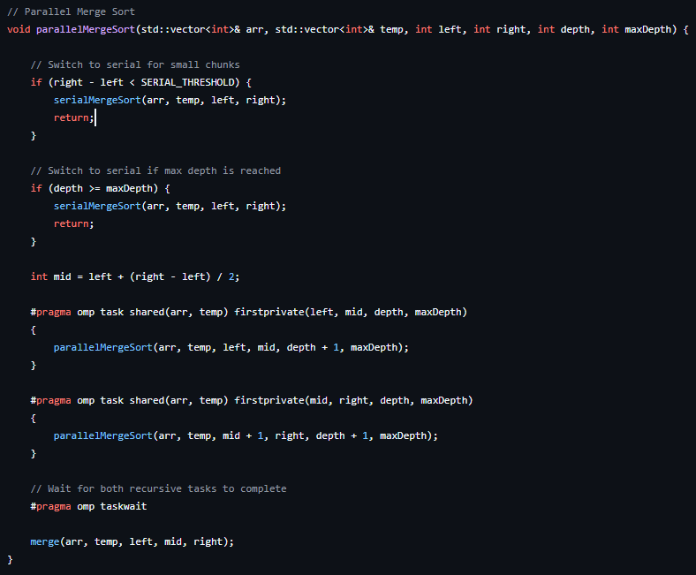
Workload Development
Implementing Parallel Merge Sort
parallerMergeSort() Function
This function is the parallel, task-based version of the merge sort implementation using OpenMP.
It enables the algorithm to run on multiple cores simultaneously.
It uses OpenMP tasks to allow different halves of the array to be sorted concurrently.
The amount of parallelism is controlled by maxDepth (recursion depth-based cutoff) and SERIAL_THRESHOLD (size-based cutoff).
Notes:
Decision Logic - First, we check the Size. If the array chunk is small, we exit parallel mode and call the serial function. Second, we check the Depth. If we have already split the work enough times to utilize all our cores, there is no benefit to splitting further. We switch to serial execution to save the CPU from managing unnecessary tasks.
Task Creation - If the chunk is large enough, we calculate the midpoint and spawn two OpenMP tasks, one for the left half and one for the right. These tasks run simultaneously on different cores (inside gem5), which creates a true multi-threaded behavior.
Task Join – Finally, we hit taskwait, which pauses the parent thread. It cannot proceed to call the merge function until both the Left and Right tasks report back that they are done. This guarantees that we never try to merge unsorted data. This prevents race conditions.

Slide 17
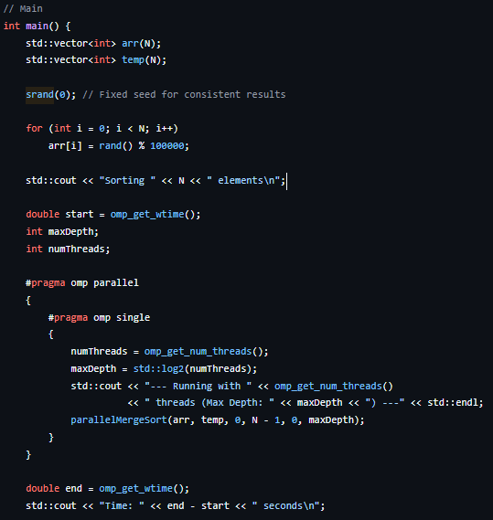
Workload Development
Implementing Parallel Merge Sort
Main Function
This function sets up the input data, allocates and initializes a random array of size N with seed 0.
Initializes OpenMP and launches the parallel merge sort.
Uses of OpenMP constructs ensure that only one thread initiates the recursive task tree.
Notes:
Initializing Random Array – We use srand(0) to ensure that the array contains the same sequence of random numbers for every single simulation run (2 cores, 4 cores, etc.), for fair comparisons.
OpenMP Parallel Call - We enter the parallel region with #pragma omp parallel. This wakes up all the threads available to the processor. However, we immediately use #pragma omp single. We don't want all 16 threads to start sorting the entire array 16 times. We want one manager thread to start the process and then delegate sub-tasks to the other threads as the recursion deepens.

Slide 18
Workload Development
Compiling Workload
To run our code on the simulation, we compile it using the following command.
g++ -o sort_algorithm_binary -fopenmp -static sort_algorithm.cpp
Where,
g++ is the GNU C++ Compiler.
-o sort_algorithm_binary is the name of the output executable file.
-fopenmp enables the OpenMP runtime library.
-static flag forces static linking of all the libraries.
sort_algorithm.cpp is the source code that implements merge sort in C++ with OpenMP
Notes:
There are two key flags:
fopenmp - This tells the compiler to recognize the #pragma tags we added in the source code. Without this, the compiler would ignore our parallel instructions and produce a single-threaded serial program.
static - This is the most important part. By default, programs are dynamically linked, which means they look for system files when they run. However, gem5 (Syscall Emulation) mode is not a full computer. It simulates the CPU but does not have a full OS with a /lib folder full of libraries. So, if we use dynamic linking, the simulation will crash immediately because it will not find the OpenMP libraries. The -static flag forces the compiler to take every piece of the code the program needs, which includes all the libraries, like math libraries, threading libraries, standard C++ libraries, and fit them inside our output file. This makes the binary larger, but it makes it completely self contained, allowing it to run on the bare metal of the simulator.

Slide 19
Workload Development
Testing Workload
The attached screenshot validates the correctness of the algorithm and parallel merge sort behavior.
As we increase the number of threads, the sorting time decreases, which confirms the correct parallel behavior.
This implies that the workload is ready for Gem5 simulation.
Notes:
Before running our simulations on Gem5, which can take hours, we check it on our native machine. The screenshot on the slide shows this verification process.
Testing Scalability - We manually set the environmental variable export OMP_NUM_THREADS to 1, 2, 3, and 4. You can see in the terminal output that the program correctly detects the changes each time. This confirmed that our OpenMP directives were working and that the binary was responsive to environmental settings.
Testing Correctness - In the terminal, you can see Validation PASSED, which confirms that our internal check of the array from index 0 to N, which ensures it is sorted, has never failed. This confirms that our parallel merge sort logic is working correctly.
Performance - For this test, we sorted 20 million elements, which took about 19 seconds on a single thread and around 11 seconds on 4 threads. For the actual gem5 simulation, we scaled these elements down to 1 million elements because the simulator runs thousands of times slower than real hardware.

Slide 20
Simulation Scripts
To evaluate CPU and memory subsystem performance of x86 multi-core architecture in gem5, we designed three automated simulation scripts that run the same workload under different hardware configurations.
These scripts are:
  Core Scaling - In this, we are varying the number of cores.
  Cache Associativity Scaling - In this, we are varying cache associativity.
  Cache Size Scaling - In this, we are varying the cache size.
We replaced manual execution with robust bash scripts. It allowed us to automate simulations without human intervention, ensuring consistency.
We utilized the Out-of-Order (O3) CPU model instead of AtomicSimpleCPU. This captures realistic pipeline stalls and memory latency effects that are crucial for analysis.
Notes:
We created bash scripts to move from the manual execution of tens of simulations by hand, which are time-consuming and also prone to human error.
Bash Scripts - We scripted the entire workflow. Each script runs multiple gem5 simulations in a loop. It changes only one hardware parameter per experiment.
CPU Model - A major upgrade from our progress report was switching to the Out-of-Order (O3) CPU. The SimpleAtomic CPU models in gem5 don't simulate memory stalls accurately. The O3 model gives us realistic timing data, which is essential for measuring cache performance.
Data Prevention - gem5 overwrites its output files every time it runs. Our scripts automatically rename and move these files into organized folders immediately after execution, so we never lose a single data point.

Slide 21
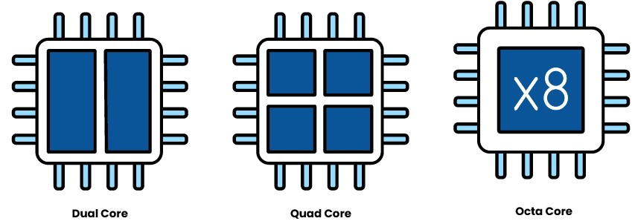
Simulation Scripts
Core Scaling
The Core scaling script evaluates system performance as CPU core count increases to reveal parallelism limits.
Increasing the cores enables higher instruction throughput, but shared memory resources create contention.
Cache hierarchy pressure grows with each added core, affecting latency and miss behavior.
Real workloads rarely scale linearly due to synchronization and coherence overhead.
Simulations helps identify architectural bottlenecks in multicore systems.
Notes:
The goal here is to evaluate Parallelism Limits. We know that adding cores improves throughput, but only up to a point. Eventually, the shared resources like the L2 cache and the Main Memory bus become saturated. Simulations expose the point where additional cores provide diminishing returns and help us identify architecture bottlenecks in multicore systems.

Slide 22
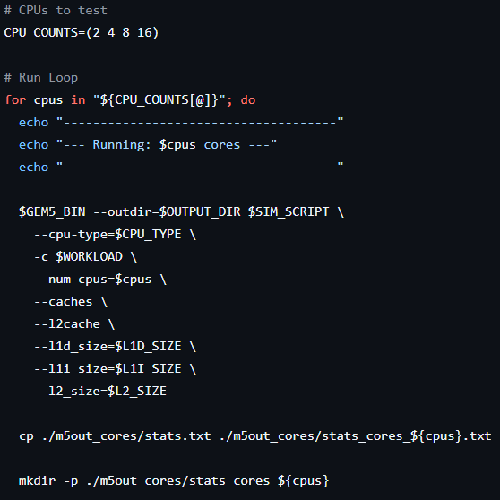
Simulation Scripts
Core Scaling
We use a loop structure to iterate through each targeted core count, which are 2, 4, 8, and 16. Ensuring automated execution for all scaling configurations.
Constructs the gem5 command by dynamically inserting the current core value, allowing systematic testing without manual edits.
Ensures reproducibility by maintaining identical cache and memory parameters across all core-scaling runs. We used the O3CPU model in gem5 for accurate timing measurement.
Moves all output files into a uniquely named folder for each core count, preventing overwrites.
Notes:
To automate this, we wrote a bash script that functions as a loop. It iterates through our target core counts, which are 2, 4, 8, and 16. In each iteration, it constructs a new gem5 command and runs the same workload.
Also, it immediately safeguards the data by moving all output files into a uniquely named folder for each core count. Since gem5 overwrites its output file every time. Allows the experiment to run unattended, making batch-simulation efficient for large-scale architectural studies.
This experiment helps identify architectural bottlenecks in multicore systems and exposes the point of diminishing returns.

Slide 23
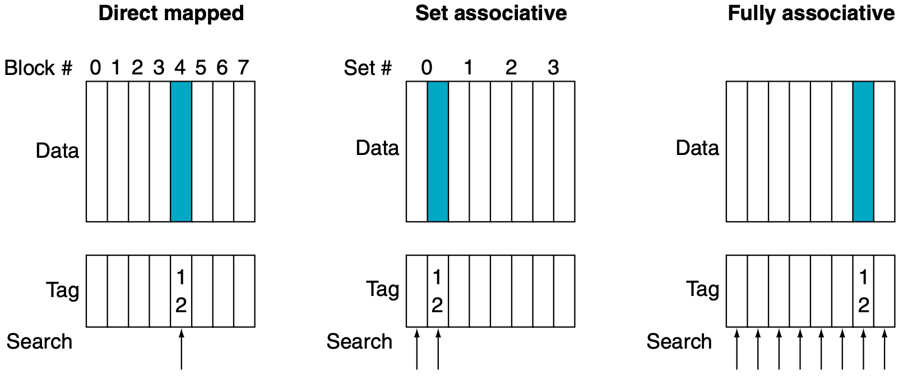
Simulation Scripts
Cache Associativity Scaling
Cache associativity controls how flexibly addresses map into cache sets.
Low associativity leads to more conflict misses, reducing overall performance.
Higher associativity reduces conflicts, improves hit rate, but introduces higher access latency and adds hardware complexity.
Balancing associativity is essential to designing power-efficient memory hierarchies.
Notes:
Associativity defines how flexible the cache is. A 1-way (Direct Mapped) cache is rigid; if two variables map to the same slot, they kick each other out, causing Conflict Misses.
By increasing associativity to 2, 4, or 8, we allow the cache to store those fighting variables in different ways. However, higher associativity isn't free as it adds hardware complexity and latency.

Slide 24
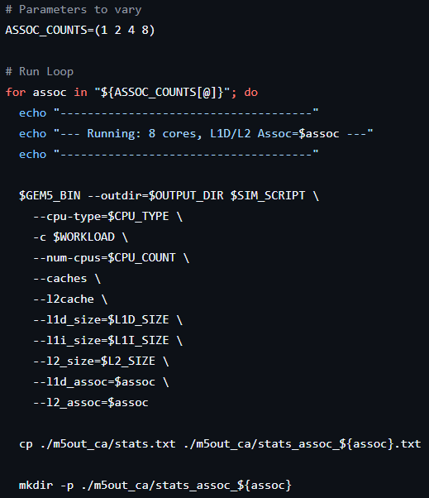
Simulation Scripts
Cache Associativity Scaling
We iterate through a predefined list of associativity values, which are 1, 2, 4, and 8, to isolate the impact of set associativity while keeping the cache size constant.
Dynamically inserts each associativity value into the simulation command for both L1D and L2 caches.
Keeps CPU count, cache size, and other parameters fixed so that associativity becomes the sole variable under study. Used the O3CPU model in gem5 for accurate timing measurement.
Moves all intermediate gem5 files into each directory to prevent mixing of results between runs.
Notes:
For this script, we froze the Core Count at 8. We didn't want the number of CPUs to confuse the data. The script loops through associativity values (1, 2, 4, 8) and injects them into both the L1 and L2 cache controllers. This effectively isolates the Conflict Miss behavior as the single variable in the experiment. And ensures reproducible and well-organized testing suitable for microarchitectural analysis.
This experiment helps us understand the balance between cache access latency, conflict miss reduction, and performance trade-offs.

Slide 25
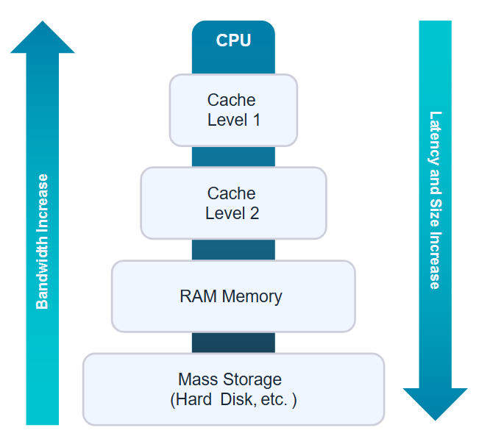
Simulation Scripts
Cache Size Scaling
Cache size scaling reveals how memory capacity impacts miss rate and execution latency.
L1D size has minimal effect because the workload's working set fits within smaller caches.
L2 size strongly influences performance by reducing costly last-level cache misses. Larger L2 caches improve hit rate consistency across cores, lowering access latency.
Results help determine optimal cache sizes for area–performance trade-offs in CPU design.
Notes:
Finally, we have cache size scaling. This experiment reveals the capacity misses. We wanted to know, does a larger L1 help? Or does a larger L2 help?

Slide 26
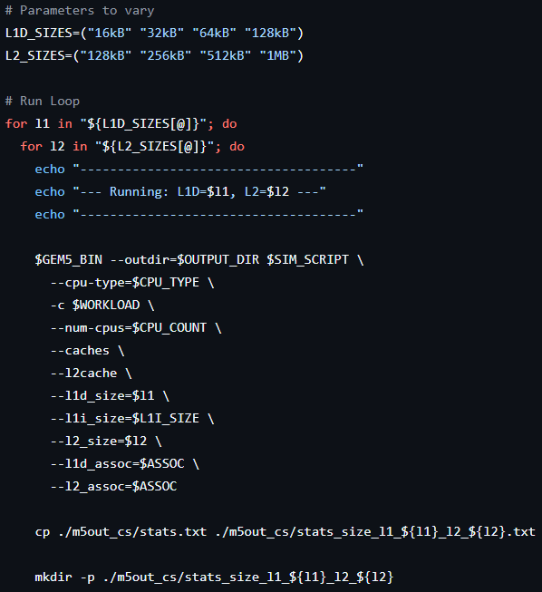
Simulation Scripts
Cache Size Scaling
We implemented a nested loop structure to iterate through every L1D - L2 combination, ensuring full coverage of cache capacity space.
The outer loop selects the L1D size (16kB, 32kB, 64kB, and 128kB), while the inner loop selects the L2 size (128kB, 256kB, 512kB, 1MB), producing a complete cross product of tested configurations.
Maintains fixed CPU count and associativity values so observed effects come solely from cache size variation.
Moves all intermediate gem5 files into the corresponding folder for clean experiment separation.
Notes:
To capture the interaction between L1 and L2, we used a Nested Loop, effectively creating a Grid Search. The Outer loop changes L1 size, whereas the Inner loop changes L2 size. This results in 16 different simulations (4x4). This Cross-Product approach is vital because it allows us to generate the 2D Heatmaps you will see in the results section, showing us exactly where the performance sweet spot lies.
Constructs gem5 execution commands dynamically using current L1 and L2 values, ensuring accurate parameter injection while maintaining fixed CPU count and associativity values so observed effects come solely from cache size variation.
Moves auxiliary gem5 output files into the corresponding folder for clean experiment separation. This structure ensures systematic, reproducible evaluation of cache capacity effects on latency and miss behavior.
This experiment helps us to reveal optimal cache sizes for this workload without wasting silicon area.

Slide 27
Data Extraction and Visualization
To systematically extract performance metrics from gem5 simulation logs and generate visual plots for analysis, we created a Python script.
The script reads gem5 stats files from all the output directories and extracts selected metrics using regex.
We then organize the results and generate plots and heatmaps with the help of the matplotlib library.
The script handles missing files or crashed simulations gracefully without stopping the batch process. It also processed the entire dataset in under a few seconds, compared to hours of manual work.
We chose a Python script because gem5 produces stats files that are often 2000+ lines long. We ran 20+ distinct simulations, and manually extracting would require opening those many files and finding the required metric values can lead to significant human error.
Notes:
Moving on to our data extraction phase, we faced a significant challenge as gem5 simulations are verbose. A single run produces a stats file that is thousands of lines long. Since we ran over 20+ distinct simulations to test all our parameters, we were looking to parse over thousands of lines of text. Manual extraction would be slow and prone to errors. Instead, we built a Python script using regular expressions (regex). This allows us to identify data by its context (like looking for the specific label 'simTicks') rather than relying on fixed line numbers, which change every time you modify the hardware configuration.

Slide 28
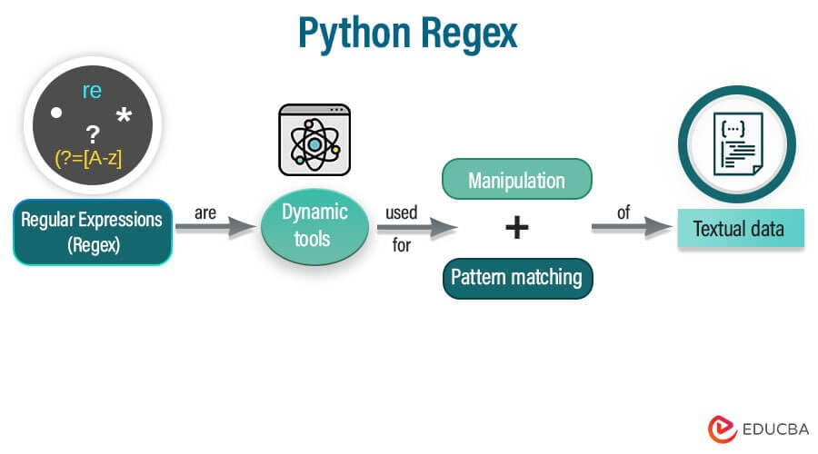
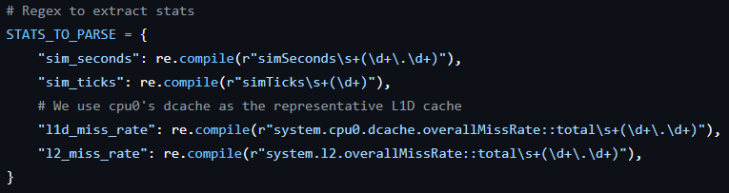
Data Extraction and Visualization
Data Parsing
We pre-compile regex patterns. This optimizes performance by parsing the regex string only once, rather than for every single file.
The (\d+) tells Python to extract only the number part of the matched line, ignoring the label.
We immediately convert extracted strings to floats so they are ready for mathematical operations in Matplotlib.
A single function can extract all required metrics across all three experiments.
Notes:
This is the core of our script, where we defined a dictionary called STATS_TO_PARSE. We use re.compile, which pre-compiles the patterns, making the script extremely fast even when looping through dozens of files.
The (\d+\.\d+) part is a capturing group that tells Python to ignore the text labels and extract only the numerical values. The script also includes a check where if the data is missing, the script will insert a None which ensures that our analysis finishes even if one run fails.

Slide 29
Data Extraction and Visualization
Visualization of Core Scaling
To visualize the core scaling, we loop through the list [2, 4, 8, 16] to maintain the correct order of data points and use two functions: plot_core_scaling_time and plot_core_scaling_ticks. Both these functions iterate through the parsed data returned from the parse_stats function.
plot_core_scaling_time - It shows real simulation runtime scaling (end-user performance). It collects the sim_seconds values into an ordered list. Maps the core count to sim_ticks and plots a graph with core counts on the X axis and total simulation time on the Y axis.
We apply axis labels, a title, formatting, and then save the output image into the output_plots directory.
plot_core_scaling_ticks - It visualizes how total CPU work changes as the core count increases. Appends sim_sicks to a list. Plots the graph with core count on the X axis and runtime on the Y axis.
Just like the others, we apply axis labels, a title, formatting, and then save the output plot into the output_plots directory.
Notes:
The first set of graphs we generated focuses on core scaling. The Python functions plot_core_scaling_time and plot_core_scaling_ticks show our standard workflow for plotting linear trends. We explicitly define our x-axis values [2, 4, 8, 16] and iterate through this list to ensure our data points are ordered correctly. In these functions, we also check if the data are missing, and then we append np.nan (Not a Number), which ensures that the missing points are skipped. np.nan simply tells matplotlib to leave a gap in the line.
We use plt.xticks(cpu_counts) to force the graph to label only the specific core counts we tested, making the graph clean and easy to read.
These functions will generate the plot and save the output plot into the output_plots directory.

Slide 30
Data Extraction and Visualization
Visualization of Cache Associativity Scaling
To visualize the cache associativity scaling, we used three helper functions. All these functions loop through the associativity settings [1, 2, 4, 8]. Extract the required metrics with the help of the parse_stats function.
plot_associativity_ticks - This measures the CPU workload vs the cache associativity. Iterates over the parsed results for different L1D/L2 associativity configurations and extracts sim_ticks from each configuration. Plots a curve showing how higher associativity changes the total executed cycles.
plot_associativity_l1d_miss - This shows the L1 data cache miss rate vs the associativity. Reads l1d_miss_rate from parsed stats and associates each L1D miss rate with its associativity levels. Plots a graph with associativity on the X axis and L1D miss rate on the Y axis.
plot_associativity_l2_miss - This visualize L2 cache miss rate changes due to L1/L2 associativity. Extracts l2_miss_rate from each simulation configuration and map it with its associativity levels. Plot a graph with associativity on the X axis and L2 miss rate on the Y axis.
Notes:
Next, for Associativity Scaling, we use a very similar logic but with a different focus. We map the associativity count (1, 2, 4, 8) in the three function names plot_associativity_ticks, plot_associativity_l1d_miss, and plot_associativity_l2_miss with sim_ticks, l1d_miss_rate, and l2_miss_rate, respectively. This allowed us to generate all three associativity graphs in seconds.
We expect the performance to be terrible at 1-way (Direct Mapped) and then jump up significantly at 2-way and so on.
These functions will generate the plot and save the output plot into the output_plots directory.

Slide 31
Data Extraction and Visualization
Visualization of Cache Size Scaling
For the cache size scaling, we move from simple line plots to 2D heatmaps. This requires a nested iteration loop to cover every combination of L1D Size [16kB, 32kB, 64kB, 128kB] and L2 Size [128kB, 256kB, 512kB, 1MB]. To implement this, we use two functions.
plot_cache_size_scaling - This function manages the data collection. It loops through the L1 sizes [16kB, 32kB, 64kB, 128kB] and the L2 sizes [128kB, 256kB, 512kB, 1MB] lists to build a 2D matrix of results. For every combination, it calls parse_stats to extract metrics like sim_ticks and miss_rate. It then passes these matrices to the helper function below to create a heatmap.
_generate_heatmap - This helper function takes the 2D data matrix and visualizes it. It uses Matplotlib’s imshow to create a color-coded heatmap. Darker colors typically represent higher values (worse performance), while lighter colors represent lower values. It also iterates through the grid cells to annotate each square with the exact numeric value, allowing for precise analysis of the optimal configuration.
Notes:
Finally, we have the Visualization of Cache Size Scaling. we needed a different approach because we are changing two variables simultaneously, the L1 size and the L2 size.
The function plot_cache_size_scaling uses a nested loop to initialize 2D matrices using NumPy to hold our data. It iterates through our defined L1 sizes as rows and L2 sizes as columns. Just like the previous functions. It extracts the simulation ticks and miss rates for all 16 combinations and stores them in a 2D matrix (a list of lists). If a specific simulation configuration is missing, we fill that cell with NaN to prevent the plot from crashing.
We then pass these matrices to _generate_heatmap. This function handles the visual heavy lifting. It applies a color map to the data, creating an immediate visual heatmap indicator of performance. We added logic to dynamically change the text color inside the cells. If a cell is dark, the text turns white, and if it's light, the text turns black. This ensures that the specific data points are always readable, which is critical for identifying the exact sweet spot in our cache hierarchy.
These functions will generate the plot and save the output plot into the output_plots directory.

Slide 32
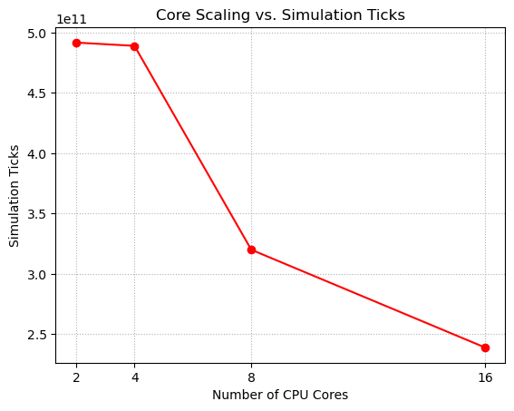
Result Analysis
Core Scaling - Ticks Measurement
The graph shows how simulation ticks decrease as the number of CPU cores increases from 2 to 16.
Ticks remain consistently high around 5.0. This indicates that moving from 2 to 4 cores provides a negligible benefit because the overhead of managing more threads nearly cancels out the parallel speedup.
There is a sharp drop from 4 to 8 cores. This is the region where the algorithm’s parallelism effectively utilizes the hardware.
Ticks drop further from 8 to 16 cores, but comparatively less than 4 to 8 cores, indicating diminishing returns caused by memory contention and limited parallel regions.
Notes:
Let’s dive into our results, starting with the core scaling. Here, we measured the total Simulation Ticks, which is essentially the total CPU cycles spent across all cores to finish the sort.
If you look at the left side of the graph from 2 to 4 cores, the line is almost flat, or there is a slight gain tells us that while 4 cores are helping, the system is fighting against the overhead of managing those extra threads. It's barely breaking even.
However, look at he sharp drop when we move from 4 to 8 cores. This is where the parallelism finally wins. The workload is large enough to keep 8 cores busy, and the synchronization overhead becomes a smaller percentage of the total work.
Finally, from 8 to 16 cores, the curve there is still a drop, but not a sharp drop, which indicates diminishing returns caused by memory contention and limited parallel regions.
For this workload, an 8-core CPU is the optimal choice.

Slide 33
Result Analysis
Core Scaling - Execution Time Analysis
The graph shows how the execution time reduces as the number of CPU cores increases.
Execution time stays near 0.49s for 2 and 4 cores, then decreases to 0.32s at 8 cores and 0.24s at 16 cores.
The transition from 2 to 4 cores yields a very small speedup, confirming that at low core counts, the task creation overhead is roughly equivalent to the compute gains. The 8-core CPU provides the best speedup.
The smaller improvement at 16 cores comes from synchronization and serial phases limiting scaling.
Notes:
We see the exact same trend when we look at the wall execution time in seconds. The sort algorithm took about 0.49 seconds on 2 and 4 cores. It dropped to 0.32 seconds on 8 cores. Then, it reached to 0.24 seconds on 16 cores.
While 16 cores is technically the fastest, 8 cores is the most efficient configuration. Going from 8 to 16 cores doubled our hardware cost and power consumption but only gave us a roughly ~25% speedup. This is the classic example of Amdahl’s law in action, where the serial parts of our merge sort algorithm (splitting and merging) limit the maximum speedup.

Slide 34
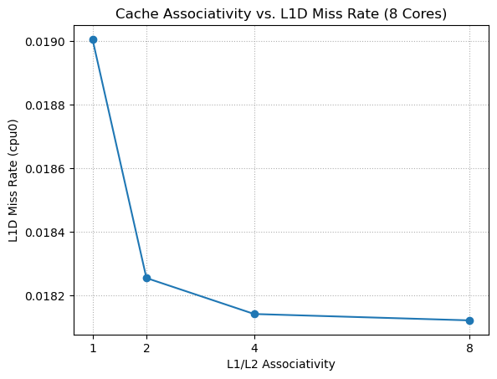
Result Analysis
Cache Associativity - L1D Cache Miss Rate
The graph shows how the L1 data cache miss rate decreases as the associativity increases.
The graph starts with the highest miss rate at 1-way (Direct Mapped), indicating that the cache suffers significantly from conflict misses where data items compete for the same slot.
There is a steep drop in the miss rate when moving from 1-way to 2-way associativity. This suggests that simply providing a second storage option for each index in cache resolves most of the mapping conflicts.
Additional associativity provides minimal gains because the remaining misses are compulsory or capacity misses.
Notes:
Let’s move on to the impact of associativity on the L1 Data Cache. This graph plots the miss rate against increasing associativity levels.
If you look at the starting point, 1-way (Direct Mapped cache), we see our peak miss rate. This happens because in a direct-mapped cache, if two active variables map to the same line, they constantly evict each other.
The moment we move to 2-way associativity, that number drops sharply tells us that our specific merge sort workload was suffering heavily from conflict misses. By simply adding one degree of flexibility, giving the data two possible places to live, we eliminated almost all those conflicts.
However, from 2-way to 4-way and 8-way, the line effectively flatlines. We hit a wall of diminishing returns. This indicates that the remaining misses are 'compulsory’, meaning we have to fetch the data from RAM at least once or 'capacity' misses, where the cache is simply full. No amount of cache associativity can fix that.
For this workload, a 2-way associativity cache is the optimal choice.

Slide 35
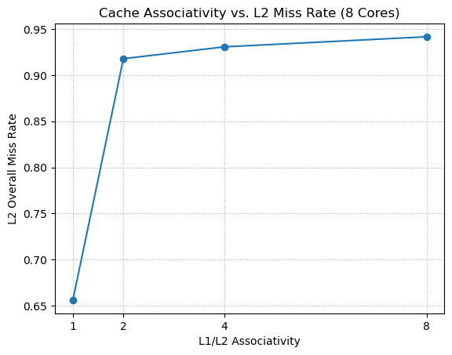
Result Analysis
Cache Associativity – L2 Cache Miss Rate
The graph shows that the overall L2 global miss rate increases as associativity increases.
Unlike the L1 cache, the L2 miss rate drastically increases as associativity improves, rising from 1-way to 2-way and drifting higher at 4-way and 8-way.
This occurs because the L1 cache becomes more efficient at higher associativity and captures all the easy, predictable memory accesses, leaving mostly difficult requests that are more likely to miss.
This makes the miss-rate percentage rise even though overall memory traffic decreases.
Notes:
Now, we come to the most interesting graph in our entire project, the L2 Global Cache Miss Rate.
Most people expect performance graphs to go down as associativity increases. But here, as we improved the cache (moving from 1-way to 8-way), the miss rate shot UP from 66% to nearly 94%. If you looked at this graph in isolation, you might think we broke the system. But we didn’t.
This phenomenon is known as the Filtering Effect. Remember, the L1 and L2 caches work together. Think of the L1 cache as a Filter. In the 1-way configuration, the L1 cache was bad, and it was letting a lot of easy, predictable requests slip through to the L2 cache. The L2 cache easily handled these, resulting in a decent hit rate.
When we upgraded the L1 cache to 2-way (as we saw in the previous slide), it became much better at its job. It started catching all those easy hits. Suddenly, the L2 cache stopped seeing the easy traffic. The only requests reaching it were the random, unpredictable ones that the L1 cache couldn't handle. Because the L2 is now only seeing the hardest problems, its miss rate goes up.
However, this increase is a good as It proves our cache hierarchy is working perfectly. The total number of slow trips to main memory went down, which is why our total execution time improved.

Slide 36
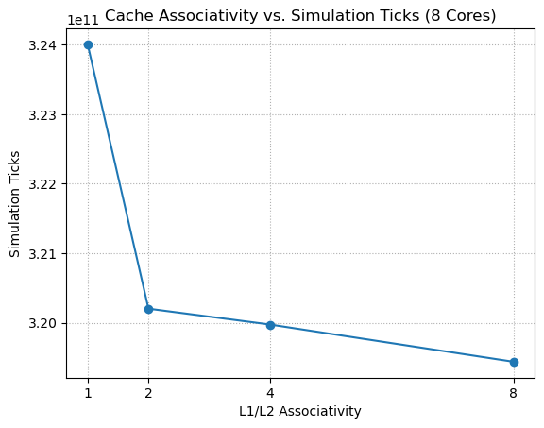
Result Analysis
Cache Associativity – Ticks Measurement
The graph shows how the total simulation ticks reduce as the associativity increases.
The total simulation ticks drop significantly from 1-way to 2-way. This confirms that resolving the conflict misses at L1 directly translates to faster execution.
Beyond 2-way associativity, the curve almost flattens. The improvement from 2-way to 4-way and 8-way is marginal.
Most of the performance benefit is achieved simply by moving away from a direct-mapped cache. Higher associativity adds extra hardware complexity with minimal impact on actual runtime.
Notes:
To wrap up our Associativity analysis, we look at Simulation Ticks. This measures the actual time the CPU spent working.
As you can see, the trend perfectly mirrors our L1 miss rate graph. We see a sharp improvement in performance when we switch from a 1-way direct-mapped cache to a 2-way Associative cache. This confirms that the 'Filtering Effect' we discussed was a good thing. Even though the L2 cache looked like it was struggling, the overall system became faster because the L1 cache was handling more of the load.
However, look at the line from 2-way to 8-way. It nearly flattens out. Going from 2-way to 8-way saved us very negligible time. In hardware design, higher associativity is expensive as it requires more comparators and uses more power.
This leads to a strong architectural conclusion for this specific Merge Sort algorithm. A simple 2-Way Set Associative design is the optimal choice.

Slide 37
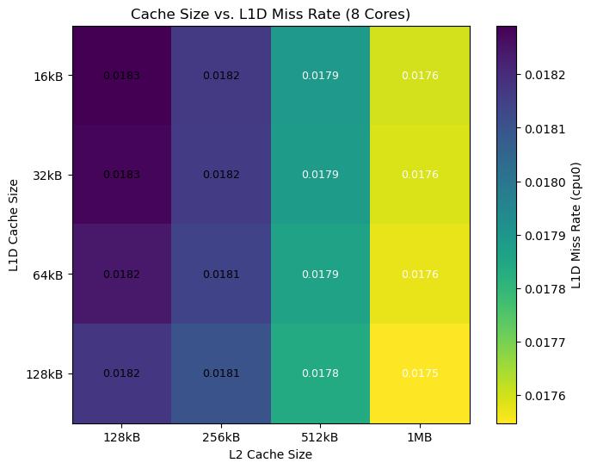
Result Analysis
Cache Size – L1D Cache Miss Rate
The heatmap shows how the L1D miss rate changes across different L1 and L2 cache size combinations.
The miss rate decreases slightly from ~0.0183 to ~0.0175 as both cache sizes increase.
Increasing L1D size reduces miss rate as larger L2 sizes reduce back-pressure on L1D.
Larger caches reduce some capacity misses, but the misses occurring here are primarily Compulsory (first-access).
Notes:
Moving into our final experiment, Cache Size Scaling. We start with this heatmap for the L1 Data Cache Miss Rate.
If you look at the scale, the difference between the worst-performing configuration in the top-left and the best-performing one in the bottom-right is less than 0.001.
Crucially, looking vertically, we see that increasing the L1 cache size has very little impact. This tells us that even at 16kB, the L1 cache is large enough to capture the working set of the sort algorithm.
The remaining misses are compulsory, meaning the CPU simply must fetch the data from memory at least once. Making the cache bigger doesn't solve this because you can't cache data you haven't touched yet. Therefore, investing silicon area into a larger L1 cache would be a waste of resources for this specific workload.

Slide 38
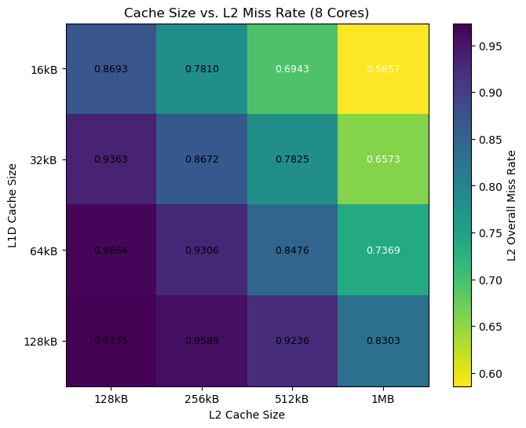
Result Analysis
Cache Size – L2 Cache Miss Rate
The heatmap shows how the L2 miss rate varies with different L1 and L2 cache size combinations.
Increasing L2 size from 128kB to 1MB significantly reduces the miss rate, as it dropped from ~0.87 down to ~0.58 in the top row.
The transition to lighter colors proves that Larger L2 caches hold more of the working set, reducing capacity misses.
As you move down the rows (increasing L1 size), the L2 miss rate increases. A larger L1 captures more hits, leaving only the most difficult, random patterns for the L2 to handle, which increases the miss percentage.
Notes:
Now, let's look at the L2 Cache Miss Rate heatmap.
First, look horizontally from left to right. We see a massive improvement. The colors shift from dark blue/purple to bright yellow. At 128kB (the left column), the cache is simply too small, causing constant evictions. By the time we get to 1MB (the right column), we have solved those capacity misses, dropping the miss rate to around ~58%.
However, when we look vertically. As we increase the L1 size (moving down), the L2 miss rate increases. This is that Filtering Effect again. A larger L1 cache does such a good job of trapping the data that it rarely speaks to the L2 cache. When it finally does send a request to L2, it's usually for something very difficult to find. This makes the L2 miss percentage look high, even though the system is working efficiently.

Slide 39
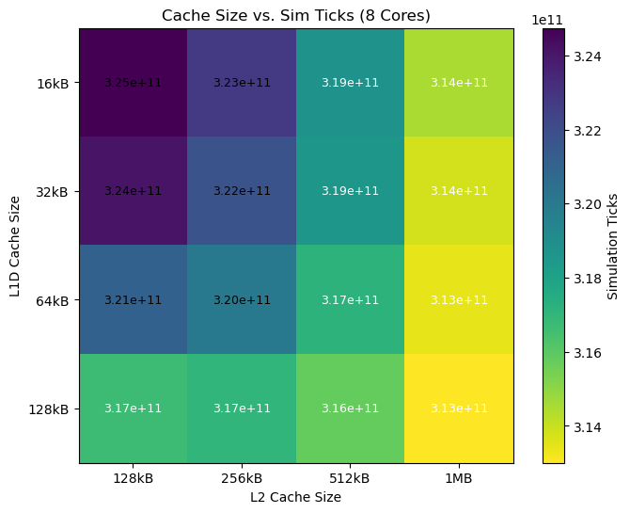
Result Analysis
Cache Size – Ticks Measurement
The heatmap shows how the total simulation ticks change with different L1 and L2 cache size configurations.
The heatmap displays a clear diagonal gradient from dark purple (top-left) to bright yellow (bottom-right). This indicates that increasing both L1 and L2 cache sizes contributes to performance.
While both axes affect the color, the shift is stronger when moving horizontally (increasing L2) than vertically (increasing L1).
The total speedup between the worst case and the best case is approximately 3-4%.
Notes:
Finally, we bring everything together with the Ticks Measurement heatmap. This tells us the actual impact of all those cache changes on the wall clock.
The first thing to notice is the gradient. Unlike the previous maps, which were mostly vertical or horizontal, this one is diagonal. This means performance improves as we increase both L1 and L2 sizes. The best performance is in the bottom right corner, where we have the largest possible caches.
However, we need to put this in perspective. While we saw L2 miss rates drop by nearly 40% in the previous slide, the actual impact on total simulation ticks is only about 3 to 4%.
Compared to the massive gains we achieved from Core Scaling (where we halved execution time), this is a fine-tuning optimization. It confirms that while cache sizing matters for efficiency, this parallel merge sort is primarily compute-bound, not memory-bound.

Slide 40
Conclusion
Parallelism is the primary performance driver. Scaling from 2 to 8 Cores yielded the most significant speedup. Beyond 8 cores, memory bandwidth saturation leads to diminishing returns.
Ticks drop from ~5.0×10¹¹ at 2–4 cores to ~3.2×10¹¹ at 8 cores, and execution time drops from ~0.49 s to ~0.32 s, showing that 8 cores use parallelism effectively.
Ticks fall further to ~2.4×10¹¹ and time to ~0.24 s, but the improvement is modest, limited by sequential work, overhead, and memory contention.
Moving from Direct Mapped to 2-way Associativity eliminated the majority of L1 conflict misses. Higher associativity (4-way/8-way) offered negligible additional benefits, making 2-way the most efficient design choice.
L2 miss rate increases with associativity because fewer, harder accesses reach L2, even though overall memory traffic and performance improve.
Performance is highly sensitive to L2 Cache Size, which buffers main memory access. L1 size had minimal impact, proving the workload's hot set fits within 16kB.
Notes:
To conclude our project, we have synthesized our data into four key architectural findings for the x86 Multi-Core system running the Parallel Merge Sort algorithm as a workload.
Core Scaling Dominates. Our most impactful result came from simply adding cores. We found that 8 Cores is the operational sweet spot. While 16 cores were faster, the efficiency dropped significantly due to memory contention (we started hitting the limits of Amdahl's Law).
The 2-Way Associativity is the Optimal Point. In terms of cache design, we proved that we don't need expensive hardware. A 2-Way Set Associative cache was sufficient to resolve the conflict misses. Going to 8-way associativity added complexity for almost negligible performance gain.
L2 Capacity is Critical. We learned that L2 capacity matters much more than L1 size. Our L1 cache is dominated by compulsory misses, so we must fetch the data at least once. However, a larger L2 cache helps hold that data closer to the core once it's fetched.
Final Verdict. We classify this workload as Compute Bound. We squeezed about 4% extra performance by fine-tuning the cache, but we got a 50% boost by adding cores.

Slide 41
Conclusion
Growing L1D from 16 kB to 128 kB slightly lowers miss rates and ticks, indicating only modest Locality benefits from a larger L1.
Increasing L2 from 128 kB to 1 MB significantly reduces L2 miss rate and modestly reduces ticks.
Larger L1D and L2 together improve performance by only ~3–4%, far less than the gains from adding cores.
The parallel merge sort workload is primarily compute-bound and parallelism-sensitive, with core scaling providing the biggest performance gains (~50%), while cache associativity and cache sizes act as secondary fine-tuning optimizations with very minimal performance gain (~4%).

Slide 42
Deliverables
Deliverables:
  A comprehensive final report with an analysis of the effect of cores and cache hierarchy on the performance of X86 multicore architecture.
  Plotted graph which includes speedup vs cores, execution time vs cache size/associativity, and L1/L2 miss rate.
  All source code (updated on GitHub) and a video demonstration.
  https://github.com/harshit-raj15/x86-Performance-Analysis
Video Demonstration:
  Starts with an introduction and overview of the project goal and setup of Gem5.
  Show and explain all the scripts and give an overview of the generated stats.txt output file, along with key metrics.
  Explain and analyse the Python script that generates the final graphs for core scaling, cache size scaling, and cache associativity scaling.
  Summarise our findings and conclusions.

Slide 43
Thank You!

