Slide 1
Deep Analysis
Code Analyser Platform
Understand HOW you solve problems — not just whether you succeed.
AST-Powered Analysis
Real-Time Code Execution
Personalized Insights

Slide 2
The Problem
Existing coding platforms (LeetCode, HackerRank, CodeChef) operate on binary feedback: Pass or Fail.
❌ Syntax vs. Logic?
❌ Concepts Understood?
❌ What Changed?
❌ What to Practice?
Platforms don't distinguish whether a failure is a typo
or a fundamental misunderstanding of the algorithm.
No visibility into which data structures or patterns
the student actually grasped during their attempts.
No tracking of how the code evolved across
multiple attempts — the iteration story is lost.
No personalised next-step recommendations;
students are left guessing what to study next.
Impact: Students repeat the same mistakes, instructors lack diagnostic data,
and bootcamps cannot measure real learning outcomes.
The core issue is that coding platforms were designed for assessment — not for learning.

Slide 3
Our Solution
Deep behavioural analysis of every coding session — tracking, analysing, and generating actionable insights.
1 ▸ Track Everything
2 ▸ Analyse Deeply
3 ▸ Generate Insights
Every code snapshot saved immutably
Time-stamped attempt timeline
Error progression across submissions
Test case pass/fail patterns
Multi-language support (Python, C, C++, Java)
AST parsing detects concepts used
Code diffs between consecutive attempts
Error classification (syntax / logic / runtime)
Time-complexity heuristic estimation
Topic mastery confidence scoring
Edit-hotspot detection (line-level)
Natural-language summary of the session
Concept-level breakdown with confidence %
Personalised practice recommendations
Weak-topic cards (Easy → Medium → Hard)
Monthly SWOT report per student
Dashboard KPIs & progress tracking
Result: "You understood loops and conditionals but struggled with edge-case handling. Practice: Two Sum (Easy) → 3Sum (Medium)."

Slide 4
How It Works — User Flow
① Login
② Browse
③ Write Code
④ Run / Submit
⑤ Analyse
⑥ View Insights
⑦ Dashboard
Firebase Auth
Email / Google SSO
Filter by difficulty,
tag, or search
Monaco Editor
Auto-save every 30s
Judge0 sandbox
execution
AST + Diff + Error
classification
Summary, concepts,
recommendations
KPIs, SWOT,
monthly reports
Key implementation details from the codebase:
• ProblemWorkspacePage.tsx (1 518 lines) — full workspace with Monaco editor, language selector, run/submit flows, inline test results, and side-by-side code diff viewer.
• DashboardPage.tsx — KPIs (solved, attempted, success rate), concept mastery bars, recent sessions deep-link, and monthly SWOT report generation.
• Analysis engine returns concept breakdown with confidence %, attempt timeline, weak-topic diagnostics, and targeted practice suggestions.
• Multi-language support: Python 3.x, C (GCC), C++ (GCC), Java (OpenJDK).

Slide 5
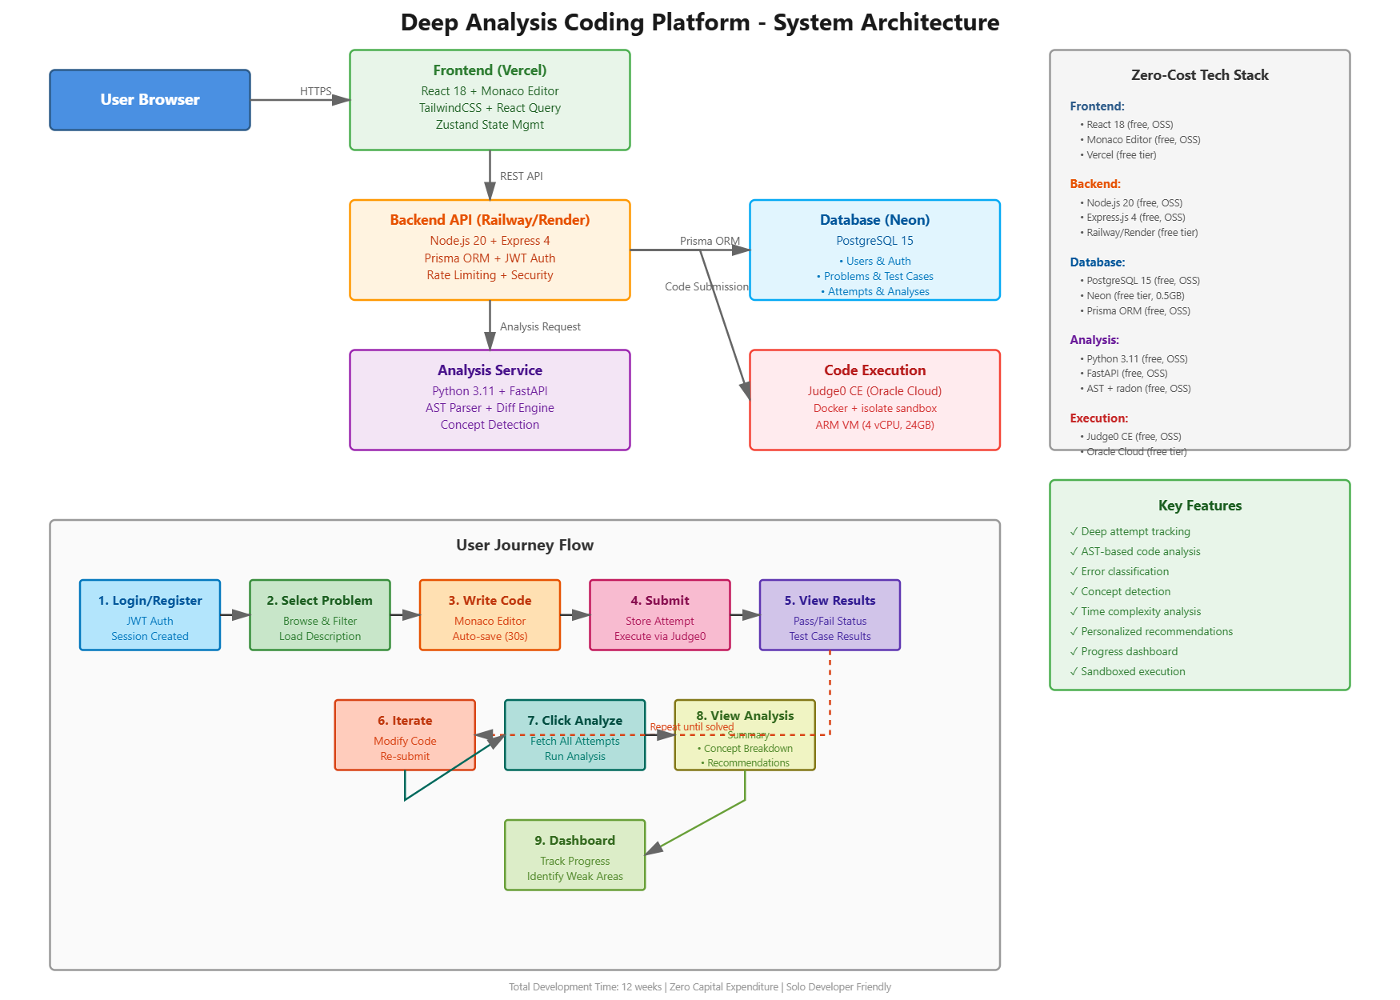
System Architecture
Frontend
React 18 · TypeScript · Vite
Monaco Editor · Zustand
Firebase Auth
Backend
Node.js 20 · Express 4
Prisma ORM · JWT
Azure Container Apps
Analysis
Python 3.11 · FastAPI
AST Parser · difflib · radon
Azure Container Apps
Database
PostgreSQL 15
Neon (serverless)
Prisma migrations
Execution
Judge0 CE
Docker · isolate sandbox
Azure VM (self-hosted)
Zero-cost hosting • All services on free tiers • Horizontally scalable micro-service design

Slide 6
Analysis Engine — Deep Dive
AST Concept Detection
Time Complexity Heuristic
Parses Python/C/C++/Java code into abstract syntax trees
Detects: loops, conditionals, recursion, data structures
Assigns confidence scores per concept
Rule-based estimation from AST loop/recursion depth
radon cyclomatic complexity scoring
Suggests optimisation opportunities
Code Diff Engine
Insight Generation
Side-by-side diff with line-level change tracking
buildDiffRows() generates same / added / removed / changed rows
Visualises iteration strategy across attempts
Natural language summary template engine
Concept breakdown table with confidence %
Weak-topic extraction with practice-next cards
Edit-hotspot detection at line level
Error Classification
Monthly SWOT Reports
Maps Judge0 status codes to error categories
Tracks syntax / logic / runtime error rates across attempts
Identifies dominant error pattern per session
Strengths / Weaknesses / Opportunities / Threats
Concept mastery progression over time
Aggregated across all sessions in period

Slide 7
Competitive Advantage
Why can't LeetCode / HackerRank simply copy this?
Architectural Lock-in
Missing Data
Existing platforms are built around single-submission evaluation.
Retrofitting multi-attempt tracking requires fundamental re-architecture.
Competitors discard intermediate attempts — they only store final
submissions. We capture every snapshot, creating a rich behavioral dataset.
Different Business Model
First-Mover Data Moat
Their revenue comes from hiring assessments, not education.
Our model is education-first: freemium for individuals, B2B for bootcamps.
Every session builds our behavioral dataset. Over time this compounds
into ML-ready training data for predictive learning recommendations.

Slide 8
Demo Flow & Future Roadmap
Live Demo (5 min)
Roadmap — Phase 2+
1. Login as demo user (Firebase Auth)
2. Browse problem catalog → select "Two Sum"
3. Write code in Monaco editor (Python / C++ / Java)
4. Run against visible tests → see inline results
5. Submit 3 attempts with different errors
6. Click "Analyse" → reveal deep insights panel
7. Navigate to Dashboard → KPIs + SWOT report
◆ ML-powered recommendation engine
◆ Cross-problem misconception detection
◆ Adaptive difficulty learning paths
◆ JavaScript / Go / Rust support
◆ Expand to 70+ curated problems
◆ Instructor analytics dashboard
◆ OAuth (GitHub, Microsoft) login
◆ Real-time collaborative code review
Business Model
Freemium: Free basic access · Premium for ML insights & advanced reports | B2B: Bootcamp & university licenses with instructor dashboards

Slide 9
Deep Analysis
Understand your code. Improve your craft.
"Existing platforms tell you PASS or FAIL.
We show you HOW you solve problems — and what to do next."
Thank you!

