Slide 1
HACKATHON PITCH DECK
Deep Analysis Coding Platform
From pass/fail scoring to learning intelligence
We reveal how developers think, where they break, and what they should practice next.
48-72 Hour MVP
$0 Deployment Stack
Rule-Based AI Insights
Deep Analysis Platform | February 2026

Slide 2
PROBLEM
What Existing Platforms Miss
TODAY'S FEEDBACK
OUR INSIGHT
"Wrong Answer on Test Case 5."
"Strong loop logic. Missed edge case first, corrected on attempt 3."
No reasoning. No context. No learning loop.
No Understanding
No Attempt Memory
No Misconception Detection
Pass/fail ignores why code failed
8 submissions collapse into one label
Recurring mistakes stay invisible

Slide 3
SOLUTION
The Analyze Button
One click transforms raw submissions into coaching-grade insights.
Attempts
Code Diff
Error Intel
Concept Map
Guidance
All submissions
+ timing
What changed
between tries
Syntax/runtime
logic labels
Loops, edge cases,
complexity
Personalized
next actions
"You understood string traversal, but your first approach missed empty input handling.
Practice edge-case checks before writing loops."

Slide 4
DEMO
3-Minute Experience
A tight, judge-friendly story from pain to proof.
Login + Problem
Write + Submit
Show Attempt History
Click Analyze
Reveal Coaching Insights
1
2
3
4
5
30s
45s
35s
40s
30s
Judge Storyline: Existing platforms say "Accepted in 3 attempts."
We show exactly what changed, why it failed, and what to practice next.

Slide 5
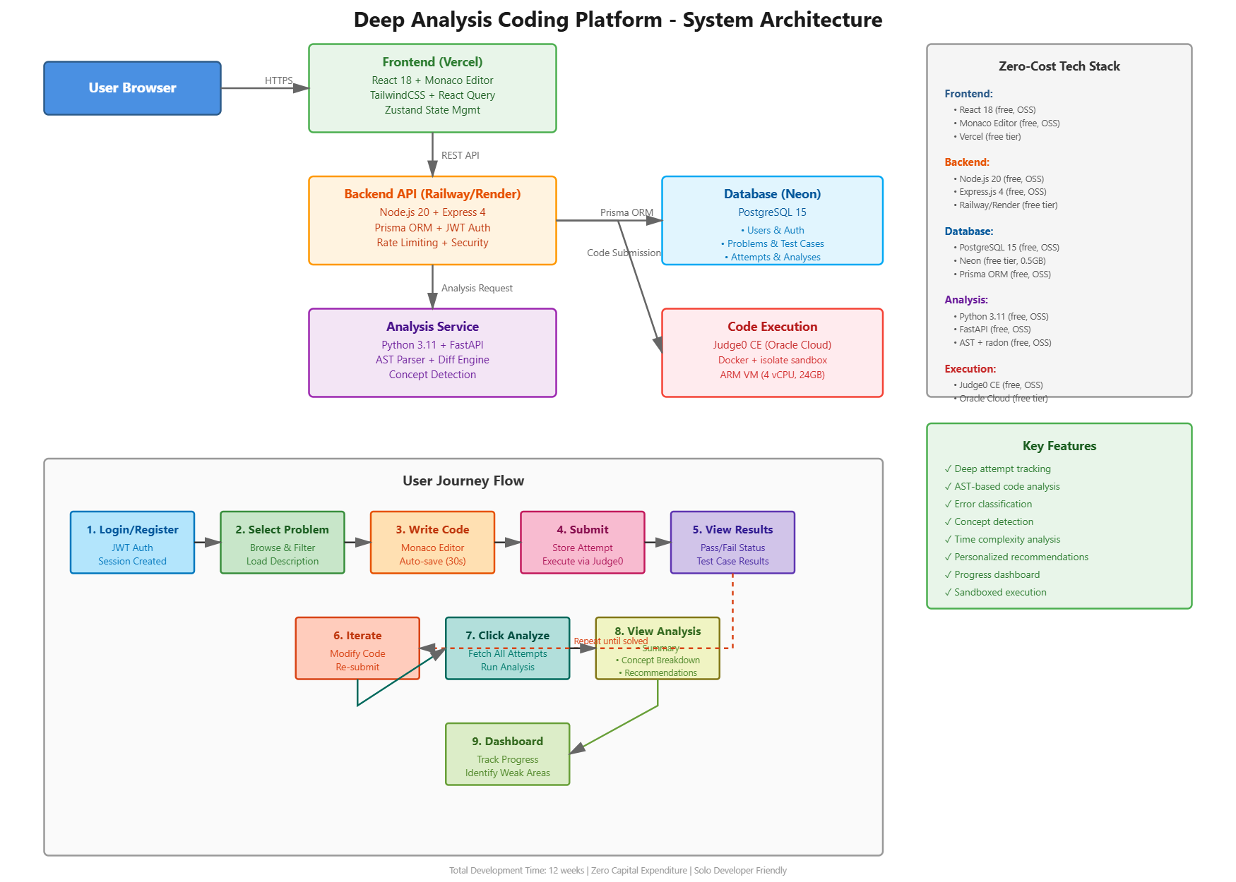
ARCHITECTURE
Zero-Cost, Production-Ready Stack
Frontend
React + Monaco
Vercel Free
Backend API
Node + Express
Railway/Render Free
Analysis Service
Python + FastAPI
Shared Instance
Database
PostgreSQL
Neon Free
Code Execution
Judge0 CE
Oracle Cloud Free
$0 monthly cost at MVP stage

Slide 6
EXECUTION
What We Build In The Hackathon
MUST SHIP (MVP)
EXPLICITLY DEFERRED
? JWT auth + user sessions
? Multi-language support
? 5-10 curated Python problems
? ML-powered personalization
? Monaco editor with Run/Submit
? Social/community features
? Judge0 execution + attempt tracking
? Advanced recommendation engine
? Analyze button with rule-based insights
? Enterprise analytics
? Dashboard: progress + weak concepts
48-HOUR SPRINT PLAN
Day 1
Backend + DB + Judge0
Day 2
Frontend + Analyze UI
Day 3
Demo polish + rehearsal

Slide 7
DIFFERENTIATION
Why This Wins
Dimension
Existing Platforms
Our Platform
Feedback
Accepted / Wrong Answer
Concept-level insight + fixes
Data Captured
Final submission only
Every attempt + timing + diffs
Learning Path
Generic problem lists
Weakness-driven recommendations
Misconceptions
Not detected
Recurring pattern detection
Data moat: rich attempt-level behavior is hard for incumbents to retrofit.

Slide 8
ROADMAP
From Hackathon MVP to Product-Market Fit
Phase 1
0-6 months
Phase 2
6-12 months
Phase 3
12-24 months
? Rule-based insights
? ML mastery scoring
? Adaptive problem engine
? 500 active users
? 5k WAU
? B2B bootcamp licenses
? 10k attempts tracked
? 5-10% premium conversion
? $10k+ MRR target
Monetization: Freemium analysis + interview prep tracks + educational licenses

Slide 9
CLOSING
We Don't Just Score Code.
We Coach Thinking.
Deep Analysis transforms every failed attempt into a measurable learning gain.
Pilot Users
Mentor Feedback
Hackathon Support
Thank you | Q&A

