Slide 1
MyStudySpace
Multi-College Academic Resource Platform
Domain: Social Impact & Accessibility
Team Members
Harshit Pal
Harsh Attri
Vansh Baranwal
AI/ML • 1st Year
AI/ML • 1st Year
AI/ML • 1st Year
KIET Group of Institutions, Ghaziabad
@codeathon 26

Slide 2
PROBLEM STATEMENT & DOMAIN RELEVANCE
2
What real-world problem are you addressing?
• Study materials scattered across WhatsApp groups, Google Drive, and emails — no single source
• Quality notes and PYQs lost forever when seniors graduate — no knowledge transfer mechanism
• No peer-review system — students cannot distinguish accurate content from outdated material
• New batches repeat the same painful search every year without benefiting from seniors' experience
Who is affected by this problem?
• 3.5+ million engineering students across 4,500+ colleges in India
• Students in Delhi-NCR: 250,000 students across 100-120 engineering colleges
• First-year students who repeat the same painful resource search every semester
Why does this fit Social Impact & Accessibility?
• Upvote/Downvote system — content liked by seniors automatically surfaces for new batches
• Democratizes access — premier college resources (IITs, NITs) available to all students
• Reduces knowledge inequality — Tier 2/3 students get same quality as Tier 1
• Community-driven — even students without connections benefit from seniors' curation
@codeathon 26

Slide 3
PROPOSED SOLUTION
3
Overview of the Solution
• Centralized platform where students share notes, PDFs, videos, and previous year questions
• Multi-college architecture — students from any college can access resources from others
• Admin-approved content with community voting (upvote/downvote) for quality assurance
Key Features & Innovations
• Smart filtering by semester, branch, and subject — find relevant content instantly
• Read-only access for external users — view resources from IITs, NITs without full account
• Separate Admin Dashboard (admin-mystudyspace website) for content moderation
• Chat rooms with threaded comments, real-time notifications, and study timer
How It Solves the Problem
• Seniors' best content surfaces via upvotes — new students naturally discover quality material
• Admin approval ensures accuracy; community voting validates usefulness over time
• Multi-college access breaks down knowledge silos between institutions
@codeathon 26

Slide 4
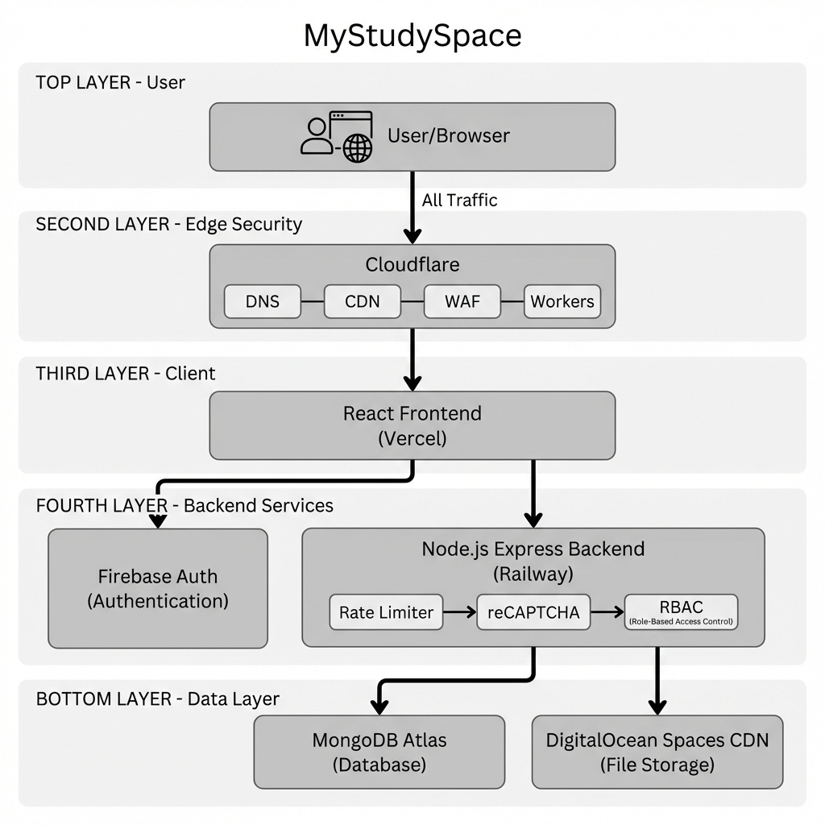
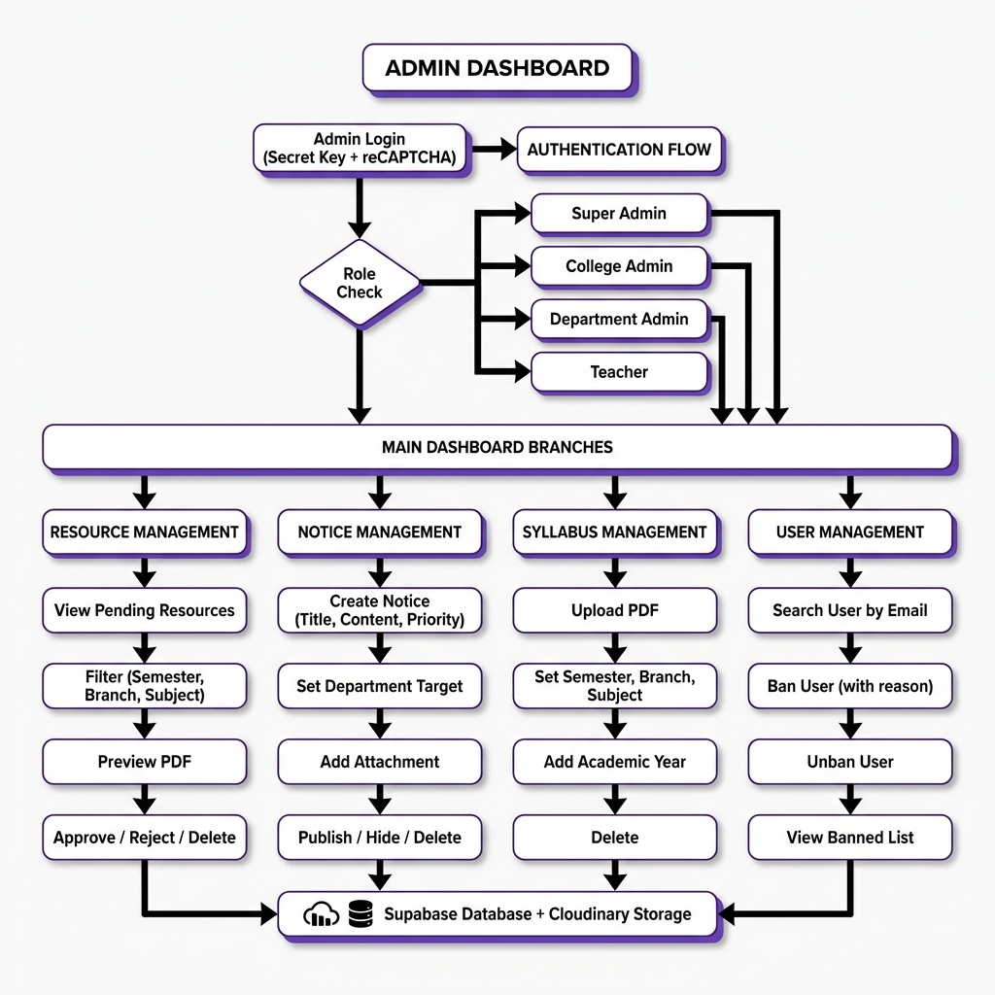
TECHNICAL APPROACH
4
Two Separate Web Applications:
🎓 MyStudySpace (Student Platform)
🛠️ Admin-MyStudySpace (Admin Dashboard)
• React 18 + Vite + TypeScript frontend
• Tailwind CSS + shadcn/ui components
• Firebase Auth (Google OAuth + Email)
• Hosted on Vercel
• Vanilla HTML/CSS/JavaScript
• Glass morphism UI, Dark/Light themes
• Role-based access control
• Hosted on Vercel
⚙️ Backend & Database
🔒 Security Layer
• Node.js + Express REST API
• Railway hosting (student credits)
• MongoDB Atlas (NoSQL database)
• DigitalOcean Spaces + CDN (file storage)
• Cloudflare Workers (edge functions)
• Cloudflare DNS + DDoS protection
• reCAPTCHA v3 for bot prevention
• Rate limiting + RBAC
High-Level Architecture Diagrams
@codeathon 26

Slide 5
PRODUCT SCOPE & FEATURES
5
📱 Student Platform (mystudyspace.me)
🛡️ Admin Dashboard
• Resource Library (Notes, PDFs, Videos, PYQs)
• Smart filtering by semester/branch/subject
• Upvote/Downvote voting system
• Bookmarking and Follow contributors
• Chat rooms with threaded comments
• College notices feed
• Real-time notifications
• Role-based access (Super/College/Dept Admin)
• Resource approval with PDF preview
• Notice management with priority levels
• Syllabus upload by semester/branch
• User ban/unban with audit trail
• Secret key authentication
What the Final Product Will Accomplish:
✓ Enable students from ANY college to access quality resources from ANY other college
✓ Provide institutions complete control over content via separate admin dashboard
✓ Reduce time students spend searching for materials from hours to minutes
✓ Build a sustainable peer-learning community through voting and contributions
@codeathon 26

Slide 6
FEASIBILITY ANALYSIS
6
🔧 Technical Feasibility
⚙️ Operational Feasibility
• Proven, well-documented stack (React, Node.js, MongoDB)
• Team has full-stack development experience
• Free tiers available: Railway, MongoDB Atlas, Vercel
• Cloudflare Workers for edge computing
• Separate admin dashboard for easy moderation
• No IT department needed — instant cloud setup
• Student-familiar design (voting, following)
• Mobile-responsive for on-the-go access
💰 Financial Feasibility
• Current development: ₹0/month using free tiers (Vercel Free, Railway student credits, MongoDB Atlas Free, Cloudflare Free)
• Sustainable B2B model: Colleges pay annual subscription, cost per student = ₹20-40/year — highly affordable
• Break-even projection: 18-20 colleges needed for profitability, achievable within 18 months
📅 Implementation Timeline
• Phase 1 (Month 1-2): KIET pilot with 500 early adopters — validate core features
• Phase 2 (Month 3-4): Full campus rollout — 3,000+ active users, gather feedback
• Phase 3 (Month 6+): Expand to other Delhi-NCR colleges based on learning
@codeathon 26

Slide 7
INNOVATION / DIFFERENTIATION
7
What makes our solution unique?
🌐 Multi-College Architecture
👥 Community-Driven Quality
Students access resources from IITs, NITs, and premier colleges — breaks down institutional barriers
Upvote/downvote system surfaces best content naturally — no admin bottleneck
♿ True Accessibility
🛠️ Separate Admin Dashboard
Democratizes quality education for Tier 2/3 college students who lack connections
Complete moderation control without cluttering the student experience
📱 Student-First Design
🤖 AI-Ready Roadmap
Built like apps students already use (Reddit voting, WhatsApp chat) — not enterprise software
Future: Practice sheet generation, smart exam questions from uploaded content
@codeathon 26

