Slide 1
MyStudySpace
Multi-College Academic Resource Platform Transforming Campus Collaboration Through Technology
Hackathon Submission | January 2026

Slide 2
The Problem: Academic Resource Chaos
• Study materials scattered across WhatsApp groups, Google Drive, and email chains
• No centralized platform for peer-to-peer learning and doubt resolution
• Previous year questions and quality notes lost when students graduate
• Students at different colleges have no access to resources from premier institutions
• Existing LMS solutions (Moodle, Canvas) are expensive (₹3-8 lakhs/year) and not collaboration-focused
• No mechanism for community validation — students can't distinguish quality content
Result: Hours wasted searching, unreliable materials, isolated learning.

Slide 3
Proposed Solution: MyStudySpace
• Centralized platform where students share notes, PDFs, videos, and PYQs
• Admin-approved content — all uploads reviewed before publishing
• Upvote/Downvote system — community surfaces the best content from seniors
• Multi-college architecture — students from any college can access resources
• Read-only access for non-college users — view content from premier colleges (IITs)
• B2B SaaS model — ₹60,000 to ₹2,50,000 per college annually
Mission: Democratize access to quality study materials across all colleges.

Slide 4
Platform Features
Core Features
Collaboration Features
• Resource Library — Notes, PDFs, Videos, PYQs
• Smart Filtering — Semester, Branch, Subject, Topic
• Community Voting — Upvote/Downvote System
• Admin Content Approval — Quality Control
• Bookmarking — Save for Quick Access
• Follow System — Follow Top Contributors
• Offline Access — Download resources
• Chat Rooms — Subject-wise discussions
• College Notices — Announcements Feed
• Threaded Comments — Reddit-style Replies
• Real-time Notifications — Stay Updated
• User Profiles — Track Contributions
• Study Timer — Pomodoro for Focus
• Mobile App — Android (In Development)

Slide 5
Market Opportunity
4,500+
3.5M+
₹360-450 Cr
100-120
Engineering Colleges in India
Engineering Students Annually
Total Addressable Market (TAM)
Colleges in Delhi-NCR
250,000
₹5.7B
25% CAGR
80-90%
Students in Delhi-NCR
Indian EdTech Market (2024)
Expected Growth to ₹30B by 2031
Cost Saving vs Canvas LMS

Slide 6
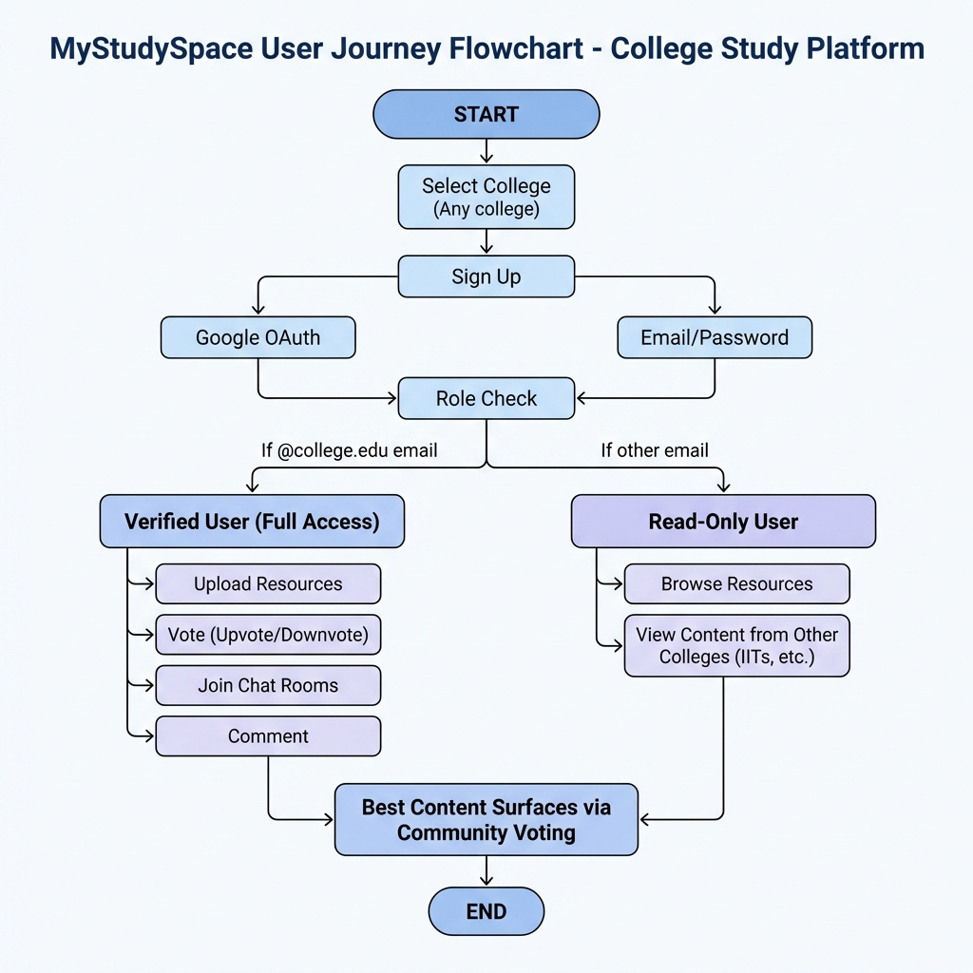
User Journey Flow
Multi-college support | Google OAuth + Email/Password | Verified vs Read-Only access

Slide 7
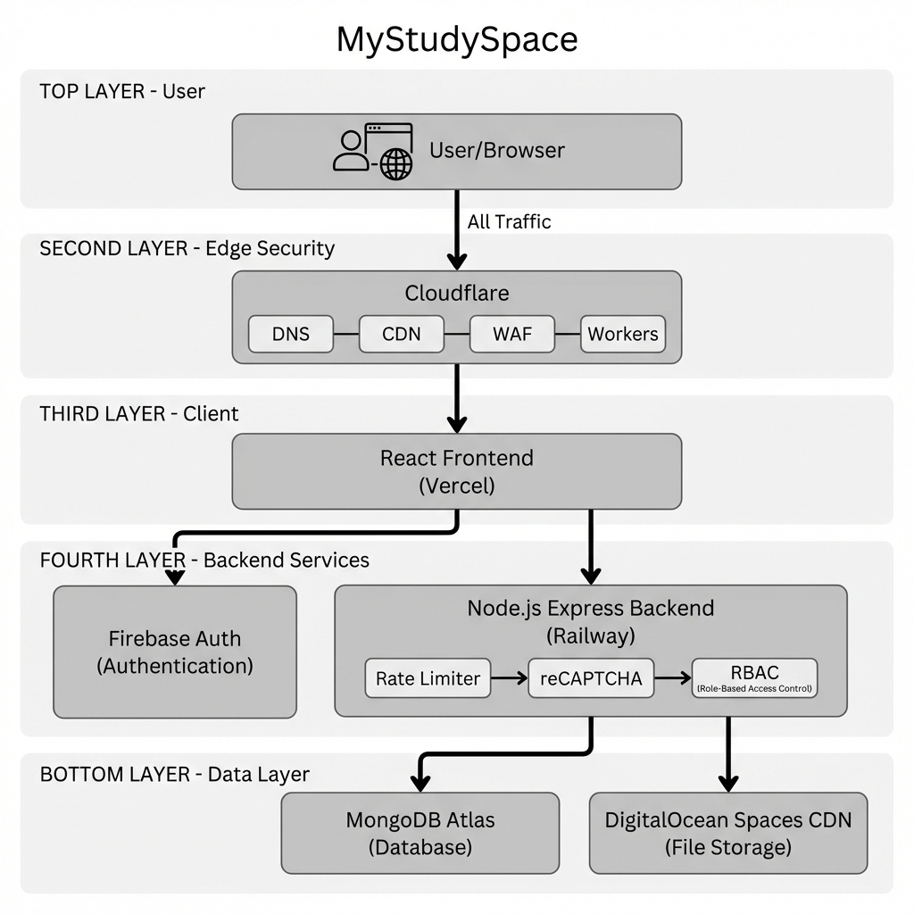
Technical Architecture
Cloudflare (CDN + WAF + Workers) → React Frontend → Node.js Backend → MongoDB Atlas + DigitalOcean Spaces

Slide 8
Technology Stack
Frontend
Backend & Infrastructure
• React 18 + Vite — Modern SPA Framework
• TypeScript — Type-safe Development
• Tailwind CSS + shadcn/ui — UI Components
• React Query — Server State Management
• Firebase Auth — Google OAuth + Email/Password
• Vercel — Frontend Hosting
• Node.js + Express — REST API Server
• Railway — Backend Hosting (Student Credits)
• MongoDB Atlas — NoSQL Database
• DigitalOcean Spaces — File Storage + CDN
• Cloudflare — DNS, CDN, WAF, Workers
• Firebase FCM — Push Notifications

Slide 9
Security Architecture
• Cloudflare — DNS, CDN, DDoS protection, WAF, Workers for edge logic
• Firebase JWT Authentication — Server-side token validation
• Role-Based Access Control (RBAC) — Admin, Verified, Read-only roles
• Rate Limiting — Sliding window algorithm per IP
• reCAPTCHA v3 — Bot prevention on critical actions
• CORS Whitelist — Only allowed origins accepted
• Input Validation — XSS and injection prevention
All traffic passes through Cloudflare edge before reaching origin servers.

Slide 10
Admin Dashboard (Separate Website)
• Separate web application for administrators at admin.mystudyspace.me
• Role-Based Access: Super Admin, College Admin, Department Admin, Teacher
• Secret Key Login with SHA-256 hashing + reCAPTCHA v3 protection
• 24-hour session duration with automatic expiration
• Glass Morphism UI with Dark/Light theme toggle
• Fully responsive: Desktop sidebar + Mobile bottom navigation
Deployed on Vercel | Built with vanilla HTML/CSS/JS + Supabase + Cloudinary

Slide 11
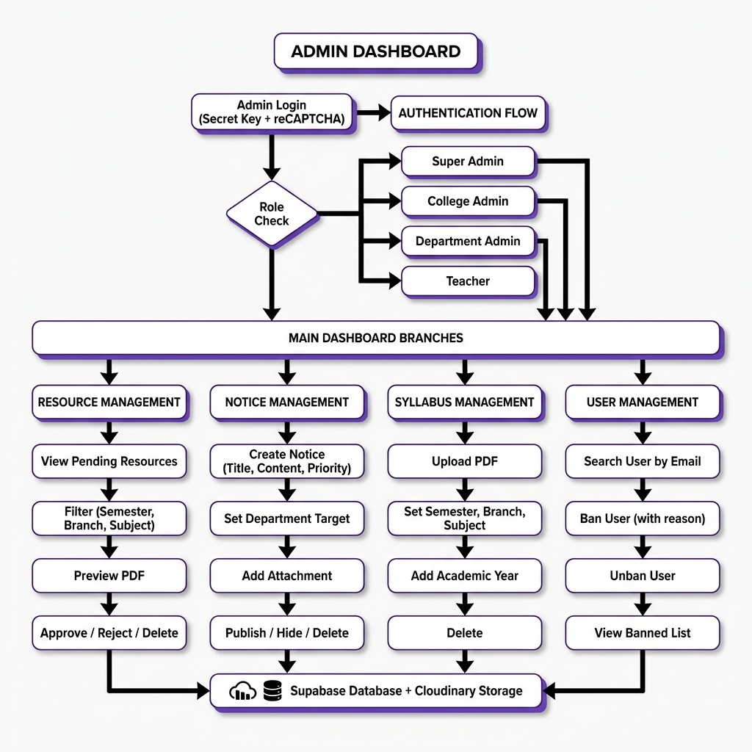
Admin Dashboard User Flow
Authentication → Role Check → 4 Management Modules → Supabase Database + Cloudinary Storage

Slide 12
Admin Dashboard Features
Content Moderation
Administrative Actions
• Resource Management:
• - View pending/approved/rejected stats
• - Filter by semester, branch, subject
• - Preview PDFs before approval
• - Approve, Reject, or Delete resources
• Notice Management:
• - Create notices with priority levels
• - Target specific departments
• - Attach PDFs or video URLs
• - Show/Hide/Delete notices
• Syllabus Management:
• - Upload PDF syllabi
• - Set semester, branch, subject
• - Add academic year tagging
• - Delete outdated syllabi
• User Management:
• - Ban users by email with reason
• - College-specific or global bans
• - Unban previously banned users
• - View banned users list with audit trail

Slide 13
Infrastructure Costing (Actual from Business Plan)
Scale | Colleges | Active Users | Monthly Cost | Cost/MAU
Current (Dev) | 0 | 500 | ₹0 | Free tier
Single College | 1 | 3,000 | ₹8,475 | ₹2.83
Growth Phase | 10 | 21,000 | ₹32,900 | ₹1.57
Enterprise | 50 | 100,000 | ₹1,25,000 | ₹1.25
Cost per user decreases significantly with scale. Infrastructure includes Railway, MongoDB Atlas, DigitalOcean, Cloudflare, Firebase.

Slide 14
Infrastructure Cost Breakdown (10 Colleges)
Service | Plan | Monthly Cost
Supabase/MongoDB | Pro Plan | ₹3,500
Railway Backend | Starter (2 instances) | ₹6,000
DigitalOcean Spaces | Plus Plan | ₹8,500
Firebase Auth | Blaze | ₹4,500
Cloudflare | Business | ₹3,200
Redis Cache | Upstash Pro | ₹2,000
Monitoring | Datadog/Sentry | ₹2,500
Backups | S3 | ₹1,500
Total: ₹32,900/month for 10 colleges (21,000 MAU)

Slide 15
Revenue Projections (3-Year)
Year | Colleges | Students | MAU | Revenue | Cost | Margin
Year 1 | 10 | 35,000 | 21,000 | ₹12.50 L | ₹26.28 L | -110%
Year 2 | 30 | 105,000 | 63,000 | ₹37.50 L | ₹36.95 L | 1%
Year 3 | 70 | 245,000 | 147,000 | ₹87.50 L | ₹57.95 L | 34%
Break-even at 18-20 colleges (Month 15-18). Each additional college after = 70%+ profit margin.

Slide 16
Business Model: B2B SaaS
Pricing Tiers
Unit Economics
• Annual subscription sold directly to colleges
• Starter: ₹60,000/year (<2,000 students)
• Growth: ₹1,00,000/year (2,000-5,000 students)
• Professional: ₹1,50,000/year (5,000-10,000)
• Enterprise: ₹2,00,000+/year (>10,000 students)
• AI Premium Add-on: ₹15,000-₹50,000/year
• Per-student cost: ₹20-40/year
• 80-90% cheaper than Canvas LMS
• 60-90 day sales cycle
• 85% annual renewal rate
• LTV:CAC ratio = 5:1
• Break-even: 18-20 colleges

Slide 17
Future Roadmap: AI Integration
• 🤖 AI Practice Sheet Generator — Create custom problems from uploaded content
• 📝 AI Exam Question Bank — Generate exam-style questions based on syllabus
• 📅 Academic Calendar Sync — Auto-import exam dates, events into calendar
• 📊 AI Study Schedule — Personalized study plans based on deadlines
• 💡 Intelligent Doubt Resolution — AI answers using college knowledge base
AI Premium Add-on: 30% of colleges expected to opt-in.

Slide 18
Go-to-Market Strategy
• Phase 1 (Month 1-2): KIET Pilot — 500 early adopters, test features, gather feedback
• Phase 2 (Month 3-4): Full Campus Rollout — 3,000+ active users, faculty partnerships
• Phase 3 (Month 6): Delhi-NCR Expansion — 3-5 paying colleges, 10,000 users
• Phase 4 (Month 12): Break-even Approach — 10 colleges, 25,000 users
• Phase 5 (Month 18): Profitability — 20 colleges, 50,000 users
• Phase 6 (Month 24): Scale Phase — 30-40 colleges, 80,000 users
Target Decision Makers: Dean of Student Welfare, Dean Academics, Principal

Slide 19
Thank You!
MyStudySpace — Transforming Campus Collaboration
Team MyStudySpace

