Slide 1
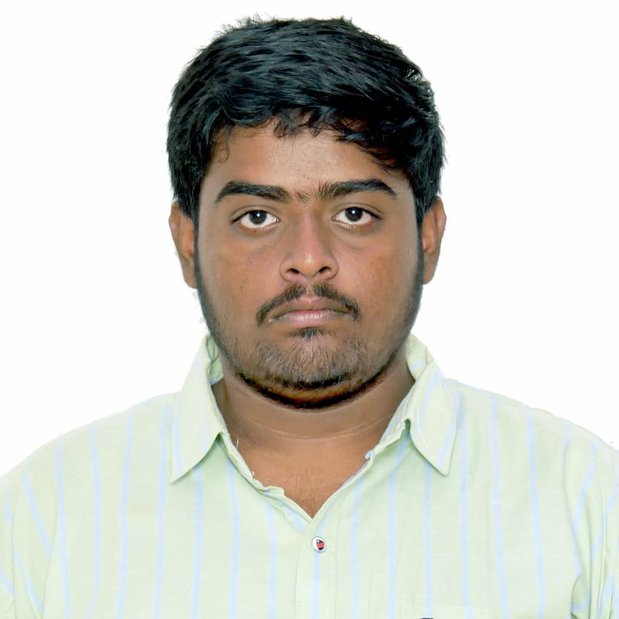



Manepalli Hanuma Harshit
Bachelor of technology
Electronics and communication : 2018 - 2022
Analyst/Software Engineer
Skills
Java 8 /J2EE | Java Basics, OOPS, Generics, Collections, Arrays, Loops, Lambda Exp, Stream API Junit, Mockito, Servlets
Spring core | IOC & Dependency Injection, autowire
Spring REST | REST controllers, Implementation of GET, POST, PUT & DELETE, Bean Validation & Exception Handling, Testing Services, Controller & Repository layer
Spring Data JPA | Implement DAO layer using spring Data repositories.
Spring Boot Microservices | Spring Boot Starters, annotations, Messaging Service, Sync/Async comms, Swagger API documents
Spring Cloud | Eureka, Feign Client, Netflix Hystrix, Netflix Zuul & Config Server
React | Components, Hooks, Event handling, Redux.
Database | MongoDB No SQL , PostgreSQL
UI Tech | HTML 5 & CSS 3,JavaScript, ES6 & TypeScript Reusable templates
Tools | Git, Postman , Eclipse IDE , Visual Studio
Add On skills | Good in Communications, Peer learning , hard working
Bangalore
manepalli-hanuma.harshit@capgemini.com
+91 63010164654
A4
Full Stack Developer
Hands on experience in creating microservices with Spring Boot, Spring Security, Spring Cloud API Gateway, Eureka server, hystrix , load balancing, Feign client.
Good in creating Web Applications using React.
Has working knowledge on react JS with react hooks, reactive forms, Routing , Redux.
Experience in creating documentation with Java docs and swagger and in unit testing using Junit, Mockito .
Development experience using Eclipse , IntelliJ ,Visual Studio , postman
E-Commerce Shopping Cart Application
Completed end to end case study of Shopping Cart Application in monolithic architecture along with Swagger and PostgreSQL for database responsive UI with CSS and React used for user interface.
Online Hotel Management System
Completed end to end case Study of an online hotel management system along with JWT Authentication, API Gateway, Swagger and used MongoDB for database and created responsive UI using React for user interface
Check out my work on GitHub & Video Profile

