Slide 1


Department of Computer Science and Engineering
Graphic Era (Deemed to be University)
MINI PROJECT
BANKING SOFTWARE
Under the Mentorship of
Dr. Rishi Kumar
Assistant Professor
Presented By: Harshit Toky
Semester III (Bachelor of Technology)
Section: IoT
Class roll: 24
University roll: 2021954
Session 2023-2024

Slide 2

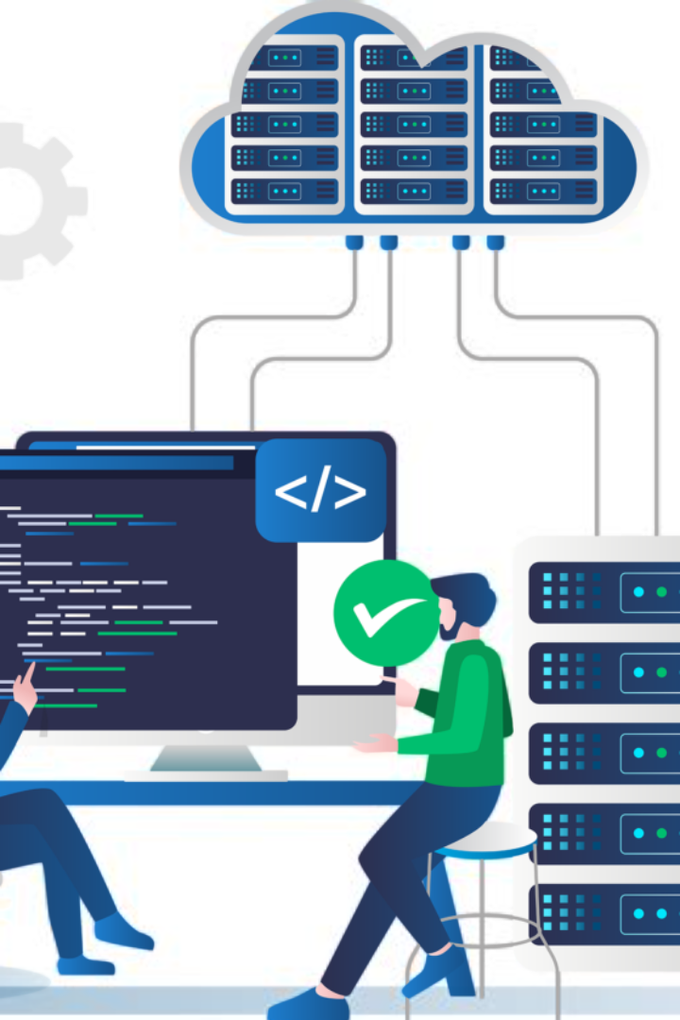
Banking Software
Banking Software is an enterprise software that is used by the banking industry to provide the financial services they provide to there customers like opening account,withdrawl money.

Slide 3

Purpose of Project
1
Efficiency
Banking Software increases the efficiency by reducing manual efforts and automate routine tasks .
2
Customer Service
It provides the easy interaction between the customer and bank , customer can prevail many services like deposit and withdraw money, apply for loan and many more.
3
Scalability
It helps for the seamless growth of Bank Operations to accomodate the increasing number of bank customers .

Slide 4
Why This Project
1
Software
I want to learn more about the software applications how they work in the industry and how Backend and UI Design is done in various softwares.
2
Helpful for Resume Building
Banking Project can be a very good option that you can add it your resume .
.

Slide 5
Key Features
Customer Transactions
Loan Services
Customer can use various bank services like deposit and withdraw money, Balance Enquiry , Monthly Statement.
Customer and Employee both can take benefits of the software to apply and manage loan.
Employee Services
Monthly Interest
The Employee can easily see all customers info and can also approve loans for the better management of Bank.
Software automatically calculates the monthly interest for its users.

Slide 6
Software Used
1
Netbeans
Apache NetBeans IDE -17 is used which is an IDE (Integrating Development Environment ) .
2
JDK 17
The JDK is a development environment for building applications using the Java programming language.
3
My SQL Workbench
MySQL Workbench delivers visual tools for creating, executing, and optimizing SQL queries..

Slide 7
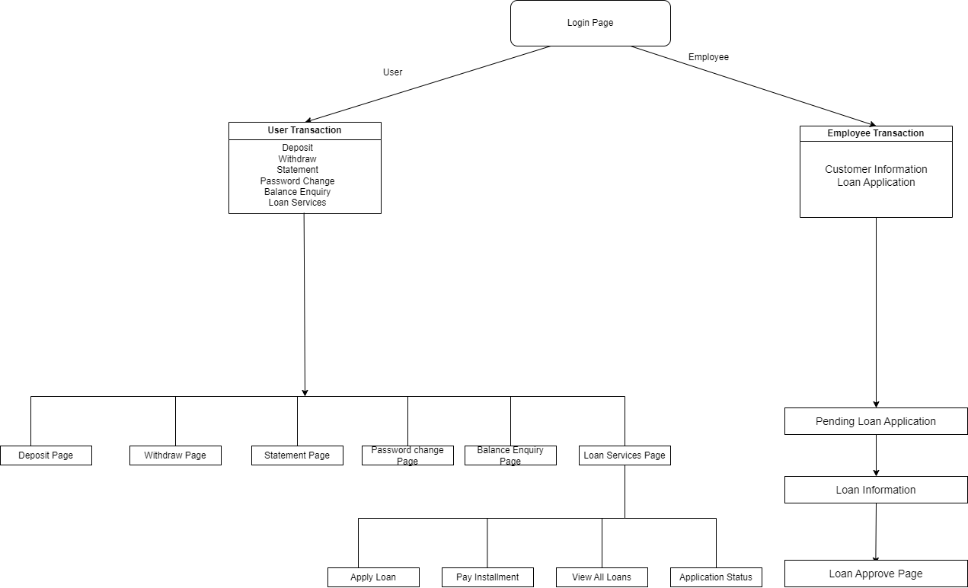
Project Flowchart

Slide 8
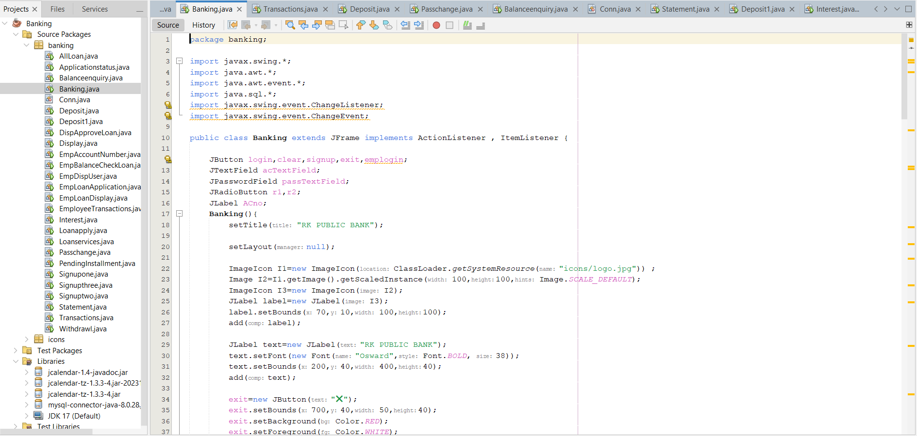
Code Snippet

Slide 9
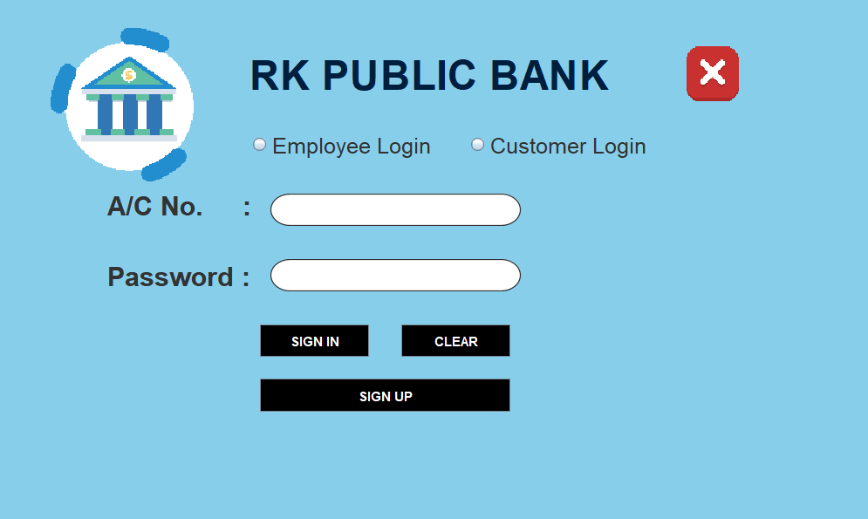
User Interface Design
LOGIN PAGE

Slide 10
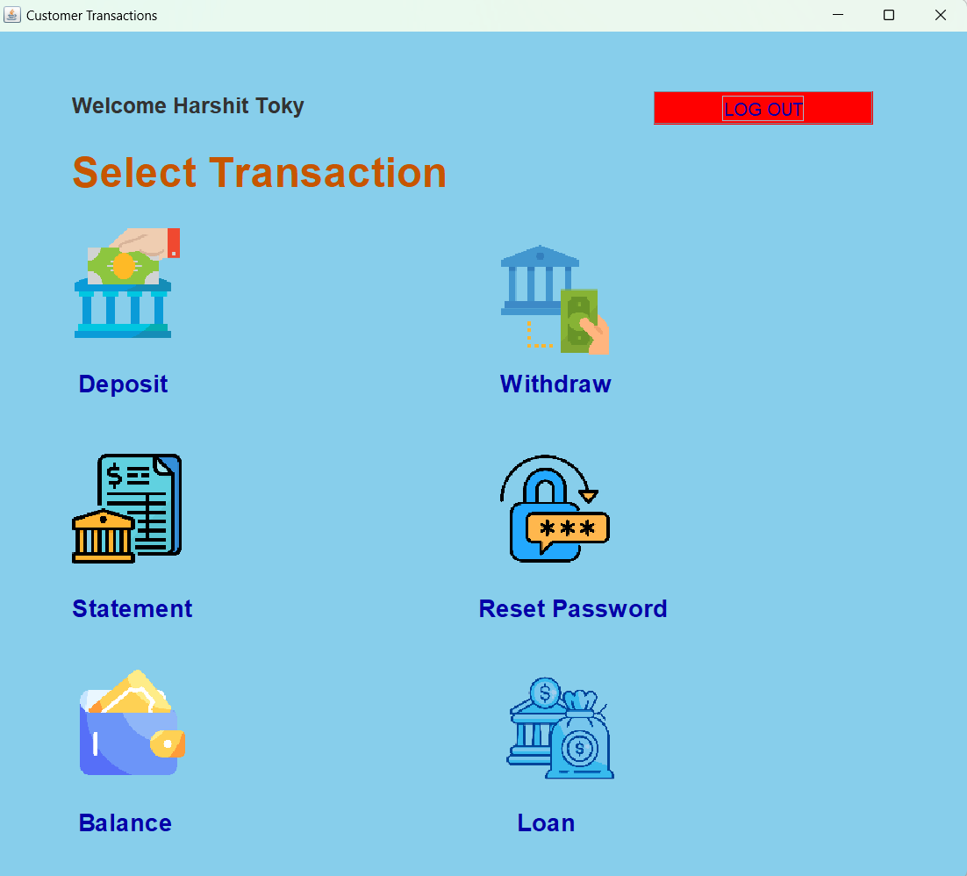
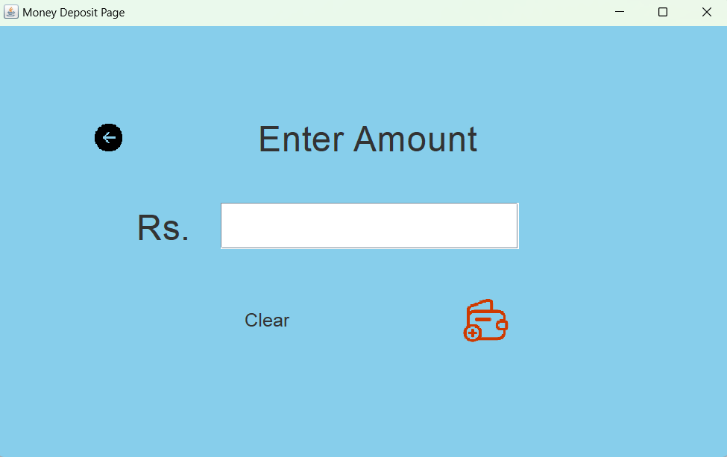
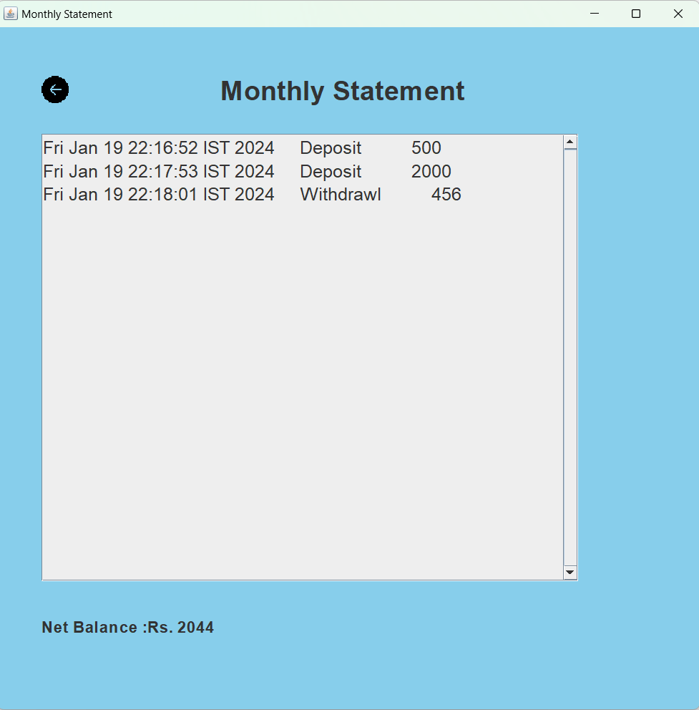
User Interface Design
Customer transactions
Deposit Page
Statement Page

Slide 11
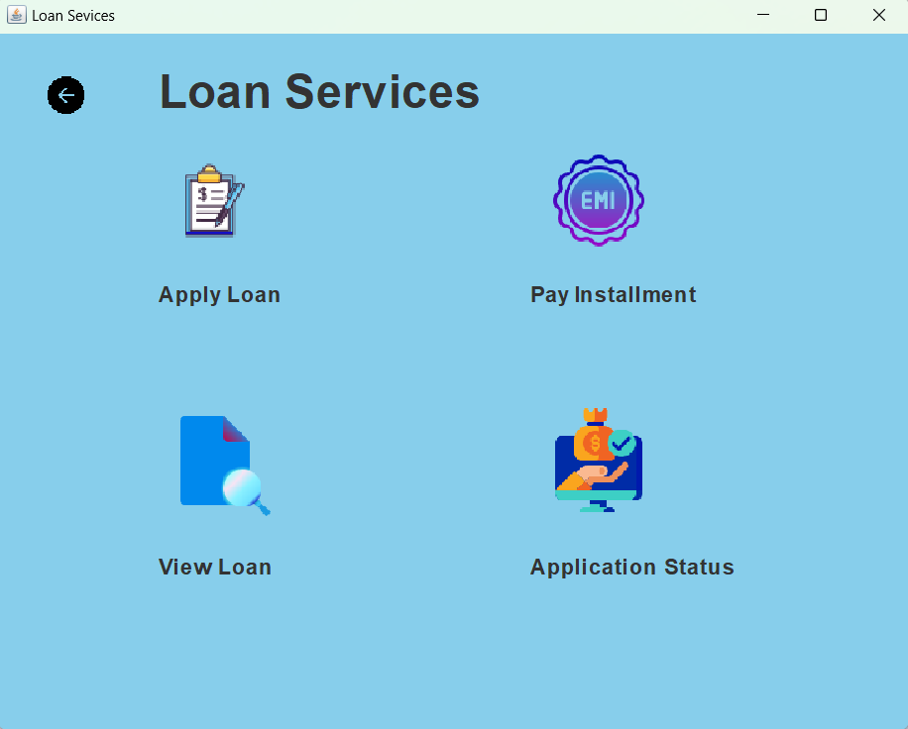
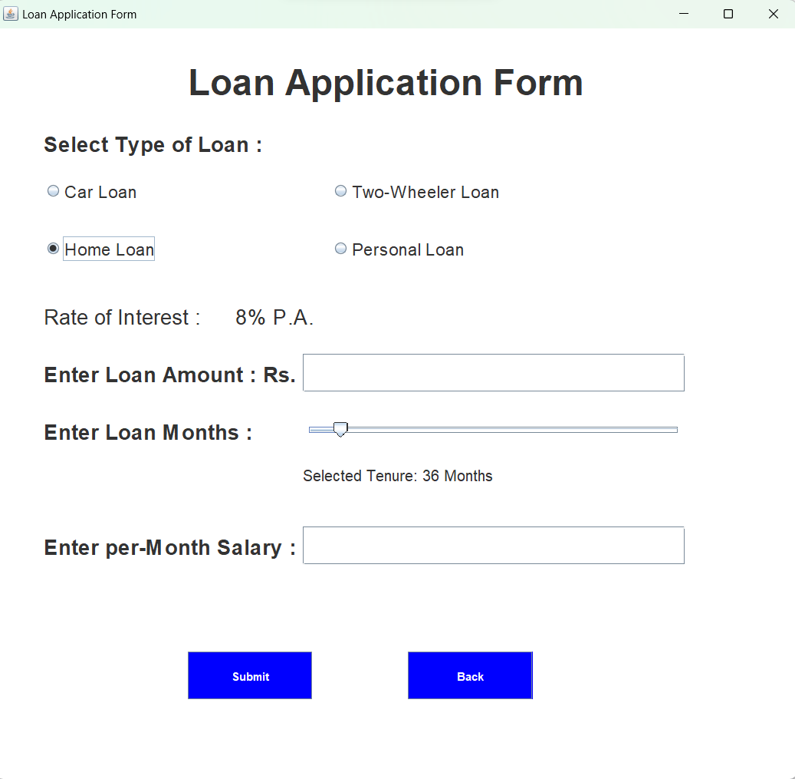
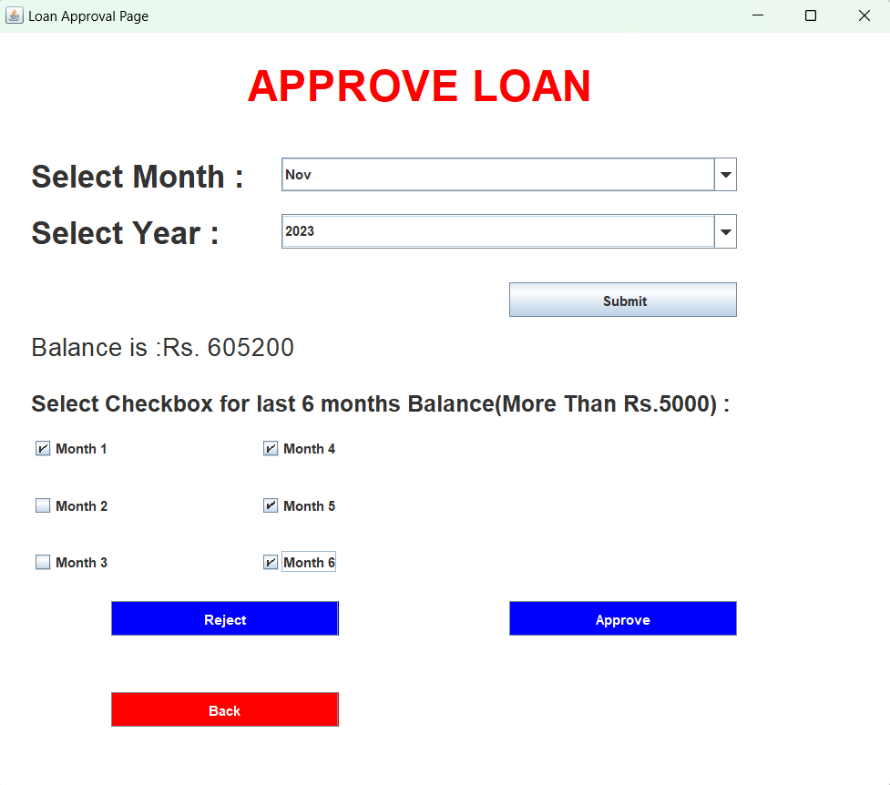
User Interface Design
Loan Services
Loan Application Form
Loan Approve Page

Slide 12
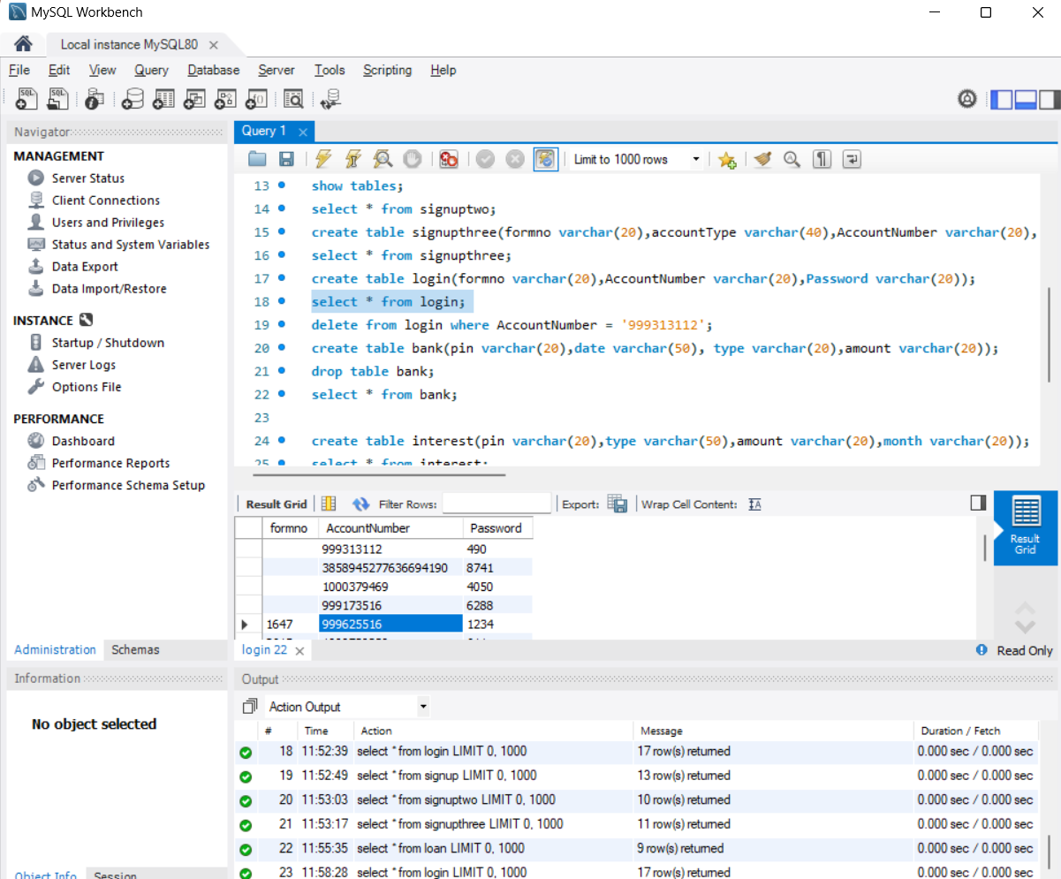
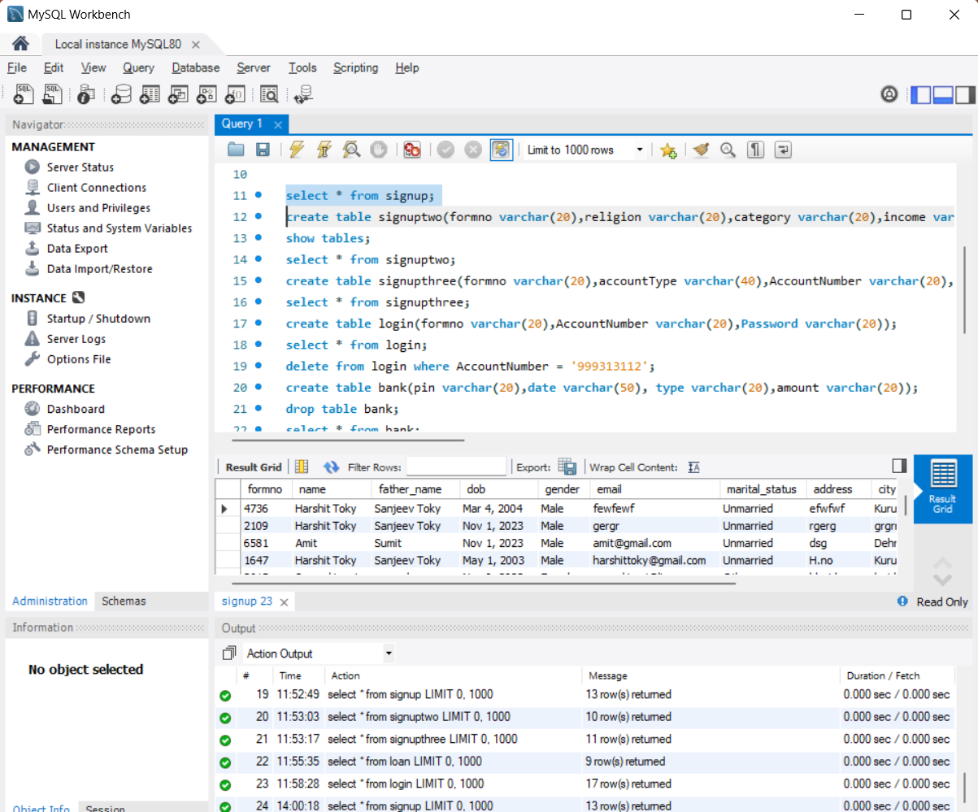
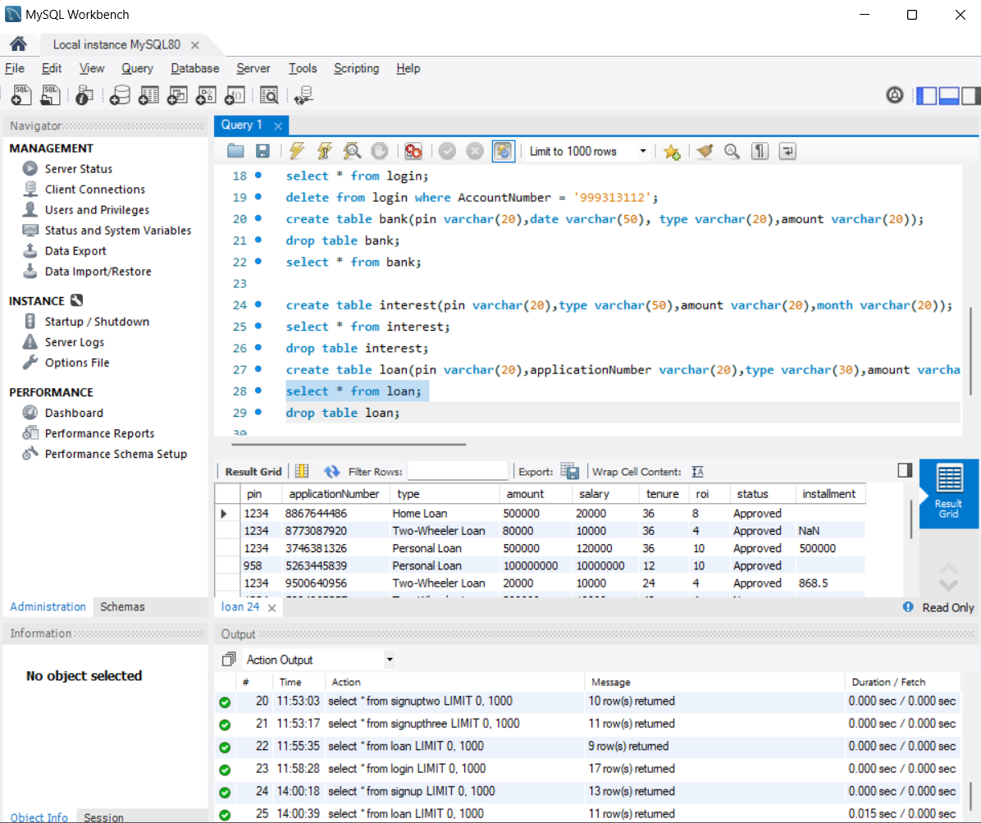
DATABASE TABLE
Login Table
Signup Table
Loan Table

Slide 13

Technology Stack Used
1
Front-end Development
2
Back-end Development
3
Database Management
Java Swing is a user interface toolkit that enables the creation of graphical user interfaces (GUIs) for Java applications.
Java is a powerful and versatile programming language often chosen for backend development in projects.
SQL (Structured Query Language) is a standard language for managing and manipulating relational databases.

Slide 14

Conclusion
In summary, the banking software project aims to provide innovative solutions, streamline operations, and enhance customer satisfaction. With its key features, user-centered design, and comprehensive technology stack, it promises to revolutionize the banking industry.

Slide 15
THANK YOU

