Slide 1
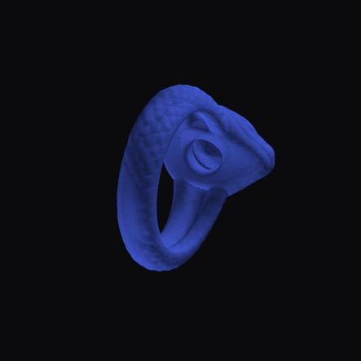
MISSION SPECTRE
Rust-backed jewelry mesh-manipulation platform
POC validation on the snake ring — the hard case, not a donut
16 algorithms shown on the snake 769 Rust tests passing
Prepared for co-founder review · 2026-06-14

Slide 2
WHAT IT IS
A complete geometry engine for jewelry CAD
Mission Spectre turns raw 3D scans and CAD meshes into manufacturable jewelry — decimate, hollow, scoop, resize to ring size, offset, boolean, repair, voxel-remesh — with the heavy geometry done by in-house Rust kernels and a MeshLib-style 3D workbench UI.
Next.js + MeshLib WASM workbench
3D viewer, ribbon commands, brushes
▼
FastAPI service
versioned mesh pipeline, jobs, artifacts
▼
geometry_sdk (Python facade)
thin pass-through — no geometry logic
▼
zennah-geometry Rust kernels (PyO3)
QEM, voxel/SDF, exact-boolean, ICP…

Slide 3
THE CLAIM
Production-grade algorithm core, validated end-to-end
25
100%
769
~13,000×
mesh algorithms verified
with before / after
geometry kernels
Rust-backed
Rust correctness
tests passing
decimate speed-up
from the rewrite
Every result was dispatched through the live workbench backend endpoint and inspected for watertightness, volume and surface quality — not unit tests alone.

Slide 4
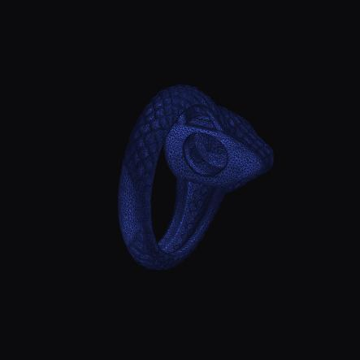

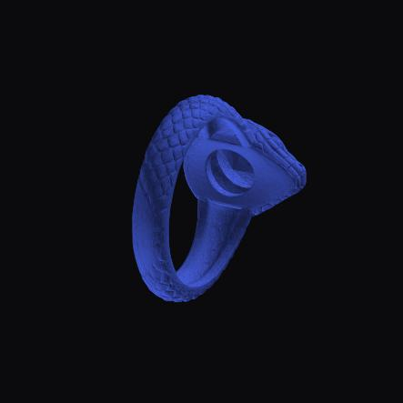


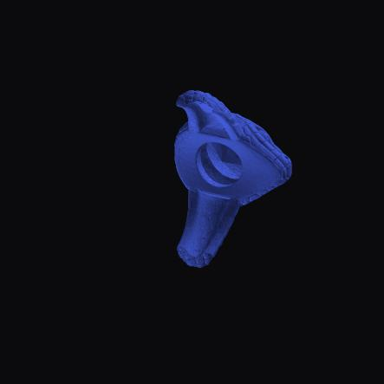
THE PROOF
Before → after on the snake ring (the hard case)
before after
before after
before after
before after
Decimate
Protected Hollow
Thicken
Boolean cut
994k → 20k faces (−98%), curved surface intact
Interior cavity, welded watertight
+86% material to minimum thickness
Snake − box, exact volumetric split
Full set of 16 snake before/after pairs + per-algorithm metrics → Mission-Spectre-Algorithm-Validation.xlsx

Slide 5
COVERAGE
Every UI command, every geometry family
1
Mesh editing
2
Hollowing
3
Offset family
4
Boolean
Decimate · Subdivide · Make-Delone · Smooth
Protected hollow · drain holes · adaptive-to-weight
Offset-verts/mesh · shell · weighted shell · expand/shrink · thicken
Exact (∪ − ∩) · voxel boolean
5
Voxel → mesh
6
Jewelry
7
Point cloud
8
Analysis / data
Simple · dual · smart · mask-to-mesh
Resize to ring size · scoop · make-manufacturable
Triangulation · pairwise & multiway ICP
Measure+features · distance maps · lines · g-code · slices

Slide 6
PERFORMANCE
Quadratic kernels rebuilt to near-linear
Decimate
Subdivide
Voxel → mesh (dual)
~13,000×
~1,500×
~1,000×
in-place collapse + lazy heap
227 s → 0.15 s
46 s → 0.05 s
bit-exact, manifold-safe
incremental adjacency
reuse ray BVH per pass
All speed-ups verified bit-identical to the reference output — faster, not approximate.

Slide 7
QUALITY & RECENT WORK
Correctness fixes + newly-migrated algorithms
Correctness hardening
Recent Rust migrations (validated)
Watertight hollow & thicken
Feature fitting
new Rust weld pass closes voxel pinch points (bnd → 0)
plane/sphere/cylinder… snaps to exact surface
Accurate ring sizing
Point-cloud triangulation
robust bore percentile — hollow rings no longer read oversize
points → watertight mesh, now UI-wired
Manifold-safe decimation
Multiway ICP registration
MeshLib-faithful collapse guard at any reduction
N clouds aligned to ≈0 mm residual
Closure / fold guards
Object-lines & G-code
offset, shell, resize refuse non-manufacturable output
contour/spline + toolpath I/O in Rust

Slide 8
POC complete — the algorithm core is real and proven
Not a prototype with stubs: every exposed operation runs in Rust, is reachable from the workbench, and produces inspected, manufacturable geometry.
Shipped & verified
Honest open items (tracked)
16 algorithms shown on the snake ring (before/after)
All Rust-backed; 769 tests green
Guards correctly protect the sub-mm snake tube
Excel proof + coverage matrix delivered
Exact-boolean ∪/− mesh-parity (volumes exact; voxel-boolean watertight today)
Section-slice in-viewer rendering
Broader official-product feature parity
Mission Spectre · POC validation · deliverables: Excel workbook + coverage matrix + before/after image set

