Slide 1
American Express Campus Analyze This 2015
Submission Deck - TEMPLATE

Slide 2
Team Details
Team Name : Dunjen_master
Name | Campus | Roll No. | Mobile No. | Email Id
Sidharth Sindhra | IIT Kharagpur | 12MT30031 | 7797391928 | Sidharth.sindhra@gmail.com
Harshit | IIT Kharagpur | 12AR10020 | 9126140688 | harshit158@gmail.com

Slide 3
Equation to Identify Citizen’s Vote
Please provide the final equation used to identify the citizen’s vote
Final result = stacking ( stacking (classification (above mentioned features)))

Slide 4
Details of each Variable used in the Equation
Please provide details of each variable used in the equation to identify citizen’s vote
Previous party votes
Donations for each party
Social shares for each party
Household size
Age
Ownership
Number of unique parties
Rallies attended for each party
Total rally visits
Income
Summation of Donations to all parties by a citizen
Summation of Social shares to all parties by a citizen

Slide 5
Estimation Technique Used
Please provide the estimation/modeling technique(s) used to arrive at the solution/equation
The following techniques were used in the written order to predict the final vote :
Classification :
The following classification algorithms were used independently at the initial stage :
1. Random Forest
2. Extra Tree classifier
3. Gradient Tree Classifier
4. Adaboost
5. Logistic Regression
Ensembling :
Each classifier predicted the probabilities for each party of being the right vote.
These predictions for parties by individual classifiers are collectively used to predict the
final vote by feeding these probabilties to a separate classifier.

Slide 6
Stacking ( first layer )
The total probabilities predicted by the classifiers are used as features by the stacker (classiffier ):
Total features ( probabilties) for the stacker classifier
= 5 (for each party) * 5 (for each classifier )= 25
These features are used by stacker to generated the second stage prediction of vote along with the probabilties of each party.
4. Stacking (second layer)
Each stacker is like a single classifier and same process is repeated as was from stage 1 to stage 2
Total four stackers were used with different combinations of base classifiers . The combinations are as follows :

Slide 7
Combination 1
1.Extra Trees classifier
2.Adaboost
3.Gradient Boost
Combination 2 :
1.Extra Tree classifier
2.Logistic
3.Gradient Boost
Combination 3 :
1.Random Forest
2.Adaboost
3.Logistic Regression
Combination 4:
1.Random Forest
2. Adaboost
3. Gradient Boost

Slide 8
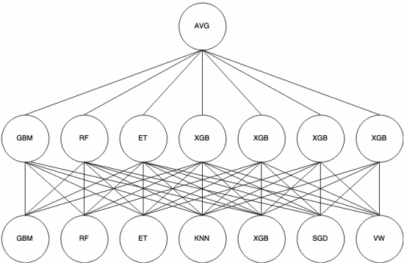
This is the schematic presentation of technique we followed

Slide 9
Reasons for Technique(s) Used
Why do you think this is the best technique(s) for this particular problem?
Following features were highly skewed :
Occupation
Region
Income
Principal Component Analysis was performed to visualise the data in 3 dimensions. But the maximum variance retained was 26 % in one of the dimensions.
As an observation, the plot was not linearly separable, therefore non – linearty had to be introduced. For this , logistic regression was used so that the data is transformed to a linearly separable form

Slide 10
Final Submission File
Please embed your final submission file (.csv) here.

