Slide 1
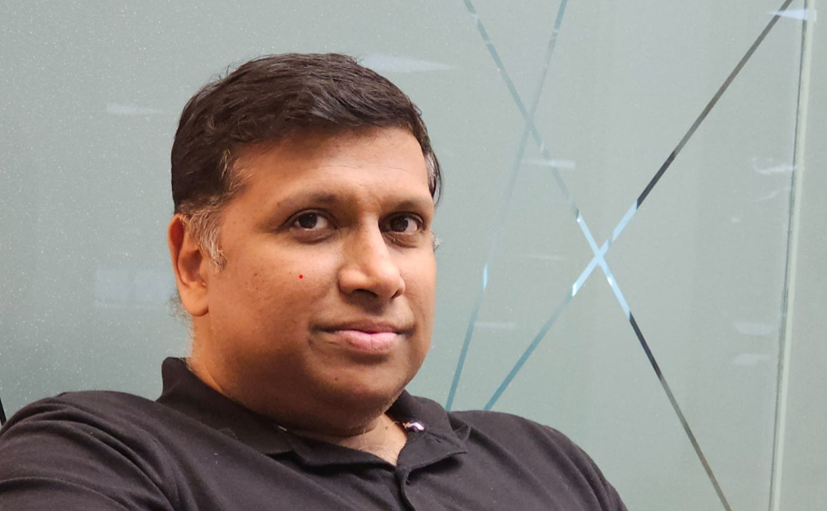
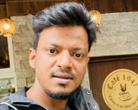
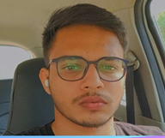

Backed by a strong team with diverse backgrounds
Ashish Garg | Jitin Doriya | Shivam Uttam
Co founder & CEO | 24+ years of expertise in enterprise software development, global team management, and strategic leadership. Formerly at Oracle, Emerson, and QiO Technologies, driving growth and innovation. | Co Founder/CTO with a unique blend of technical expertise (AI/ML, cloud, AWS) and entrepreneurial spirit. IIT-BHU grad (2012) with 12+ years of software development experience Previous companies: CTO( Chikitsa), Engineering Manager (Peak AI) | Co founder & Full-Stack Expert | Driving Quibble AI's tech vision. Background in Computer Science, business development, and project management. Skilled in Nodejs, ReactJs, WebSocket, Open AI, and Prompt Engineering.
LinkedIn | LinkedIn | LinkedIn
Quibble AI

