Slide 1

E-PHARMACY
SESSION
2022-2023
BY-
Harshit Sharma(2210991640)
Harshita Ahuja(2210991643)
Teacher In Charge-
Ms. Soni Singh
Institute of engineering and technology
Department of computer science and engineering
Chitkara University Punjab

Slide 2
INTRODUCTION
● We have looked at the world around us changing rapidly and each
second being completely different than the other.
● With highly indulgence of technology in our lives , we came through a
way to introduce it to add to medical facilities.
● This project is called E-PHARMACY owing to its usage in providing
accurate medical prescription.

Slide 3
PROBLEM STATEMENT
● It is very tedious to plan a visit to the doctor, take an
appointment, stand in long queues in order to avail medical
facility for even smallest of the symptoms.
● It leads to wastage of one’s time, money and other resources
resulting in inconveniences.
● So to make our lives easier, we made this E-PHARMACY
code which guides the patient about the medicine to be taken
based on his/her symptoms.

Slide 4

AIM AND OBJECTIVE
● To help getting the most important
and essential utility, i.e. medication
in way easier manner.
● Help conserving all the resources
involved otherwise; time, money,
energy by making life easier.

Slide 5
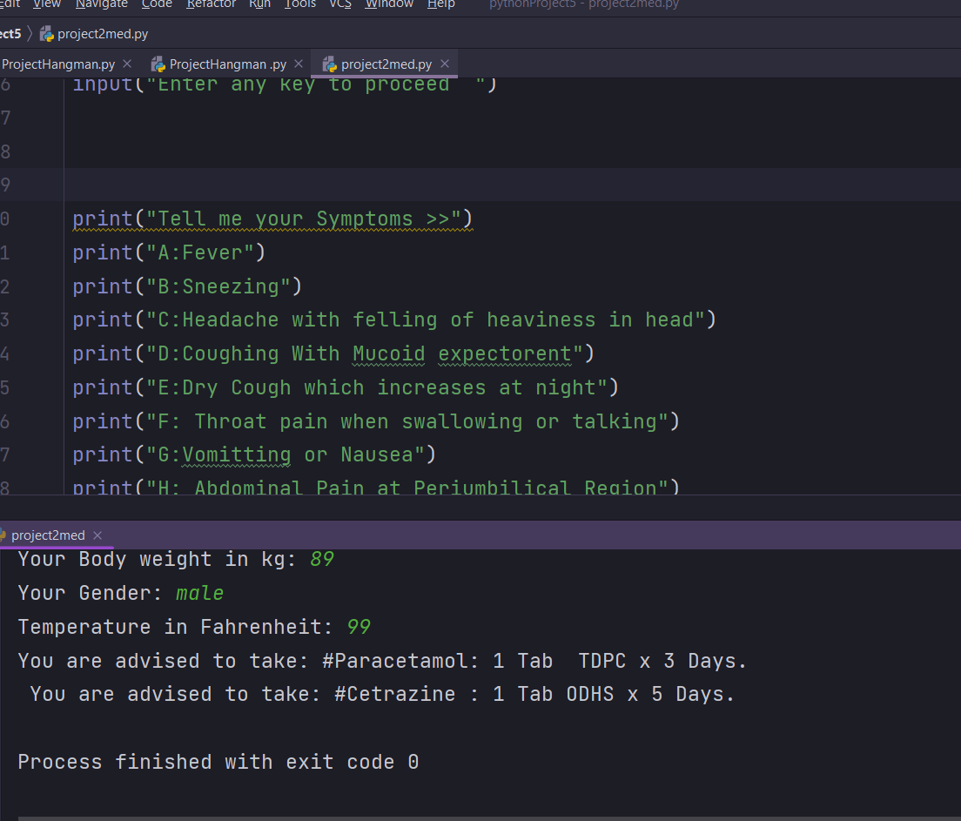
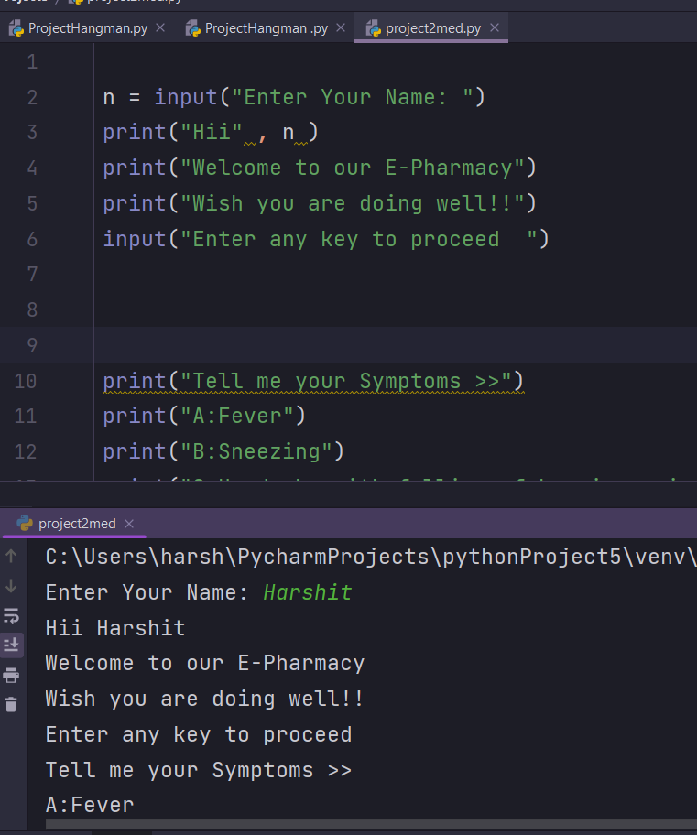
RESULTS AND ANALYSIS
● E-PHARMACY tool helps
to get the suitable
mediation just with the
help of the some clicks.

Slide 6

CONCLUSIONS
If used correctly it is a very useful and efficient program.
Easily made and accessed using python.
Time saving program.
High in necessity in today’s world of tech.
After further modifications , this program can be very efficiently used worldwide.

Slide 7

REFERENCE
Head-First Python by- Paul Barry
Learning with Python : How to think like a computer scientist by- Allen Downey
In guidance of MS. SONI SINGH

Slide 8
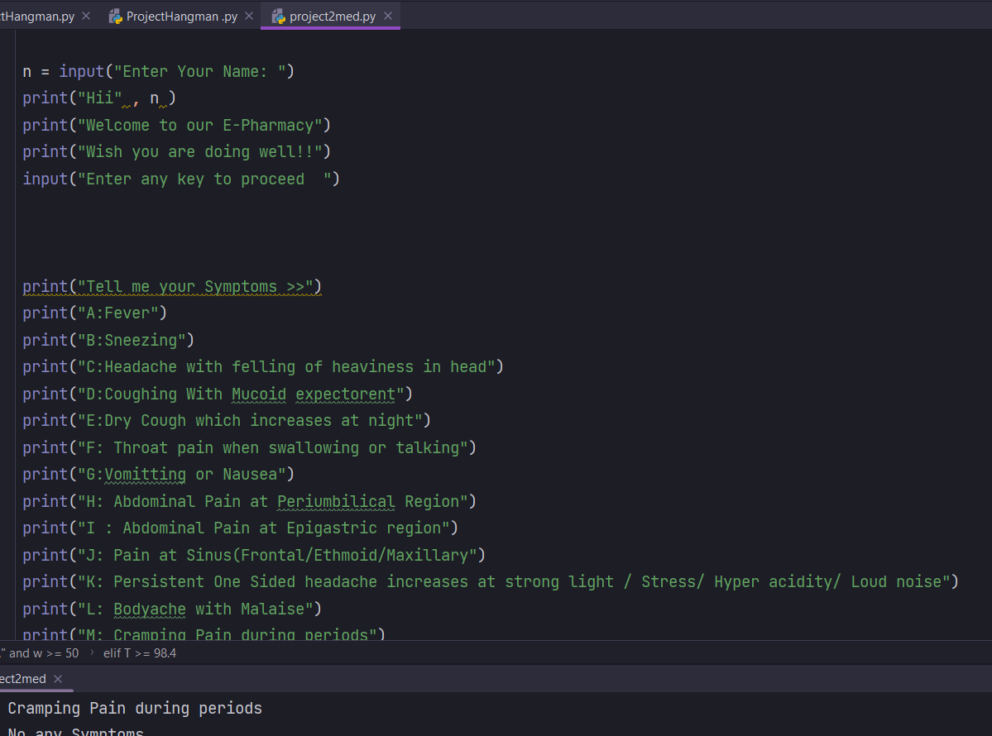
APPENDIX
When executed the code, the result is as follows -

Slide 9
THANK YOU!

