Slide 1
Front End Engineering-I Project
Team Details:
HARSHIT RANA 2210991639
HARSHIT SHARMA 2210991640
HARSHIT SHARMA 2210991641
HARSHITA 2210991642
Faculty Coordinator: MRS GARIMA CHOPRA
:
Chitkara University Institute of Engineering and Technology,
Chitkara University, Punjab

Slide 2
Table of Contents
Introduction
Problem Statement
Technical Details
Key Features
Project Highlights
Conclusion
References/Links used

Slide 3
Introduction
EXIT THE PLUGIN
Exit widgets are used to capture the attention of website visitors who are about to leave a website or close a tab. These widgets provide a last-ditch effort to retain the visitor's attention and prevent them from leaving the website. This project helped us to make an exit widget and a pop-up ad on our webite.
TEAM MEMBERS ::
HARSHIT RANA
HARSHIT SHARMA
HARSHIT SHARMA
HARSHITA

Slide 4
Problem Statement
Many users struggle to exit a specific web browser plugin, resulting in frustration and lost productivity.
This project aims to develop a user-friendly web interface that allows users to easily and efficiently exit the plugin, improving their overall browsing experience.
The project helps the user to leave the interface of the site and redirects the user to the google homepage .

Slide 5
Technical Details
Here are some technical details that you can consider for a project on social share buttons using HTML and CSS:
HTML and CSS Frameworks: We have used HTML and CSS frameworks to make the development process easier and more efficient.
Icon Fonts: We have used Google icon fonts to display more amazing icons and buttons. This will help to keep the file size small and make the icons look sharp on any screen resolution.
CSS Flexbox: We have used CSS flexbox to create a responsive layout for the social share buttons. This will allow the buttons to adjust to different screen sizes and device orientations.
Add Interactivity: HTML and CSS alone won’t make your webpage interactive. You’ll need to use JavaScript to add interactivity, such as showing and hiding fields based on user input or validating input fields to ensure they are filled out correctly.

Slide 6
Key Features
1. Customizable exit
2. No need to install heavy code editors
3. Cross-browser compatibility
4. Tracking options
5. Responsive design
6. Accessibility options
Overall, the key features are designed to make exiting webpages easy, convenient and hassle-free with customizable design, tracking options and many more features.
The exit popup should be triggered by a specific event, such as when the user moves their mouse towards the top of the browser window or attempts to close the browser tab.
The exit popup should be timed appropriately to avoid being too intrusive or annoying to the user.
The exit popup should include a clear way for the user to dismiss it or opt-out if they are not interested in engaging with it.

Slide 7
Project Highlights
Our project is online code editor. Basically, our vision is to resolve the problem of setting up an environment of programming languages on systems for developers. Many people use online code editors on a daily basis when they don’t have the resources to install the compilers on their personal computers, so this is a very helpful website in daily use. As the owner of the website, our job is to keep the user on the website as long as possible, so we use the idea of exit-intent-plugin.
It is basically a popup that appears on the webpage whenever the user tries to leave the website and the popup tries to keep them on the webpage longer through motivational language and other exciting challenges.
Here are some screenshots of the webpage while working:

Slide 8
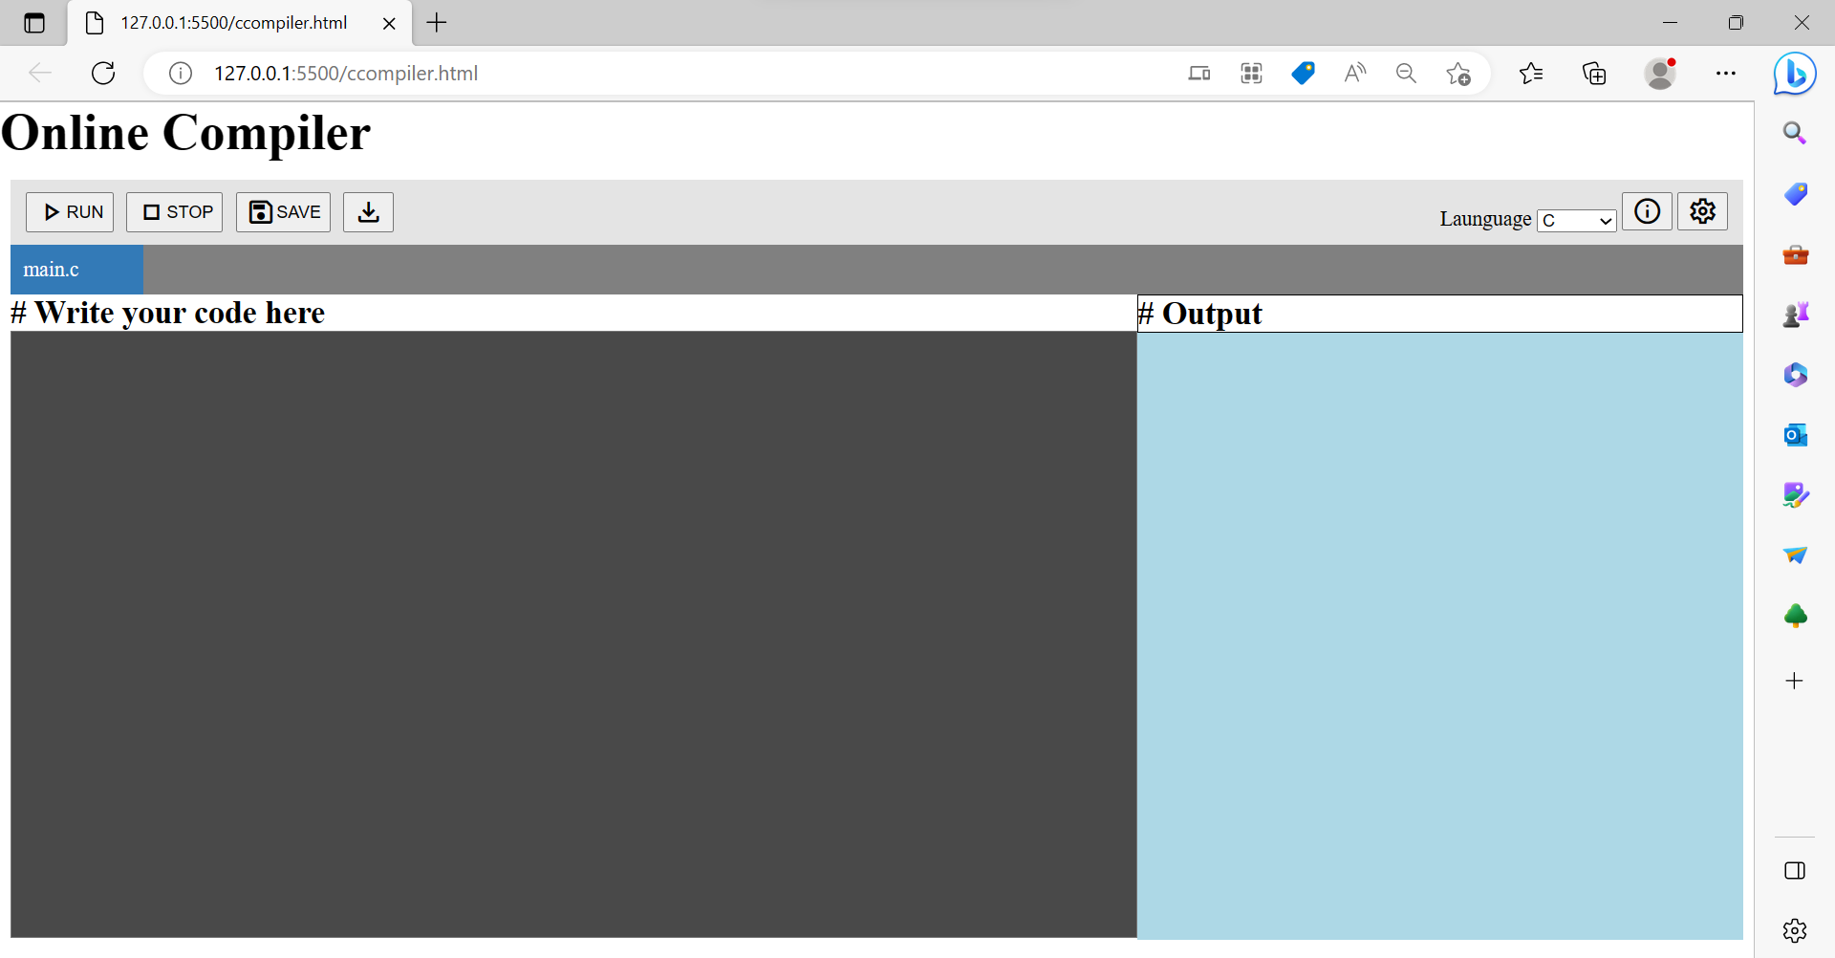

Slide 9
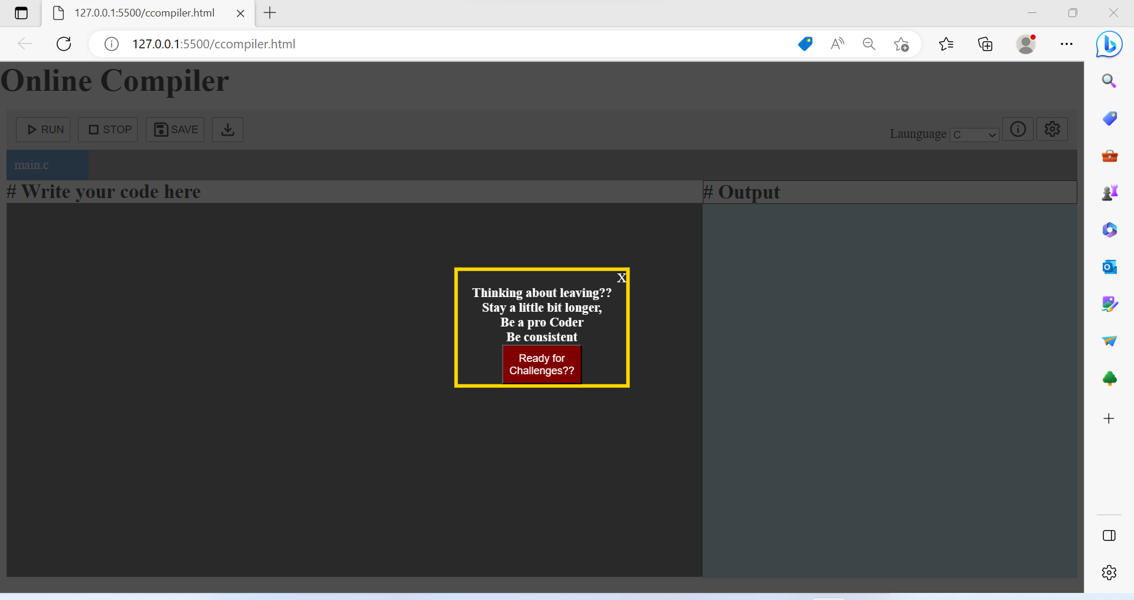

Slide 10
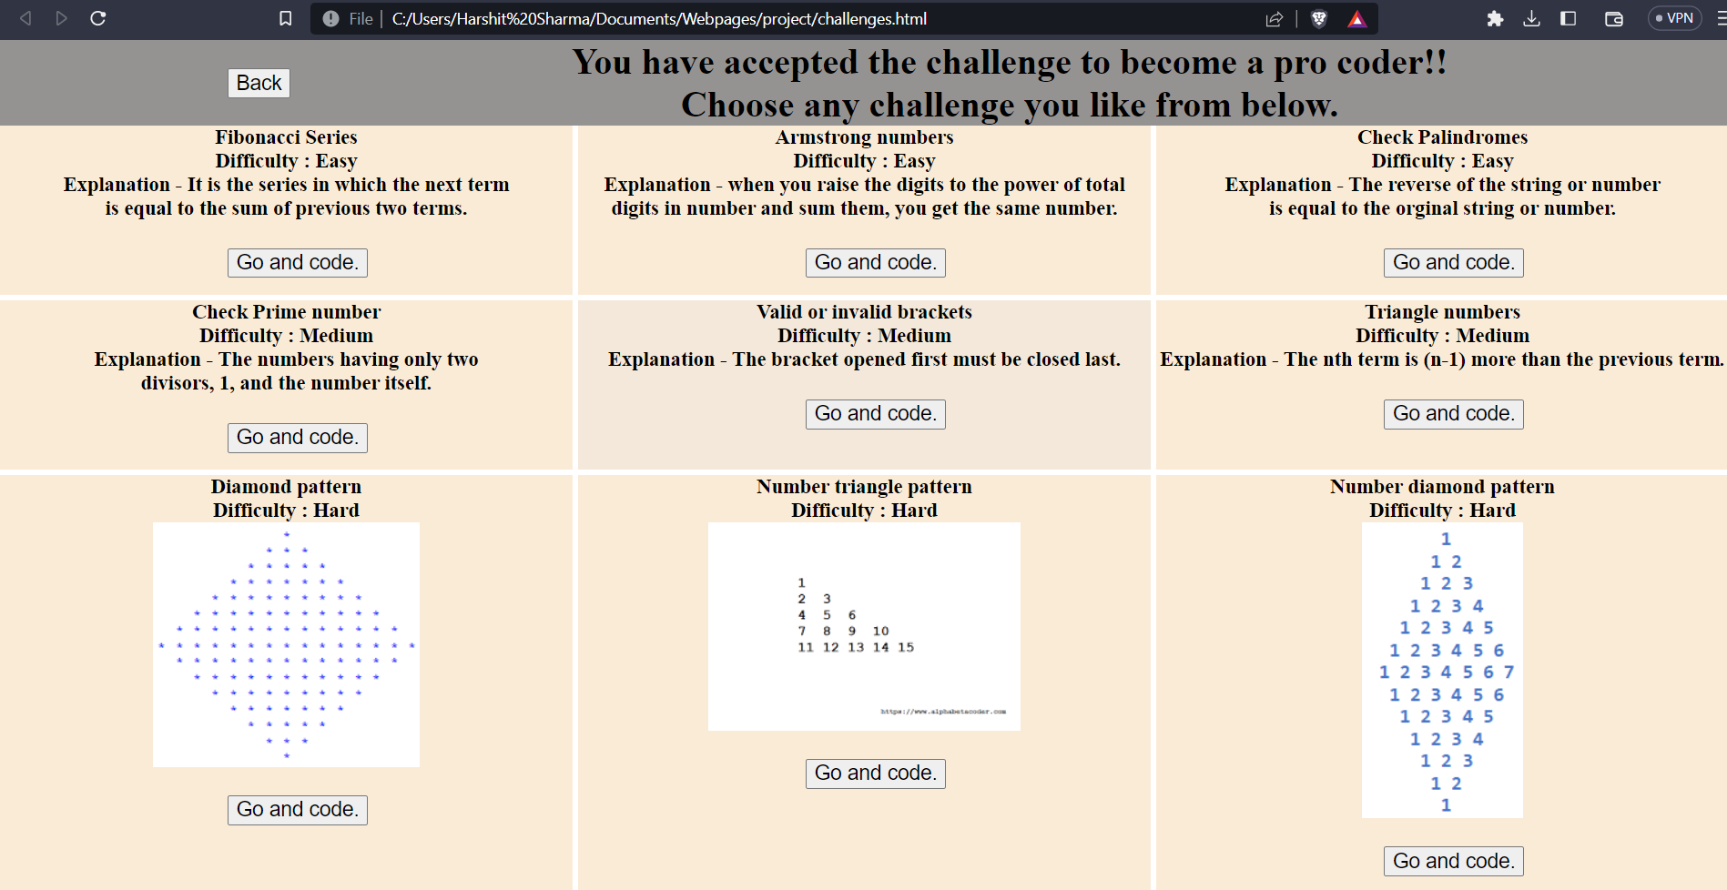

Slide 11
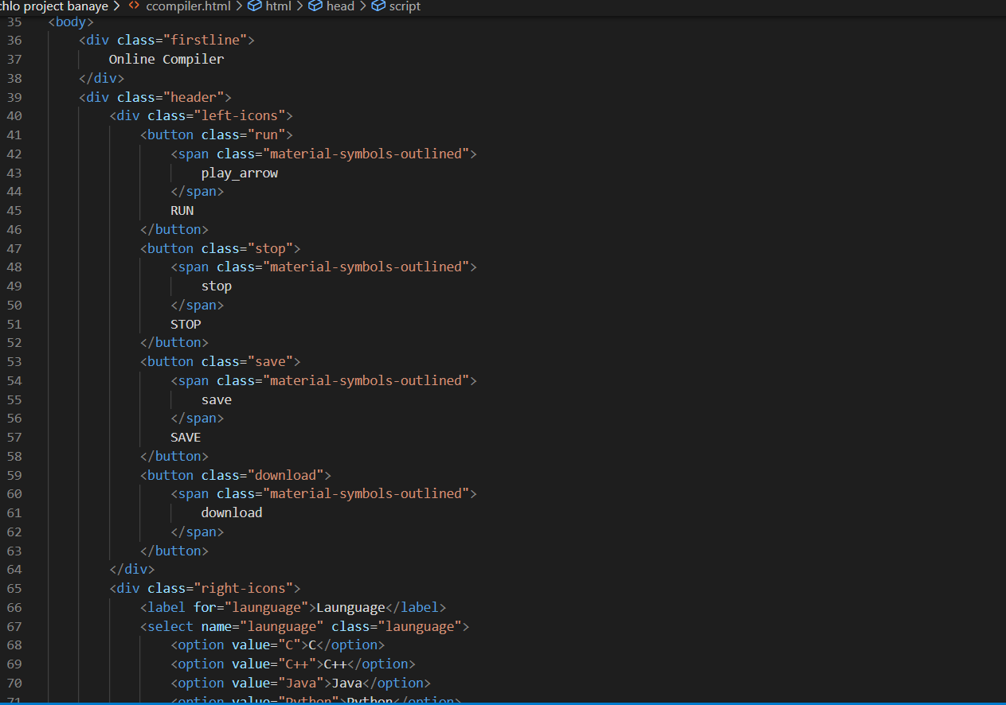
HTML(Main compiler)

Slide 12
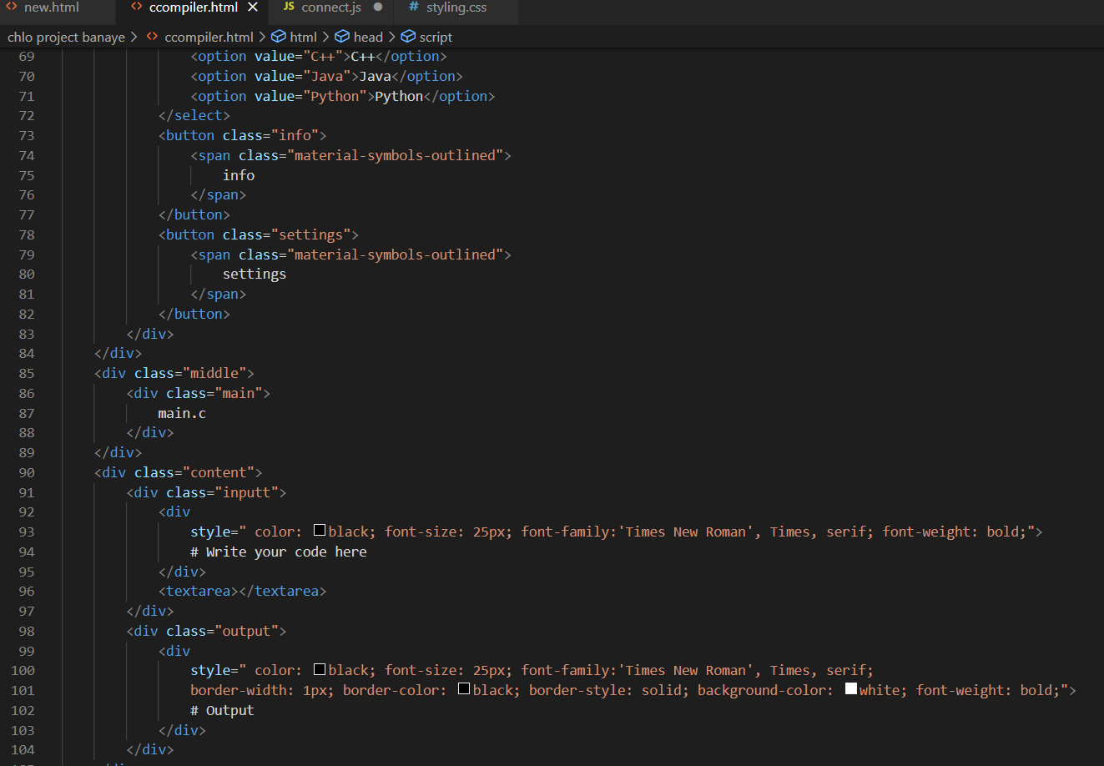

Slide 13
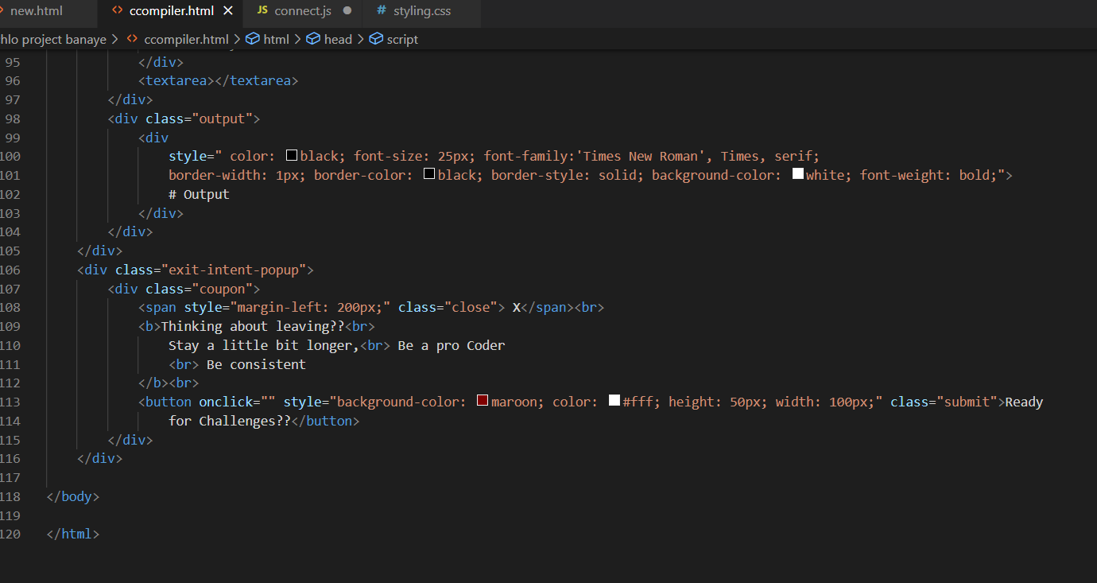

Slide 14
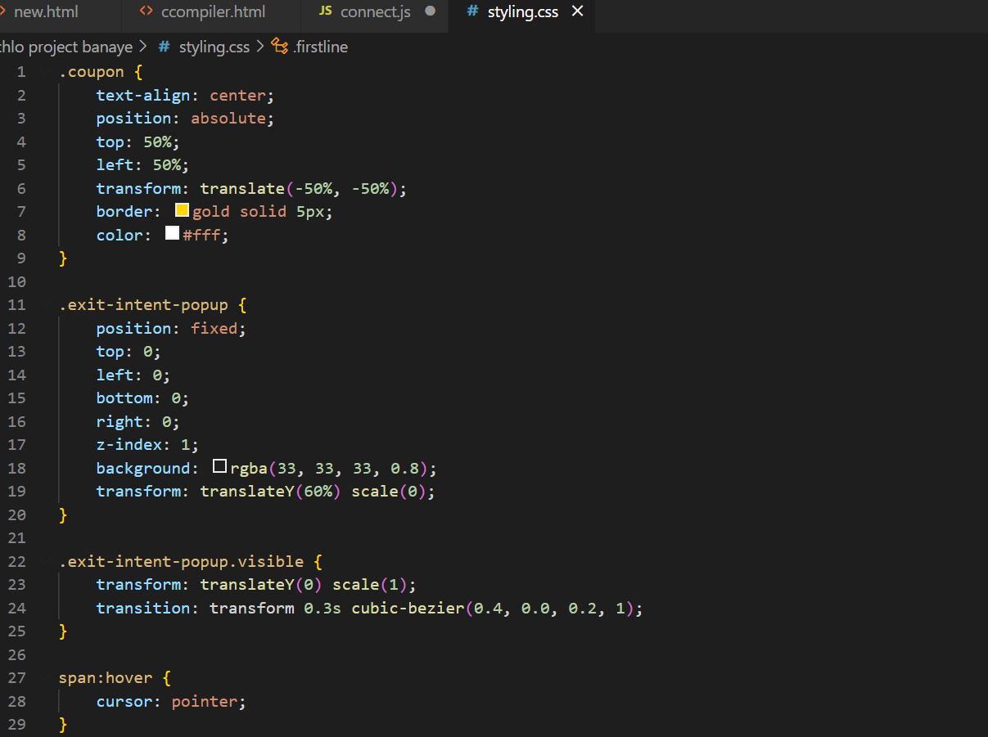
CSS(Main compiler)

Slide 15
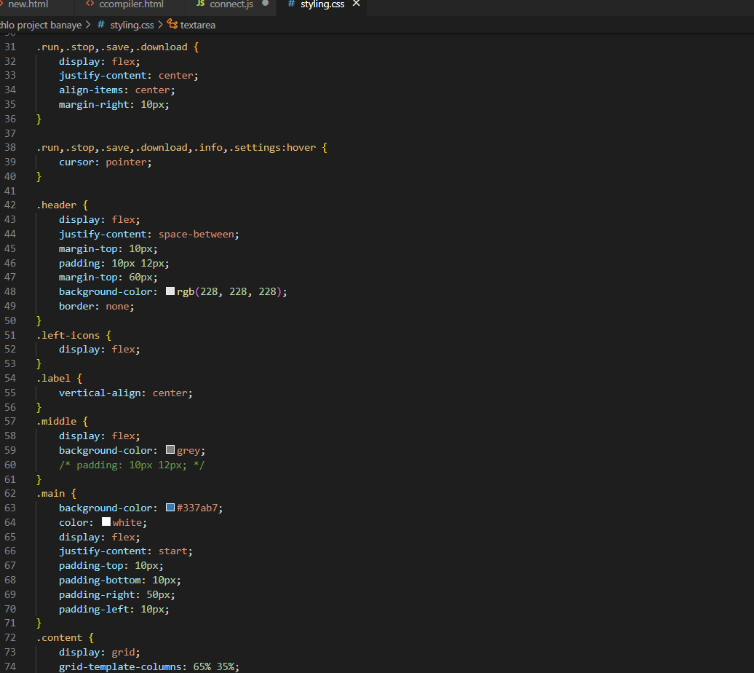

Slide 16
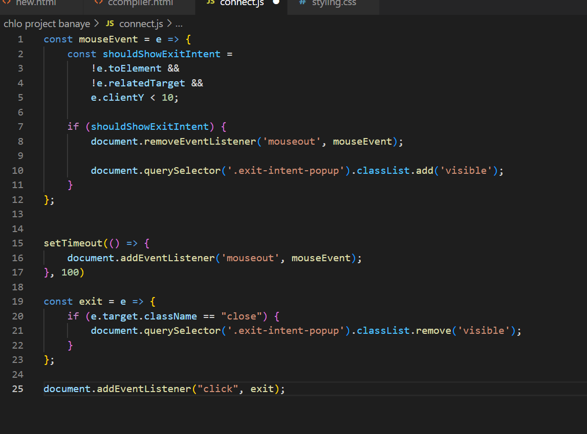
JS(Main compiler)

Slide 17
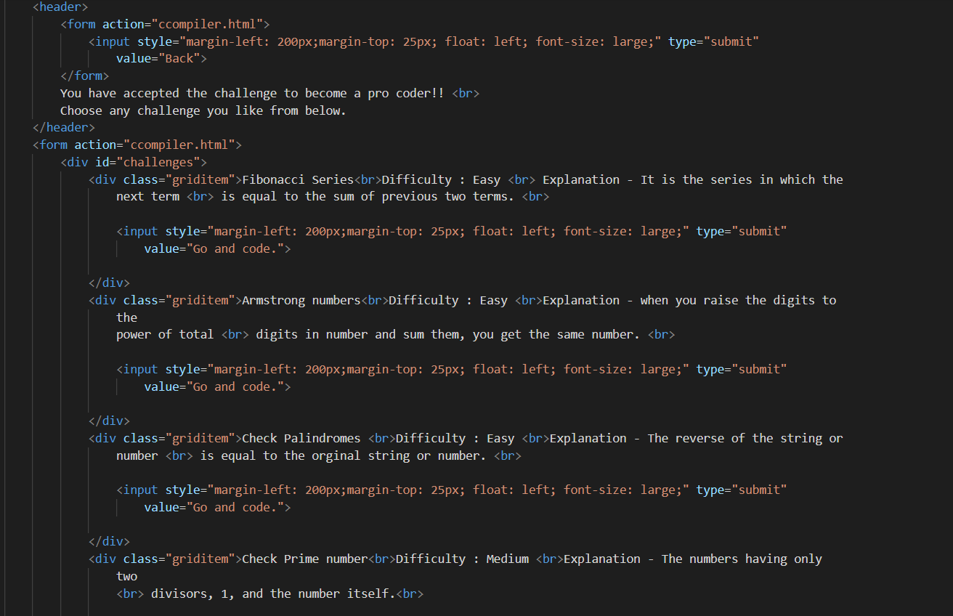
HTML(challenge page)

Slide 18
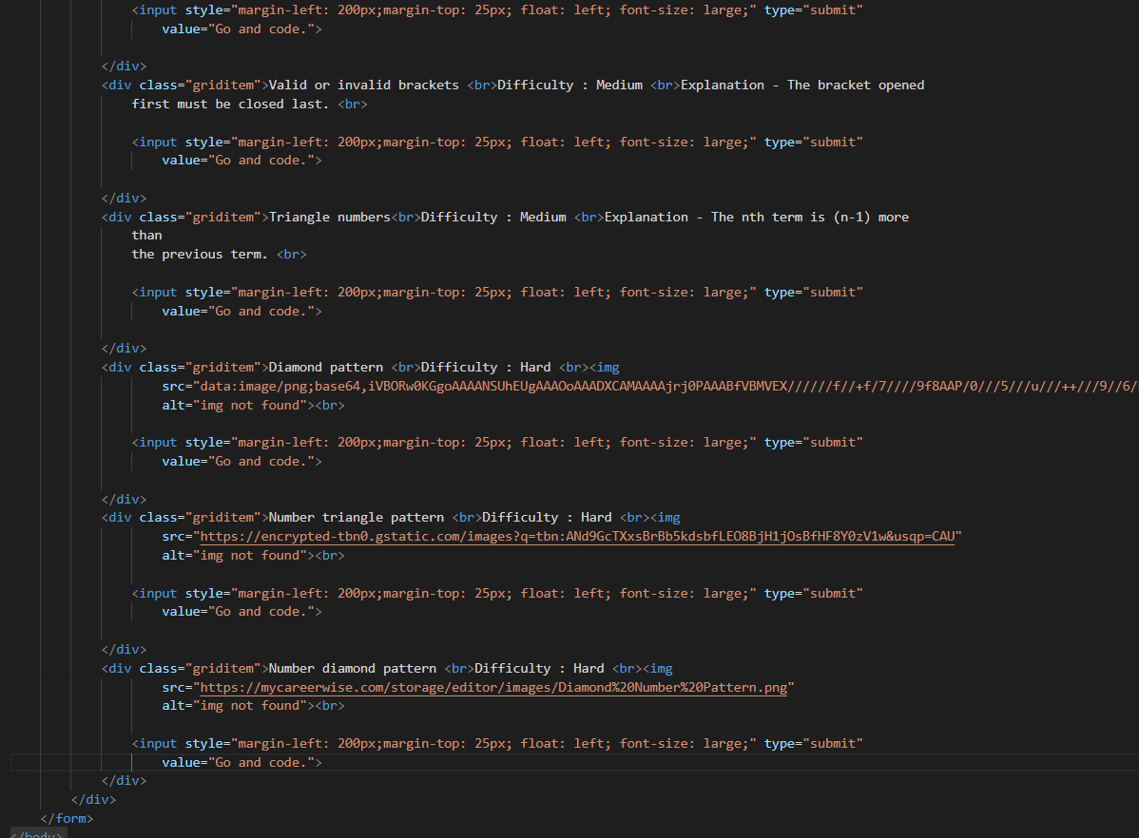

Slide 19
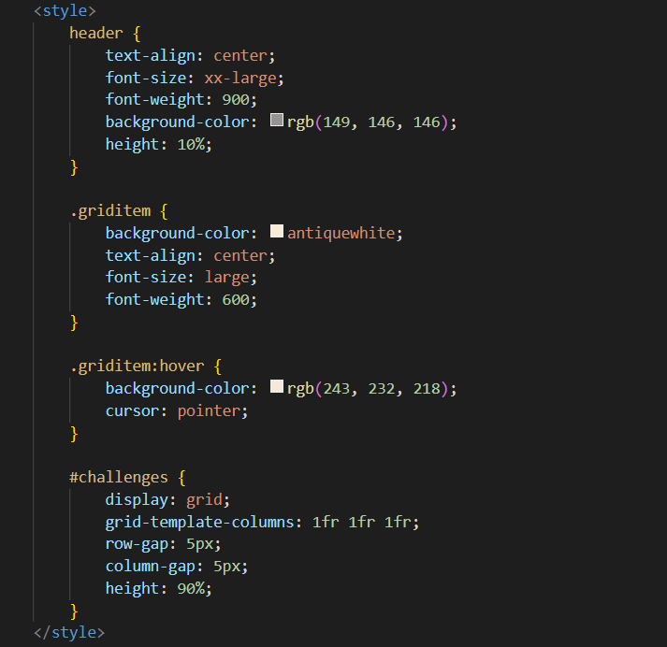
CSS(challenge page)

Slide 20
Conclusion
The project entitled “EXIT THE PLUGIN” gives a pop up when the user tries to exit the website. The project designed is very user friendly and very easy to understand.

Slide 21
References/Links used
https://www.w3schools.com/
https://stackoverflow.com/
https://www.geeksforgeeks.org/
HTML and CSS: Design and Build Websites
Learning Web Design: A Beginner's Guide to HTML, CSS, JavaScript, and Web Graphics

Slide 22


