Slide 1
Tank Stars Assets Factory
For Lib GDX

Slide 2
RESUME
CLOSE
START
Vibration: ON
Vibration: OFF
MAIN MENU
Sound: ON
Sound: OFF
OK
Music: ON
Music: OFF
EXIT
RESTART
Notification: ON
Notification: OFF
CANCEL

Slide 3



Player 1
Player 2
No fuel
V/S
Fuel (25%)
Fuel (50%)
Fuel (75%)
Fuel (100%)

Slide 4
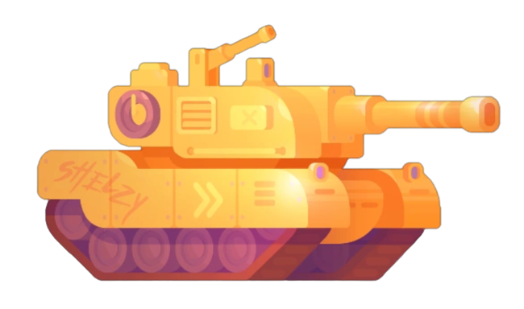

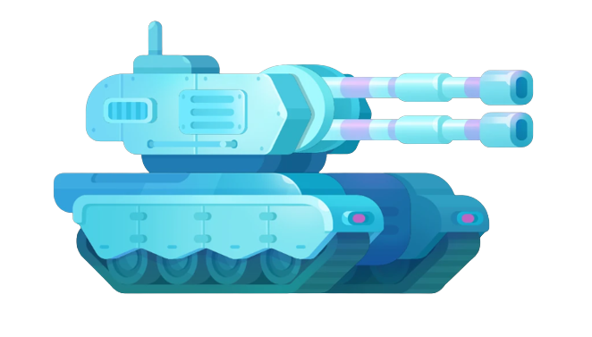
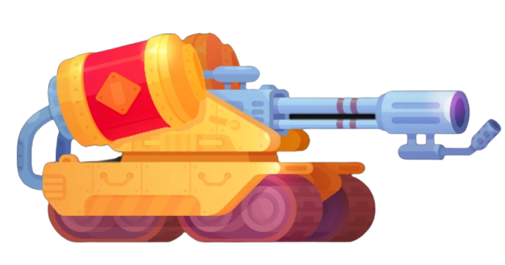

Slide 5

Settings

Slide 6
Player 1 : Choose tank
Player 2 : Choose tank

Slide 7
Frost
Abrams
Atomic
Helios
Frost
Abrams
Atomic
Helios

