Slide 1
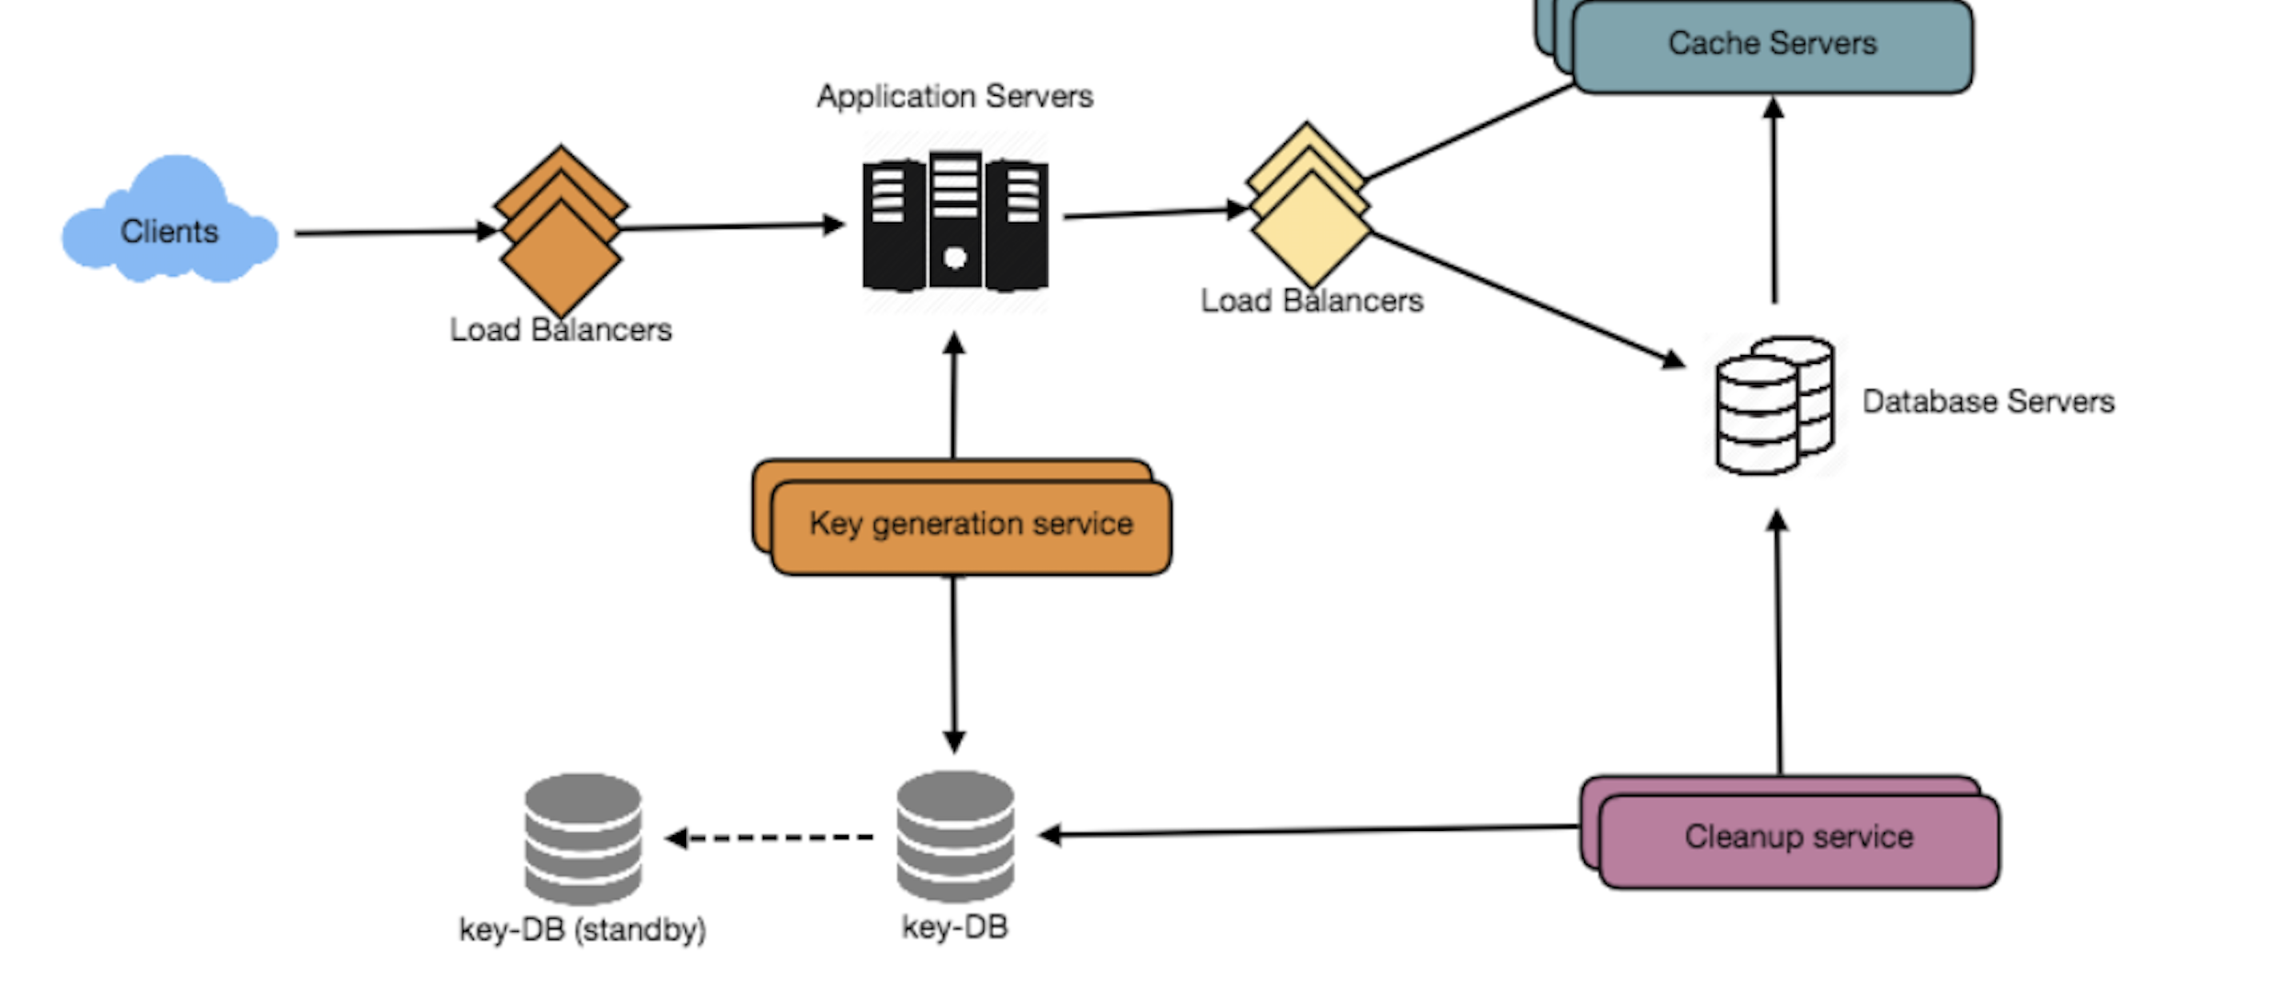
System Design -Scalability

Slide 2
What is Scalability and Why need Scaling
Scalability is the property of a system to handle sudden change by adding/ removing the resources in the system.
Performance is a measurement (speed) of the application for a user.
When load increases, all users gets affected (Ex: Latency increases).
Need scaling to make the system available.
Web
Server
Client
DB

Slide 3


How can you scale
Vertical and Horizontal scaling:
Vertical scaling(Scale Up) means adding more resources such as CPU, Memory etc to the existing host or server. Technology limit.
Horizontal Scaling(Scale out) means adding one or more machine to existing machine and distributing the work over them. Theoretically no technology limit.
Web
Server
Web
Server
Web
Server
Web
Server
Web
Server

Slide 4
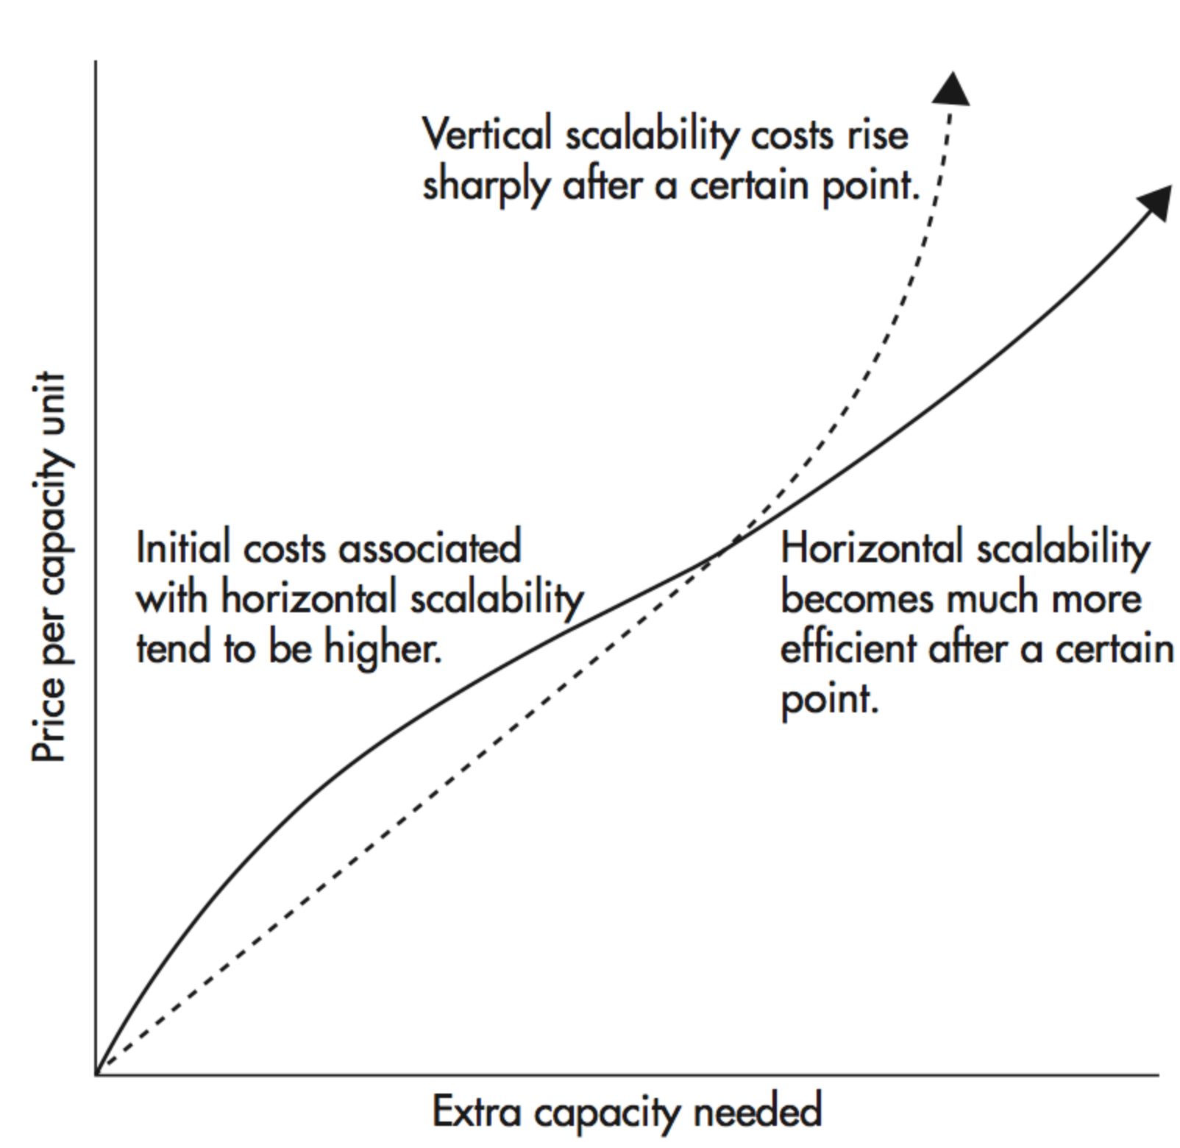
Horizontal vs Vertical
Need to find a way to distribute load on multiple servers. (Load Balancing)
Fault tolerant.
Servers talk to each other on network.
Data Inconsistency.
Theoretically can scale up to infinite.
No such thing is needed.
Single point of failure.
Data is consistent.
Limit of Hardware.

Slide 5
How to achieve scalability
Using load balancers , to evenly distribute load across the servers.
It acts an intermediate between client and server.
It keeps track of Ip addresses of servers to route the traffic.
As its only work is to route the request so it can handle much more load than web servers.
We can use multiple LBs to have a back up in case of failures.
Round Robin, Weighted Round Robin, Random, Dynamic (least connections, least traffic, least latency)
Web
Server
Load Balancer
DB
Web
Server
Client
Web
Server

Slide 6
How to achieve scalability
Using Shared Data store, to manage sessions.
Sessions are used to identify users.
Storing sessions on a web server can be a problem.
Avoid sticky sessions.
Cache sessions in Distributed In-Memory Cache. Ex: Redis or Memchache.
Anything being store on servers should have it’s own storage solutions.
Session store
Web
Server
Load Balancer
DB
Web
Server
Client
Web
Server

Slide 7
How to achieve scalability
Using Asynchronous Data Processing.
Time consuming tasks can be processed asynchronously.
Async executions are non-blocking. It will allow user to do other tasks.
No need to block main thread for every process.
Ex: Sending mails, log processing etc.
Session store
Web
Server
Load Balancer
DB
Web
Server
Client
Web
Server
queue
App server

Slide 8
How to achieve scalability
Using Distributed DataBase.
Loads are handled on Dbs using replication and Partionting.
Replication: Using different Dbs for read and write. Master-Slave Architecture, master for write and slaves for reading.
Partioning: Dividing dataset on different servers. Each partition is called shard and it is a subset of whole data set.
Also, dedicated servers for different use cases.
Write to Master
Session store
Read From Slave
Web
Server
Slave
Load Balancer
Shard A
Load Balancer
Slave
Web
Server
Shard B
Slave
Client
Slave
Shard C
Slave
Web
Server
Slave
queue
App server

Slide 9
How to achieve scalability
Stateless services, singleton design pattern, reuse objects, avoid unnecessary data base calls.
'Stateless' means that the server-side application isn't keeping information about individual clients across calls to it.
Using CDN for static content.
Optimize your queries. Avoid N+1 queries. It means for 1 parent query querying n additional queries for child.
Write to Master
Session store
Read From Slave
Web
Server
Slave
Load Balancer
Shard A
Load Balancer
Slave
Web
Server
Shard B
Slave
Client
Slave
Shard C
Slave
Web
Server
Slave
queue
App server
Ex:
SELECT * FROM Cars;
SELECT * FROM Wheel WHERE CarId = ?
SELECT * FROM Wheel

Slide 10
How to achieve scalability
Separating out platform layer from web Application allow both to scale independently.
Adding a new API is quick, as you only need to add platform servers without adding unnecessary capacity for web application tier.
Reusing platform layer for other infrastructures and interfaces.
Write to Master
Session store
Read From Slave
Web
Server
Platform
Server
Slave
Load Balancer
Shard A
Load Balancer
Slave
Web
Server
Platform
Server
Shard B
Slave
Client
Slave
Shard C
Slave
Web
Server
Platform
Server
Slave
queue
App server

Slide 11
System Design
Thank you.
Please provide suggestions and send questions.

