Slide 1
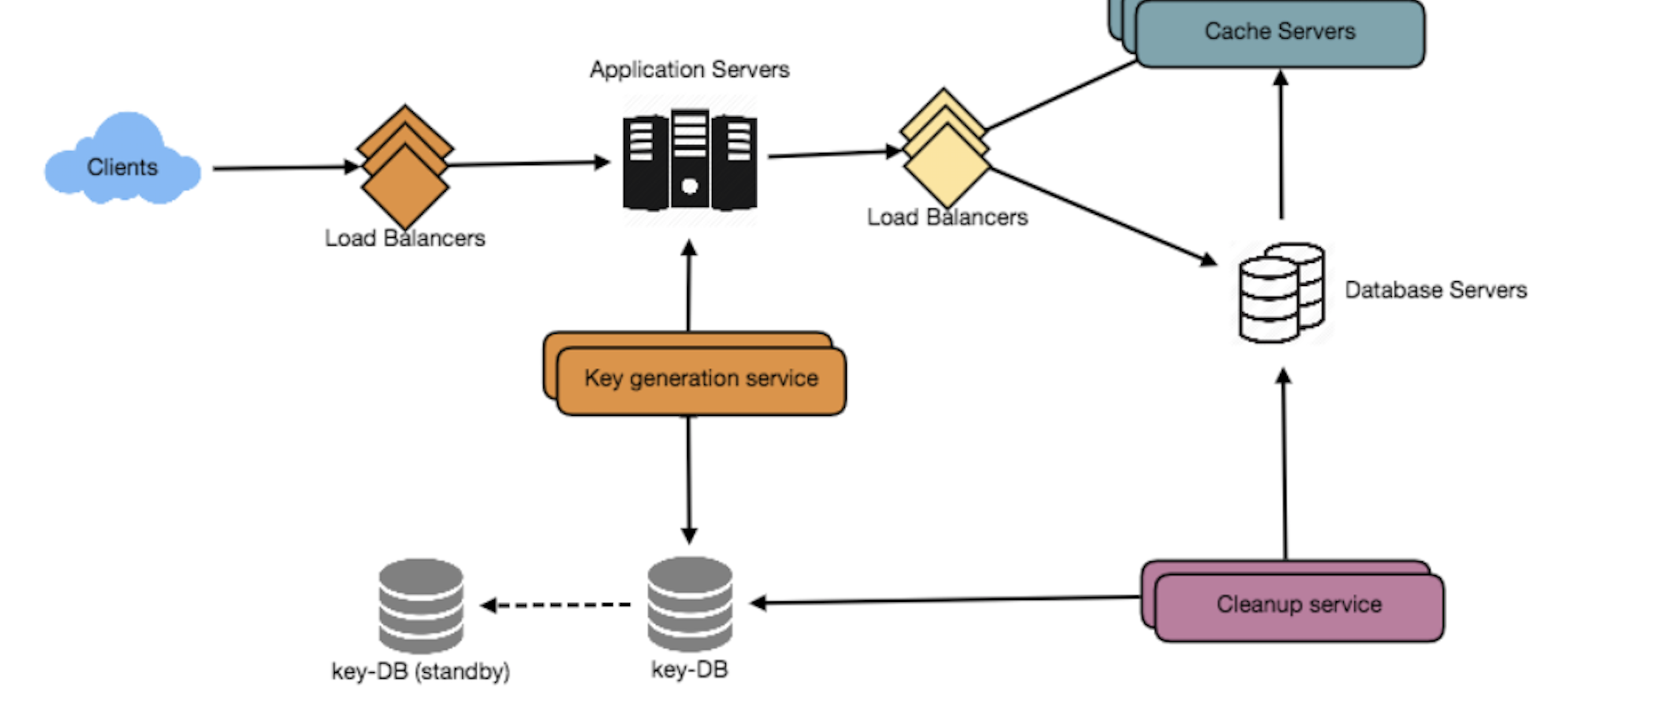
System Design - Intro to System Design

Slide 2
What is System
Wikipedia Def: A system is a group of interacting or interrelated entities that form a unified whole.
Examples:
Real World Systems: Schools, Colleges, Hospital etc.
Components: Rooms, Electric/ water supply resources, etc.
Computing Systems: Youtube, FaceBook, Instagram etc.
Components: Databased, Caches, Load balancers, Queues, Servers, etc.
Basically, a system is a group of components working together to serve a set of users as per their requirements.

Slide 3
What is Design
Wikipedia Def: A design is a plan or specification for the construction of a system.
Based on the user requirements, Designing it to select what technologies to use and how they are going to interact with each other.
Note: Two systems can have same components but different design.

Slide 4
Why need System Design
Need to design a large scale reliable, available systems.
To design system, one should know the requirements, trade offs based on the requirements, bottlenecks, technologies.
Everything is a trade off in system design. One select a component or technology over other as per the needs.
Example: Memcache is more scalable than Redis but redis provides more options for the developers.

Slide 5
Steps of System Design
Clarify Requirements.
Estimations and Calculations.
Scale, Data storage need, IO throughout, Engineering Efforts.
Components.
Data model, Data Flow, Data management and Data Storage.
High Level Design.
Bottlenecks and Optimization.

Slide 6
Steps of System Design
Clarify Requirements:
Functional Requirements. (Main goal of the system)
What is the input to the system.
What system has to deliver.
Non-functional Requirements.
Restrictions in the system to match business plan.
Performance, availability, Scalability, reliability,
System
Input
Output

Slide 7
Steps of System Design
Components:
Data, Databases, Applications, Cache, Message Queues, Infra, Communication.
Data: Text, Images, videos etc.
DataBases: MongoDB, MySQL, Cassandra etc.
Applications: Java, Python, Golang, Amber, React etc.
Cache: Redis, MemCache, etc.
Queues: Kafka, SQS, Rabbit MQ, etc.
Infrastructure: AWS, GCP etc.
Communication: APIs, messages, RPCs, etc.
Client
App
App

Slide 8
Some Concepts:
Vertical and Horizontal scaling:
Vertical scaling means adding more resources such as CPU, Memory etc to the existing host or server. Technology limit.
Horizontal Scaling means adding one or more machine to existing machine and distributing the work over them. Theoretically no technology limit.
CAP theorem: Consistency, Availability and Partition Tolerance.
Consistency: Reading the most recent written data.
Availability: Response Guaranteed.
Partition Tolerance: In Distributed system, communication breakdown between two nodes and still your cluster continues to work.
ACID and BASE
Atomicity, Consistency, Isolation and Durability.
Used for traditional databases.
Basically, available soft state eventual consistency.
Used for NoSql Databases.
Partioning/Sharding of Data.
Sharding means splitting a data onto many nodes.
Every node is responsible for some part of the Data.
Consistent Hashing.

Slide 9
Some Concepts:
Optimistic and Pessimistic locking: Used during Transactions.
In Optimistic, we don’t acquire lock and check if data has been updated before the commit. Better where more reads than updates or deletes.
In Pessimistic, we acquire lock beforehand and then commit your transaction.
Strong vs Eventual Consistency:
Strong consistency means reads will always get latest write. Up-to-date data at cost of high latency.
Eventual Consistency means reads will get stale data write but eventually get latest write. Low latency. High availability.
Relational DB vs NoSql:
Don’t use NoSql databases just because everybody uses them.
Relational DB provides ACID properties. NoSql Dbs compromise ACID properties.
NoSql scales better and high availability.
Type of NoSql Dbs:
Key value: Key value pair.
Wide Column: Many kinds of Column.
Document based: Semi Structured Data.
Graph Based: graph data.

Slide 10
Some Concepts:
Caching:
Speed up request to retrieve data. Basically, it caches the previous responses of similar requests.
Bases on assumptions that some data is accessed frequently.
Cache can’t be always right, can’t store everything, need eviction policy to update the cache.
Cache hits and Cache misses.
Remember, Indexing is different, as it means searching data faster.
Data center/ Racks/ hosts.
One should know latency of talking across racks and hosts.
CPU/Memory/ Hard drive/ Network Bandwidth
Everything is limited.
One should design a system considering optimizations, such as improving through put and reducing latencies.
Http vs http2 vs websockets
Http is the request-reply kind of architecture between client and server. After sending the response connection gets closed. It is used to get old data or get the data only once. Used in RESTful Web services.
WebSockets- Bidirectional communication over the same connection. It is used to get real-time updated data. Used in trading, chatting etc. We get the data without refreshing the UI.

Slide 11
Some Concepts:
TCP/IP model
Transmission Control Protocol/ Internet Protocol.
4 Layers:
Application, Transport, Internet and Network access.
Ipv4 vs ipv6
Ipv4 has 32 bit addresses and Ipv6 has 64 bit addresses.
Ipv routing.
TCP vs UDP
TCP is connection oriented, reliable connection.
TCP is well established, provides packet ordering, prevents packet loss. It is used where every transferring every packet is important.
UDP is non-reliable connection (Fast). UDP is used to real time streaming data. Where some loss of data packets are allowed.
Youtube, Netflix, all uses TCP. Live TC streams uses UDP.
DNS lookup: Domain name server
Each website request goes to dns and it translate it into Ip address.

Slide 12
Some Concepts:
Https and TLS
TLS is transport layer security.
HTTPS is HTTP with TLS.
TLS is used to secure communication between client and server.
Public key infrastructure and certificate Authority
Public key infrastructure is used to manage a public key and digital certificates.
Certificate Authority is a trusted entity which tells whether public key is from trusted party.
Load balancers:
To distribute load over the servers.
Round robin, Weighted Round-robin, based on availability.
L4, L7 (What to consider for routing)
CDNs & Edge
Content delivery network: reduce latency and performance.
Edge is somewhat similar, processing the request and Edges have dedicated network to Data center.

Slide 13
Some Concepts:
Bloom Filters and Count-min sketch
Space efficient Probabilistic based Data structures.
Bloom Filters are used to decide if a element is present in the set or not.
Bloom filters can have false-positive but cannot have false negatives.
Count-min is somewhat similar but it used to count frequency of the events.
Paxos- Consensus over distributed hosts
Leader election among distributed hosts.
Design patterns & object-oriented design.
Common design patterns: Singleton, builder, Factory etc.
Ood: OOPs and SOLID.
Virtual machines & Containers.
Vm is a way to run multiple OS instances using shared resources.
Containers is a way to virtualize an OS so that multiple workloads on same OS.

Slide 14
Some Concepts:
Publisher-Subscriber over Queue.
Publisher publishes the message.
Subscriber receives the message.
Very useful pattern.
Map reduce.
Used to do distributed and parallel processing of Big Data.
Filtering and Sorting of Data and Reducing its size.
Multi-threading, concurrency, locks, synchronization, CAS.

Slide 15
Implementations of above Concepts:
Cassandra
White Column highly scalable.
Time series data.
Provides both eventual and Strong Consistency.
Uses consistent hashing to Shard data.
Gossiping to talk to other nodes in the Cluster.
MongoDB/ Couch base
Nosql, json llike structure.
MySql
Relational
ACID full.
Scales using Master-Slave Architecture.
Memcached and Redis
In-memory Data Stores.
Redis provides more options.
Zookeper
Centralized configuration management system
It is used by any Cluster to coordinate between themselves.

Slide 16
Implementations of above Concepts:
Kafka
Fault tolerant and highly available queue.
Distributed pub sub model.
NGINX and HAProxy
Load balancers.
Solr and Elastic Search
Search platform on Lucene.
Highly available, fault tolerant, scalable.
BlobStore/ S3
Big documents.
Docker: Software platform provide containers inside which you can develop and run your distributed applications.
Kubernetes
Mesos
Both are used to manage these containers.
Hadoop/ Spark
HDFS

Slide 17
System Design
Thank you.
Please provide suggestions and send questions.

