Slide 1


VISVESVARAYA TECHNOLOGICAL UNIVERSITY “Jnana Sangama” Belagavi – 590018 Sir M Visvesvaraya Institute Of Technology,Bengaluru-56257 DEPARTMENT OF ELECTRONICS AND COMMUNICATION ENGINEERING Mini Project Presentation on “BABY MONITORING SYSTEM”
Presented by
ANKIT KUMAR (1MV20EC016) ARMAN ARYAN (1MV20EC024)
HARSHIT (1MV20EC055)
HIMANSHU S DAS (1MV20EC055)
Under the Guidance of
DR. SASMITA MOHAPATRA
Professor

Slide 2
INTRODUCTION:-
The People these days seem to be always in urge with their work and they may not be able to monitor the child all the time.
In order to come over this difficulty, the baby monitoring system is developed that works on the principle of IoT.
The baby monitoring system is a kind of alarm system which can detect baby movements and activities and can convey the message about the condition of babies to the concerned authority on a laptop.

Slide 3
LITERATURE SURVEY:-
PAPER TITLE:
IoT- BBMS :Internet of things-based baby monitoring system for smart cradle ,Waheb a jabbar and Saidatul n.i.s hamid,IEEE,2019 CONTENT:
The system consists of a baby cradle with a swinging motor, an external web camera for remote monitoring, and an MQTT server to control the lullaby toy. The prototype was designed using Nx Siemens software, tested, and proven effective.
DISADVANTAGE:
Privacy and Security Risks: IoT devices, including baby monitoring systems, can introduce privacy and security concerns.
If not properly secured, these systems may be vulnerable to hacking, unauthorized access, or data breaches, potentially compromising the privacy and safety of the baby and their family.

Slide 4
PAPER TITLE:
IoT based Smart Cradle for Baby Monitoring System, N Lakshman Pratap and Sunanda Nalajala,IEEE,2021
CONTENT:
The system uses sensors to capture the baby's motion and position and displays the readings in a mobile application. Abnormal readings trigger alerts to the caretaker and parents.
DISADVANTAGE:
Reliance on Network Connectivity: IoT-based baby monitoring systems rely on a stable internet connection for communication and data transmission.
If the network connection is disrupted or unreliable, it can affect the system's functionality, leading to gaps in monitoring or false alarms.

Slide 5
PAPER TITLE:
Design and Development of a Smart Baby Monitoring System based on Raspberry Pi and Pi Camera, Aslam Forhad Symon and Nazia Hassan,IEEE,2017
CONTENT: This system can detect the baby’s motion and sound; especially crying and video output of baby’s present position can be displayed on a display monitor so that the mother or another responsible person can watch the baby while away from him or her.
DISADVANTAGE:
Like any technology, IoT-based baby monitoring systems can experience technical issues, such as software bugs, hardware malfunctions, or compatibility problems.
These issues may impact the system's reliability and accuracy, potentially leading to false alarms or missed alerts.

Slide 6
PAPER TITLE:
IOT Based Baby Monitoring System Smart Cradle ,Senoj Joseph and Ajay Gautham.J,IEEE,2022
CONTENT:
The project is centered around a plan to develop a IOT based Smart baby cradle that would assist the Parents with monitoring and keeping an eye on their infants regardless o f whether they are at home or at work and can identify each activity of the infants from any inaccessible corner of the world.
DISADVANTAGE:
Cost and Maintenance: IoT-based baby monitoring systems can be expensive to purchase, install, and maintain.
Additionally, they may require regular updates, software upgrades, or battery replacements, adding to the overall cost of ownership.

Slide 7
PROBLEM STATEMENT:-
Current baby monitoring systems have limitations that hinder their effectiveness in ensuring the safety and well-being of infants.
Existing systems may have connectivity issues, range limitations, or complex setups that make them inconvenient for parents to use.
Parents and caregivers often face challenges when it comes to keeping a close watch on their infants or young children, particularly when they are in a different room or away from home.

Slide 8
OBJECTIVES:-
Develop a baby monitoring system that utilizes temperature and sound sensors to provide real-time monitoring of a baby's environment.
Ensure accurate and reliable measurement of temperature fluctuations in the baby's surroundings, allowing parents or caregivers to respond promptly to any changes that may affect the baby's comfort or well-being.
Implement a robust sound sensing capability to detect and analyze various audio cues, such as crying, laughter, or irregular noises, enabling caregivers to monitor the baby's activities and intervene when necessary.

Slide 9
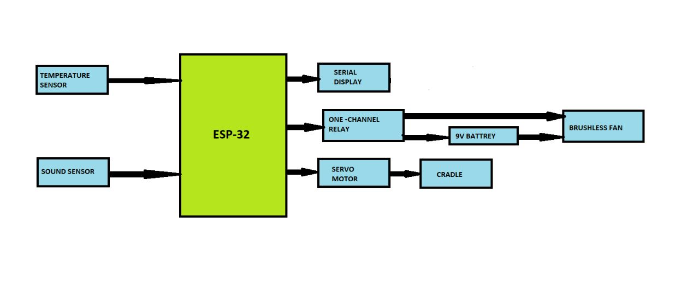
METHODOLOGY:-
The temperature sensor continuously measures the temperature fluctuation in the baby's room. It provides temperature readings in real-time.
As soon as the temperature rises above 31 deg celcius the dc fan which is connected to one channel relay is switched on.
The sound sensor detects the sound levels in the room, capturing any noise or disturbances that occur.
As soon as the sound is detected the cradle starts to swing using the servo motor.

Slide 10
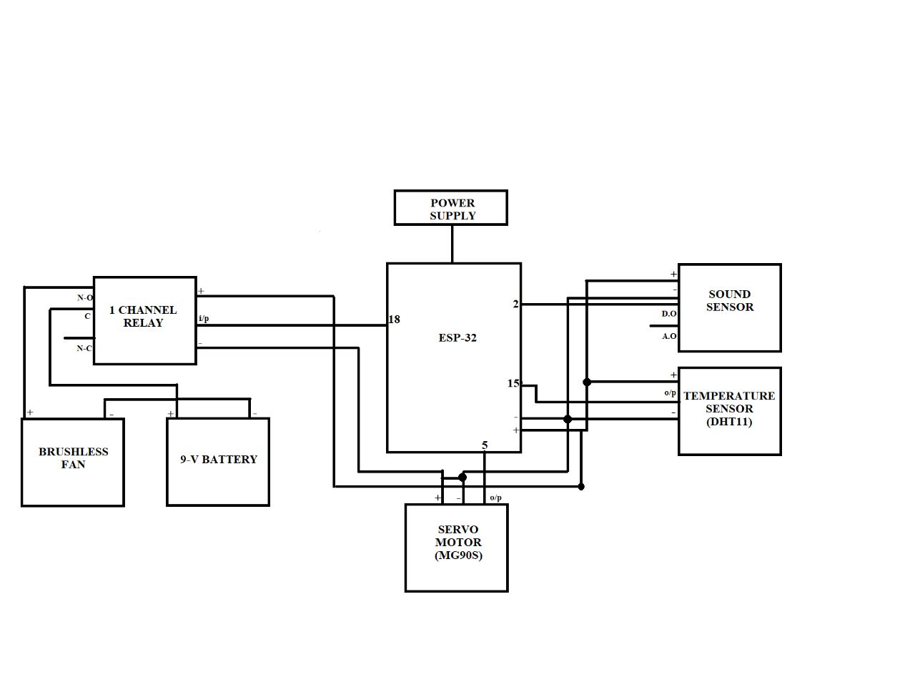
CIRCUIT DIAGRAM:-

Slide 11
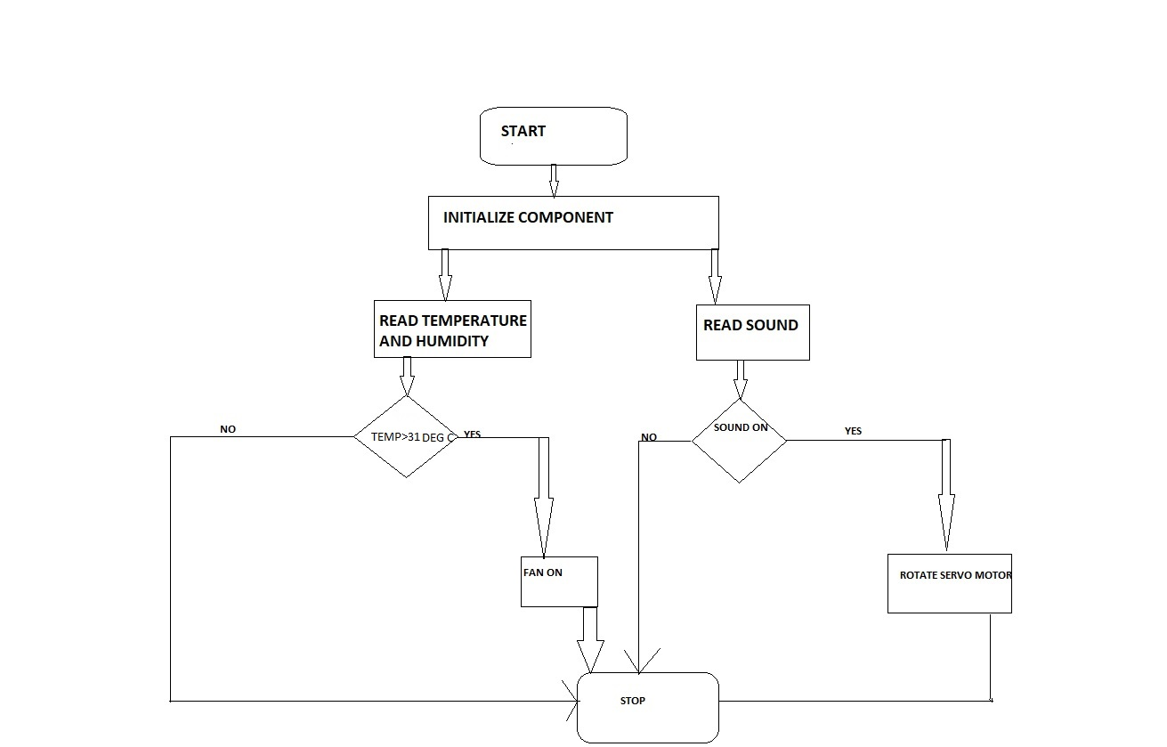
FLOW CHART:-

Slide 12
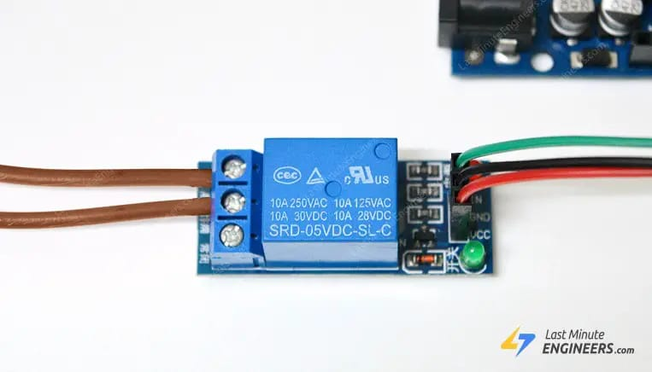
HARDWARE DETAILS:-
ONE CHANNEL RELAY
A one-channel relay, also known as a single-channel relay, is an electrical switching device that allows the control of a single circuit or load using an input signal.
It is commonly used in various applications to automate or control the operation of devices or systems.

Slide 13
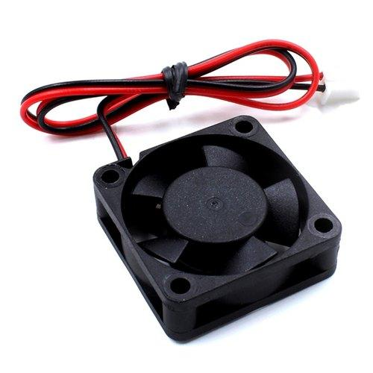
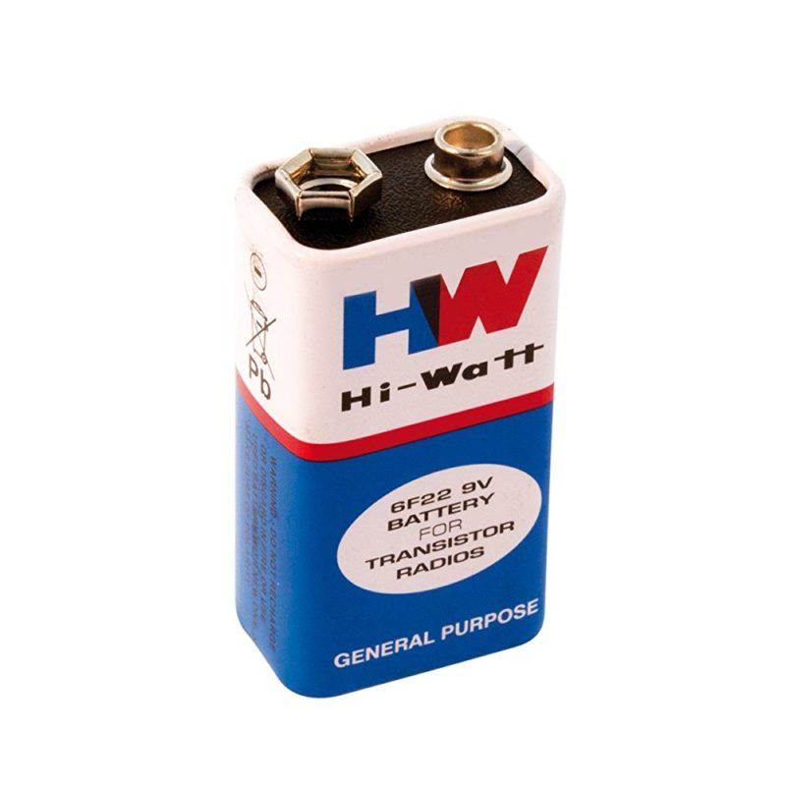
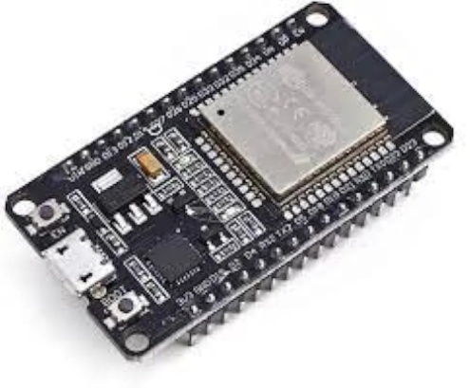
BRUSHLESS FANS
A 5V brushless DC (BLDC) fan is a type of fan that operates on a 5-volt power supply and utilizes brushless DC motor technology
DC BATTERY
A 9V DC battery is a type of portable power source that provides a direct current (DC) voltage of approximately 9 volts.
ESP32 MICROCONTROLLER
The ESP32 is a popular microcontroller module that combines Wi-Fi and Bluetooth connectivity with a powerful dual-core processor, making it a versatile platform for a wide range of applications

Slide 14
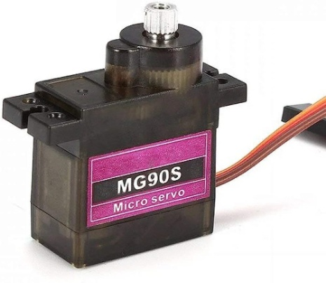
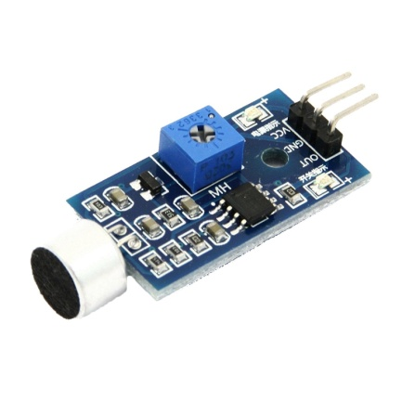
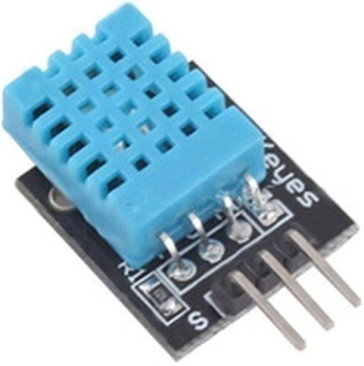
SERVO MOTOR
The MG90S servo motor typically comprises a DC motor, a set of gears, a control circuit, and a feedback mechanism.
SOUND SENSOR
A sound sensor, also known as a sound detector or microphone sensor, is an electronic device that detects sound waves in the surrounding environment and converts them into electrical signals
TEMPERATURE AND HUMID SENSOR
The DHT11 sensor is a widely used digital temperature and humidity sensor.

Slide 15
SOFTWARE DETAILS:-
Arduino IDE (Integrated Development Environment) is a software platform specifically designed for programming Arduino boards.
The Arduino IDE provides a user-friendly interface for writing, compiling, and uploading code to Arduino boards.
The IDE offers a range of built-in functions and libraries that make it easier for beginners to get started with Arduino programming.
It provides a straightforward way to control digital and analog inputs and outputs, read sensors, communicate with other devices, and perform various tasks.

Slide 16
RESULTS AND OUTCOMES:-
Real-Time Temperature Monitoring: The ESP32-based baby monitoring system will provide real-time monitoring of the temperature in the baby's room.
Sound Level Monitoring: The system will continuously monitor the sound levels in the baby's room. It will capture and measure the intensity of sound, helping parents assess the noise level and detect any sudden loud noises or disturbances.
Low Power Consumption: The ESP32 microcontroller's efficient power management capabilities will ensure optimal power consumption for the baby monitoring system.

Slide 17
MERITS AND DEMERITS:-
MERITS
Enhanced Safety: A baby monitoring system allows parents to keep a close eye on their baby, ensuring their safety and well-being.
Convenience: Baby monitoring systems provide convenience by allowing parents to monitor their baby remotely through audio or video feeds.
Connectivity and Mobile Apps: Many modern baby monitoring systems offer connectivity features and mobile apps, allowing parents to monitor their baby's activities using smartphones or tablets.

Slide 18
DEMERITS
False Alarms: Baby monitoring systems may sometimes generate false alarms, such as motion detection triggered by unrelated movements or sound detection misinterpreting ambient noise.
Over-Reliance and Stress: In some cases, parents may become overly reliant on the baby monitoring system, constantly monitoring the baby's activities.
Cost: Baby monitoring systems can vary in cost, and more advanced systems with additional features may come with a higher price tag.

Slide 19
CONCLUSION AND FUTURE SCOPE:-
CONCLUSION
In conclusion, the baby monitoring system using ESP32 offers a range of benefits for parents and caregivers in ensuring the safety and well-being of their infants. The project has a promising future scope with several potential enhancements and advancements.
By expanding the sensor capabilities, including parameters like temperature, humidity, air quality, and motion detection, the system can provide a comprehensive monitoring solution. Integrating a camera module enables real-time video streaming, allowing parents to visually check on their baby remotely.

Slide 20
FUTURE SCOPE
Mobile Application: Develop a dedicated mobile application that can connect to the ESP32-based baby monitoring system.
Wearable Devices: Explore the possibility of developing wearable devices, such as smart clothing or wristbands, for the baby.
Cloud Connectivity: Enable cloud connectivity to store and analyze the collected data.
Video Monitoring: Integrate a camera module with the ESP32 to enable real-time video streaming and monitoring of the baby.

Slide 21
REFERENCES:-
Jabbar, Waheb A., et al. "IoT-BBMS: Internet of Things-based baby monitoring system for smart cradle." IEEE Access 7 (2022): 93791-93805.
Pratap, N. L., Anuroop, K., Devi, P. N., Sandeep, A., & Nalajala, S. (2021, January). Iot based smart cradle for baby monitoring system. In 2021 6th International Conference on Inventive Computation Technologies (ICICT) (pp. 1298-1303). IEEE.
Symon, A.F., Hassan, N., Rashid, H., Ahmed, I.U. and Reza, S.T., 2017, September. Design and development of a smart baby monitoring system based on Raspberry Pi and Pi camera. In 2022 4th International Conference on Advances in Electrical Engineering (ICAEE) (pp. 117-122). IEEE.
Joseph, Senoj, Akshaya Kumar, and MK Harish Babu. "IOT based baby monitoring system smart cradle." 2021 7th International Conference on Advanced Computing and Communication Systems (ICACCS). Vol. 1. IEEE, 2021.
Duman, Ülkü, and Erdoğan Aydin. "IOT Based Baby Cradle System with Real Time Data Tracking." 2020 5th International Conference on Computer Science and Engineering (UBMK). IEEE, 2022

Slide 22
THANK YOU

