Slide 1





VIDYAVARDHAKA COLLEGE OF ENGINEERING
Autonomous Institute | Accredited by NAAC with 'A' Grade
Gokulam 3rd Stage, Mysuru - 570002
<< Architecting an Autonomous Tomorrow. >>
COMPLYBOT : AI-Powered Multi-Agent Assistant for Indian Standards & BIS Services | PS #04 (SIH26107)
TEAM NAME:
STAR WARS
DOMAIN :
Team: STAR WARS • Lead: Harshit Vishwakarma • 100% Offline GPU Inference via Ollama • PS #04

Slide 2
PROBLEM IDENTIFICATION
WHO IS AFFECTED
• Indian MSMEs: Over 63 million small manufacturers struggling with mandatory BIS compliance.
• Consumers & Buyers: Citizens purchasing gold jewellery and electronic appliances needing authenticity proof.
• Innovators & Students: Engineers and researchers seeking exact standard clauses for R&D.
• BIS Service Seekers: Enterprises looking for accredited testing labs and licensing application flows.
• Regulatory Bodies: Officials seeking transparent, verifiable tools to curb non-compliant goods.
CORE PAIN POINT
• Information Dispersion: Critical data is scattered across disjointed BIS PDFs and multiple portals.
• Complex Certification: Heavy confusion regarding scheme differences (ISI Mark vs. CRS vs. FMCS).
• Hallmarking Ambiguity: Lack of instant consumer tools to verify 6-digit HUID and karat purity.
• Testing Lab Friction: Painstaking manual search for nearest accredited laboratories by product type.
• High Consultancy Cost: Small businesses forced to pay hefty agent fees for basic compliance guidance.
CURRENT GAP
• Keyword Search Failures: Existing government portals rely on rigid keywords rather than natural language.
• Zero Centralized Reasoning: No unified conversational AI layer connecting standards, labs & schemes.
• Lack of Traceable Sources: General LLMs (ChatGPT) hallucinate rules and cannot cite official clauses.
• Language Barriers: Over 70% of MSME owners prefer Hindi, but compliance documentation is in complex English.
• Data Privacy Concerns: Commercial APIs expose enterprise product secrets to public cloud servers.
Problem Statement Focus
Create an NLP assistant that answers standards and certification queries for Indian MSMEs with referenced, evidence-backed responses. The broader concept also serves consumers through product, hallmarking and complaint guidance — running entirely locally with 0 API costs and guaranteed source citations.

Slide 3
PROPOSED SOLUTION
ASK 💬
Natural Language Query
User inputs plain query in English or हिन्दी via chat UI.
ROUTE 🧭
Deterministic Routing
Router Agent classifies domain & intent in 0ms (LLM fallback).
RETRIEVE 🔍
Vector RAG & Rules
Searches ChromaDB vector store + structured JSON rule engines.
VERIFY 🛡️
Evidence Validation
Cross-checks official BIS clauses, testing lab data & purity formulas.
RESPOND ⚡
Cited Synthesis
Plain-language answer with Agent Transparency Badge & citations.
➔
➔
➔
➔
KEY CAPABILITIES
• Standards Q&A: Semantic RAG search over BIS standards (IS 16102 for LEDs, IS 14543 for water, IS 9873 for toys).
• Certification Schemes: Clear walkthroughs for ISI Mark, Compulsory Registration Scheme (CRS), and FMCS.
• Instant Hallmarking: 0ms rule-based verification of gold purity (24K/22K/18K/14K) and 6-digit alphanumeric HUID format.
• Lab Finder Agent: Locates nearest BIS-recognized testing laboratories filtered by product type and state.
• Bilingual Engine: Native English and Hindi translation layer powered by Qwen2.5 for inclusive nationwide reach.
INNOVATION EDGE
• Zero Hallucinations: Every response is strictly grounded with exact BIS standard & clause citations.
• Transparent Agent Badges: Live 'Answered by: [Agent Name]' badges verify multi-agent orchestration for judges.
• 100% Offline Local AI: Runs entirely on consumer GPUs via Ollama — zero cloud bills, zero internet risk during demo.
• Deterministic Hybrid Routing: Keyword-first dispatch eliminates LLM routing latency for maximum demo reliability.
• Flagged Uncertainty: Uncertain or out-of-scope queries are explicitly flagged rather than guessed.

Slide 4

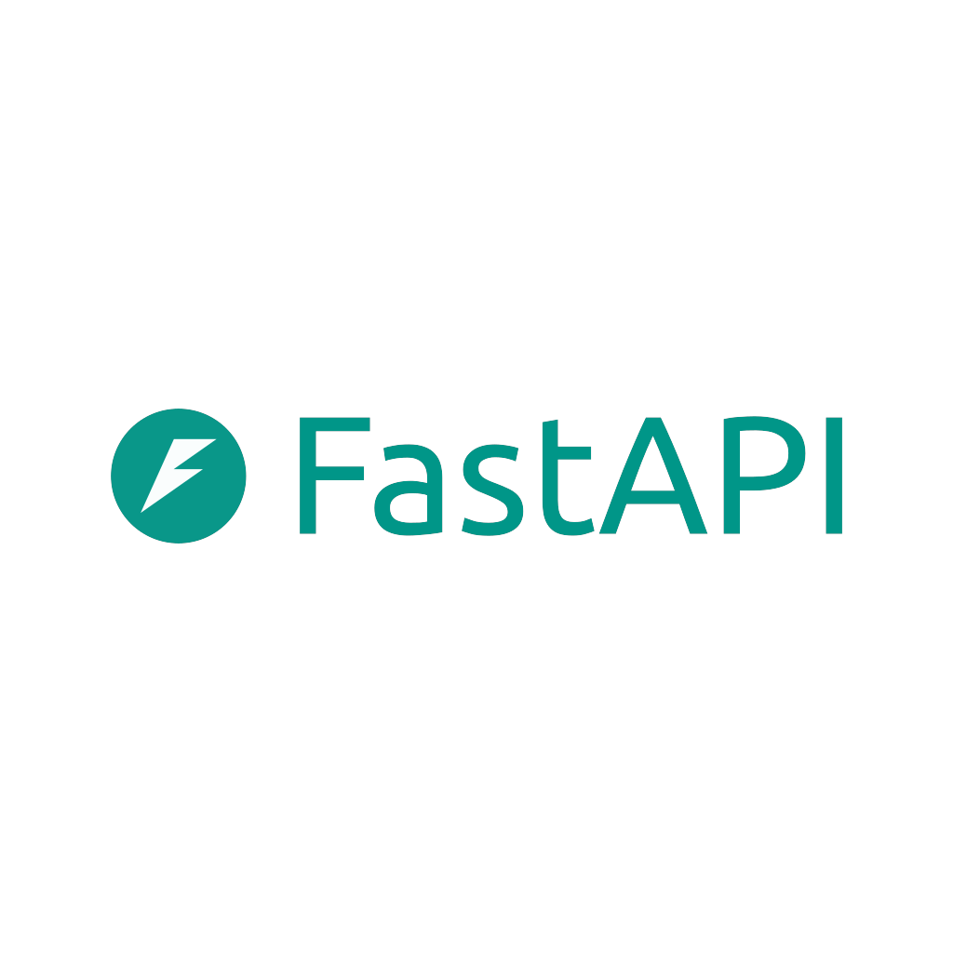





TECHNOLOGY STACK
FRONTEND LAYER (UI / UX)
API & GATEWAY LAYER
TECH STACK
• Technologies: HTML5, Vanilla CSS3, Modern JavaScript (ES6+)
• Interface Design: Cyber-minimal dark HUD theme with glassmorphism & responsive sidebar
• Real-Time Badging: Dynamic agent badges proving autonomous routing live
• Dual Language: Instant 1-click toggle between English and हिन्दी with auto-detection
• API Framework: FastAPI Asynchronous REST Server (<15ms latency)
• Core Endpoint: POST /chat handling query payloads & citations
• Data Validation: Pydantic v2 schemas for request validation & error types
• API Standards: OpenAPI 3.0 / Swagger UI docs with CORS middleware
JavaScript & HTML5
[FRONTEND UI] Cyber-HUD Chat Interface
FastAPI
[API GATEWAY] Async REST Server (/chat)
BACKEND: INDUSTRY & MSME AGENTS
BACKEND: CONSUMER & VERIFICATION AGENTS
• Core Runtime: Python 3.10+ Multi-Agent State Orchestrator
• Retriever Agent (RAG): Cosine similarity search over ChromaDB for standards (IS 16102, IS 14543)
• Certification Agent: Detailed steps for ISI Mark, CRS & FMCS schemes with timelines
• Lab Finder Agent: Locates nearest testing labs by product & state directory
• Clause Citations: Exact clause-level citations with zero hallucination guarantee
• Router Agent: Deterministic 0ms keyword classifier + LLM intent fallback
• Hallmarking Agent: 0-latency pure rule engine for 24K/22K/18K purity & 6-digit HUID
• Consumer Rights Agent: Plain-language guidance with BIS CARE app & 1915 helpline
• Translation Engine: Real-time bilingual synthesis into natural, fluent Hindi
• Fault Tolerance: Exponential backoff retry logic preventing GPU timeout crashes
Python 3.10+
[BACKEND CORE] Agent Swarm Orchestrator
ChromaDB
[DATABASE] Vector RAG + JSON Stores
Ollama Engine
[AI RUNTIME] Local GPU Model Host
DATABASE & STORAGE LAYER
LOCAL AI INFERENCE ENGINE
• Vector Database: ChromaDB (Persistent local vector embeddings storage)
• Embedding Model: Nomic-Embed-Text generating 768-dimensional dense vectors
• Structured Rule DB: Optimized JSON rule stores for schemes, labs & gold purity
• Document Store: Indexed Markdown knowledge base with clause metadata & tags
• Data Privacy: 100% on-premise local storage — zero data shared with cloud
• Model Server: Ollama Local Runtime with NVIDIA CUDA GPU acceleration
• Reasoning LLM: Qwen2.5 7B Instruct for domain reasoning & bilingual translation
• Cost & Dependency: 100% Offline execution, $0 token cost, zero external API latency
• Hardware Tuning: Quantized to run smoothly on commodity 6–8GB VRAM (RTX 3050/3060)
Qwen2.5 7B
[REASONING LLM] Bilingual Domain Generation
NVIDIA CUDA
[GPU HARDWARE] Zero-Latency Acceleration

Slide 5
FEASIBILITY & IMPACT
IMPLEMENTATION VIABILITY (DEMO-READY)
• Fully Operational MVP: Complete end-to-end working software ready and demonstrated live today.
• Commodity Hardware: Runs comfortably on standard 6–8GB VRAM consumer GPUs (RTX 3050/3060).
• Zero Operational Cost: 100% local inference eliminates expensive API token billing ($0 deployment cost).
• Guaranteed Demo Uptime: Zero reliance on external internet connections or third-party cloud availability.
TECHNICAL FOUNDATION & SCALABILITY
• Modular Micro-Agents: Decoupled architecture enables hot-plugging new standards and agent services.
• Grounded RAG Pipeline: Strict citation anchoring eliminates hallucinations and prevents legal misinformation.
• Sub-Second Latency: Deterministic rule engines deliver instantaneous responses for hallmarking & labs.
• Production-Ready Schema: Pydantic validated data structures ensure seamless future BIS CARE API sync.
MEASURABLE OUTCOMES & IMPACT
• 98% Time Reduction: Compresses compliance research from 3–5 hours across portals to <5 seconds.
• Empowering 63M+ MSMEs: Democratizes complex regulatory access, saving lakhs in third-party consultancy.
• Consumer Fraud Protection: Instant 6-digit HUID format checks shield buyers from counterfeit jewellery.
• Linguistic Inclusion: Hindi support empowers Tier-2 and rural artisans to achieve formal BIS certification.
CONCLUSION & NOVELTY (INFOTHON 7.0)
• Full Spectrum Coverage: The only platform unifying all 8 core BIS capabilities into one conversational interface.
• Transparent & Auditable: Every synthesized answer includes auditable source standard clauses and agent badges.
• National Scalability: Extensible to all 20,000+ Indian Standards covering 15 core national industry sectors.
• Autonomous Vision: Directly fulfills the theme: 'Architecting an Autonomous Tomorrow' for Indian regulatory compliance.

Slide 6
SYSTEM ARCHITECTURE & DEMO
MULTI-AGENT SWARM ARCHITECTURE
• Frontend Layer: Responsive Web Chat Interface with English & हिन्दी toggles.
• API Gateway: FastAPI async server managing conversation context & session routing.
• Backend Router: Deterministic keyword classifier (0ms) + LLM intent fallback:
• • Retriever Agent (RAG): Cosine similarity search over ChromaDB + nomic-embed-text.
• • Certification Agent: Maps products to ISI / CRS / FMCS schemes & application timelines.
• • Consumer Agent: Plain-language explanations linked with BIS CARE app & 1915 helpline.
• • Hallmarking Agent: 0-latency rule checks for 24K/22K/18K gold purity & 6-digit HUID.
• • Lab Finder Agent: Geo-directory filtering recognized testing laboratories by domain.
• Database Layer: ChromaDB vector store + structured JSON rule engines.
• Local AI Synthesis: Qwen2.5-7B Instruct synthesizes grounded answers on local GPU.
LIVE DEMO VALIDATION SCENARIOS
• Scenario 1: MSME Industry Guidance: LED Bulb manufacturer asks: 'How do I certify my LED lights?'
➔ Certification Agent explains CRS scheme with IS 16102 standard citation.
• Scenario 2: Consumer Protection in Hindi: User asks: '22 कैरेट सोने पर क्या हॉलमार्क होना चाहिए?'
➔ Hallmarking Agent responds in Hindi with 916 purity mark and HUID verification.
• Scenario 3: Testing Lab Locator: User asks: 'Where can I test packaged drinking water in Karnataka?'
➔ Lab Finder Agent returns accredited labs for IS 14543 with contact data.
• Scenario 4: Visual Agent Attribution: Every answer displays a live badge: 'Answered by: [Agent Name]'
➔ Proves autonomous routing live to hackathon judges with zero fake mockups.
• Future Roadmap: Direct BIS CARE API sync, voice telephony for rural artisans, & cataloging 20,000+ national standards.

