Slide 1



CYBER AEGIS

Slide 2
Fake News Analyzer

Slide 3
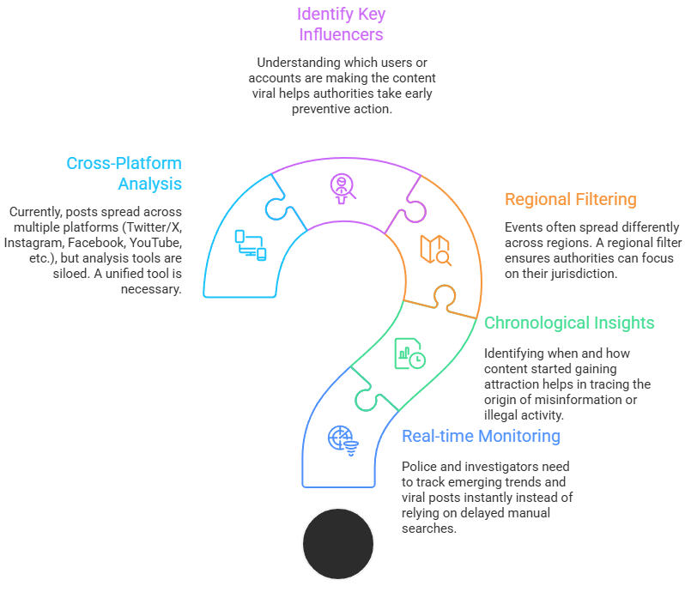
Why To Implement This Solution?
Key Problem
Social media has become a major platform for spreading news, opinions, and even misinformation. In sensitive situations like protests, crimes, or emergencies, certain posts can go viral and directly impact public safety. Law enforcement agencies require quick access to such information, but the current manual and platform-specific search methods are inefficient and time-consuming.
What Does We Want?
An Implemented solution which will help law enforcement agencies move from reactive investigation to proactive monitoring. Instead of finding out about viral posts after they cause harm, authorities will be able to trace, analyze, and mitigate risks in real-time.

Slide 4
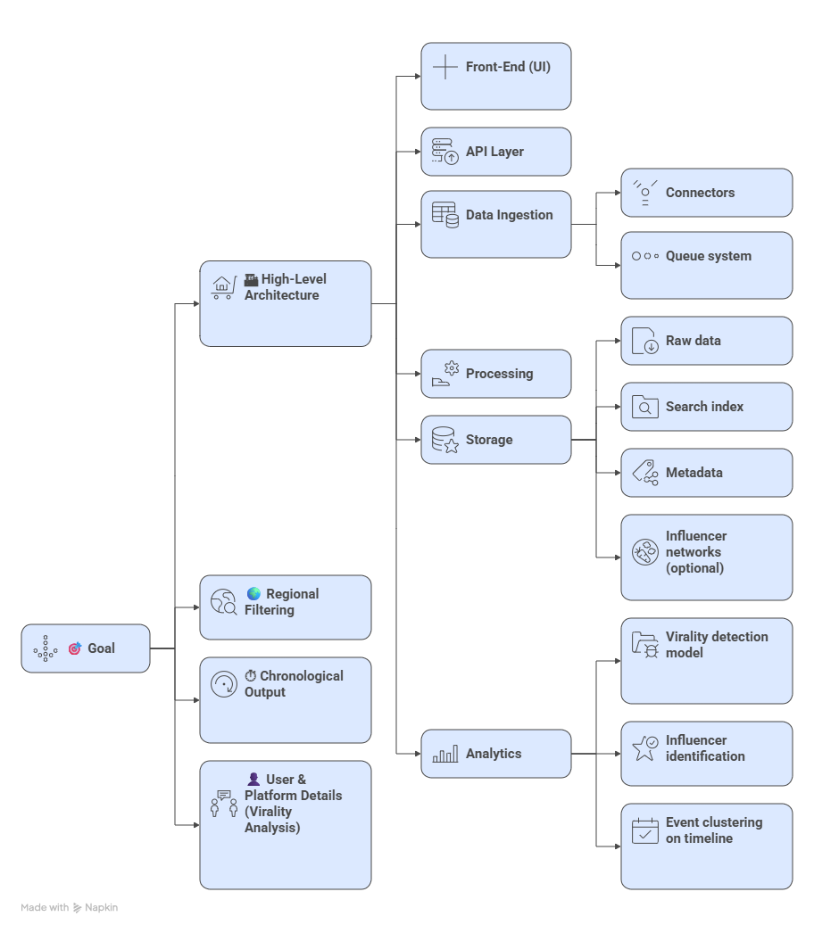
Workflow
How the System Works
Front-End (What police see):
A screen to type in keywords, select region, and choose time range.
Results shown as a timeline of posts.
Highlight the most influential users spreading the content
Data Collection:
Gathers posts directly from social media platforms.
If needed, gathers information through safe and legal methods.
Uses a system to handle large amounts of data smoothly.
Analysis (Making sense of data):
Detects viral content early.
Identifies influencers who spread it.
Groups posts into events along a timeline.
Key Features:
Regional filtering (tags, profile, text, language)
Chronological results (standard time order)
User details :-
Author Verification: Verifies the user posting content is valid or not.
Unique Key ID: It also shows unique key ID of author, posts, reposts, the author who had done reposts.
Dates & Time: Dates & Time of every posts and reposts will be shown.

Slide 5
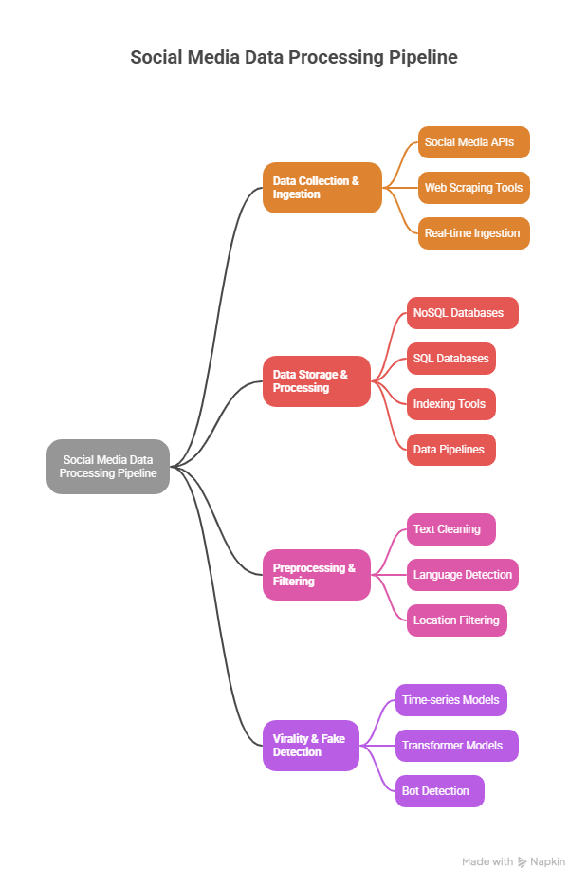
TECHNICAL APPROACH
Data Collection & Ingestion:
Collect posts through official social media APIs (Twitter/X API, Facebook Graph API, Instagram APIs).
Use web scraping tools (BeautifulSoup, Scrapy) where APIs are limited.
Real-time ingestion using Kafka or RabbitMQ for streaming.
Normalize collected data into a common schema (user info, post text, timestamp, engagement)
Data Storage & Processing:
Store raw posts, metadata, and user details in MongoDB (NoSQL) or PostgreSQL (SQL).
Use Elasticsearch/OpenSearch for indexing and fast keyword search.
Implement data pipelines with Apache Spark / Flink for large-scale processing.
Create a search index for quick retrieval of chronological results
Preprocessing & Filtering:
Text cleaning: NLTK / SpaCy
Language detection: fastText / langdetect
Location filtering: Geotags + Named Entity Recognition (NER)
Virality & Fake Detection:
Virality: Time-series models (ARIMA / Prophet / LSTM)
Fake post detection: Transformer models (BERT, RoBERTa)
Bot detection: Account metadata + anomaly detection

Slide 6
BENEFITS
Quick Access to Evidence – Instantly search and retrieve relevant posts with time, location, and user details.
Early Warning System – Detect viral or fake content before it causes public disorder.
Region-Specific Insights – Focus investigations on posts from the exact area of concern.
Fake News Filtering – Automatically flags suspicious posts, reducing manual verification work.
Better Decision Making – Data-driven insights for planning responses to protests, scams, or misinformation campaigns.
Legal Support – Provides digital evidence that can be used in reports or court cases.
Time Efficiency – Saves officers from manually scanning huge amounts of social media data.
Improved Public Safety – Helps prevent panic, fraud, or violence caused by fake/viral posts.
Cross-Platform View – One system shows activity across multiple platforms (Twitter, Facebook, Instagram, etc.).

Slide 7
RESEARCH AND REFERENCES

