Slide 1
3)Soham Gurav
Problem Statement :- Search and analyze social media posts regionally in chronological order
Team Name :- CYBER AEGIS

Slide 2
PRIVIOUS PROBLEMS
Privious fake posts example:

Slide 3
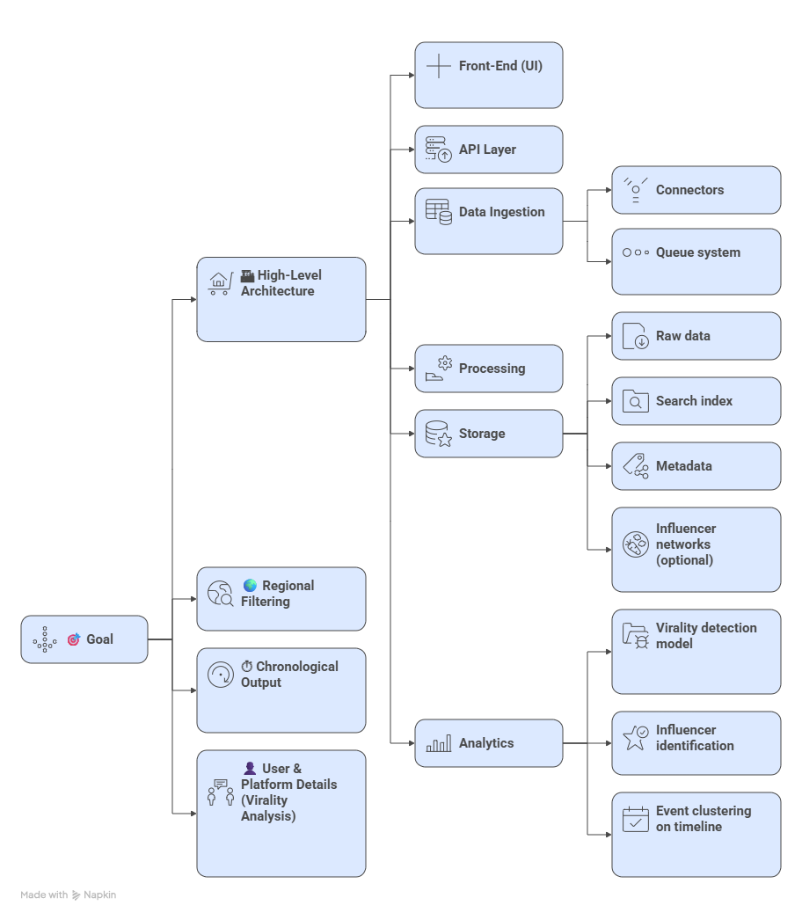
IDEA TITLE
Proposed Solution :-
🎯 Goal:
Allow police to search social media posts using keywords.
Show results by region and in correct time order.
Find out which users and platforms are making posts go viral
🏗 How the System Works
Front-End (What police see):
A screen to type in keywords, select region, and choose time range.
Results shown as a timeline of posts.
Highlight the most influential users spreading the content
Data Collection:
Gathers posts directly from social media platforms.
If needed, gathers information through safe and legal methods.
Uses a system to handle large amounts of data smoothly.
Analysis (Making sense of data):
Detects viral content early.
Identifies influencers who spread it.
Groups posts into events along a timeline.
🌍 Key Features:
Regional filtering (tags, profile, text, language)
Chronological results (standard time order)
User details (followers, account age, verification)

Slide 4
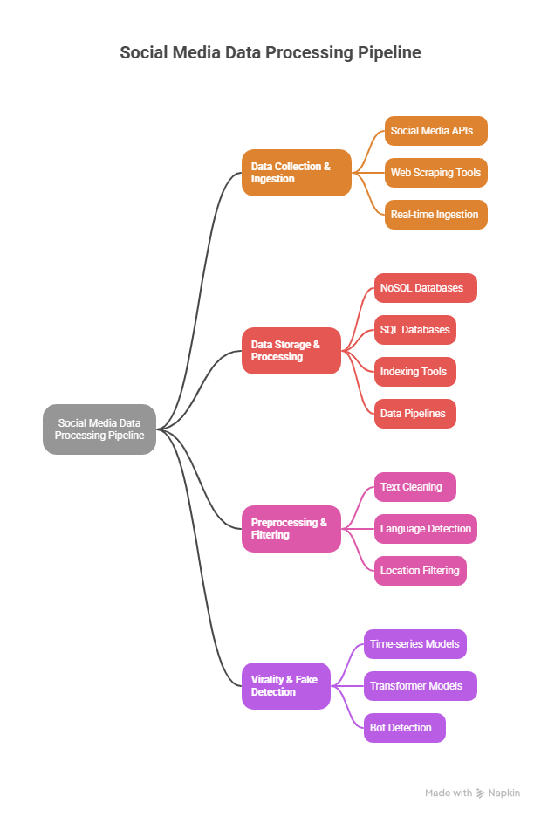
TECHNICAL APPROACH
Data Collection & Ingestion:
Collect posts through official social media APIs (Twitter/X API, Facebook Graph API, Instagram APIs).
Use web scraping tools (BeautifulSoup, Scrapy) where APIs are limited.
Real-time ingestion using Kafka or RabbitMQ for streaming.
Normalize collected data into a common schema (user info, post text, timestamp, engagement)
Data Storage & Processing:
Store raw posts, metadata, and user details in MongoDB (NoSQL) or PostgreSQL (SQL).
Use Elasticsearch/OpenSearch for indexing and fast keyword search.
Implement data pipelines with Apache Spark / Flink for large-scale processing.
Create a search index for quick retrieval of chronological results
Preprocessing & Filtering:
Text cleaning: NLTK / SpaCy
Language detection: fastText / langdetect
Location filtering: Geotags + Named Entity Recognition (NER)
Virality & Fake Detection:
Virality: Time-series models (ARIMA / Prophet / LSTM)
Fake post detection: Transformer models (BERT, RoBERTa)
Bot detection: Account metadata + anomaly detection

Slide 5
BENEFITS
Quick Access to Evidence – Instantly search and retrieve relevant posts with time, location, and user details.
Early Warning System – Detect viral or fake content before it causes public disorder.
Region-Specific Insights – Focus investigations on posts from the exact area of concern.
Fake News Filtering – Automatically flags suspicious posts, reducing manual verification work.
Better Decision Making – Data-driven insights for planning responses to protests, scams, or misinformation campaigns.
Legal Support – Provides digital evidence that can be used in reports or court cases.
Time Efficiency – Saves officers from manually scanning huge amounts of social media data.
Improved Public Safety – Helps prevent panic, fraud, or violence caused by fake/viral posts.
Cross-Platform View – One system shows activity across multiple platforms (Twitter, Facebook, Instagram, etc.).

Slide 6
RESEARCH AND REFERENCES

