Slide 1
A Practical Example
It’s time to write our first example of inserting data in and deleting it from a MySQL table using PHP.
The code in the next slides
First checks for any inputs that may have been made
Then either inserts new data into the table classics of the publications database or deletes a row from it, according to the input supplied.
Regardless of whether there was input, the program then outputs all rows in the table to the browser.
So let’s see how it works…

Slide 2
<?php // sqltest.php
require_once 'login.php’;
$conn = new mysqli($hn, $un, $pw, $db);
if ($conn->connect_error) die($conn->connect_error);
if (isset($_POST['delete']) && isset($_POST['isbn']))
{
$isbn = get_post($conn, 'isbn’);
$query = "DELETE FROM classics WHERE isbn='$isbn’”;
$result = $conn->query($query);
if (!$result) echo "DELETE failed: $query<br>" .
$conn->error . "<br><br>";
}
…
Notes:
The first section of new code starts by using the isset function to check whether values for all the fields have been posted to the program.
Upon confirmation, each line within the if statement calls the function get_post, which appears at the end of the program. This function has one small but critical job: fetching input from the browser.

Slide 3
…
if (isset($_POST['author']) && isset($_POST['title']) &&
isset($_POST['category']) && isset($_POST['year']) &&
isset($_POST['isbn']))
{
$author = get_post($conn, 'author’);
$title = get_post($conn, 'title’);
$category = get_post($conn, 'category’);
$year = get_post($conn, 'year’);
$isbn = get_post($conn, 'isbn’);
$query = "INSERT INTO classics VALUES" .
"('$author', '$title', '$category', '$year', '$isbn')";
$result = $conn->query($query);
if (!$result) echo "INSERT failed: $query<br>" . $conn->error . "<br><br>";
}
…

Slide 4
…
echo <<<_END
<form action="sqltest.php" method="post"><pre>
Author <input type="text" name="author">
Title <input type="text" name="title">
Category <input type="text" name="category">
Year <input type="text" name="year">
ISBN <input type="text" name="isbn">
<input type="submit" value="ADD RECORD">
</pre></form>
_END;
$query = "SELECT * FROM classics";
$result = $conn->query($query);
if (!$result) die ("Database access failed: " . $conn->error);
$rows = $result->num_rows;
…

Slide 5
…
for ($j = 0 ; $j < $rows ; ++$j)
{
$result->data_seek($j);
$row = $result->fetch_array(MYSQLI_NUM);
echo <<<_END
<pre>
Author $row[0]
Title $row[1]
Category $row[2]
Year $row[3]
ISBN $row[4]
</pre>
<form action="sqltest.php" method="post">
<input type="hidden" name="delete" value="yes">
<input type="hidden" name="isbn" value="$row[4]">
<input type="submit" value="DELETE RECORD"></form>
_END;
}
…

Slide 6
…
$result->close();
$conn->close();
function get_post($conn, $var)
{
return $conn->real_escape_string($_POST[$var]);
}
?>

Slide 7
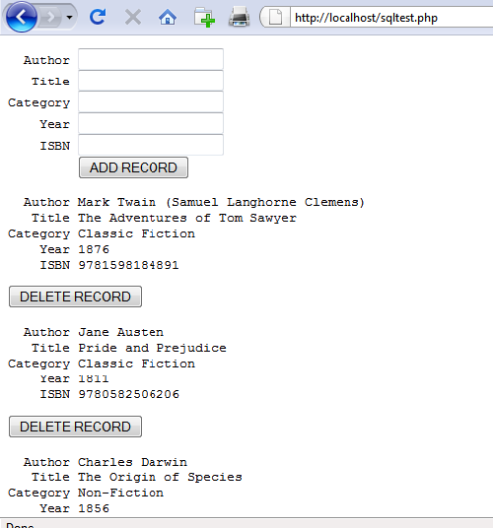

Slide 8
The $_POST Array
I mentioned in an earlier lecture that a browser sends user input through either a Get request or a Post request.
The Post request is usually preferred (because it avoids placing unsightly data in the browser’s address bar), and so we use it here.
The web server bundles up all of the user input (even if the form was filled out with a hundred fields) and puts in into an array named $_POST

Slide 9
The $_POST Array
Depending on whether a form has been set to use the Post or the Get method, either the $_POST or the $_GET associative array will be populated with the form data.
They can both be read in exactly the same way.
Each field has an element in the array named after that field.
Example: $_POST['isbn'] or $_POST["isbn"]

Slide 10
The $_POST Array
There is no reason to write to an element in the $_POST array.
Its only purpose is to communicate information from the browser to the program, and you’re better off copying data to your own variables before altering it.
TIP: So, back to the get_post function, which passes each item it retrieves through the real_escape_string method of the connection object to strip out any characters that a hacker may have inserted in order to break into or alter your database, like this:
function get_post($conn, $var)
{
return $conn->real_escape_string($_POST[$var]);
}

Slide 11
Deleting a Record
Prior to checking whether new data has been posted, the program checks whether the variable $_POST['delete'] has a value.
If so, the user has clicked the DELETE RECORD button to erase a record.
In this case, the value of $isbn will also have been posted.
As you’ll recall, the ISBN uniquely identifies each record.
The HTML form appends the ISBN to the DELETE FROM query string created in the variable $query, which is then passed to the query method of the $conn object to issue it to MySQL.

Slide 12
Deleting a Record
If $_POST['delete'] is not set, $_POST['author'] and other posted values are checked.
If they have all been given values, then $query is set to an INSERT INTO command, followed by the five values to be inserted.
The string is then passed to the query method, which upon completion returns either TRUE or FALSE.
If FALSE is returned, the error message held in the error property of the $conn object is displayed, like this:
if (!$result) echo "INSERT failed: $query<br>" . $conn->error . "<br><br>";

Slide 13
Displaying the Form
You should recall the echo <<<_END..._END structure from previous lectures, which outputs everything between the _END tags.
Instead of the echo command, the program could also drop out of PHP using ?>, issue the HTML, and then reenter PHP processing with <?php.
Whichever style used is a matter of programmer preference, but I always recommend staying within PHP code for these reasons:
It makes it very clear when debugging (and also for other users) that everything within a .php file is PHP code. Therefore, there is no need to go hunting for dropouts to HTML.
When you wish to include a PHP variable directly within HTML, you can just type it. If you had dropped back to HTML, you would have had to temporarily reenter PHP processing, access the variable, and then drop back out again.

Slide 14
Displaying the Form
The HTML form section simply sets the form’s action to sqltest.php
This means that when the form is submitted, the contents of the form fields will be sent to the file sqltest.php, which is the program itself.
The form is also set up to send the fields as a Post rather than a Get request.
This is because Get requests are appended to the URL being submitted to and can look messy in your browser.

Slide 15
…
echo <<<_END
<form action="sqltest.php" method="post"><pre>
Author <input type="text" name="author">
Title <input type="text" name="title">
Category <input type="text" name="category">
Year <input type="text" name="year">
ISBN <input type="text" name="isbn">
<input type="submit" value="ADD RECORD">
</pre></form>
_END;
$query = "SELECT * FROM classics";
$result = $conn->query($query);
if (!$result) die ("Database access failed: " . $conn->error);
$rows = $result->num_rows;
…

Slide 16
Displaying the Form
A Get request also allows users to easily modify submissions and try to hack your server.
Therefore, whenever possible, you should use Post submissions, which also have the benefit of hiding the posted data from view.
Having output the form fields, the HTML displays a Submit button with the name ADD RECORD and closes the form.
Note the <pre> and </pre> tags, which have been used to force a monospaced font and allow all the inputs to line up neatly.
The carriage returns at the end of each line are also output when inside <pre> tags.

Slide 17
Querying the Database
Using the value in $rows, a for loop is then entered to display the contents of each row. Within each iteration of the loop, the data_seek method of the $result object is called to seek to the relevant items of data we’re interested in, like this:
$result->data_seek($j);
Then the array $row is populated with a row of results by calling the fetch_array method of $result, passing it the constant value MYSQLI_NUM, which forces the return of a numeric (rather than associative) array, like this:
$row = $result->fetch_array(MYSQLI_NUM);
With the data in $row, it’s now a simple matter to display it within the heredoc echo statement that follows in which I have chosen to use a <pre> tag to line up the display of each record in a pleasing manner.

Slide 18
Querying the Database
After the display of each record, there is a second form that also posts to sqltest.php (the program itself) but this time contains two hidden fields: delete and isbn.
The delete field is set to yes and isbn to the value held in $row[4], which contains the ISBN for the record.
Then a Submit button with the name DELETE RECORD is displayed, and the form is closed.
A curly brace then completes the for loop, which will continue until all records have been displayed, at which time the $result and $conn object’s close methods are closed to release resources back to PHP:
$result->close();
$conn->close();

Slide 19
for ($j = 0 ; $j < $rows ; ++$j)
{
$result->data_seek($j);
$row = $result->fetch_array(MYSQLI_NUM);
echo <<<_END
<pre>
Author $row[0]
Title $row[1]
Category $row[2]
Year $row[3]
ISBN $row[4]
</pre>
<form action="sqltest.php" method="post">
<input type="hidden" name="delete" value="yes">
<input type="hidden" name="isbn" value="$row[4]">
<input type="submit" value="DELETE RECORD"></form>
_END;
}

Slide 20
Querying the Database
Finally, you see the definition for the function get_post, which we’ve already looked at.
And that’s it—our first PHP program to manipulate a MySQL database. So, let’s check out what it can do.

Slide 21
Querying the Database
Once you have typed the program (and corrected any typing errors), try entering the following data into the various input fields to add a new record for the book Moby Dick to the database:
Herman Melville
Moby Dick
Fiction
1851
9780199535729

Slide 22
Running the Program
When you have submitted this data using the ADD RECORD button, scroll down to the bottom of the web page to see the new addition.

Slide 23
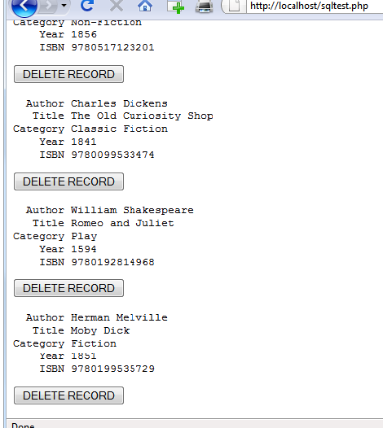

Slide 24
Running the Program
Now let’s look at how deleting a record works by creating a dummy record.
So try entering just the number 1 in each of the five fields and click the ADD RECORD button.
If you now scroll down, you’ll see a new record consisting just of 1s.
Obviously, this record isn’t useful in this table, so now click the DELETE RECORD button and scroll down again to confirm that the record has been deleted.

Slide 25
Running the Program
Assuming that everything worked, you are now able to add and delete records at will.
Try doing this a few times, but leave the main records in place (including the new one for Moby Dick), as we’ll be using them later.
You could also try adding the record with all 1s again a couple of times and note the error message that you receive the second time, indicating that there is already an ISBN with the number 1.

Slide 26
Practical MySQL
You are now ready to look at some practical techniques that you can use in PHP to access the MySQL database, including tasks such as:
creating and dropping tables;
inserting, updating, and deleting data;
protecting your database and website from malicious users

Slide 27
Creating a Table
Let’s assume that you are working for a wildlife park and need to create a database to hold details about all the types of cats it houses.
You are told that there are nine families of cats—Lion, Tiger, Jaguar, Leopard, Cougar, Cheetah, Lynx, Caracal, and Domestic—so you’ll need a column for that.
Then each cat has been given a name, so that’s another column, and you also want to keep track of their ages, which is another.
Of course, you will probably need more columns later, perhaps to hold dietary requirements, inoculations, and other details, but for now that’s enough to get going.
A unique identifier is also needed for each animal, so you also decide to create a column for that called id.

Slide 28
<?php
require_once 'login.php’;
$conn = new mysqli($hn, $un, $pw, $db);
if ($conn->connect_error) die($conn->connect_error);
$query = "CREATE TABLE cats (
id SMALLINT NOT NULL AUTO_INCREMENT,
family VARCHAR(32) NOT NULL,
name VARCHAR(32) NOT NULL,
age TINYINT NOT NULL,
PRIMARY KEY (id)
)";
$result = $conn->query($query);
if (!$result) die ("Database access failed: " . $conn->error);
?>
As you can see, the MySQL query looks pretty similar to how you would type it directly in the command line, except that there is no trailing semicolon, as none is needed when you are accessing MySQL from PHP.

Slide 29
Describing a Table
When you aren’t logged into the MySQL command line, here’s a handy piece of code that you can use to verify that a table has been correctly created from inside a browser.
It simply issues the query DESCRIBE cats and then outputs an HTML table with four headings—Column, Type, Null, and Key—underneath which all columns within the table are shown.

Slide 30
<?php
require_once 'login.php’;
$conn = new mysqli($hn, $un, $pw, $db);
if ($conn->connect_error) die($conn->connect_error);
$query = "DESCRIBE cats";
$result = $conn->query($query);
if (!$result) die ("Database access failed: " . $conn->error);
$rows = $result->num_rows;
...

Slide 31
…
echo "<table><tr><th>Column</th><th>Type</th><th>Null</th><th>Key</th></tr>";
for ($j = 0 ; $j < $rows ; ++$j)
{
$result->data_seek($j);
$row = $result->fetch_array(MYSQLI_NUM);
echo "<tr>";
for ($k = 0 ; $k < 4 ; ++$k) echo "<td>$row[$k]</td>";
echo "</tr>";
}
echo "</table>";
?>

Slide 32
The output from the program should look like this:
Column Type Null Key
id smallint(6) NO PRI
family varchar(32) NO
name varchar(32) NO
age tinyint(4) NO

