Slide 1
RESTAURANT PROFIT ANALYSIS
Presented By:-
HARSHIT
JAI
SOWMEYA
ANUBHAV

Slide 2
PROBLEM
At what location in a city can open a restaurant, so that he can make maximum profit according to his budget?

Slide 3
SOLUTION
So we prepared a dataset of restaurants at various locations in Jaipur city their cuisines with the cost for two persons, parking facility and several other parameters.
This dataset is used to predict profit at which place, what kind of restaurants must be started to get the maximum of profit.
Also to solve queries whose analysis are done through MAPREDUCER.

Slide 4
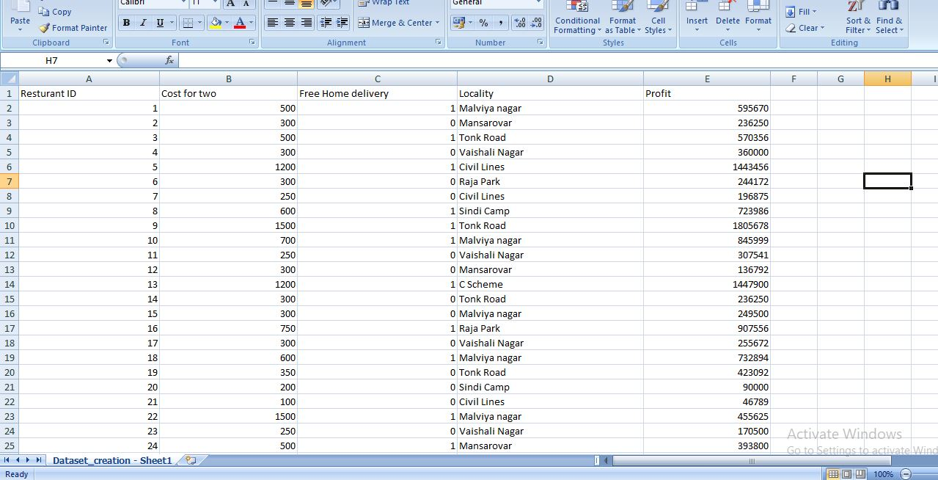
OUR DATASET

Slide 5
TECHNOLOGIES USED
Computer Vision
Speech Recognition
Ansible
Docker
Hadoop
MapReduce
Machine Learning (Multi Linear Regression)

Slide 6
FACE AUTHENTICATION
MENU
INPUT
OpenCV
Socket programming
HADOOP CLUSTER AND MAP REDUCE CLUSTER SETUP
ML
(Multi-Linear Regression)
MAP REDUCE
PROGRAM
PREDICTION OF DATA
ANALYSIS OF DATA
OUTPUT

Slide 7
FUTURE ASPECTS
Our future aspect is to make our model feasible for other cities too.
Also we will make an Android app & Website
Also we will make our model feasible not only for resturants but also for other businesses like Electronics , clothing etc

