Slide 1
IBM University Engagement Project Submission
“Exploring the Power of Agentic AI with IBM Granite and LangFlow”

Slide 2

Project Tile – Multi-language Course Content Translator Agent
Domain of Project – Education
Student Name | Recent Passport Photo | Email ID | Mobile number [WhatsApp]

Slide 3
Problem Statement - 17
Multi-language Course Content Translator Agent
The Challenge:-
Language barriers create difficulties for students in understanding academic materials, especially when technical concepts are available primarily in English. Traditional translation tools often fail to preserve subject-specific terminology, technical accuracy, and educational context. There is a need for an intelligent translation solution that can convert academic notes, PDFs, and presentations into regional languages while maintaining the original meaning and learning value.
Objectives:-
Develop an AI-powered agent to translate academic content into multiple regional languages, including Hindi, Marathi, Tamil, and Bengali.
Utilize Retrieval-Augmented Generation (RAG) to retrieve relevant academic glossaries and subject-specific terminology.
Integrate IBM Granite to generate accurate, context-aware translations.
Support uploads of PDFs, presentations, notes, and other learning materials.
Preserve technical terms, original meaning, and educational context during translation.
Promote inclusive education by making quality learning resources accessible to students from diverse linguistic backgrounds.

Slide 4
Proposed Solution -
Multi-language Course Content Translator Agent
We propose an AI-powered, RAG-based multilingual translation agent that converts academic learning materials into regional languages while preserving technical accuracy and educational context.
The system allows students to upload PDFs, PPTs, and study notes, select their preferred language, and receive clear, context-aware translations.
Key Components of the Solution:
Document Processing: Extracts text from uploaded PDFs, presentations, and notes.
RAG Integration: Retrieves relevant academic glossaries, curriculum references, and subject-specific terminology.
IBM Granite Integration: Uses IBM Granite to understand academic content and generate accurate translations.
Multilingual Translation: Supports regional languages such as Hindi, Marathi, Tamil, Bengali, and more.
Context Preservation: Maintains technical terms, subject meaning, and the original educational context.
Downloadable Output: Provides translated content in an easy-to-read and reusable format.
Our Goal: To make quality educational resources accessible to every student, regardless of their language preference, through intelligent and context-aware AI translation.

Slide 5
Technology Used
IBM Cloud: watsonx.ai, IBM Granite, Watson Translator.
RAG: ChromaDB, Sentence Transformers, Academic Glossary.
Backend: Python 3.14, FastAPI, Uvicorn.
Document Processing: PyMuPDF, python-docx, python-pptx.
Frontend: HTML5, CSS3, JavaScript.
Testing: Pytest (28/28 tests passed).

Slide 6
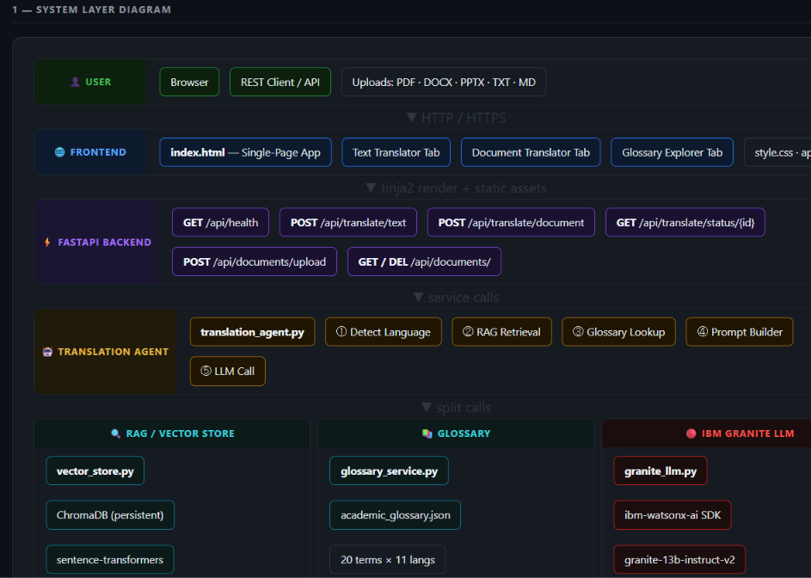
Architecture blueprint

Slide 7
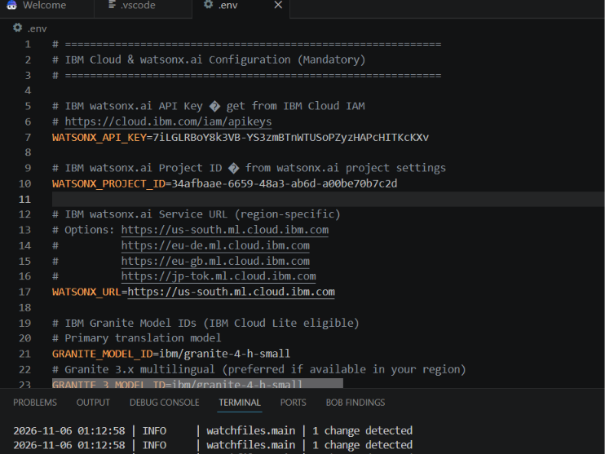

Slide 8

Role of Agentic AI in the solution
Role of Agentic AI in the Solution
Agentic AI acts as an intelligent coordinator that autonomously manages the academic translation process by understanding user requirements, selecting appropriate tools, retrieving relevant information, and generating context-aware translations.
Key Roles:
Intelligent Document Analysis: Automatically identifies the uploaded document's content, subject, and academic context.
Language Selection: Processes the user's preferred regional language and translation requirements.
Smart Knowledge Retrieval: Uses RAG to retrieve relevant academic glossaries and subject-specific terminology.
Context-Aware Translation: Uses IBM Granite to generate accurate translations while preserving technical terms and original meaning.
Quality Validation: Checks translated content for missing information, terminology consistency, and contextual accuracy.
Automated Workflow Management: Coordinates document processing, retrieval, translation, and output generation through Langflow.
Overall Role: Agentic AI transforms traditional translation into an intelligent, automated, and context-aware process, making academic learning materials more accessible across different regional languages.

Slide 9
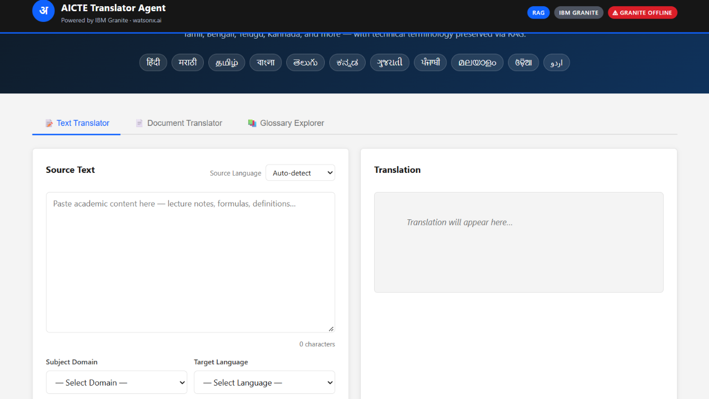
Project Output Screenshot

Slide 10
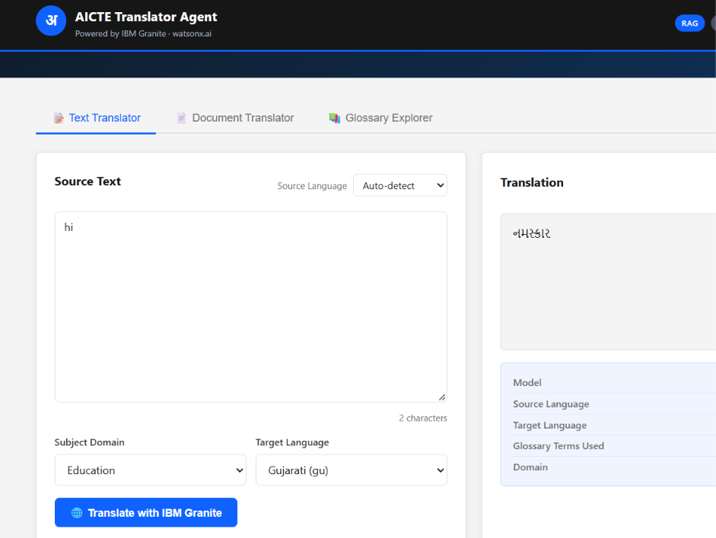

Slide 11
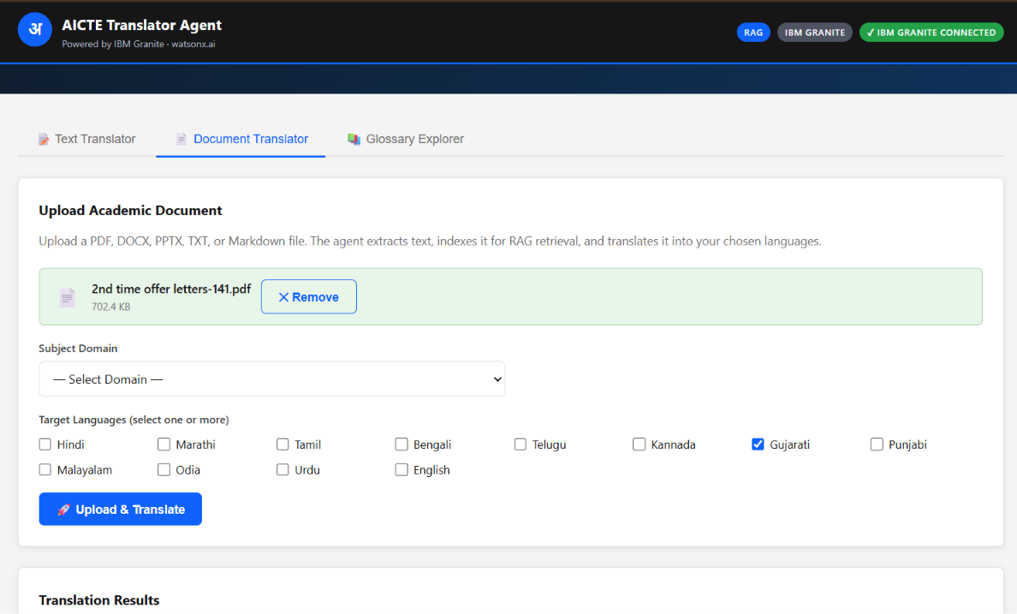

·
·
·

Slide 12
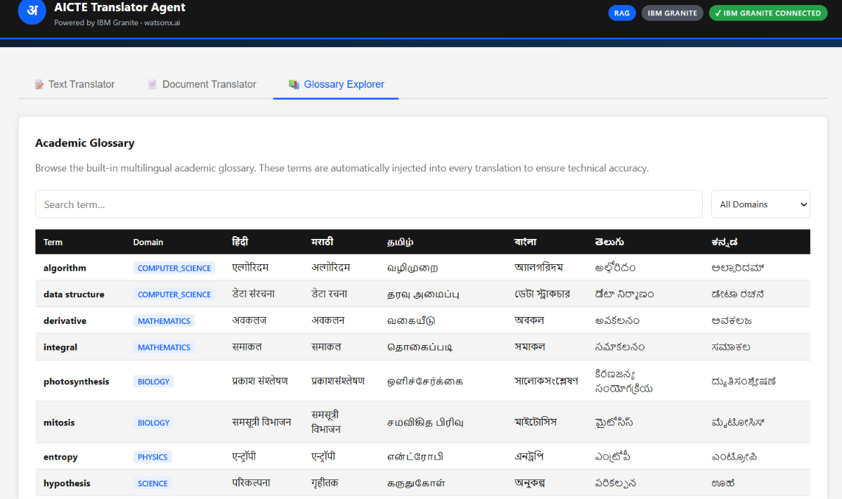

Slide 13
Novelty and Uniqueness
Context-Aware Academic Translation: Goes beyond word-to-word translation by understanding subject-specific concepts and educational context.
RAG-Powered Accuracy: Retrieves relevant academic glossaries, curriculum references, and technical terminology before generating translations.
Agentic AI Automation: Intelligently coordinates document analysis, knowledge retrieval, translation, and quality validation.
Multilingual Accessibility: Supports multiple Indian regional languages, including Hindi, Marathi, Tamil, Bengali, and more.
Technical Terminology Preservation: Maintains important scientific, mathematical, and technical terms without losing their intended meaning.
Multi-Format Document Support: Enables translation of academic PDFs, PowerPoint presentations, and study notes.
IBM Granite Integration: Leverages IBM's generative AI technology for intelligent and context-aware translation.
Inclusive Learning Experience: Helps students access educational resources in their preferred languages, reducing language barriers in education.
What Makes It Unique?
Unlike conventional translation tools, our solution combines Agentic AI, RAG, and IBM Granite to deliver academically meaningful translations while preserving technical accuracy and educational context.

Slide 14
Git Hub Link
Github URL – https://github.com/harshita-07Z/Aicte-Translator-Agent.git
·
·
·

Slide 15
Future Scope
Expansion of Regional Languages: Extend support to more Indian and international languages to reach a wider student community.
Voice-Based Translation: Introduce speech-to-text and text-to-speech features for audio-based learning and accessibility.
Real-Time Translation: Enable instant translation of live lectures, classroom discussions, and educational videos.
AI-Powered Summarization: Generate concise summaries, key points, and revision notes in the user's preferred language.
Interactive AI Learning Assistant: Integrate a chatbot that answers students' questions based on uploaded academic materials.
Improved Translation Quality: Continuously enhance accuracy using updated academic glossaries and curriculum-specific knowledge bases.
Mobile Application Integration: Develop Android and iOS applications for easy access to translated study materials.
Personalized Learning Experience: Adapt explanations and translations according to students' academic levels and learning needs.
Long-Term Vision: To build an intelligent multilingual learning ecosystem that makes quality education accessible, inclusive, and understandable for students regardless of their linguistic background.
·
·
·

Slide 16
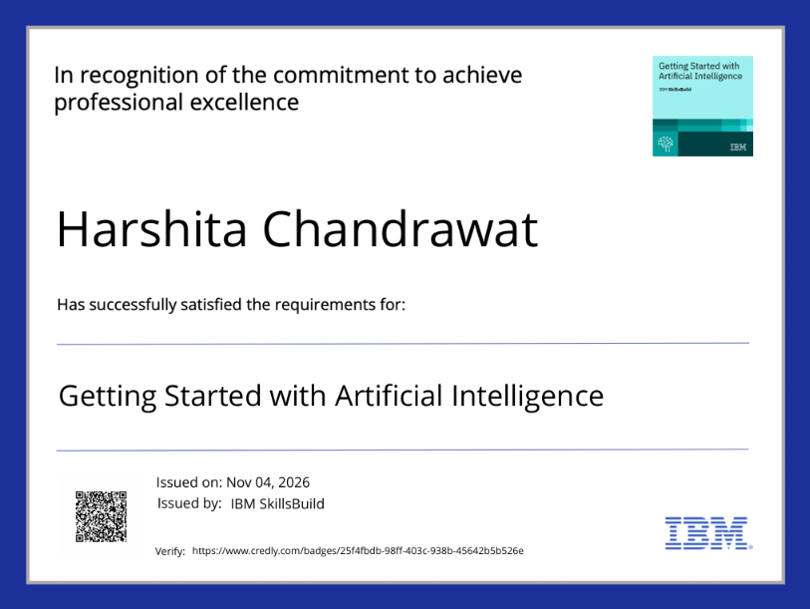
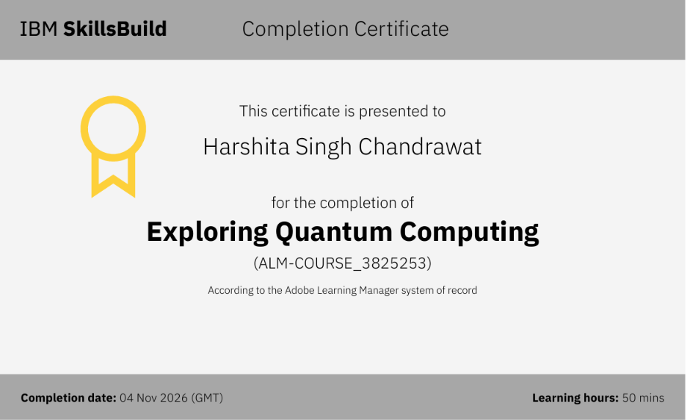
Certificates Earned:
Please add your credly certificate

Slide 17
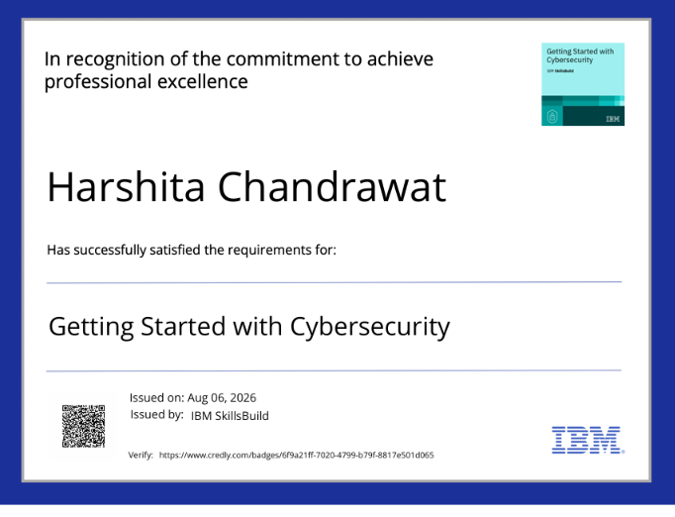

Slide 18
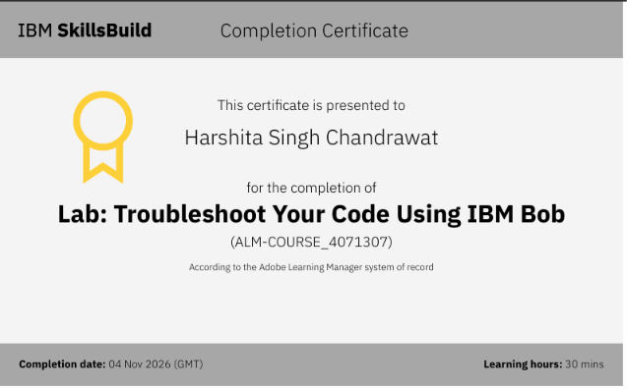
Certificates Earned:​
Add your IBM BOB Certificate

Slide 19


