Slide 1



HIRING PROCESS ANALYTICS
Submitted By Harshita Mundhe

Slide 2

PROJECT DESCRIPTION
In this project we have given a dataset of a company which includes the details about people who registered for a particular post in a department of this company. We have to go through this datasets and need to draw insights out of it as it this analysis will be helpful for hiring departments in finding number of rejections, number of interviews, types of jobs, vacancies etc. which are very important for a company to analyze before hiring fresher or any other individual.
For implementing this project we are required to use Excel formulas and statistics to draw useful insights which will help the company.

Slide 3

APPROACH
For implementing this project first we have to download the given dataset and open it using Google Sheets or Excel to give the answers and to draw the meaningful insights from it.
I used different excel formulas to get the results like min, max, avg and so on. I also used pivot table and pivot chart concepts for getting output. And to present the output in more effectively I used graphs, charts and so on as they help us to quickly analyze data and see relationships.

Slide 4

TECH-STACK USED
Microsoft Excel: I have used Microsoft Excel 2019 MSO (Version 2212 Build 16.0.15928.20196) for getting the meaningful insights from given dataset as it provides high-level visual summaries, trends and it helps us to understand the data through natural language queries that allow us to ask questions about the data without having to write complicated formulas.
PowerPoint Presentation: I have used Microsoft PowerPoint 2019 MSO (Version 2212 Build 16.0.15928.20196) 64-bit to create a report as it allow us to present the complex ideas, facts, or figures into easily digestible visuals.

Slide 5
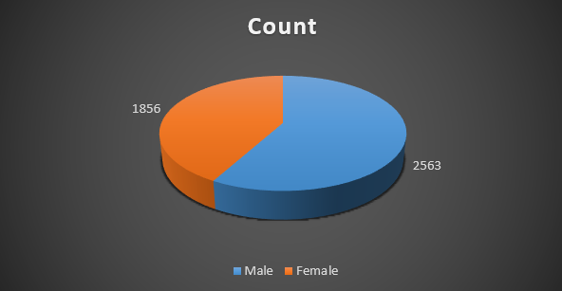


INSIGHTS
Count of Male and Females that are hired :-
For getting count of hired male and females I have used two COUNTIF() functions one for counting those people who are hired and other count to differentiate male and female. And at last I have used pie chart to convert the result into visual representation.
Result:

Slide 6

INSIGHTS
Average salary offered by the company :-
For getting average salary offered by the company I used AVERAGE() function by taking range as column offered salary.
Result:

Slide 7
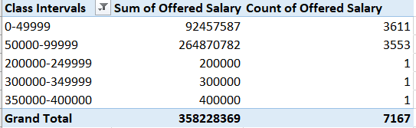
INSIGHTS
Class intervals for salary in the company:-
For getting class intervals I first created a pivot table which contains offered salary, sum of offered salary, count of offered salary. Then I used Group option to group salaries with difference of 50000.
Result:

Slide 8
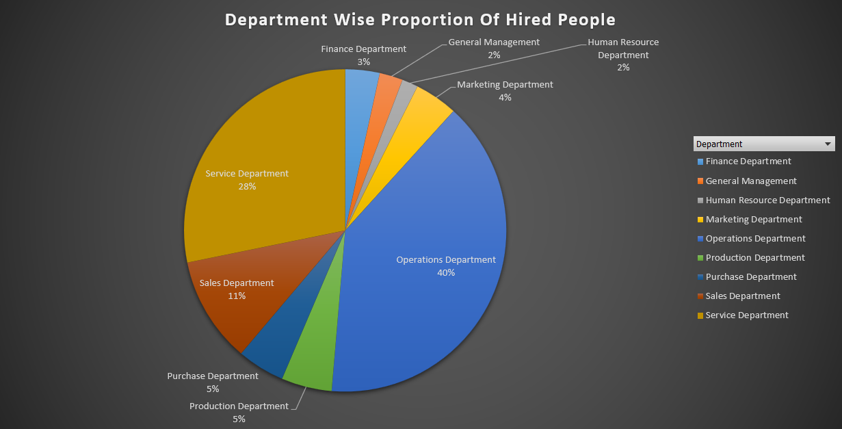
INSIGHTS
Pie Chart/Graph for showing proportion of people working in different department :-
For getting proportion of people working in different department I created a pivot table of department and value as Grand %. And then I have used pivot chart to display results into graphical representation.
Result:

Slide 9
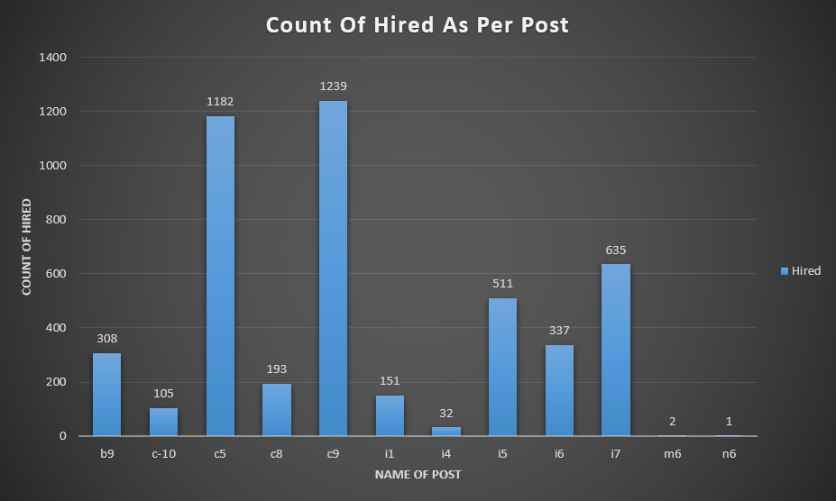
INSIGHTS
Representation of different post tiers using chart/graphs :-
First I created a pivot chart containing count of people hired for different post. And then I used pivot chart for representing the results.
Result:

Slide 10

RESULTS
From these project I understood how to use excel formulas to get the desired insights / output. I got to learn various excel formulas like min, max, avg, count and so on. I got to learn what is pivot table, how to create it and importance of the same. I also got to learn how to represent the data using graphs/charts to make the data / insights quickly and easily understandable.
Drive link: https://docs.google.com/spreadsheets/d/1qbPOANwZJM7dh4fNRIJ3VygnYstPwUfe/edit?usp=sharing&ouid=107724859837928146273&rtpof=true&sd=true

Slide 11

THANK YOU

