Slide 1
Analyzing the Fast Food Market
Python for Data Science
Javier Marín
Marçal Garcia Boris
Team 1: Enric, Harshita, Henning, Iman, Pien

Slide 2
Objective
Analyzing and comparing the stock market performance of 10 leading fast-food companies, uncover industry trends, and evaluate key performance drivers through data-driven insights and visualizations
SBUX: Starbucks Corporation
DPZ: Domino's Pizza, Inc.
MCD: McDonald's Corporation
LKNCY: Luckin Coffee Inc.
QSR: Restaurant Brands International Inc. (propietario de Burger King, Tim Hortons, y Popeyes)
WEN: The Wendy's Company
PZZA: Papa John's International, Inc.
YUM: Yum! Brands, Inc. (propietario de KFC, Pizza Hut y Taco Bell)
BRK-A: Berkshire Hathaway Inc. (Clase A)
DNUT: Krispy Kreme, Inc.

Slide 3
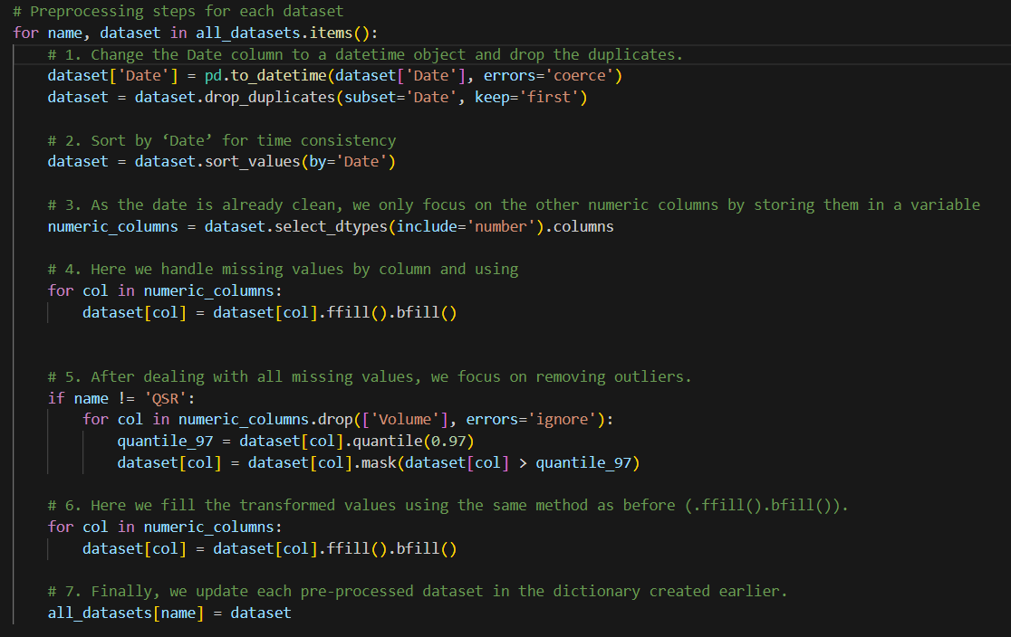
Data Preprocessing
Remove Duplicate Dates
Sort data base on Date column
Imputing Null data
Removing outliers
Replacing outliers data
Replace dataset
Notes:
Meeting notes: things to prepare for the Q&A: Why did we use this plot, or did preprocessing metric.
Is this real or fake and how did you get this number.
Ask us about the real markets, why is the data set reacting this way?
Why is there a lower price in 2019?

Slide 4
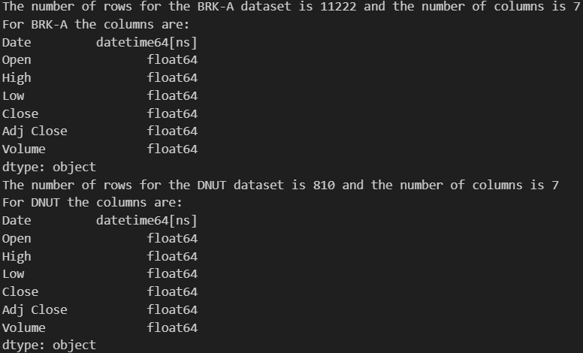
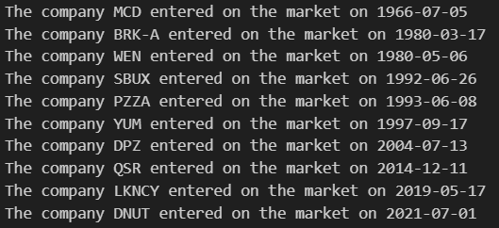
Exercise 1 – Understanding the Data Formats
Each dataset has the same columns and the same types
Columns & Data Type
The datasets have different shapes, which means that each company has different time entries in the historical stock data
Each company went public at different times
Rows

Slide 5
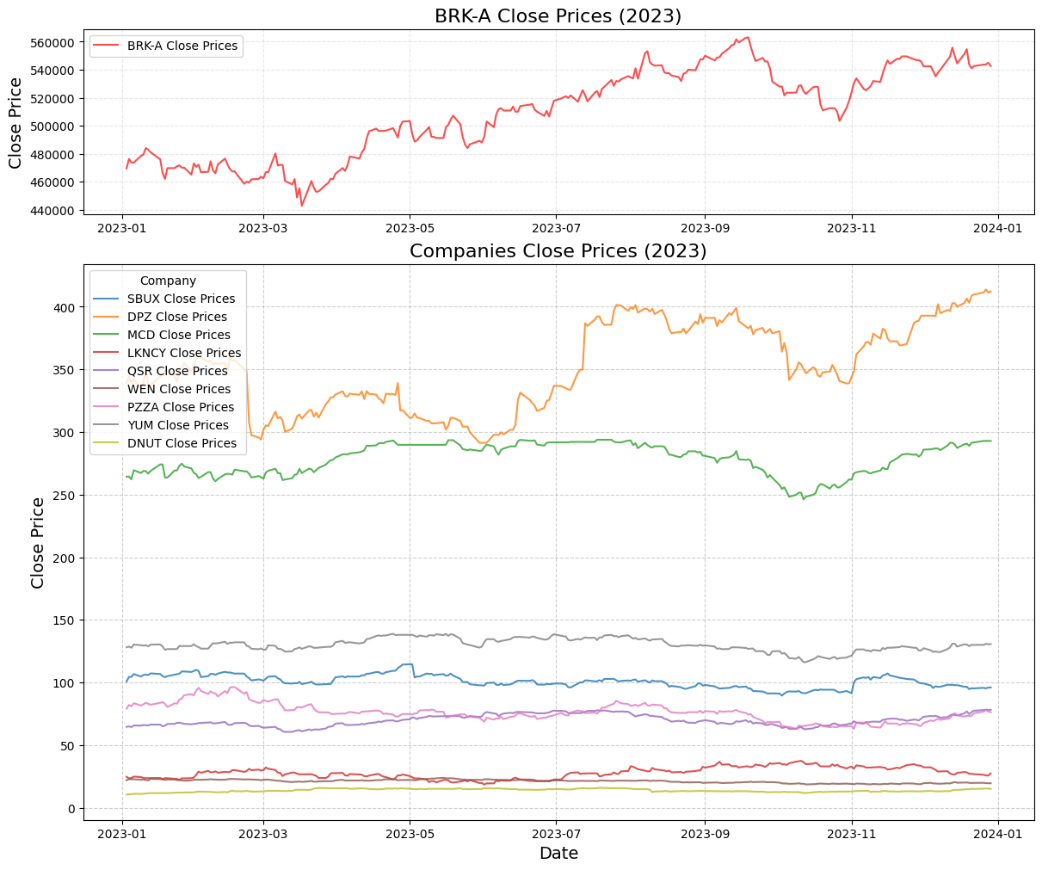
Exercise 2 - Trends and Rows for the year 2023
Rows & Subplots
For the year 2023 there 2500 rows 250 for each company
The subplots helps visualize the Price Close trend for each company in 2023
Key Insights
Huge Close Price diff: BRK-A (440k - 560$) vs rest of Companies (400 - 10$)
Stable stock price pattern
Price fluctuations for DPZ and BRK-A
Domino's Pizza price rise. (Partnerships Uber, Promotions, Tech investments...)
BRK-A price rise. (Warren Buffet investment strategy)
Market Perspective

Slide 6
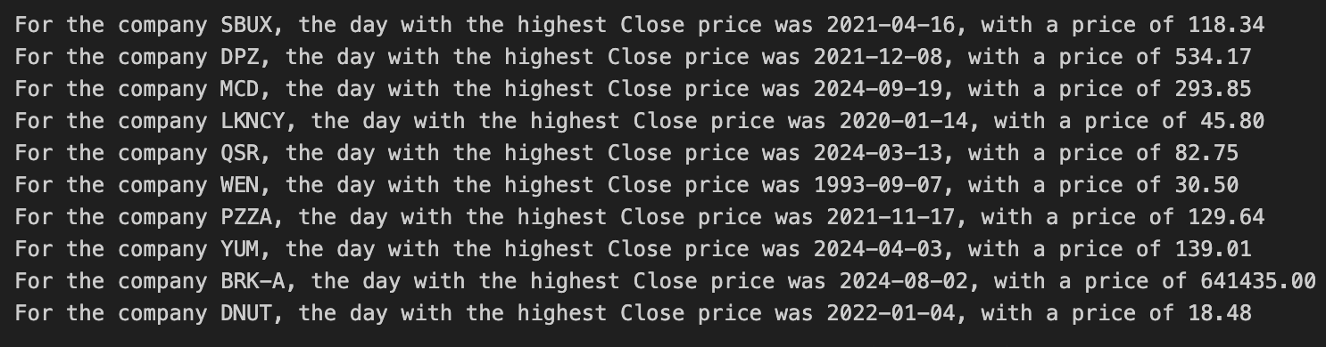
Exercise 3 - Spotting the Pinnacle of Stock Market Success
Loops through datasets to find each company's highest close price and date.
Using max() and idxmax() to identify the price and its index
Prints the company name, price, and date in a formatted output
Looping
Most companies hit peak prices recently, except Wendy's (WEN), which peaked in 1993
Berkshire Hathaway (BRK-A) dominates with a peak of $641,435 in 2024
Domino's (DPZ) and McDonald's (MCD) outperformed others, while most remain below $150
Key Insights
Wendy's (WEN) peak price of $30.50 in 1993 was driven by a 68% stock return that year
Post-COVID Recovery
Shift in Consumer Behaviour and global expansions
Market Perspective

Slide 7
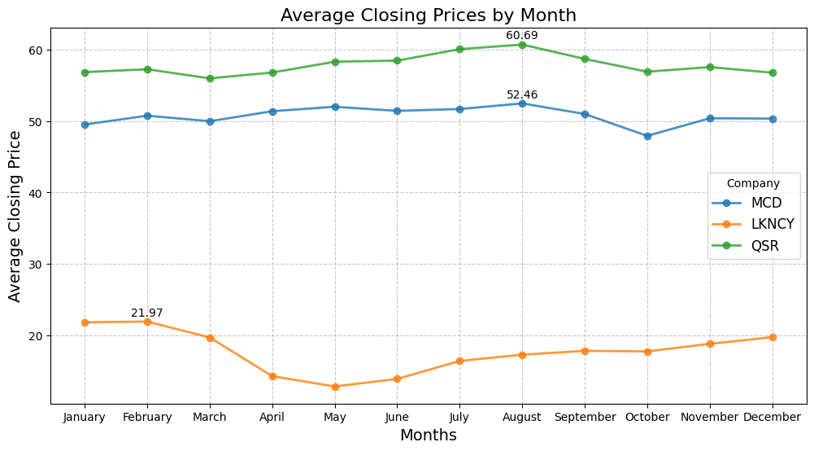
Exercise 4 - Visualizing Monthly Closing Price Averages
Line Chart
Ideal for grouping by months and showing trends in average closing prices
Highlights peaks in months with highest stock prices and shows patterns in stock fluctuations
Key Insights (MCD, LKNCY, QSR)
LKNCY: Decline from March–May; recovery at year-end/beginning
MCD & QSR: Mostly consistent throughout with peaks in August, dips in March/October
MCD: Higher prices reflect its long history and market dominance compared to QSR
LKNCY May Dip and Winter peak: Lower demand -> post-spring break and exams. Higher demand -> more coffee demand in the colder months
August Peak: Higher demand driven by vacations and tourism
MCD’s Growth: Stock surged since its 1966 IPO, growing from $3 to nearly $300
Market Perspective

Slide 8
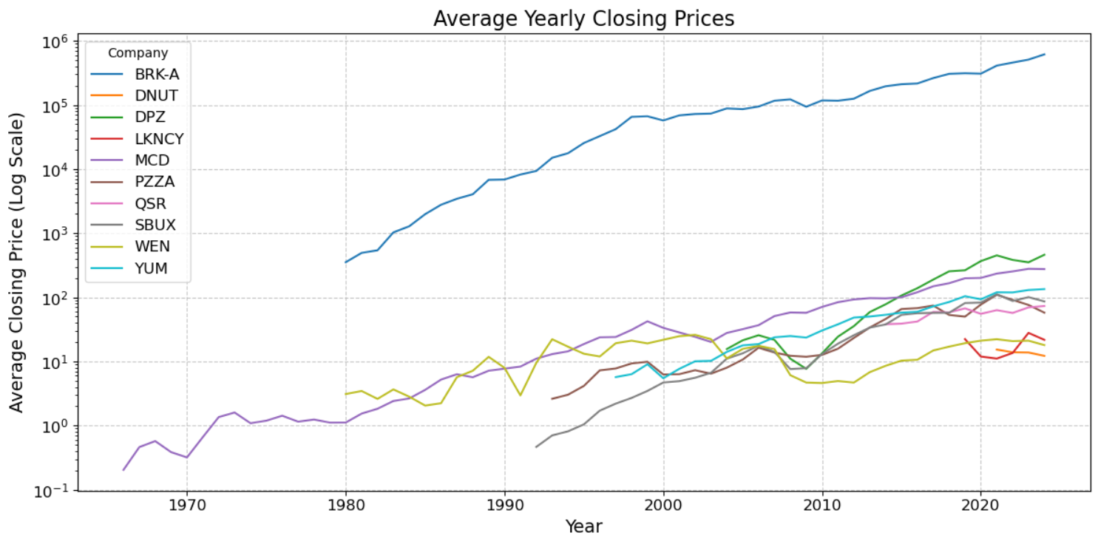
Exercise 5 - Analyzing Average Closing Prices Over Time
Line Chart
Enables comparison of annual close price both individually and for the market
Logarithmic scale is used to represent price difference
Key Insights
All companies show steady growth except for BRK-A, DPZ and MCD who grow significantly faster
Total market dips around 2008
LKNCY shows fluctuations
BRK-A: growth and price can be attributed to Warren Buffet's investment strategies
MCD and DPZ global expansion and standardization
2008 global financial crisis
Resilient market: example Covid-19
Market Perspective

Slide 9
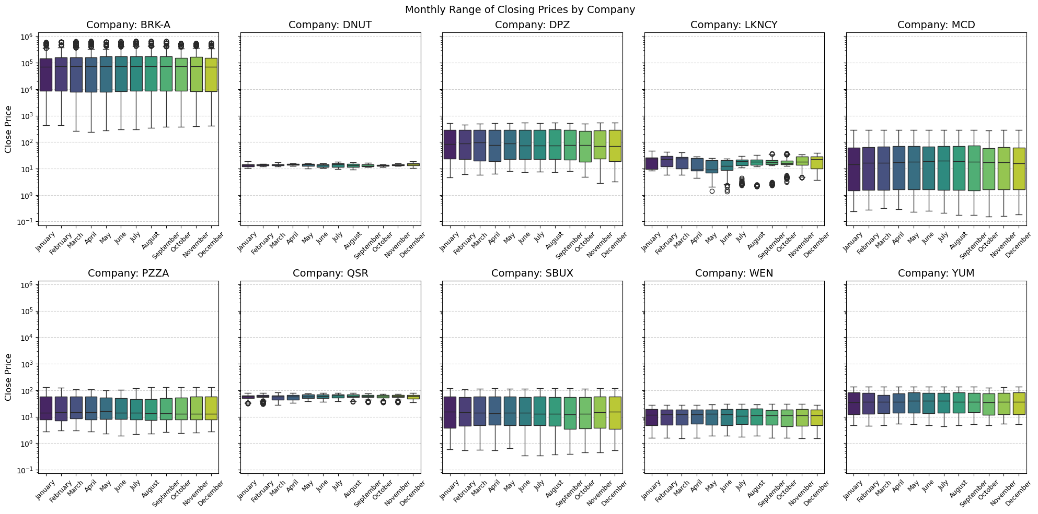
Exercise 6 - Visualizing Monthly Stock Variability Across Companies
Seaborn
Boxplot with 10 sub-plots and logarithmic scale offers comparability and industry-wide as well as company-specific insights
One boxplot, separate boxplots, strip plots were all less effective
Key Insights
DNUT and QSR show stable ranges reflecting less fluctuations in stock performance
Consistency in median, market valuation
BRK-A, QSR and LKNCY have outliers
BRK-A has high prices, showing small percentage and big absolute changes
DNUT and QSR: reliable and predictable
LKNCY: rapid growth and instability
Overall stable market
Market Perspective

Slide 10
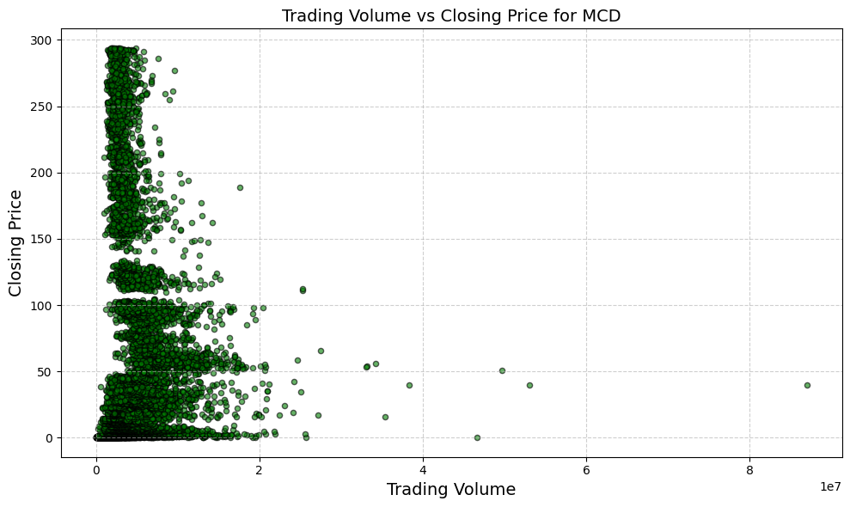
Exercise 7 – Exploring MCD: Trading Volume vs. Closing Price
Scatterplot
Effectively visualizes the relationship between two continuous variables: trading volume and closing price
Highlights patterns, clusters, and outliers
Key Insights
Volume concentration at low levels: prices $50–$250
No strong correlation = Price stability
High-volume outliers linked to major events (e.g., earnings)
McDonald’s stability and adaptability (e.g., digital platforms) ensure consistent stock performance
Investor confidence remains strong, sustaining market interest
Market Perspective

Slide 11
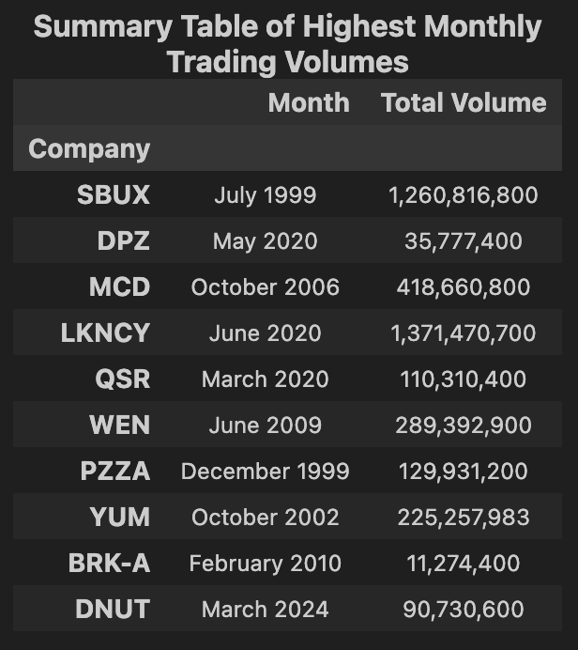
Exercise 8 - Insights into Trading Behavior and Market Influences
Groups trading data by month to calculate total trading volumes
Locates the month with the highest trading volume using idxmax
Organizes results into a dictionary and consolidates them into a DataFrame
Data Aggregation
SBUX and LKNCY show significantly higher peak trading volumes than others
BRK-A's high price per share corresponds to the lowest trading volume
Three companies reached their highest trading volumes in 2020
Key Insights
2020 peaks driven by COVID-19 market volatility
Starbucks’ 1999 peak reflects late 1990s global expansion
Luckin Coffee’s 2020 peak linked to post-scandal speculation
Market Perspective

Slide 12
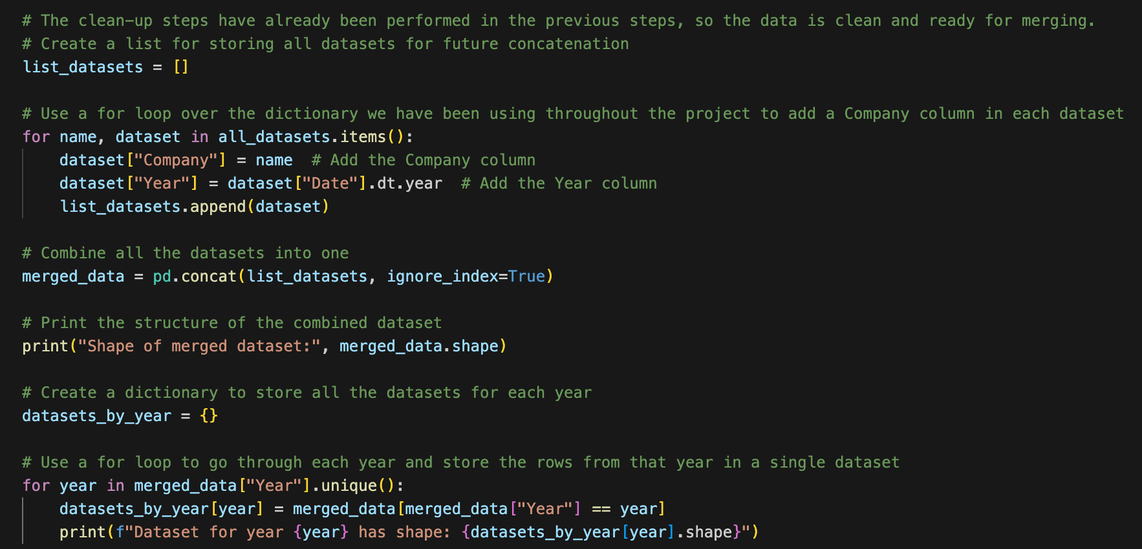
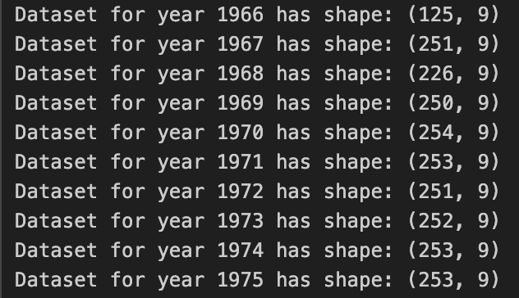
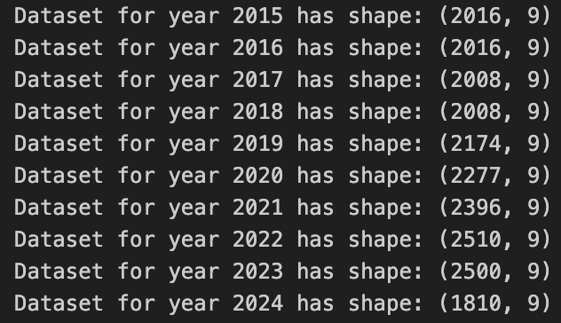
Exercise 9 - Merging companies and creating annual datasets
Used a for loop for merging the datasets adding a Year and Company column
Used another for loop for creating the yearly's datasets.
Merging Datasets
58 datasets containing different numbers of rows
In total 69549 rows and 9 columns (Company & Year)
Structure
As more rows more companies in the market. Due to sector attractiveness. (new techs, delivery, new business models...)
*Curious fact (the year 2016 has 2016 rows*
Key Insights
Output

Slide 13
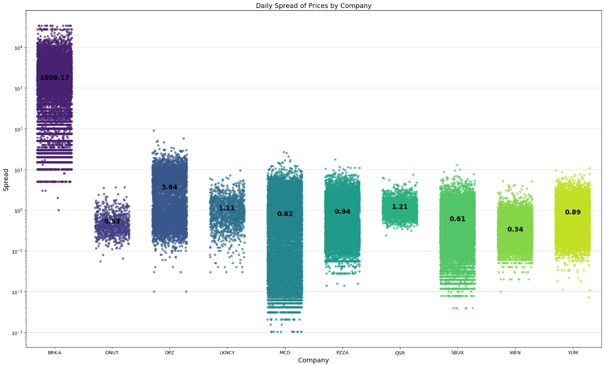
Exercise 10 - Analyzing Daily Price Variability Across Companies
Strip Plot
It can effectively show the different price ranges and average spread to the graph
Use a logarithmic scale to use a single chart to illustrate all companies with various range
Key Insights
Larger spreads indicate higher daily price variability and fluctuations
MCD shows variable spread ranges but a low average due to its established market presence
MCD and DPZ show low average spreads but wider variability due to market maturity
LKNCY has higher spreads driven by speculation and past volatility
Market Perspective

Slide 14
Overall Evaluation & Conclusion
Efficient Data Handling: Loops and functions streamlined preprocessing, addressing missing values, duplicates, and outliers
Dynamic Visualizations: Used Matplotlib and Seaborn for tailored plots like line charts and boxplots
Scalability: Created a reusable framework for seamless multi-dataset analysis
Coding insights
Closing Prices as Key Indicators: Identified as the most reliable metric for tracking company performance, market trends, and investor confidence.
Analytical Insights
Sector Growth Leaders: McDonald’s (MCD) and Domino’s Pizza (DPZ) emerged as top performers, fueled by strong market presence and digital innovations.
Stable and Mature Market: Consistent median prices and limited outliers across most companies reflected investor confidence and reliability.
Resilience and Recovery: The sector showed long-term stability, rebounding from major disruptions like the 2008 financial crisis.
Market Observations

Slide 15
Git-hub repository
Repository

