Slide 1

Automobile World
DAB-103 Analytical Tools & Decision Making

Slide 2
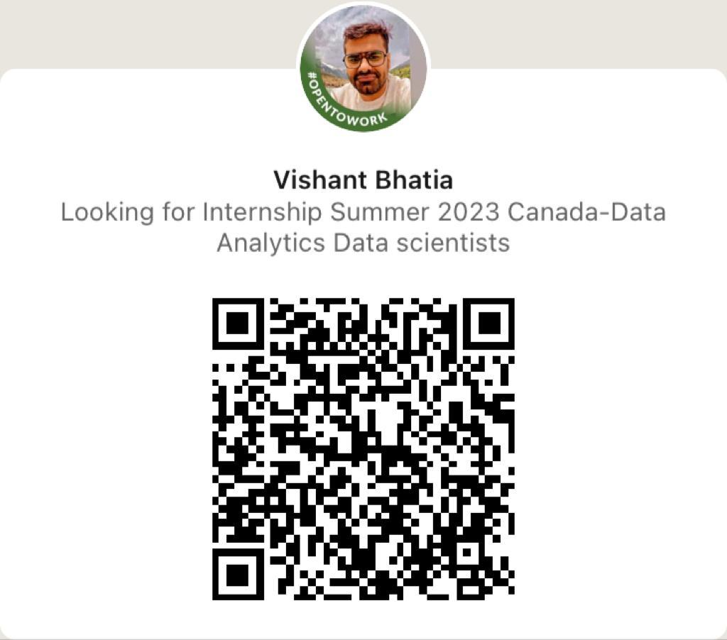

Group 002
Vishant Bhatia Alisha Mahajan

Slide 3



Harshita Sanjay Dhiman Asbin Ghimire
Mahima Mehandiratta

Slide 4
Contents
Background/Motivation
Problem Statement
Target Audience
Analyzing Questions
Data Description
Data Cleaning
Data Transformation
Visualizations

Slide 5
Motivation
The automobile industry, over the years, has revolutionized modern society making people more approachable to jobs and services, and above all personal freedom. Earlier, people relied on public transit to commute but with the comfort and ease that comes with a car, we have seen a huge shift from public transport to personal cars[1]. However, not everyone can afford the luxury of a new car owing to numerous reasons thus increasing the market of used cars. The basis for selecting this dataset is to make data-driven decisions about sales of used cars in different countries based on different aspects such as the colour, make, model, depreciation, buyer gender and age, to name a few.
Source: https://www.forbes.com/sites/davekeating/2020/09/29/covid-causing-shift-from-public-transport-to-cars/?sh=671609725aea

Slide 6
Target Audience
The automobile dealers who would benefit from our project's EDA are our primary target audience. This enables them to accomplish their goal of offering their client the finest deal possible. As a result, they will benefit from an overall rise in customer satisfaction and business growth.

Slide 7
Problem Statement
Automobile dealers need to know which car companies are most popular in their country, which age group to target and which type of cars give a better resale value to increase their inventory, expand their business and provide the best deal to their clients.

Slide 8
Analyzing Questions
Explain the profits of the second-hand cars market across the globe.
Which maker has more resell value?
Is the car worth the money? (comparison between a car’s sale price and resell price)
Which age group is more inclined towards purchasing cars?
How to depict country-by-country sales of automobile manufacturers?
Which feature in the car is more preferred by the buyers?

Slide 9
GitHub Repository Link
https://github.com/harshita0410/automobile_project

Slide 10
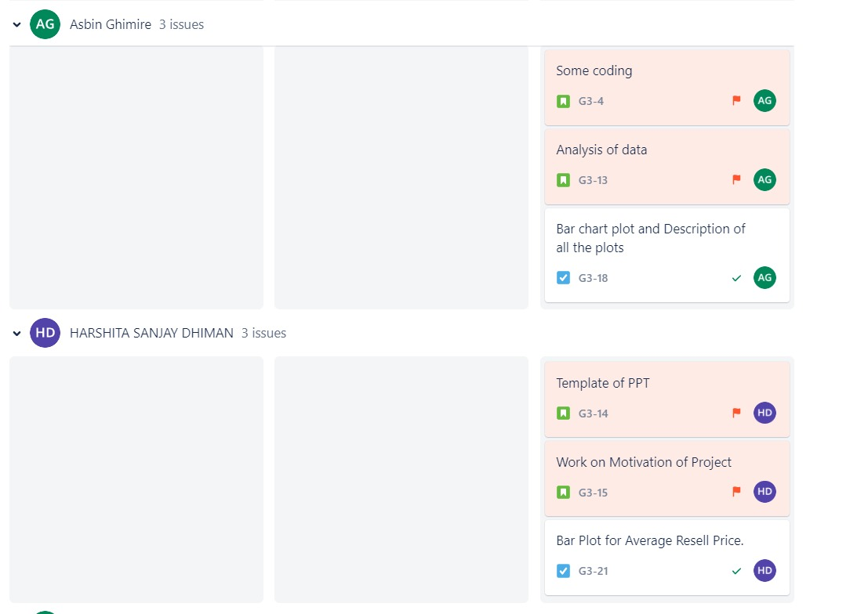
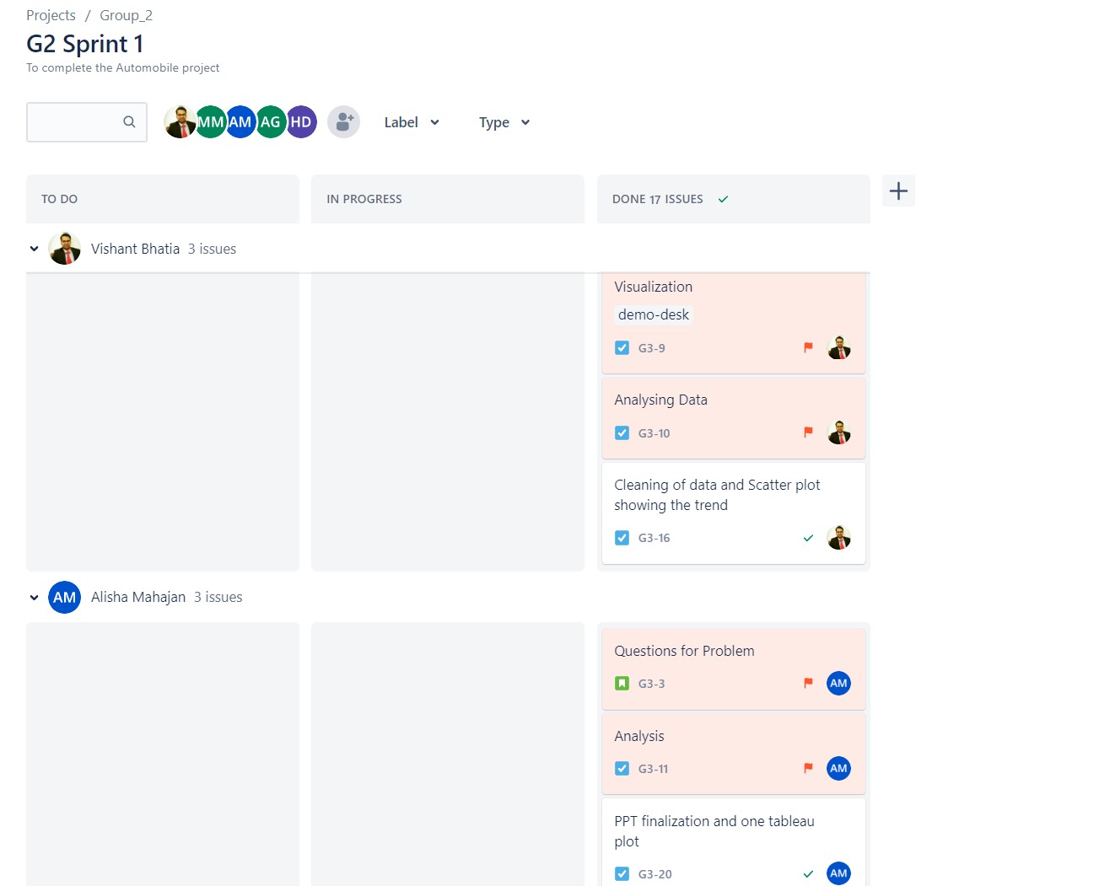
JIRA

Slide 11
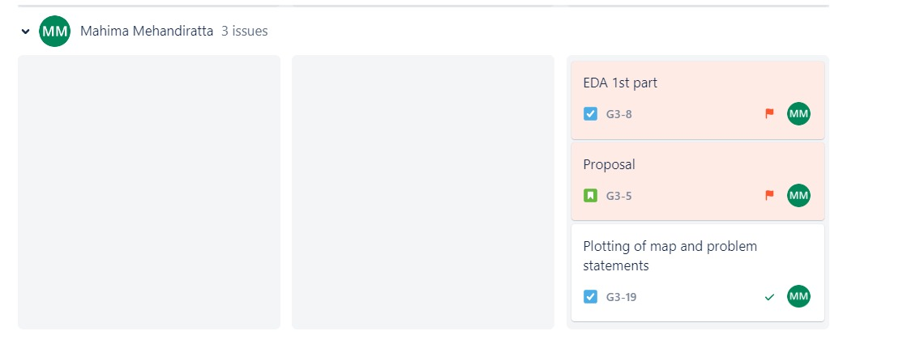

Slide 12
Data Description
Dataset Link: https://data.world/vizwiz/car-sales-mock-data
Automobile World
Categorical | Data types
Make | Object
Model | Object
Car Gender | Object
Country | Object
City | Object
Buzzword | Object
Colour | Object
New car | Bool
Purchase Date | Object
Numerical Variables | Data types
Buyer age | int64
Dealer Latitude | float64
Dealer longitude | float64
Top speed | float64
0-60 time | float64
Discount | float64
Sale price | float64
Resale price | float64

Slide 13
Data Cleaning
1. The datatype of Purchase_Date columns was converted from object to Date Time.
2. There are some columns in our data set that could not be used to gain insight that would be beneficial for automobile dealers so few of the columns were removed from the original data set and a new data set was created the columns that were deleted are as follows:
Car Gender
Nickname

Slide 14
Data Transformation
The name of the columns in the original dataset had spaces between them which were replaced by an underscore for ease of coding.
Average Sale and Resell Price was calculated for each maker using a group by and aggregate function and a scatter plot was created with a trend line to observe the relationship between sale and resell price for different car companies.
The Buyer Age column in the original dataset had discrete values which were converted into bins (continuous) so that the bar chart could be plotted to observe which age group is more inclined towards buying cars.

Slide 15
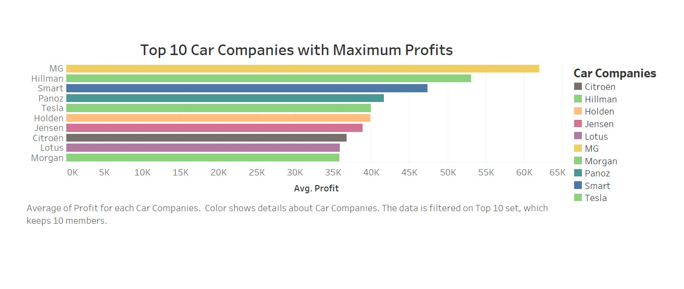
Car companies with Maximum and Minimum Profit
The two plots presented in this and the next slide clearly represent the car companies (top and bottom 10) that have maximum and minimum profits.
MG is the automaker with the highest profit margin.

Slide 16
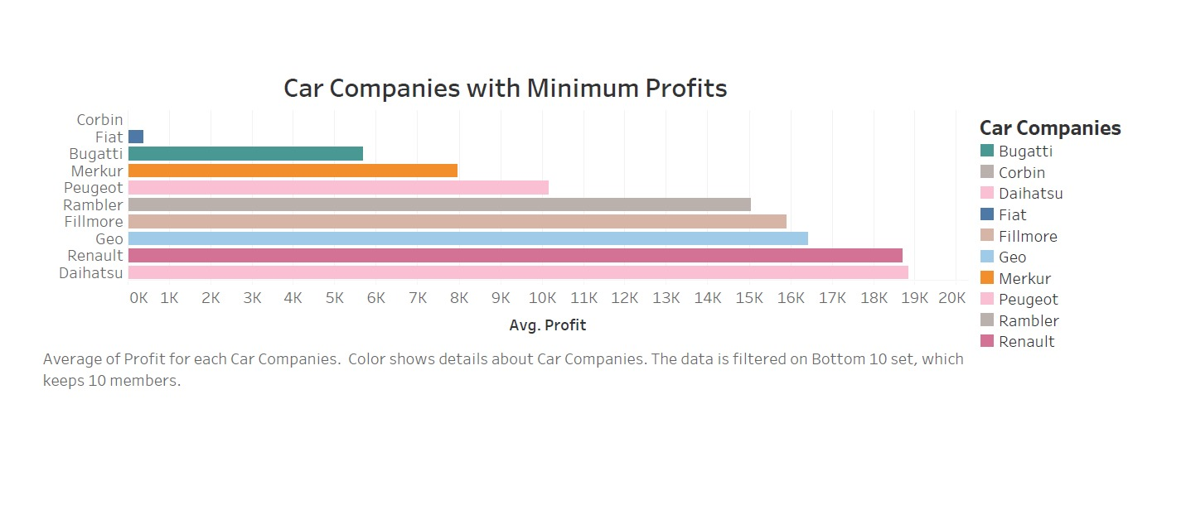
Corbin, on the other side, is a company that is hardly turning a profit.

Slide 17
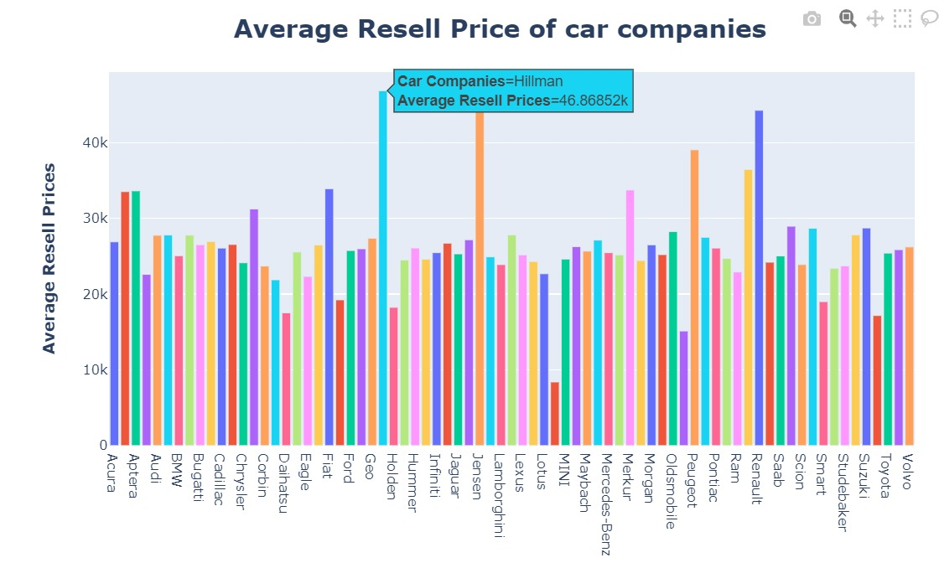
Average Resell Price of Car Companies
This bar chart clearly shows that the Hillman car company has the highest average resell value.

Slide 18
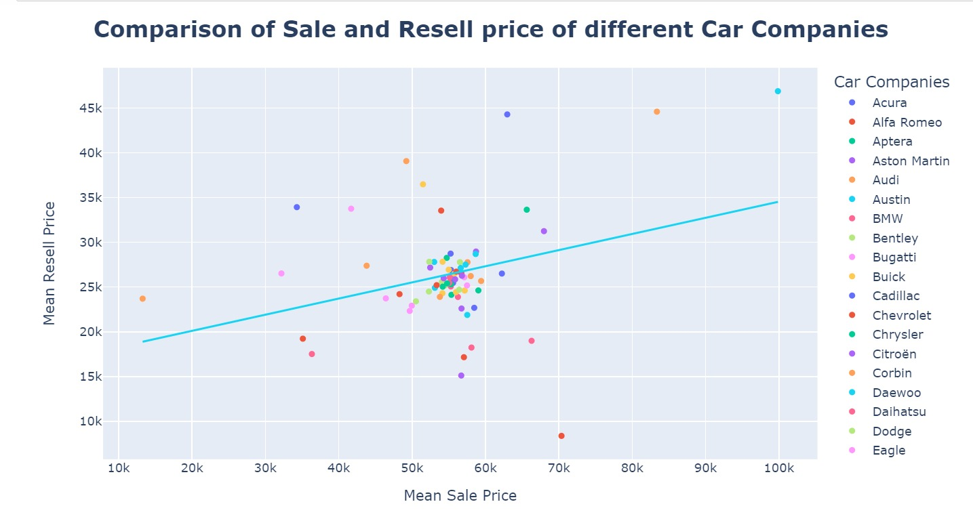
Comparison of Sale and Resell Prices of different Companies
.
The Mean Sale Price and Mean Resell Price of the car companies have a positive correlation. The trend line shows that the Mean Resell Price increases proportionally with the increase of the Mean Sale Price.

Slide 19
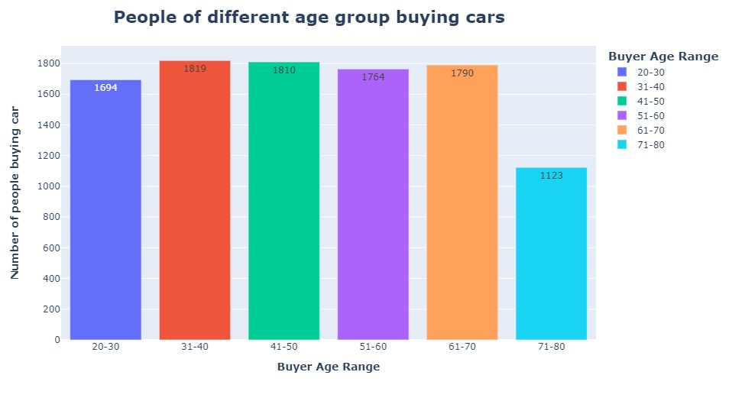
Different Age groups of people inclined towards buying a car
The Age Group that is more into buying cars is between 31-40, leading the age group 41-50 by a smaller margin while the people between the age group 71-80 have the least interest in buying a car.

Slide 20
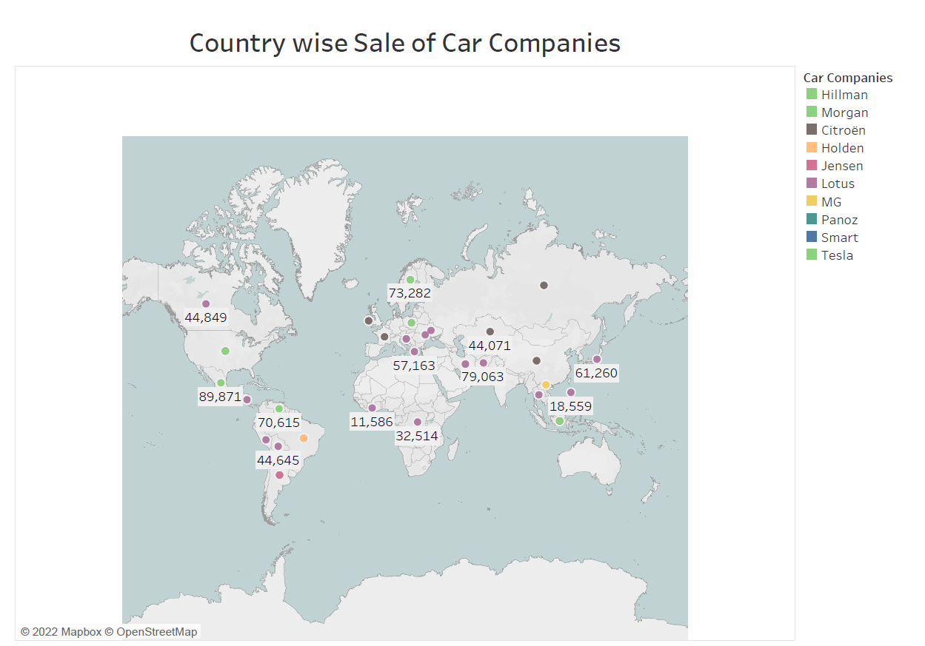
Country-wise Sale of Car Companies
The map above displays the country-by-country sales of the top 10 automobile manufacturers. When it comes to global auto sales, Hillman boasts the largest global sales presence.

Slide 21
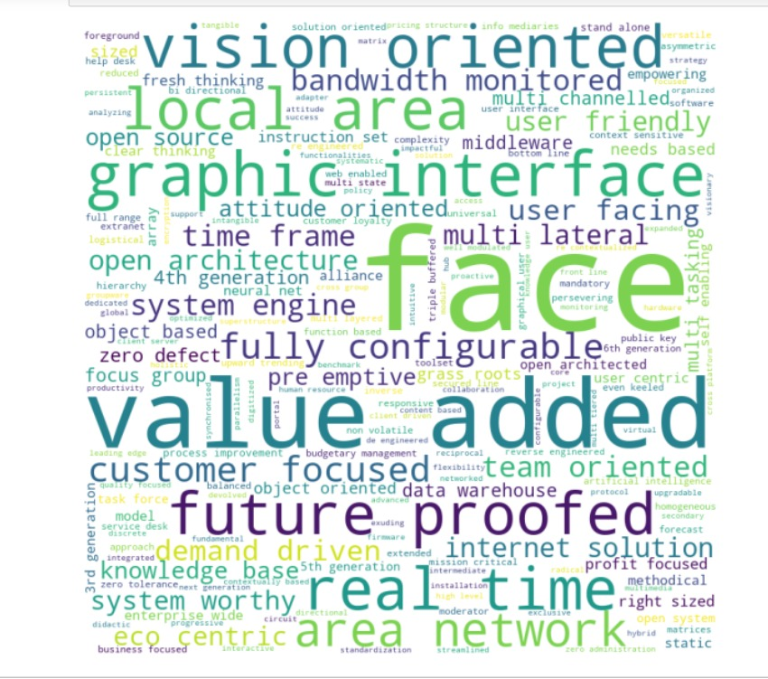
Which feature in the car is more preferred by the buyers?
Car buyers are more fascinated with the keyword (Feature) that are more readable in the picture.

Slide 22
Conclusion
To conclude, on the basis of slides 14 and 17, Hillman has the highest average sale and resell price which is in agreement with the trend line shown in the plot (slide 15) which depicts that the higher the sale price, the higher the resell value. With the help of a map, we can easily learn which automakers hold a strong position in which country. Furthermore, we are also aware of the age group that purchases the most cars. Additionally, we can determine which country would be best for growing our business and investment.

Slide 23
Recommendations
For expanding the business, car dealers should concentrate on expanding their car inventory with those models that fascinate the buyers most and can help in the overall expansion of their business with respect to sales and profit.

Slide 24
References
[1] https://www.forbes.com/sites/davekeating/2020/09/29/covid-causing-shift-from-public-transport-to-cars/?sh=671609725aea

Slide 25
Thank You !

