Slide 1
Student Name: Harshita Sharma
Roll No.: 25SCS1003003715
B.Tech CSE
Tata iQ
GenAI Powered
Data Analytics
Job Simulation Project Presentation
COMPLETED • SEPTEMBER 17, 2026
Presented by Harshita Sharma
A practical learning journey across GenAI, data analysis, predictive analytics and AI strategy.
Notes:
Opening: This presentation summarizes my Tata iQ GenAI Powered Data Analytics job simulation. I will cover the work involved, the analytical workflow, the AI strategy component, the skills I developed, and the overall experience.,Keep the introduction brief and move quickly into the project overview.

Slide 2
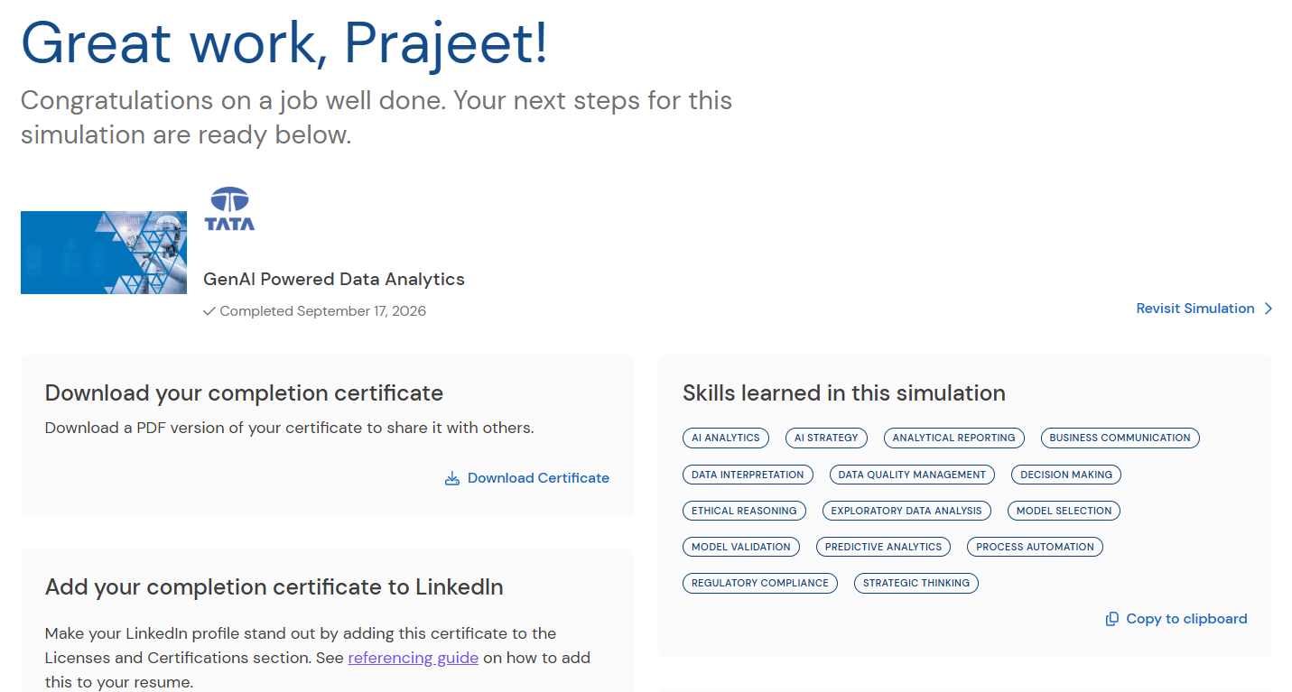
01
Simulation Overview
WHAT THE EXPERIENCE INVOLVED
GenAI Powered Data Analytics
Completed a job simulation involving AI-powered data analytics and strategy development for the Financial Services team at Tata iQ.
FORAGE PLATFORM
FINANCIAL SERVICES
GENAI
Core focus
• Exploratory data analysis (EDA) and data quality assessment
• Predictive modeling framework and model evaluation thinking
• AI-driven collections strategy using agentic AI and automation
GenAI • Data Analytics • Financial Services • Tata iQ
COMPLETED • 17 SEPTEMBER 2026 • FORAGE
Notes:
The simulation was completed on September 17, 2026. The completion page identifies the experience as Tata iQ's GenAI Powered Data Analytics job simulation on the Forage platform, with work related to AI-powered data analytics and strategy development for the Financial Services team at Tata iQ.,Mention that this slide establishes the context for the rest of the presentation.

Slide 3
02
Project Focus
FROM DATA EXPLORATION TO AI STRATEGY
01 Explore
02 Model
03 Strategize
Conduct EDA, assess data quality, identify risk indicators and organize useful signals for analysis.
Propose a no-code predictive modeling framework and think through model selection and validation.
Design an AI-driven collections strategy using agentic AI and automation, with ethics and compliance in scope.
EDA
DATA QUALITY
PREDICTIVE ANALYTICS
AI STRATEGY
PROCESS AUTOMATION
RISK INDICATORS
MODEL VALIDATION
COMPLIANCE
The three stages connect analytical evidence with a practical business strategy.
Notes:
Explain the overall project as a three-stage flow. First, explore the data and assess quality. Second, structure a predictive modeling approach. Third, use those insights to design an AI-driven collections strategy.,The key point is that the analysis and strategy components are connected rather than being separate activities.

Slide 4
03
Analytical Workflow
HOW THE PIECES FIT TOGETHER
01
Explore data
02
Structure insights
03
Define model logic
Understand patterns, quality and risk indicators
Turn observations into useful analytical signals
Propose a no-code predictive modeling framework
04
Validate approach
05
Design strategy
06
Add safeguards
Consider model selection and evaluation criteria
Translate insights into an AI-driven collections approach
Include ethics, compliance and scalable implementation
Workflow emphasis: analysis → prediction → strategy → responsible implementation
Notes:
Use this as the main process slide. Walk from left to right and then to the second row. The source material supports a progression from EDA and risk indicators to predictive modeling, then into an AI-driven collections strategy with ethics, regulatory compliance and scalability considered.

Slide 5
04
Exploratory Data Analysis
UNDERSTANDING DATA BEFORE MODELING
What I worked on
Signal discovery
Used GenAI tools to support exploratory data analysis (EDA)
Assessed data quality before predictive modeling
Looked for indicators associated with customer risk
Structured findings into insights that could inform prediction
Data quality
Risk indicators
Structured insights
→
→
Check reliability
Identify useful signals
Prepare for prediction
The objective was not only to find patterns, but to organize findings in a way that could support later modeling and business decisions.
AI ANALYTICS
DATA INTERPRETATION
DATA QUALITY
Notes:
Explain EDA as the first analytical stage. The completion summary says the work involved exploratory data analysis using GenAI tools to assess data quality, identify risk indicators and structure insights for predictive modeling.,Emphasize that good modeling starts with understanding and cleaning the information first.

Slide 6
05
Predictive Modeling Framework
TURNING SIGNALS INTO STRUCTURED PREDICTION
Input signals
Model selection
Evaluation criteria
Validation
Output
→
→
→
→
Risk indicators and structured data
Choose a suitable no-code approach
Define how the model should be judged
Check whether the approach is reliable
Useful prediction
MODEL SELECTION
MODEL VALIDATION
PREDICTIVE ANALYTICS
DECISION MAKING
The source describes this as an initial no-code predictive modeling framework supported by GenAI for structured model logic and evaluation criteria.
Notes:
The job simulation summary says I proposed and justified an initial no-code predictive modeling framework to assess customer delinquency risk. GenAI was used for structured model logic and evaluation criteria.,On this slide, explain the framework conceptually rather than claiming a specific model algorithm, because the supplied material does not name a particular algorithm.

Slide 7
06
AI-Driven Collections Strategy
FROM ANALYSIS TO ACTION
01
02
03
04
Identify risk
Prioritize action
Automate support
Keep safeguards
Use predictive signals to identify customers who may need attention.
Use structured criteria to organize outreach and collections effort.
Leverage agentic AI and automation for scalable workflows.
Apply ethical AI principles and regulatory compliance throughout.
Strategy theme
Combine analytical evidence, automation and responsible decision-making into a scalable collections process.
Notes:
Explain the collections strategy as a business translation of the analytical work. The source specifically describes an AI-driven collections strategy leveraging agentic AI and automation, while incorporating ethical AI principles, regulatory compliance and scalable implementation frameworks.,Do not invent a specific collection channel, policy or customer action beyond that scope.

Slide 8
07
Responsible AI & Governance
MAKING THE STRATEGY USABLE IN THE REAL WORLD
01
Ethical reasoning
02
Regulatory compliance
Use AI with awareness of responsible decision-making and potential impact.
Keep relevant compliance requirements in scope for the strategy.
03
Process automation
04
Scalable implementation
Automate repeatable work while keeping the workflow controlled.
Design a framework that can grow beyond a single manual process.
Responsible AI was treated as part of the strategy—not an afterthought.
Notes:
This slide focuses on the governance elements that appear directly in the completion summary: ethical AI principles, regulatory compliance, process automation and scalable implementation frameworks.,The important message is that AI strategy includes not just what the system can do, but also how it should be implemented responsibly.

Slide 9
08
Skills Learned
SKILLS LISTED IN THE COMPLETION SUMMARY
Analytics
Strategy & Modeling
Business & Governance
AI Analytics
AI Strategy
Analytical Reporting
Data Interpretation
Model Selection
Business Communication
Data Quality Management
Model Validation
Decision Making
Exploratory Data Analysis
Process Automation
Ethical Reasoning
Predictive Analytics
Strategic Thinking
Regulatory Compliance
These 15 skills are the skills listed on the Tata iQ job simulation completion page.
Notes:
These are the skills listed on the completion page. The skill groups here reorganize them into three easy-to-explain categories: analytics, strategy, and business/governance.,The presentation does not claim expertise beyond the skills identified by the simulation.

Slide 10
09
Professional Communication
EXPLAINING THE WORK CLEARLY
What the experience added
Interview-ready explanation
Practice presenting analytical work as a business problem-solving story
Build confidence in discussing GenAI tools and responsible AI strategy
Connect data interpretation with decisions and strategic action
“I worked on a GenAI-powered data analytics simulation for Tata iQ, where I explored data quality and risk indicators, structured a predictive modeling approach, and translated the findings into an AI-driven collections strategy.”
This keeps the explanation focused on what was actually completed in the simulation.
BUSINESS COMMUNICATION
ANALYTICAL REPORTING
Notes:
The supplied screenshot includes an interview tip and a suggested explanation of interest in the role. Adapt that idea into a concise, accurate description of my own experience.,Use the quoted sentence as a speaking guide rather than reading it word-for-word if possible.

Slide 11
10
Overall Experience
WHAT I TAKE FORWARD
Data-first thinking
Start with quality, context and useful signals before jumping to conclusions.
AI with purpose
Use GenAI as a practical support layer for analysis, modeling logic and strategy.
Business translation
Turn technical findings into decisions, workflows and measurable next steps.
Responsible implementation
Keep ethics, compliance and scalability visible throughout the process.
Overall, the simulation connected GenAI, analytics, prediction and strategy into one practical workflow.
Notes:
Close the main content with four learning takeaways. The source material supports the combination of GenAI, exploratory analysis, predictive modeling, strategy, ethics, compliance and communication.,Frame these as lessons learned rather than claims of extensive professional experience.

Slide 12
11
Conclusion
FROM CLASSROOM LEARNING TO APPLIED ANALYTICS
This experience helped me understand how GenAI can support a real business analytics workflow — from exploring data and identifying risk signals to structuring predictive modeling and designing an AI-driven strategy.
GENAI
DATA ANALYTICS
PREDICTIVE MODELING
AI STRATEGY
RESPONSIBLE AI
Key message: analytical thinking becomes more valuable when it can be translated into responsible, actionable strategy.
Notes:
Final content slide. Summarize the learning journey in one sentence: GenAI supported a workflow that connected EDA, predictive modeling and AI strategy, with responsibility and compliance considered.,Then move to the Thank You slide.

Slide 13
Thank You
Tata iQ — GenAI Powered Data Analytics
Harshita Sharma
Roll No.: 25SCS1003003715
B.Tech CSE
GenAI • Data Analytics • Predictive Modeling • AI Strategy
Notes:
Thank the audience and invite questions. If asked about the experience, focus on the work explicitly listed in the completion summary: EDA, data quality, predictive modeling framework, AI-driven collections strategy, automation, ethics and compliance.

