Slide 1
Threat Detection via surveillance camera for security purpose
Submitted To: Submitted By:
Dr. Pawan Singh Mehra Harshita Agarwal(19318003)
Prateek Jain(19318007)

Slide 2
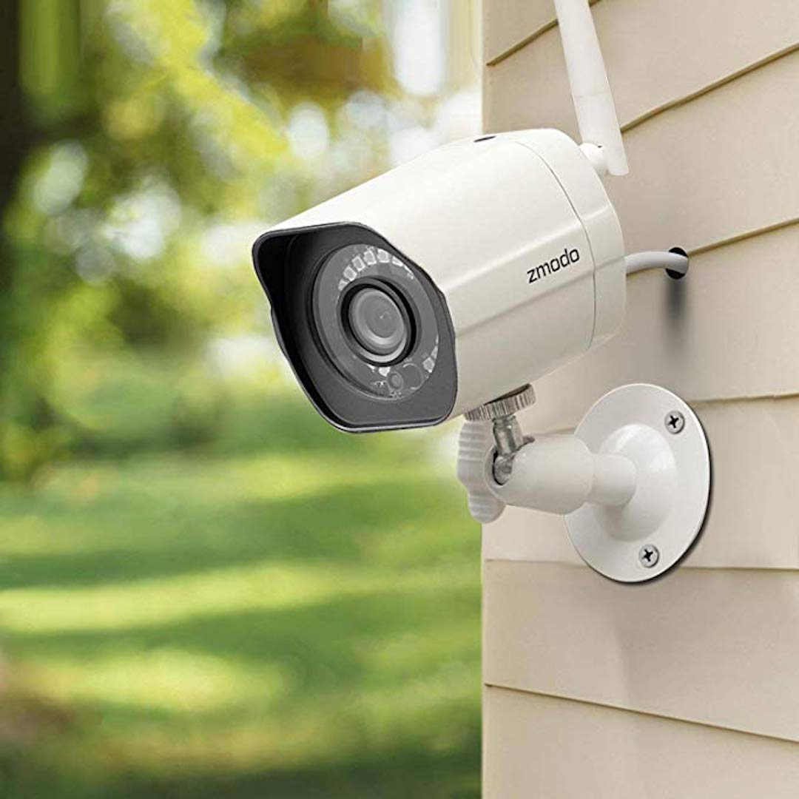
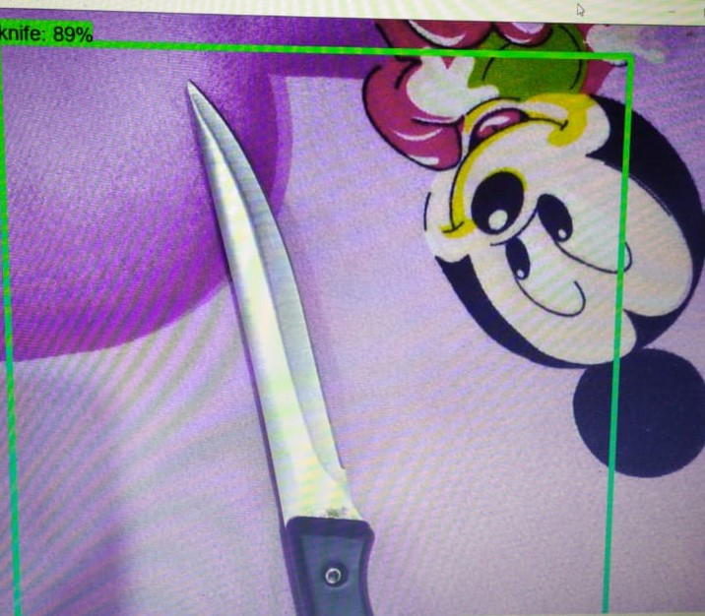
Introduction
THIS MODEL IS ALL ABOUT TO INCREASE THE SECURITY PARAMETERS, BY USING THIS PRODUCT MAINLY, IT IS MAINLY FOR OUR POLICE AS ANYONE IS IN TROUBLE AS SOMEONE IS TRYING TO KILL SOMEONE VIA KNIFE THEN IT WILL IMMEDIATELY DETECT THE KNIFE AND WILL SEND AN ALERT TO THE NEAREST POLICE STATION.

Slide 3
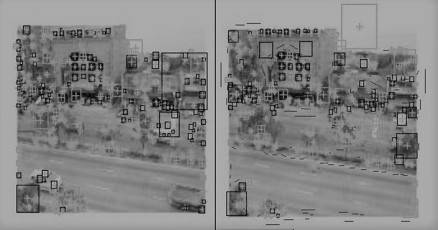
Methods Used:
Under Machine Learning:
1)Scale-Invariant Feature Transform

Slide 4
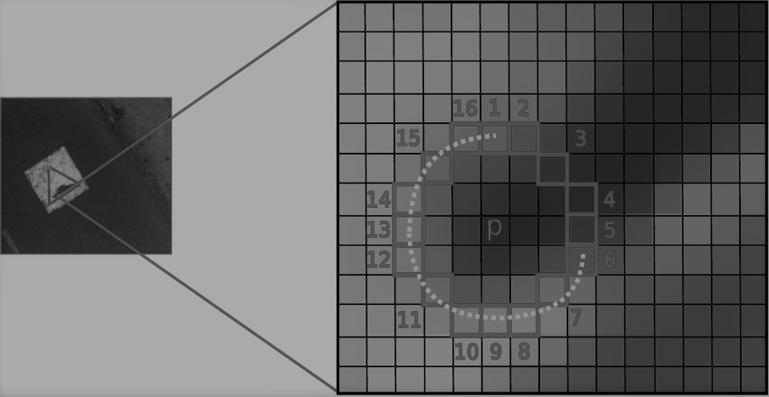
2)Features from Accelerated Segment Test corner detector

Slide 5
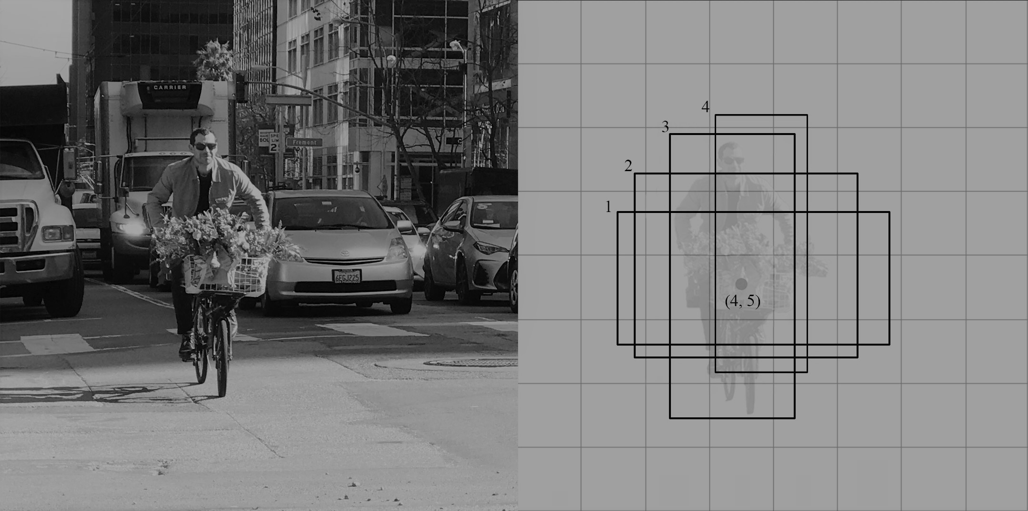
Under Deep learning:
1)Single Shot MultiBox Detector (SSD)

Slide 6
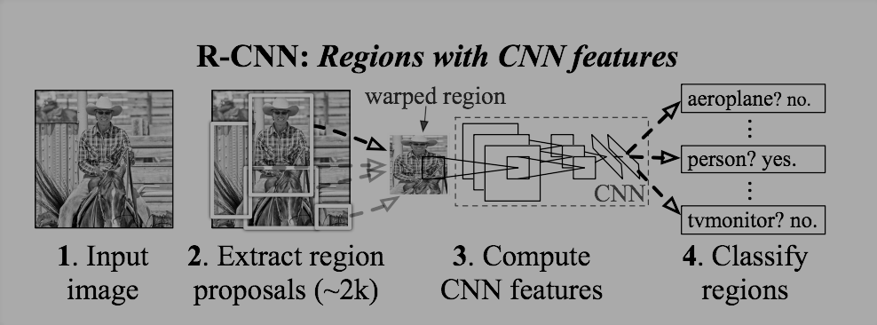
2)Fast Region convolutional networks

Slide 7
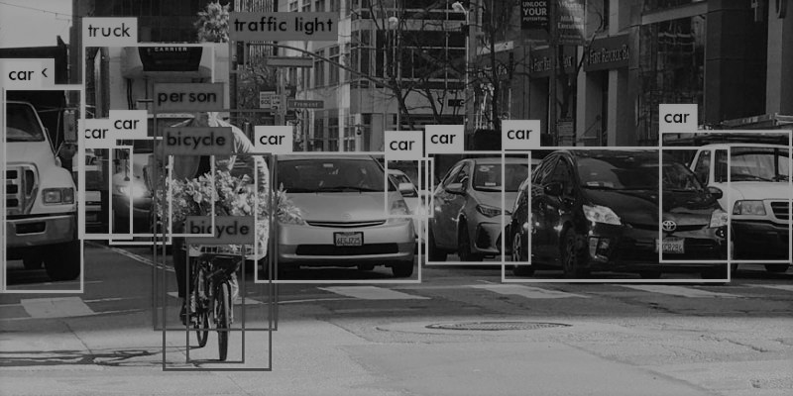
Under computer vision
1)Classification

Slide 8
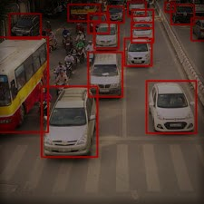
2)Localization

Slide 9
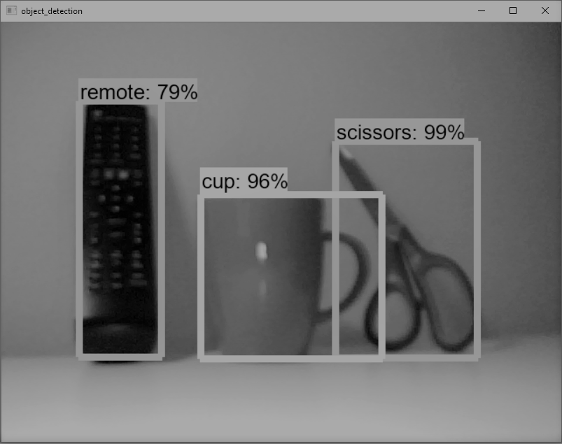
3)Detection

Slide 10
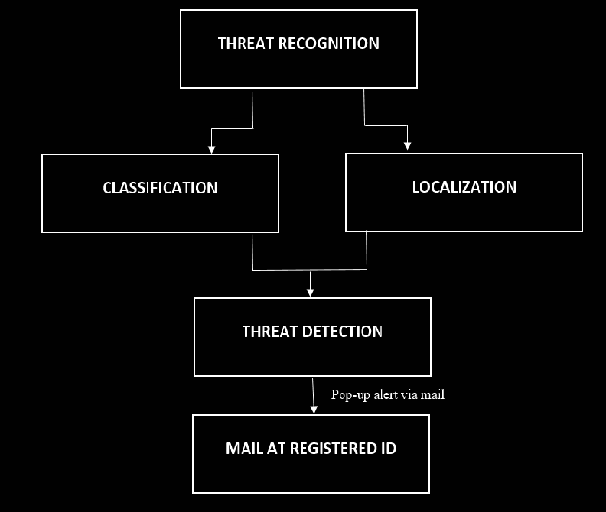
Flow Chart :

Slide 11
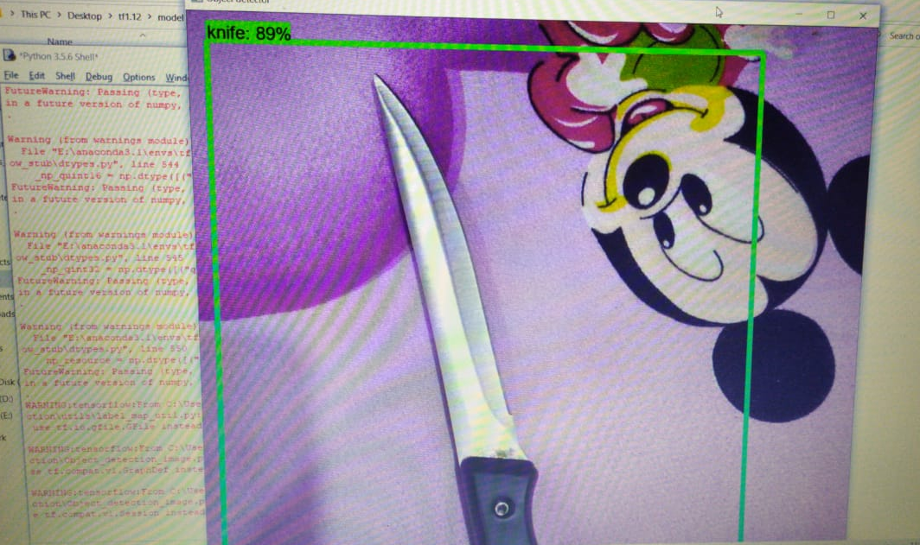
Results

Slide 12
Future Work :
Human Activity Recognition
False Alert Recognition
Concealed Threat Detection
Integration With Cloud
Enhance user Interface For Remotely Surveillance

Slide 13
Thank You

