Slide 1
Project presentation on :- CUSTOMER RETENTION ANALYSIS
Submitted by :
Harshita Panchamia

Slide 2
Table Of Contents :-
1. Introduction
1.1 What is customer retention?
1.2 Conceptual Background of the Domain Problem
2. Review of Literature
3. Motivation for the Problem Undertaken
4. Visual and graphical analysis
5. Conclusion
6. Limitations of this work and Scope for Future Work.

Slide 3
INTRODUCTION
What is customer retention?
Customer retention refers to the activities and actions companies and organizations take to reduce the number of customer defections.
The goal of customer retention programs is to help companies retain as many customers as possible, often through customer loyalty and brand loyalty initiatives.
It is important to remember that customer retention begins with the first contact a customer has with a company and continues throughout the entire lifetime of the relationship.

Slide 4
Conceptual Background of the Domain Problem
Customer satisfaction has emerged as one of the most important factors that guarantee the success of online store; it has been posited as a key stimulant of purchase, repurchase intentions and customer loyalty.
A comprehensive review of the literature, theories and models have been carried out to propose the models for customer activation and customer retention.

Slide 5
Review of Literature
Customer acquisition, customer retention and customer development are the three elements that form a customer lifecycle.
A customer is acquired into the company as a part of reaching the ambition to grow the business.
Acquired customers form the base of customer retention – without any customers, there is no churn to prevent or value to enhance.

Slide 6
Motivation for the Problem Undertaken
The aim of this project is to determine and understand customer patterns and their needs while shopping online from different websites.
Five major factors that contributed to the success of an e-commerce store have been identified as: service quality, system quality, information quality, trust and net benefit.
The research furthermore investigated the factors that influence the online customers repeat purchase intention.
The combination of both utilitarian value and hedonistic values are needed to affect the repeat purchase intention (loyalty) positively.
The data is collected from the Indian online shoppers.

Slide 7
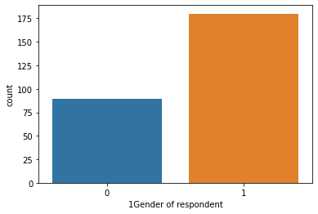
Data Analysis
Observation:
Majority, 181 of the customers are Female whereas Male are 88.

Slide 8
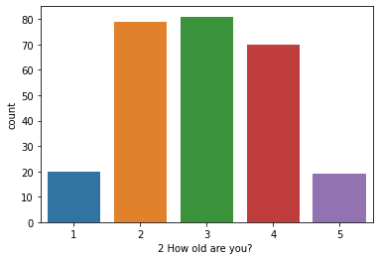
Observation:
Majority, 81 of the customers are from index column 3.

Slide 9
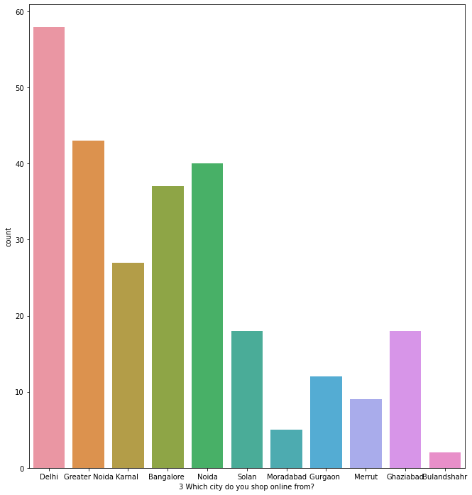
Observation:
Majority, 58 of the customers placed the order from Delhi city.

Slide 10
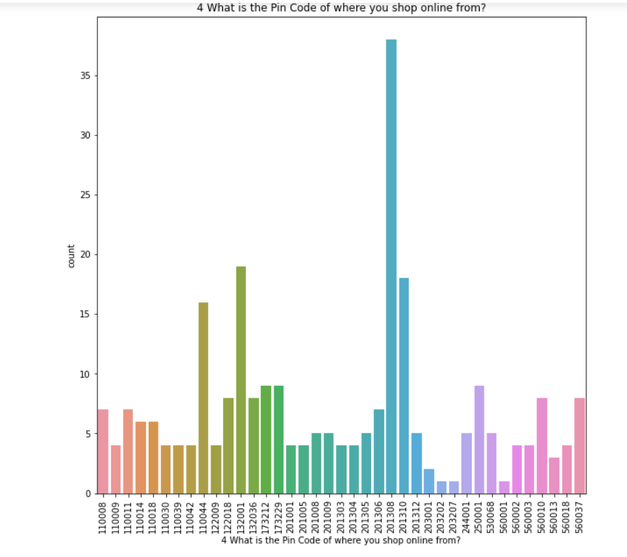
Observation:
Majority, 38 of the customers placed an order from the pincode 201308.

Slide 11
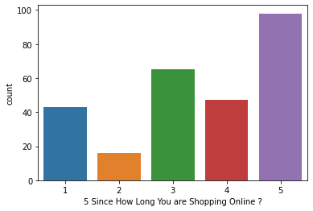
Observation:
Majority, 98 customers are shopping for 5 years.

Slide 12
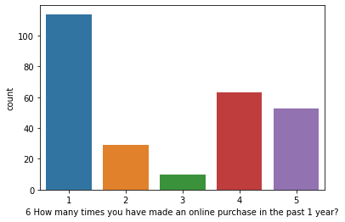
Observation:
Majority 114 of the customers have made less than 10 times online purchase in past 1 year

Slide 13
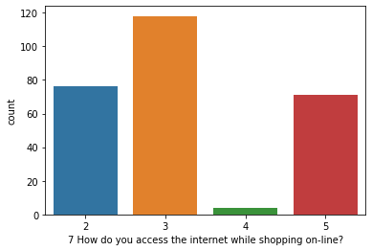
Observation:
Majority, 189 customers use 3rd index column while shopping online.

Slide 14
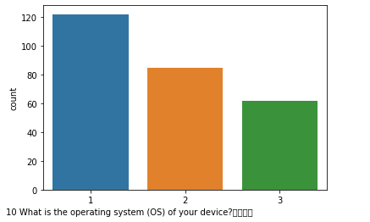
Observation:
Majority, 122 customers device operating system is 1st index column.

Slide 15
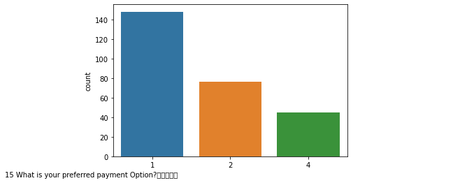
Observation:
According to the data, 148 customers choose the 1st payment option the most.

Slide 16
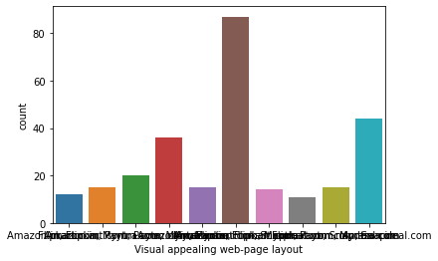
Observation:
87 customers think Amazon.in and Flipkart.com has Visual appealing web-page layout

Slide 17
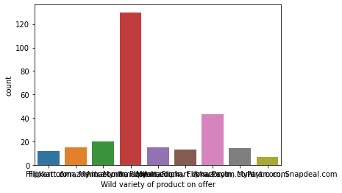
Observation:
130 customers think Amazon.in and Flipkart.com have Wild variety of product on offer.

Slide 18
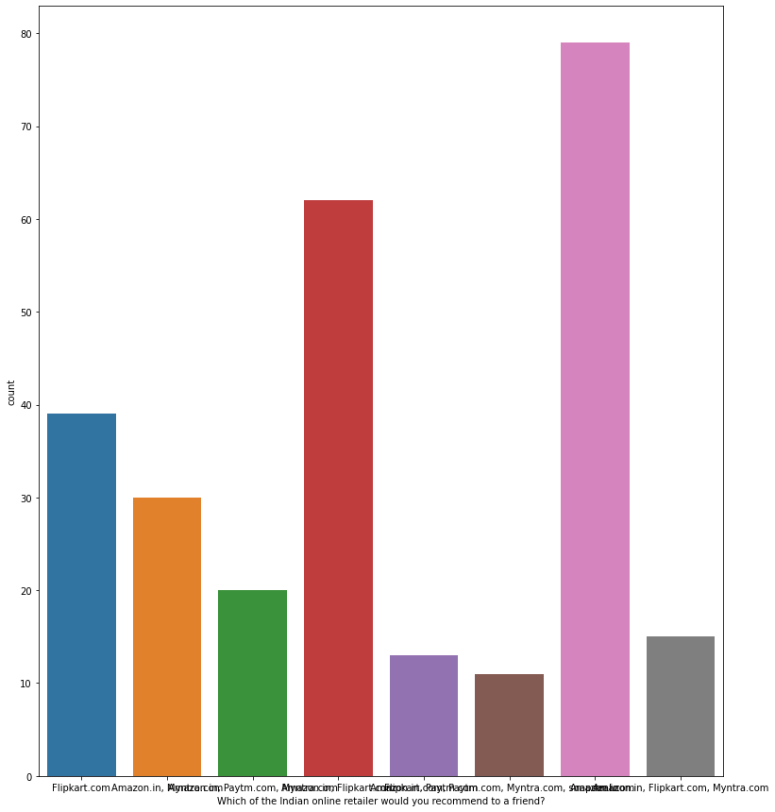
Observation:
Majority, 79 customers agree to Amazon.in to recommend to a friend.

Slide 19
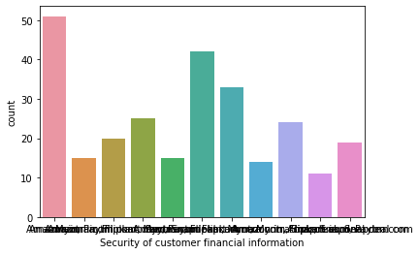
Observation:
51 customers think Amazon.in has highest Security of customer financial information

Slide 20
Conclusion
Customer retention was determined as the way to keep the customers in house, maintain the customer relationship and the improvement of the level of customer service.
The improvement of the level of customer service was seen as the end result of the activities the customer dissatisfaction causes.

Slide 21
Limitations of this work and Scope for Future Work
We are able to properly analyse the valuable feedback of the customers but given, the dataset was very small as it may result in bias understanding.
If we are able to increase the feedbacks from more customers all over it would provide a great understanding of the strategies we will have to use to improve customer retention.

