Slide 1
CS322: Computer Architecture
Mini Project
Bluetooth Controlled Robot Car
Done by:
Harshita Meena(2001CS30)
Kushum(2001CS42)

Slide 2
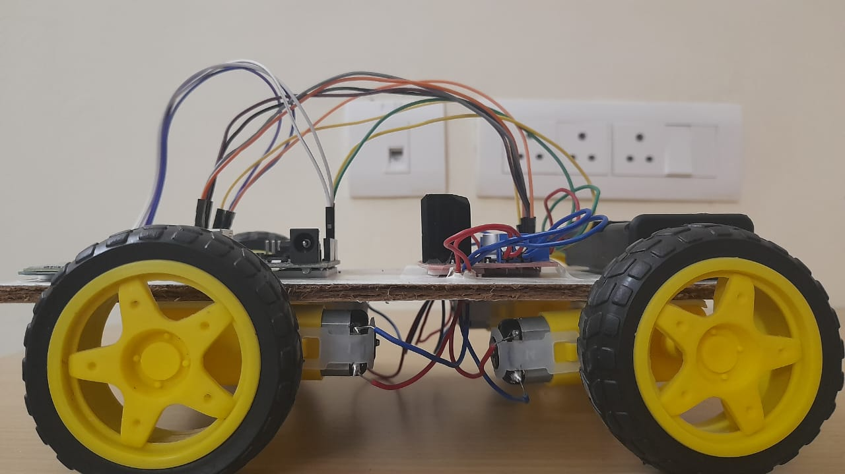
Description
Of the
Car:
In this project, we have made an arduino based bluetooth controlled robot car. This device is controlled by a bluetooth device like a mobile with an app, whose link is provided below, through a bluetooth module. We can control the direction and speed of the car using this app.

Slide 3
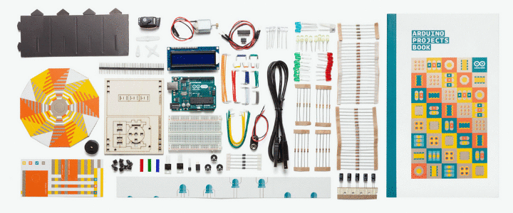
Components
Used:
Arduino UNO R3 module
Motor Driver L298N module
Bluetooth HC-05 module
Gear motors - 4
Wheels - 4
18650 Lithium ion batteries - 2
Battery holder
Jumper wires - male-to-female
Connecting wires
Soldering iron
Wooden base

Slide 4
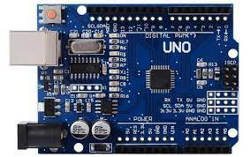
Arduino UNO R3:
Arduino UNO is a microcontroller board based on the ATmega328P. It has 14 digital input/output pins (of which 6 can be used as PWM outputs), 6 analog inputs, a 16 MHz ceramic resonator, a USB connection, a power jack, an ICSP header and a reset button. It contains everything needed to support the microcontroller; simply connect it to a computer with a USB cable or power it with a AC-to-DC adapter or battery to get started.

Slide 5
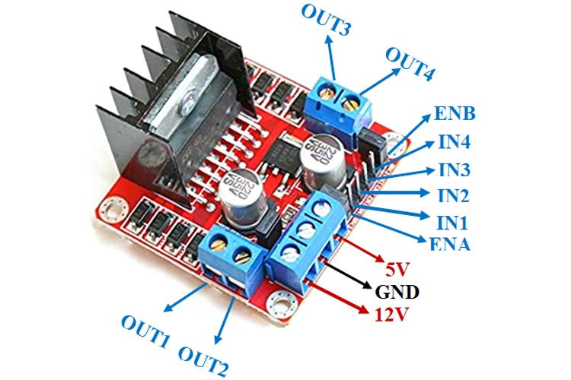
Motor Driver L298N module:
This L298N Motor Driver Module is a high power motor driver module for driving DC and Stepper Motors. This module consists of an L298 motor driver IC and a 78M05 5V regulator. L298N Module can control up to 4 DC motors, or 2 DC motors with directional and speed control.
ENA & ENB pins are speed control pins for Motor A and Motor B while IN1& IN2 and IN3 & IN4 are direction control pins for Motor A and Motor B.

Slide 6
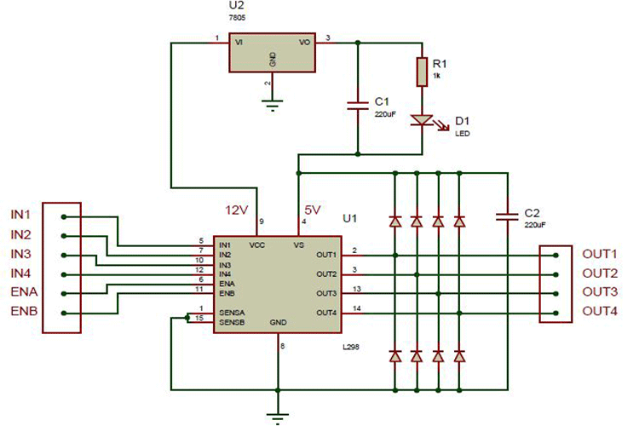
Internal circuit diagram of L298N module:

Slide 7
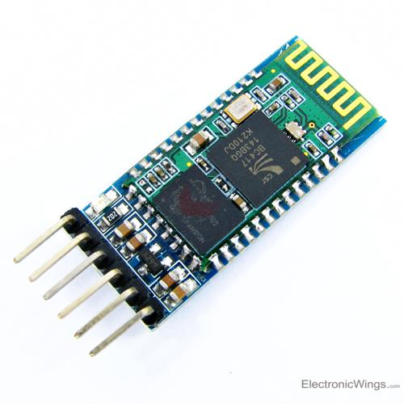
Bluetooth HC-05 module:
HC-05 is a Bluetooth module which is designed for wireless comunication. This module can be used in a master or slave configuration. It has 6 pins:
Key/EN: If Key/EN pin is set to high, then this module will work in command mode. Otherwise by default it is in data mode. The default baud rate of HC-05 in command mode is 38400 bps and 9600 in data mode.
HC-05 module has two modes,
1. Data mode: Exchange of data between devices.
2. Command mode: It uses AT commands which are used to change setting of HC-05. To send these commands to module serial (USART) port is used.
VCC: Connect 5V or 3.3V to this pin.
GND: Ground pin of module
TXD: Transmit Serial data (wirelessly received data by Bluetooth module transmitted out serially on TXD pin).
RXD: Receive data serially (received data will be transmitted wirelessly by Bluetooth module).
State: it tells whether the module is connected or not.

Slide 8
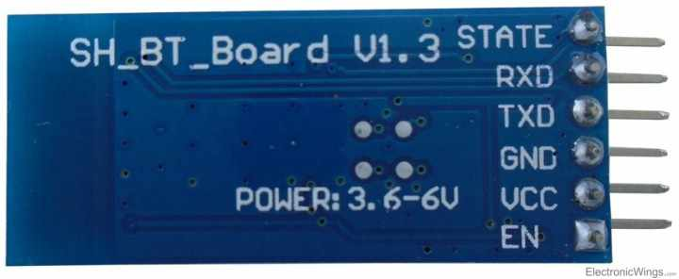
Bluetooth HC-05 module:
HC-05 has red LED which indicates connection status, whether the Bluetooth is connected or not. Before connecting to HC-05 module this red LED blinks continuously in a periodic manner. When it gets connected to any other Bluetooth device, its blinking slows down to two seconds.
This module works on 3.3 V. We can connect 5V supply voltage as well since the module has on board 5 to 3.3 V regulator.
As HC-05 Bluetooth module has 3.3 V level for RX/TX and microcontroller can detect 3.3 V level, so, no need to shift transmit level of HC-05 module. But we need to shift the transmit voltage level from microcontroller to RX of HC-05 module.

Slide 9
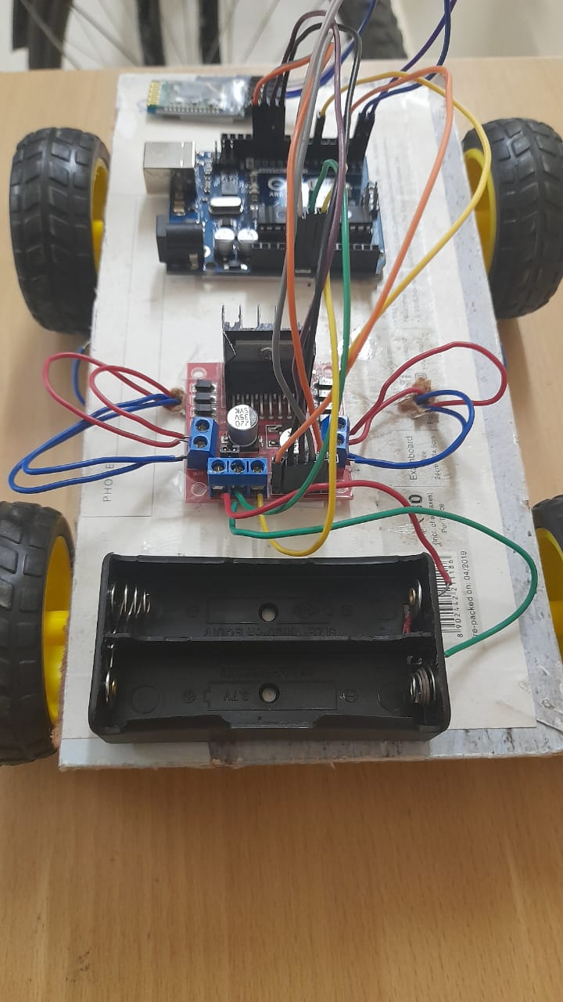
Making/Working:
First we have taken a wooden board (we have used a writing board) and attached the 4 gear motors to it using a double tape. After that we soldered the connecting wire to the terminals of the motor gears. Next, we attached the L298N module and the Arduino UNO R3 module to the board. We attached the connections of the gear motors to the L298N module. Then we made the other connections of the L298N module with the Arduino UNO R3 module. Next we attached the Bluetooth HC-05 module to the base and made its connections to the Arduino UNO R3 module. Then, we attached the battery holder to the base and made its connections with the L298N module. We attached the wheels to the gears.

Slide 10
Making/Working:
Then comes the code uploading part. While uploading the code we made sure that the bluetooth module is disconnected to the arduino and the batteries are also disconnected. After uploading the code, the connection with the bluetooth module is again made. Here, our robot car is ready. We now put the batteries in. Then we connect the car with the bluetooth RC controller app and give commands. The car moves according to the commands. The commands we have provided as per the bluetooth RC controller app. The commands are as follows:
Forward-> F
Backward-> B
Left-> L
Right-> R
Forward Left-> G
Forward Right-> I
Back Left-> H
Back Right-> J
Stop-> S

Slide 11
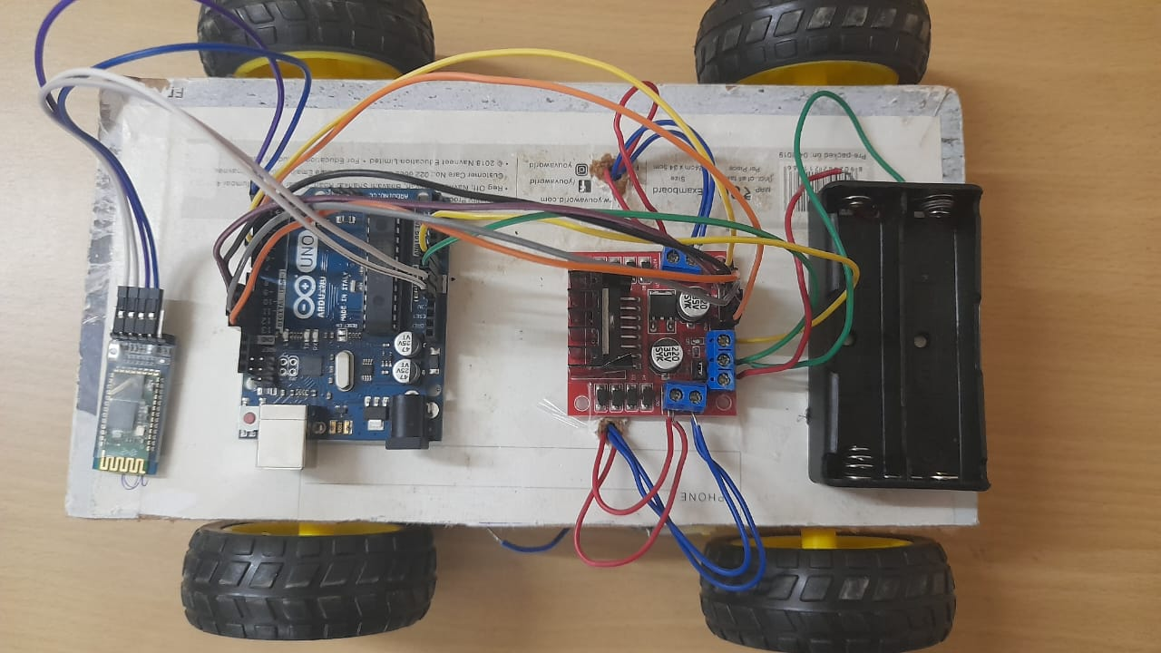
Connections and Circuit Diagram:
Motor driver connections are attached to the L298N module’s output 1, 2, 3 and 4.
The ena and enb enable the PWM for motor A and motor B respectively.
The ena, in1 and in2 controls the motor A whereas enb, in3 and in4 controls the motor B.
ena is connected to the pin 3 of the UNO module whereas enb is connected to the pin 6 of the UNO module.
The in1, in2, in3, and in4 are connected to pins 10, 11, 12, and 13 respectively.
The ground of the L298N module is connected to the ground(power) of the UNO.

Slide 12
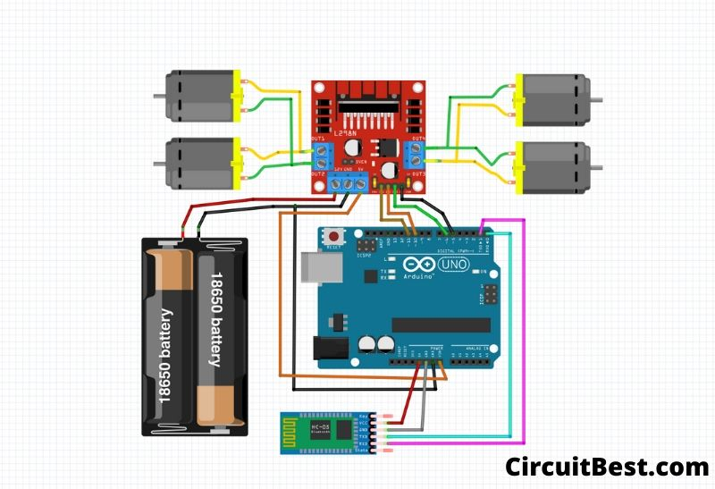
Connections and Circuit Diagram:
The Vin of the L298N module is connected to the Vin(power) of the UNO module.
The positive terminal of the battery holder is connected to the +12V of the L298N module and the negative terminal is connected to the ground of the L298N module.
The bluetooth module’s RX is connected to the TX(pin 1) of the UNO module.
The TX of the bluetooth module is connected to the RX(pin 0) of the UNO module.
The ground of the bluetooth module is connected to the ground(power) of the UNO module.
The +5V of the bluetooth module is connected to the 5V(power) of the UNO module.

Slide 13
Code:
Part-1
int in1 = 10 ;//L298n Motor Driver pins.
int in2 = 11 ;
int in3 = 12;
int in4 = 13;
int ena = 3;
int enb = 6;
int command; //Int to store app command state.
int Speed = 204; // 0 - 255.
int Speedsec;
int buttonState = 0;
int lastButtonState = 0;
int Turnradius = 0; //Set the radius of a turn, 0 - 255 Note:the robot will malfunction if this is higher than int Speed.
int brakeTime = 45;
int brkonoff = 1; //1 for the electronic braking system, 0 for normal.
void setup() {
pinMode(in1, OUTPUT);
pinMode(in2, OUTPUT);
pinMode(in3, OUTPUT);
pinMode(in4, OUTPUT);
Serial.begin(9600); //Set the baud rate to your Bluetooth module.
}

Slide 14
Code:
Part-2
void loop() {
analogWrite(ena,150);
analogWrite(enb,150);
if (Serial.available() > 0) {
command = Serial.read();
Stop(); //Initialize with motors stopped.
switch (command) {
case 'F':
forward();
break;
case 'B':
back();
break;
case 'L':
left();
break;
case 'R':
right();
break;
case 'G':
forwardleft();
break;
case 'I':
forwardright();
break;

Slide 15
Code:
Part-3
case 'H':
backleft();
break;
case 'J':
backright();
break;
case '0':
Speed = 100;
break;
case '1':
Speed = 140;
break;
case '2':
Speed = 153;
break;
case '3':
Speed = 165;
break;
case '4':
Speed = 178;
break;
case '5':
Speed = 191;
break;
case '6':
Speed = 204;
break;

Slide 16
Code:
Part-4
case '7':
Speed = 216;
break;
case '8':
Speed = 229;
break;
case '9':
Speed = 242;
break;
case 'q':
Speed = 255;
break;
}
Speedsec = Turnradius;
if (brkonoff == 1) {
brakeOn();
} else {
brakeOff();
}
}
}
void forward() {
analogWrite(in1, Speed);
analogWrite(in3, Speed);
}

Slide 17
Code:
Part-5
void back() {
analogWrite(in2, Speed);
analogWrite(in4, Speed);
}
void left() {
analogWrite(in3, Speed);
analogWrite(in2, Speed);
}
void right() {
analogWrite(in4, Speed);
analogWrite(in1, Speed);
}
void forwardleft() {
analogWrite(in1, Speedsec);
analogWrite(in3, Speed);
}
void forwardright() {
analogWrite(in1, Speed);
analogWrite(in3, Speedsec);
}
void backright() {
analogWrite(in2, Speed);
analogWrite(in4, Speedsec);
}
void backleft() {
analogWrite(in2, Speedsec);
analogWrite(in4, Speed);
}

Slide 18
Code:
Part-6
void Stop() {
analogWrite(in1, 0);
analogWrite(in2, 0);
analogWrite(in3, 0);
analogWrite(in4, 0);
}
void brakeOn() {
//Here's the future use: an electronic braking system!
// read the pushbutton input pin:
buttonState = command;
// compare the buttonState to its previous state
if (buttonState != lastButtonState) {
// if the state has changed, increment the counter
if (buttonState == 'S') {
if (lastButtonState != buttonState) {
digitalWrite(in1, HIGH);
digitalWrite(in2, HIGH);
digitalWrite(in3, HIGH);
digitalWrite(in4, HIGH);
delay(brakeTime);
Stop();
}
}
// save the current state as the last state,
//for next time through the loop
lastButtonState = buttonState;
}
}
void brakeOff() {
}

Slide 19
Bluetooth RC Controller app link:
Contributions:
https://play.google.com/store/apps/details?id=braulio.calle.bluetoothRCcontroller
Code:
Harshita Meena(2001CS30)
Hardware/Connections:
Kushum(2001CS42)

